Slide 1
大尺度海洋-大气相互作用
Large Scale Ocean-Atmosphere Interaction
杨海军（YANG Haijun）复旦大学大气与海洋科学系
Department of Atmospheric and Oceanic Sciences, Fudan University
Email: yanghj@fudan.edu.cn
This powerpoint was prepared for purposes of this lecture and course only. It contains graphics from copyrighted books, journals and other products. Please do not use without acknowledgment of these sources.

Slide 2
Ocean-Atmosphere Interaction
Tropical-Extratropical, Interhemispheric Climate Interaction : Atmospheric Bridge and Oceanic Tunnel
Dynamics of Decadal Climate Variability and Tropical Decadal Variability
Ocean-Atmosphere Interaction: A Global Scale, Coupled Climate Dynamics and Bjerknes Compensation
Timescale and Reversibility of Climate Change

Slide 3
Can We Return to Normal?
If not, why?
If so, how long?
Linear system – Reversible
Complex system – Irreversible
Atmosphere and Ocean – Different timescales

Slide 4
Concept
Climate Sensitivity
Climate Response Pattern
Climate Response Timescale

Slide 5
Timescale for Climate Change
Relaxation or Recovery timescale
  Response to a pulse forcing
Transient and Equilibrium Response timescale
  Response to a persistent forcing

Slide 6
Definition of Timescale
Transient Response Timescale
  e-folding time: time for 1/e of final response
Equilibrium Response Timescale
  (1-1/e) of final response
Do we know “Final response”?

Slide 7
What Determine Timescale?
Climate sensitivity
Ocean mixing
Form of external forcing
etc…..

Slide 8
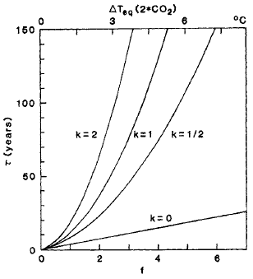

Climate Sensitivity and Feedback on the Timescale
1-d model box diffusion model
Climate sensitivity
Feedbacks f delay
Mixing k
Hansen et al. (1985)

Slide 9
Climate Sensitivity and Feedback on the Timescale
Diffusion-upwelling model (Dickinson and Schaudt, 1998)

Slide 10

Climate Sensitivity and Feedback on the Timescale
Fast timescale: damping
  λ: non-dimensional sensitivity parameter
  λ =1 for a “sensitive climate” 4 °C for 2CO2
  λ =2 for a “insensitive climate” 2 °C for 2CO2
Slow timescale: upwelling
  197 yrs for w=4m/yr and k=1 cm²/s
Notes:
2 centuries are required for vertical diffusion to balance upwelling and so to warm the ocean to the depth of the main thermocline (1km). This is also the timescale for upwelling to move water from the base of the thermocline to the surface.

Slide 11
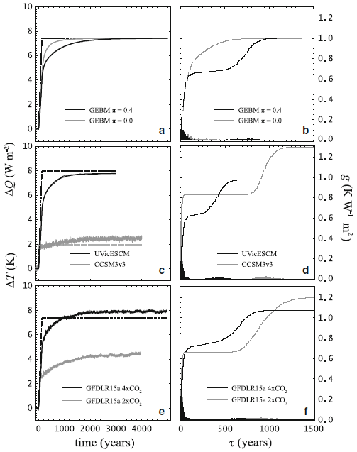
Timescale in GEBM
1-D GEBM (Jarvis and Li, 2010)
GEBM & Coupled Models
20 yrs for upper ocean
700 yrs for deep ocean
Notes:
GEBM: global energy balance model

Slide 12
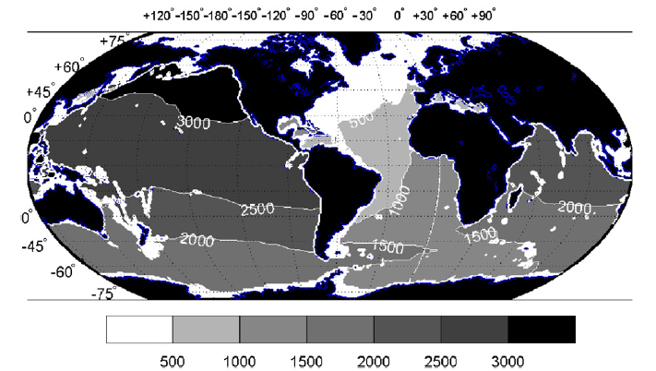
Timescale in OGCM
Tracer equilibrium timescale (Wuncsh and Heimbach, 2008)
t₉₀ at 1975 m for source in global surface

Slide 13
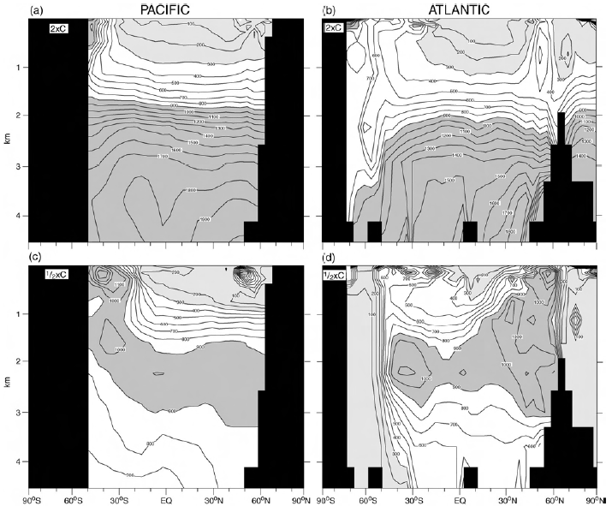
Timescale in AOGCM
Different in different basin, forcing size and sign (Stouffer, 2004)

Slide 14
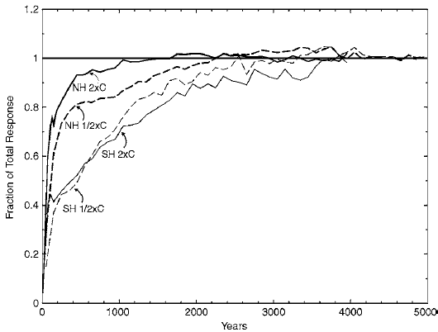
Timescale in AOGCM
Fraction of the total response, interhemispheric difference (Stouffer, 2004)

Slide 15
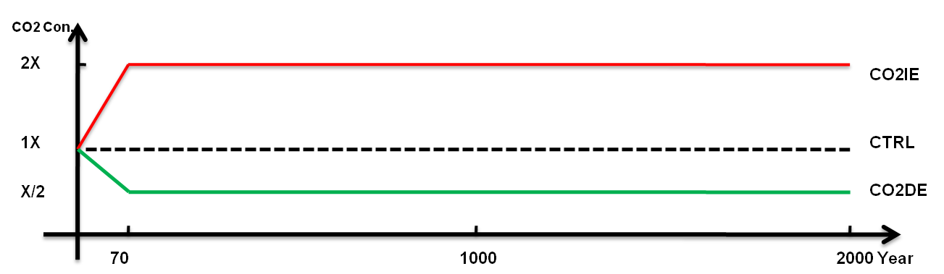
Model and Experiments
Fast Ocean-Atmosphere Model (FOAM)
  Atmos. – R15, NCAR-CCM3
  Ocean – 1.4°×2.8°×32-level, GFDL-MOM2
  Control Run: 2000 years

Slide 16
General Responses
SAT
SST
T_{sub}(40-400m)
T_{mid}(1k-3km)
T_{btm}(3k-5km)
Sensitivity:
SAT and SST: 0.8-1.2°C at 70, 1.4-2.0°C at final
Tsub: 0.4°C, 1.2°C; Tmid: < 0.1°C, 0.9°C

Slide 17
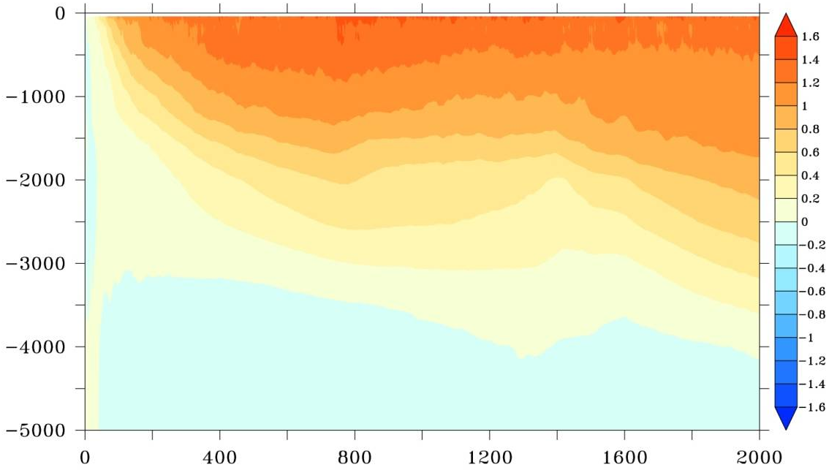
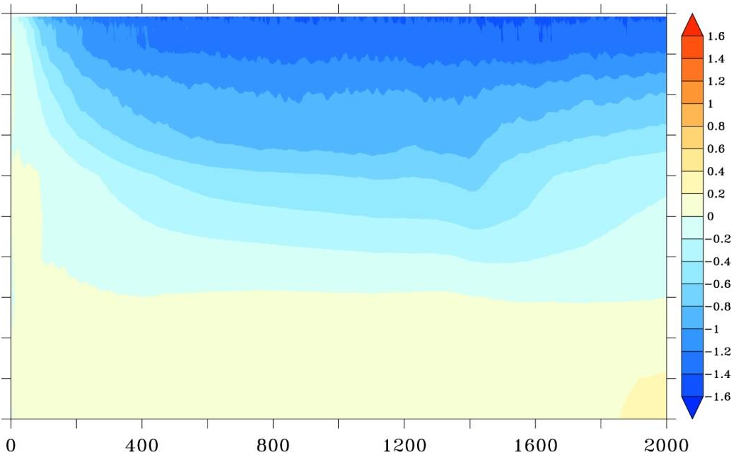
Evolution of Ocean Temperature

Slide 18
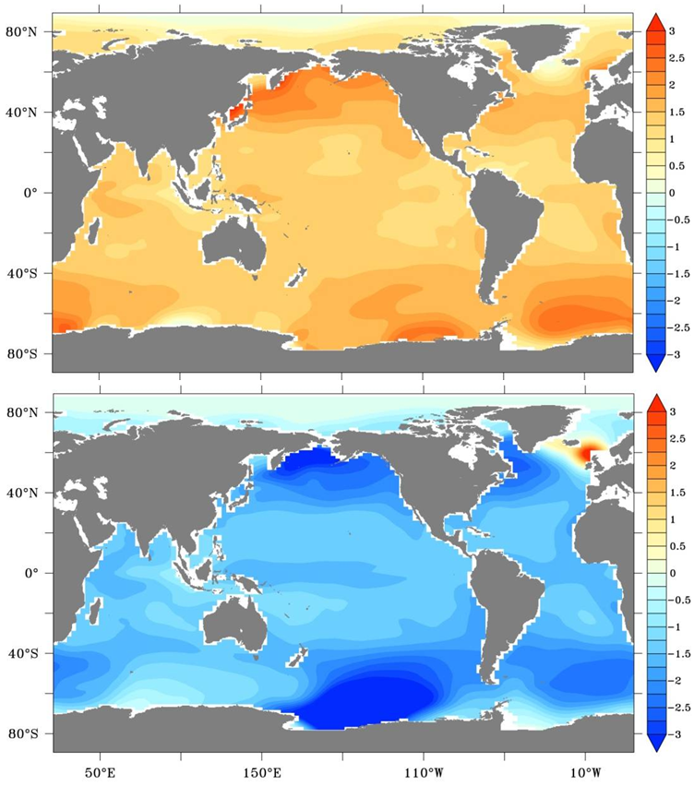
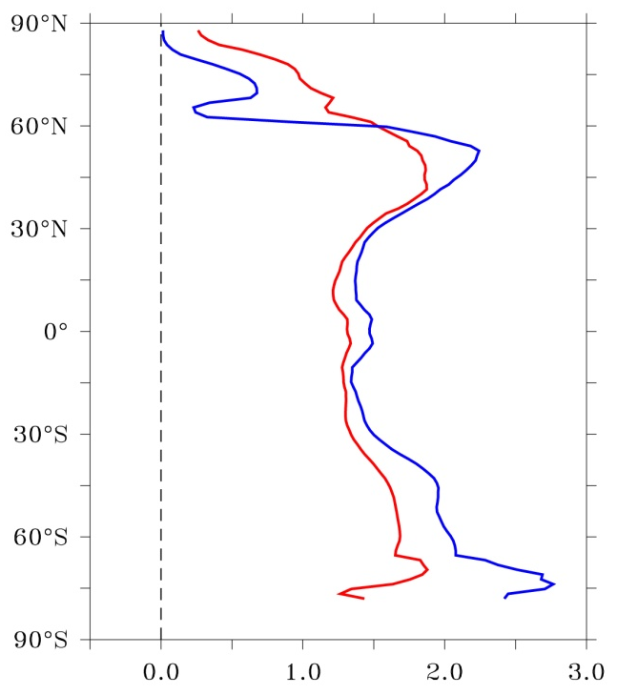
Final SST
Symmetric in low latitudes
Big different in high latitudes
Notes:
symmetric

Slide 19
Defining the Timescale of Climate Response
  Assuming that the climate system has reached equilibrium monotonously, and using anomalies of the last 100 years as the final changes, we define the year when reaching their 70% as the response timescale (Stouffer, 2004).

Slide 20
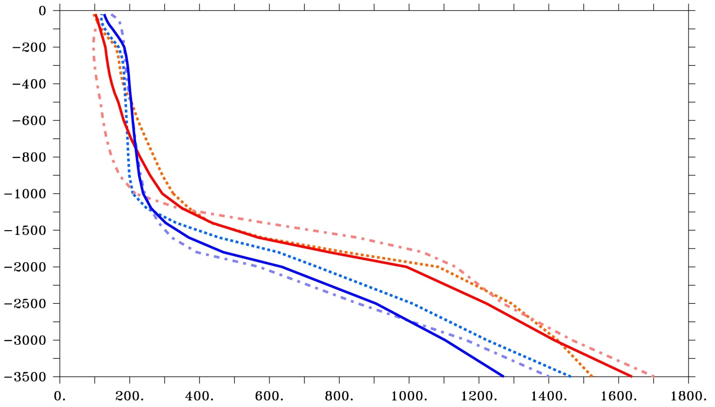
Time Profile with Depth
Warm color - CO2IE
Cold color - CO2DE
Solid line - global mean
Dashed line - Pacific
Dash-dotted - Atlantic
Depth
Temporacline
Time (Year)
Time Profile – “Temporacline” ⇔ “Density-profile or Pycnocline or Thermocline
200 yrs for upper 1km; 300-1000 yrs for 1-2km; > 1000-2000 yrs for deep ocean

Slide 21
Timescale for Global Oceans
Pacific
Atlantic
Global Ocean
200 yrs above1000m; > 1000 yrs below 2000m
Time abrupt change zone: 1500-2000m
Different timescale for warming and cooling forcings

Slide 22
Summary and Mechanism
General timescale
Temporacline – Upper ocean and deep ocean
  Upper ocean – MLD and thermocline circulation
  Lower ocean – Deep water formation and AMOC
Different timescale in warming and cooling world
  Different Responses in AMOC
Notes:
Stouffer, 2004

Slide 23
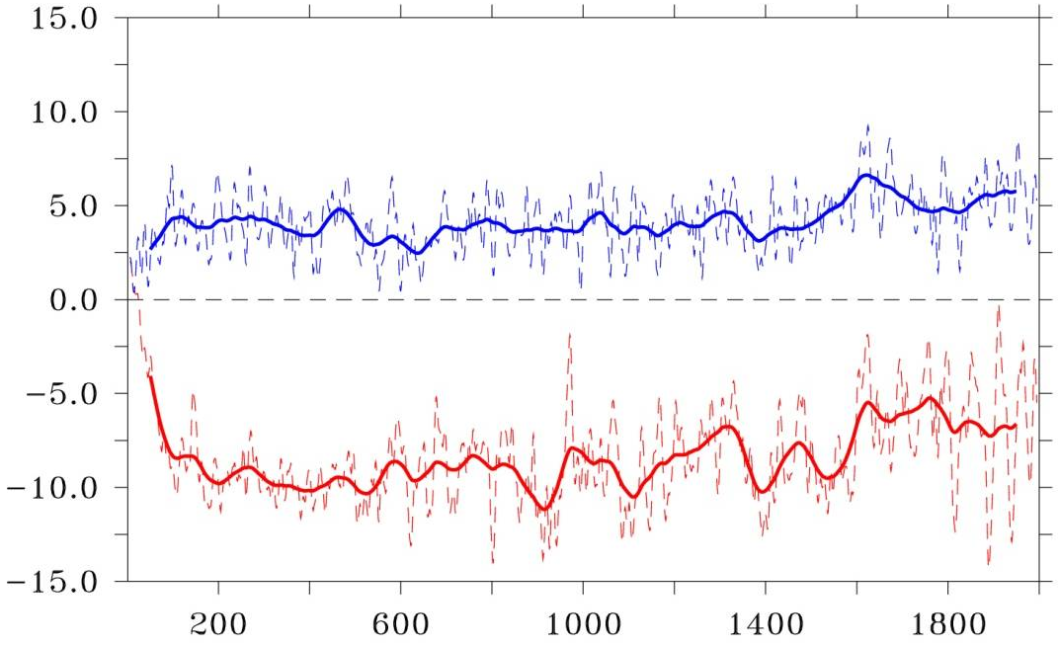
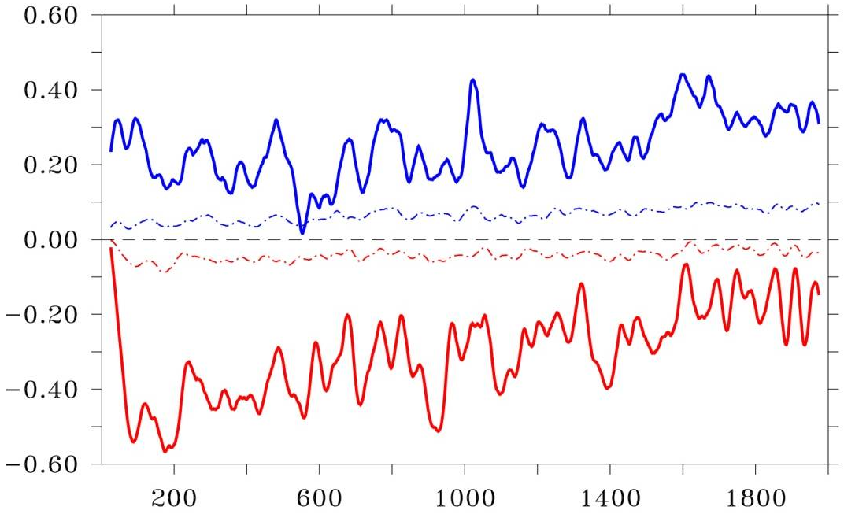
Lower Ocean: AMOC Changes
Anomalous AMOC index (Sv)
Local thermal and haline density flux changes, 10⁻⁶ kg/m³s
Warming : AMOC ⇓→ Longer time; Cooling : AMOC ⇑ → Shorter time
AMOC changes mainly determined by local heat flux change in North Atlantic sub-polar region
Asymmetric changes in AMOC in warming and cooling world: Nonlinearity , local feedback and remote feedback

Slide 24
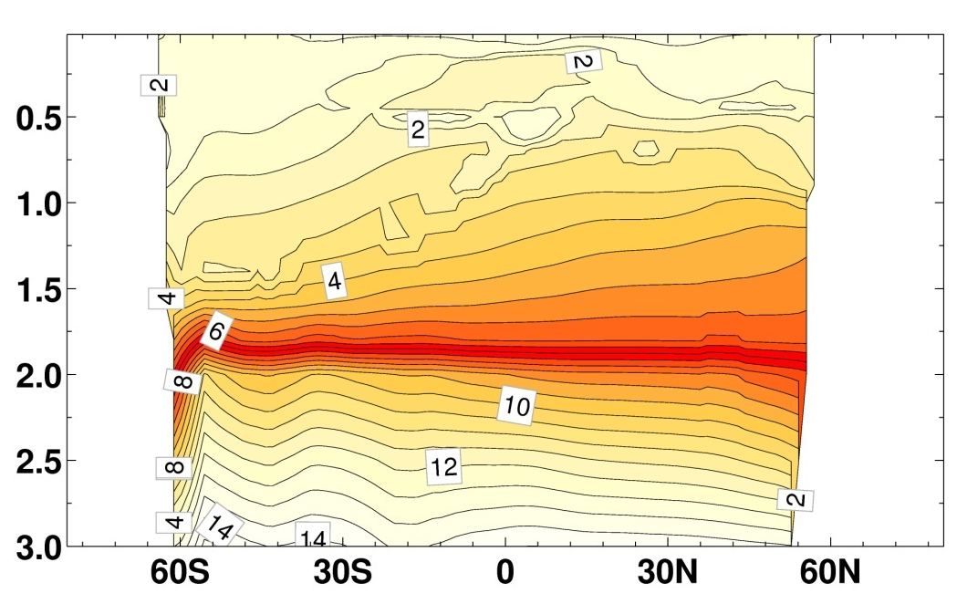
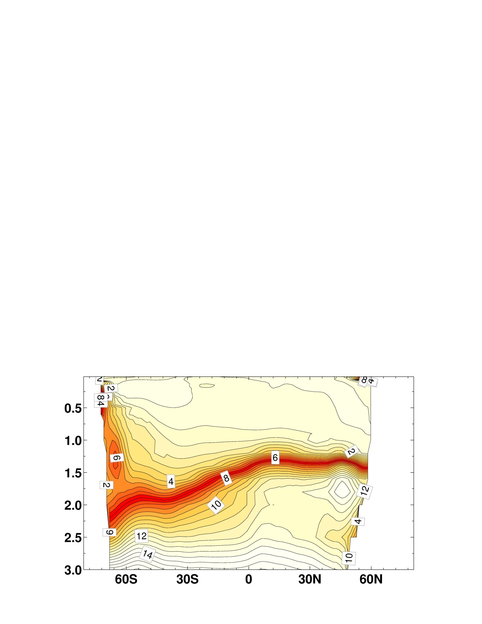
Upper Ocean: Surface Heat Flux, STC and AMOC
Pacific Warming
Atlantic Warming
HF & STC
HF & STC & AMOC
AMOC ⇓ → Upwelling and northward HT ⇓ → Warming enhanced

Slide 25
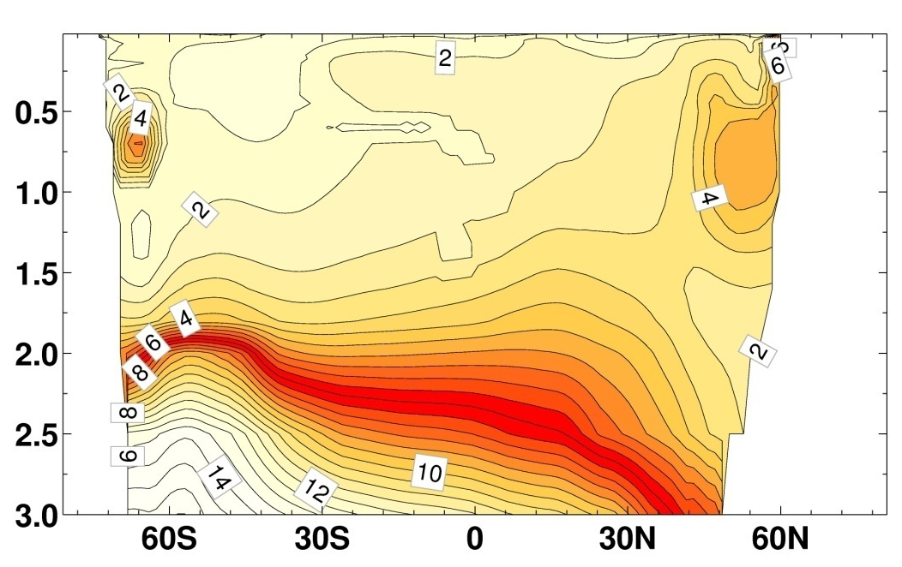
Upper Ocean: Surface Heat Flux and AMOC
Atlantic Warming
Atlantic Cooling
Warming: HF stabilize upper ocean, AMOC ⇓ → weaken vertical exchange
Cooling : HF destabilize upper ocean, AMOC ⇑ → strengthen vertical exchange

Slide 26
Discussions
The deep ocean is far from equilibrium.
Lacking of AABW: affect the deep ocean greatly.
Abrupt changes could happen in some regions.

Slide 27
Reversibility of the Climate Change
To what extend the climate is reversible?
Threshold for climate reversibility?
Reversible aspects – how long?
Irreversible aspects – timescale and impact
Solomon et al., 2009: Irreversible climate change due to CO2 emissions, PNAS, 1704-1709.

Slide 28
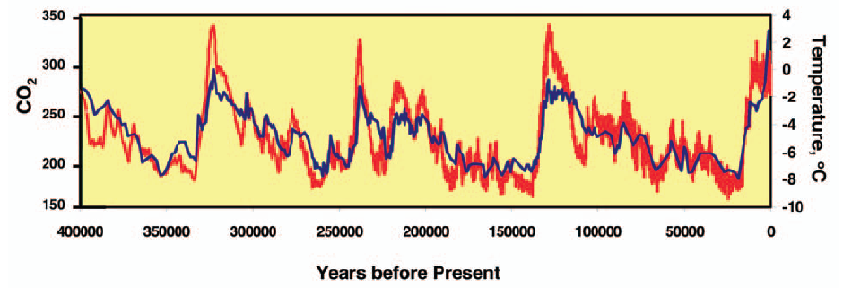
Periodic Change in Past Climate
Paleoclimate data: Ice core from Vostok, Antarctica. Petit et al. (1999, Nature)

Slide 29
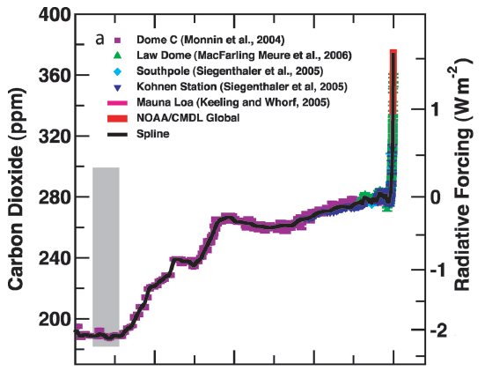

CO2 Change Since LGM
IPCC, AR4, 2007

Slide 30
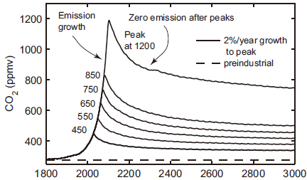
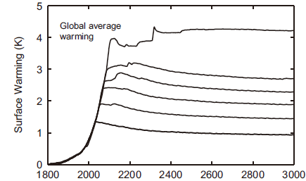
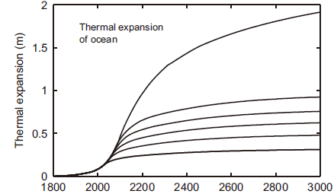
Irreversible Climate Change ?
irreversibility – climate change does not recover for 1000 years after emission stop
Bern 2.5CC EMIC
(Solomon et al., 2009)
Notes:
Fig. 1. Carbon dioxide and global mean climate system changes (relative to
preindustrial conditions in 1765) from 1 illustrative model, the Bern 2.5CC
EMIC, whose results are comparable to the suite of assessed EMICs (5, 7).
Climate system responses are shown for a ramp of CO2 emissions at a rate of
2%/year to peak CO2 values of 450, 550, 650, 750, 850, and 1200 ppmv,
followed by zero emissions. The rate of global fossil fuel CO2 emission grew at
1%/year from 1980 to 2000 and 3%/year in the period from 2000 to 2005
(13). Results have been smoothed using an 11-year running mean. The 31-year
variation seen in the carbon dioxide time series is introduced by the climatology
used to force the terrestrial biosphere model (15). (Top) Falloff of CO2
concentrations following zero emissions after the peak. (Middle) Globally
averaged surface warming (degrees Celsius) for these cases (note that this
model has an equilibrium climate sensitivity of 3.2 °C for carbon dioxide
doubling). Warming over land is expected to be larger than these global
averaged values, with the greatest warming expected in the Arctic (5). (Bottom)
Sea level rise (meters) from thermal expansion only (not including loss of
glaciers, ice caps, or ice sheets).

Slide 31
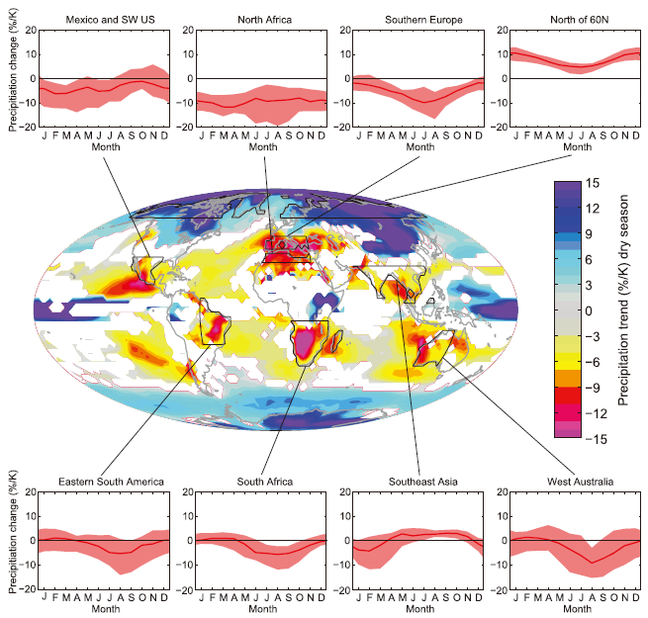
Irreversible Climate Change: Precipitation Change
(Solomon et al., 2009)
Notes:
Expected decadally averaged changes in the global distribution of precipitation per degree of warming (percentage of change in precipitation per
degree of warming, relative to 1900–1950 as the baseline period) in the dry season at each grid point, based upon a suite of 22 AOGCMs for a midrange future
scenario (A1B, see ref. 5). White is used where fewer than 16 of 22 models agree on the sign of the change. Data are monthly averaged over several broad regions
in Inset plots. Red lines show the best estimate (median) of the changes in these regions, while the red shading indicates the1- likely range (i.e., 2 of 3 chances)
across the models.

Slide 32
Questions
Regarding the dramatic increase of CO2 now, can our climate system recover in the future if CO2 recovers?
  Paleoclimate data during past 500k: CO₂ 200~300 ppmv
  Past 150 years: CO₂ nearly doubled.
If the climate system can recover, how many extra years it will take after CO2 recovery?
  Ocean delay the recovery process.

Slide 33
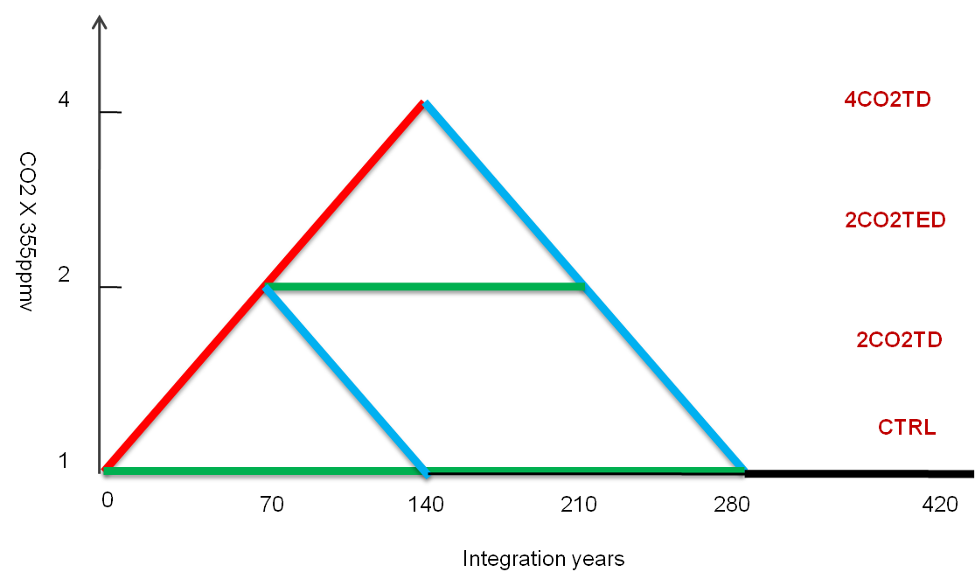
Experiments
All experiments run for 420 years
Each has 3 ensembles

Slide 34
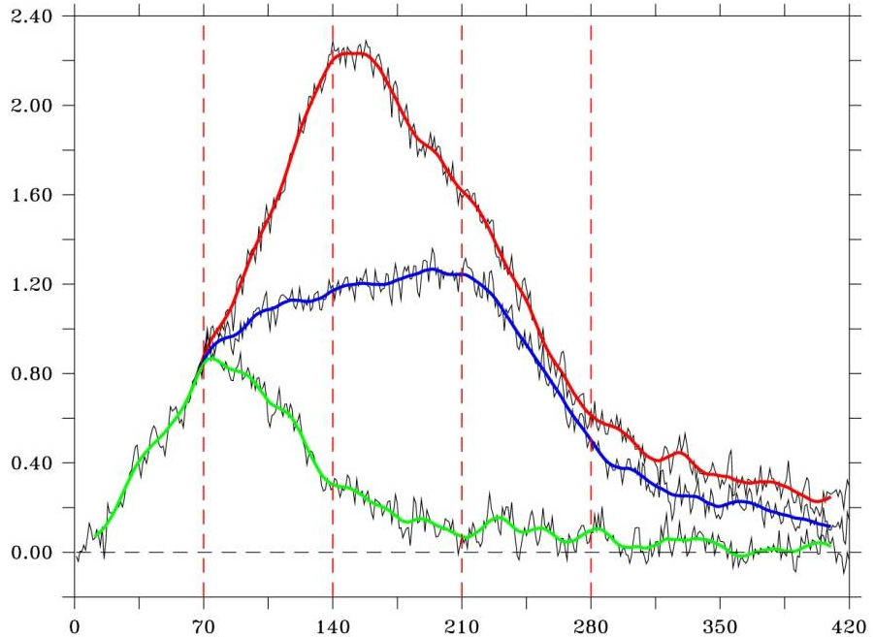
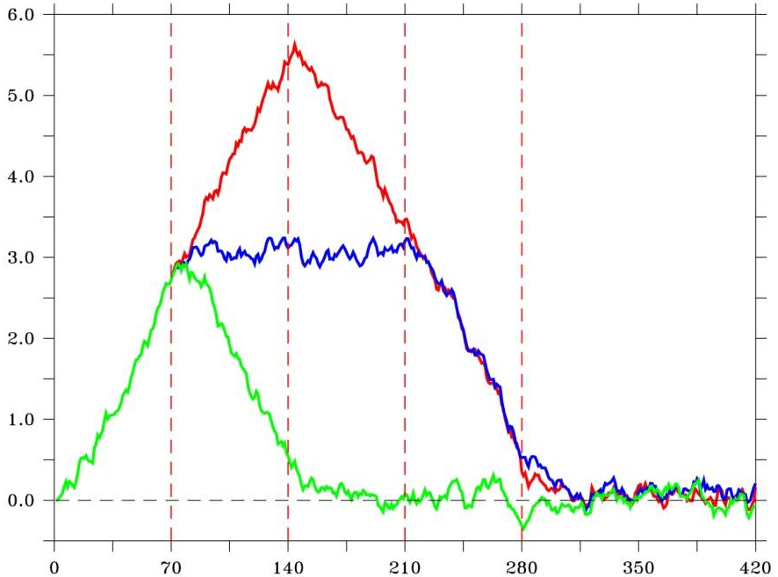
General Evolution in Global SST
Fully coupled
SST Trends for 2CO2 and 4CO2
( increasing VS. decreasing)
94%
87%
78%
SLAB ocean
72%

Slide 35
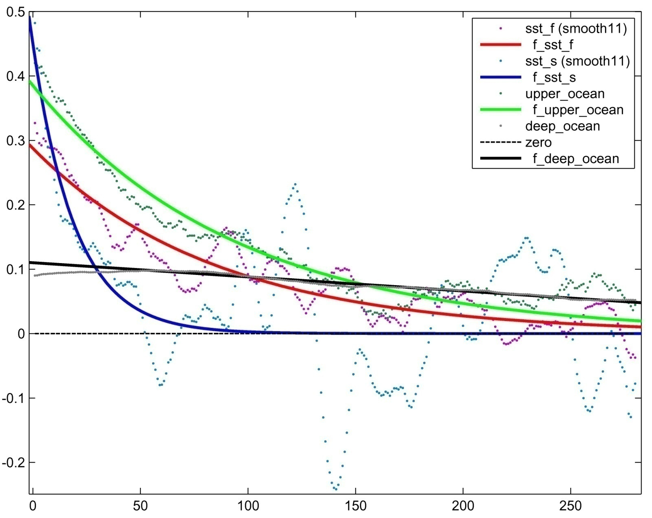
Recovery Time
Slab Ocean: 20Yr
SST fully couple: 85Yr
Upper ocean: 100Yr
Deep ocean: 500Yr
Notes:
How to define the time scale?

Slide 36
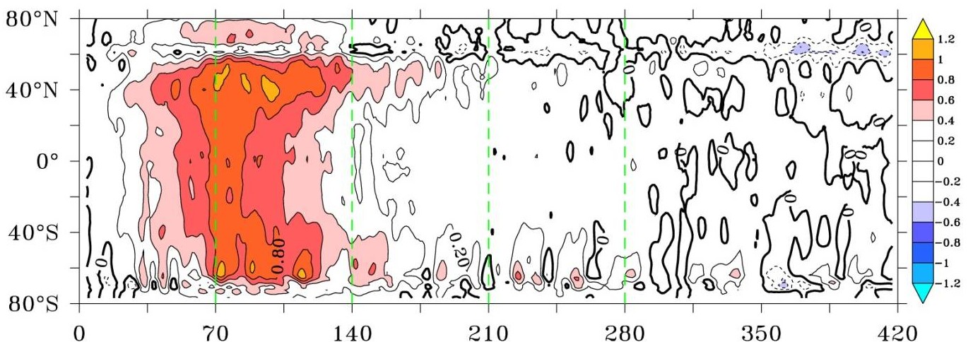
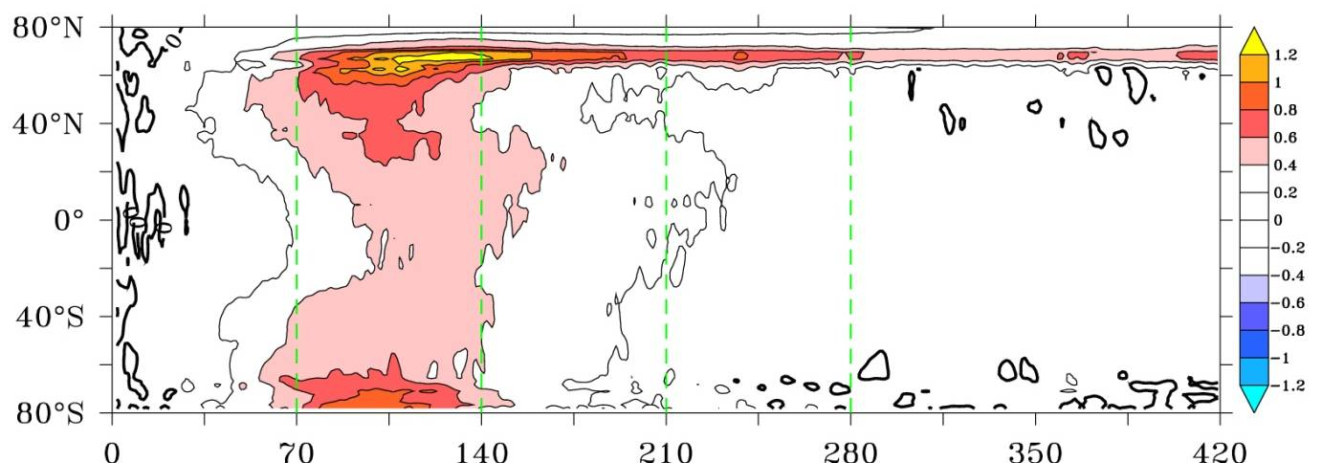
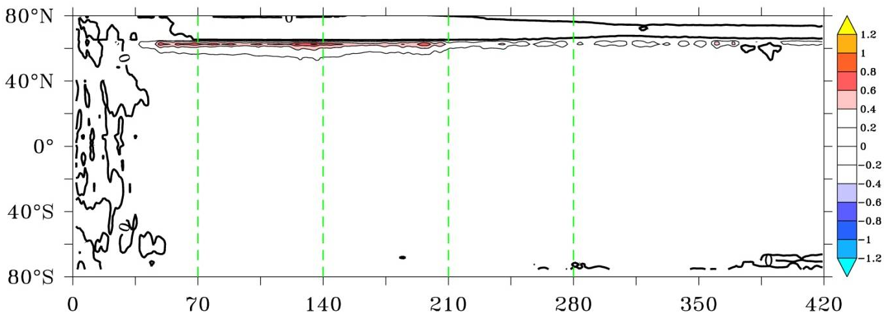
Evolution in Ocean Temperature in 2CO2TD
SST
T(40-1km)
T(1km-3km)

Slide 37
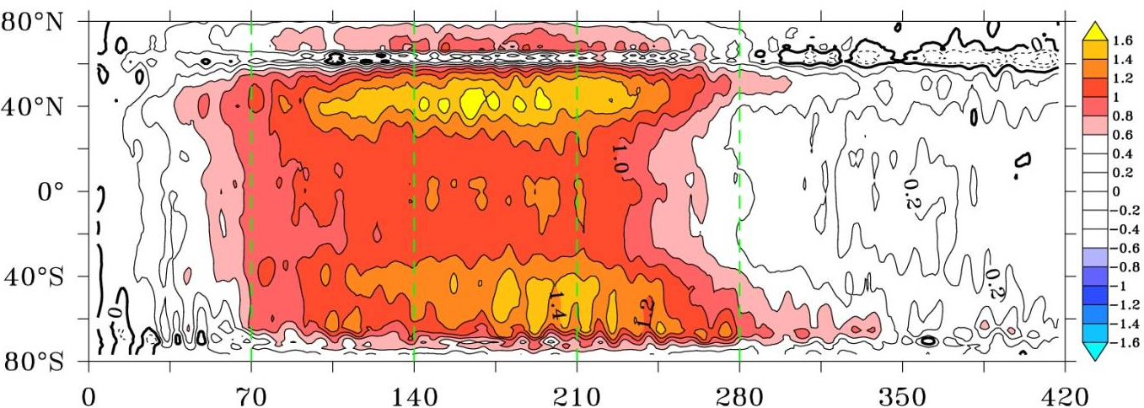
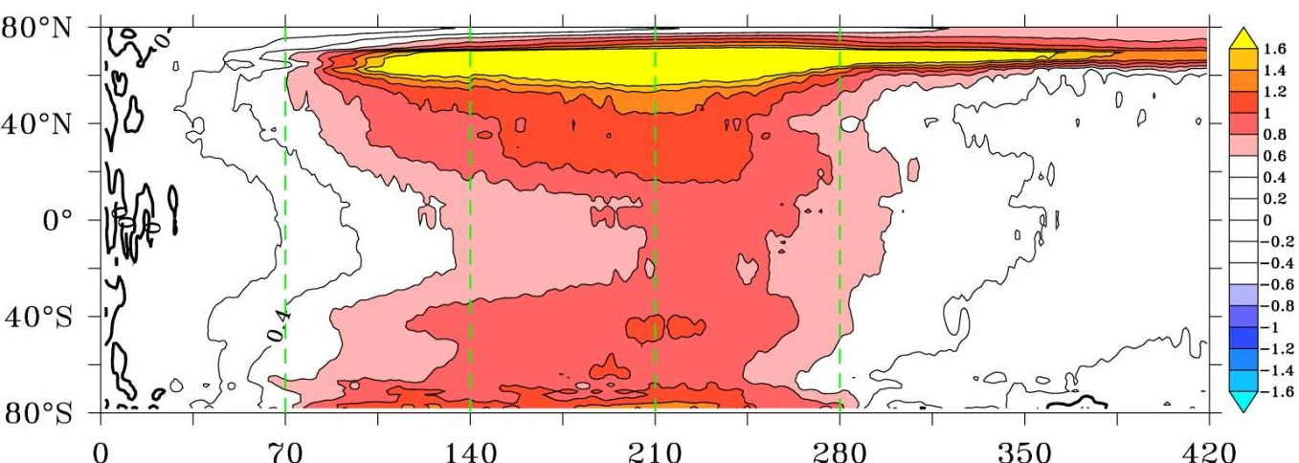
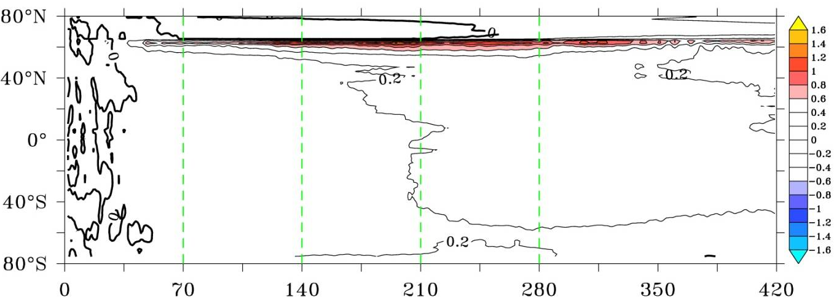
Evolution in Ocean Temperature in 2CO2TED
SST
T(40-1km)
T(1km-3km)

Slide 38
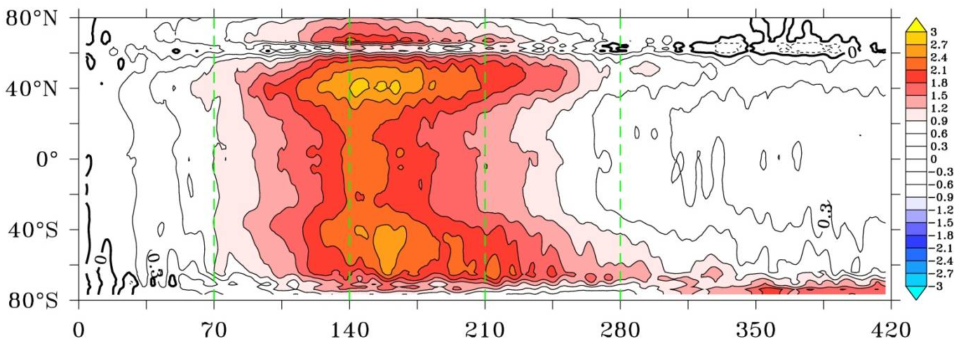
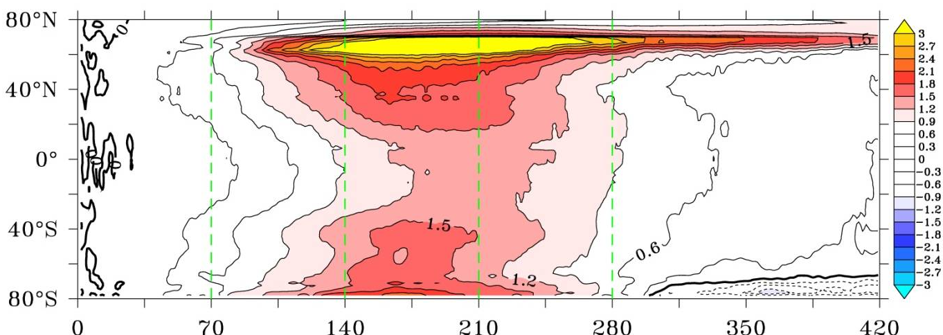
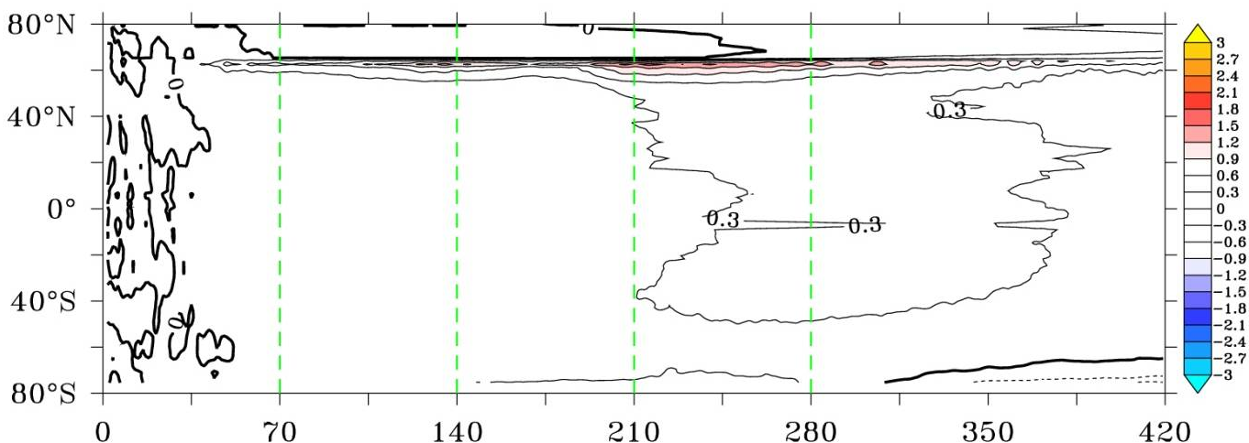
Evolution in Ocean Temperature in 4CO2TD
SST
T(40-1km)
T(1km-3km)

Slide 39
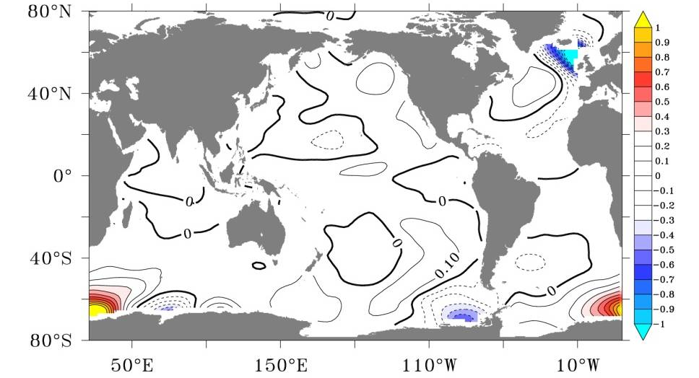
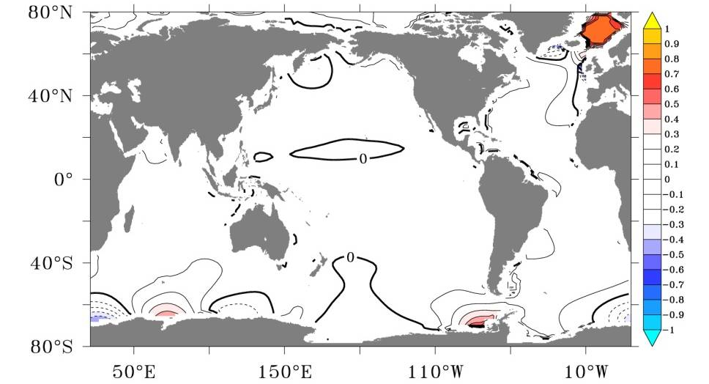
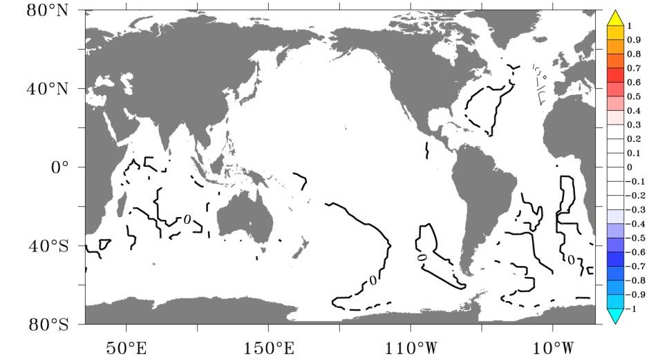
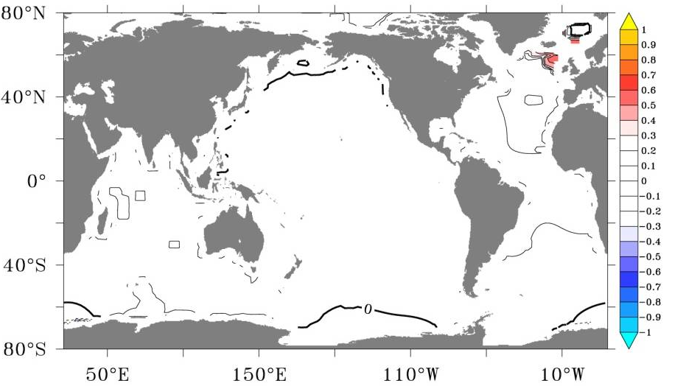
Residuals in 2CO2TD
SST
T(40-1km)
T(1km-3km)
T(3km-5km)

Slide 40
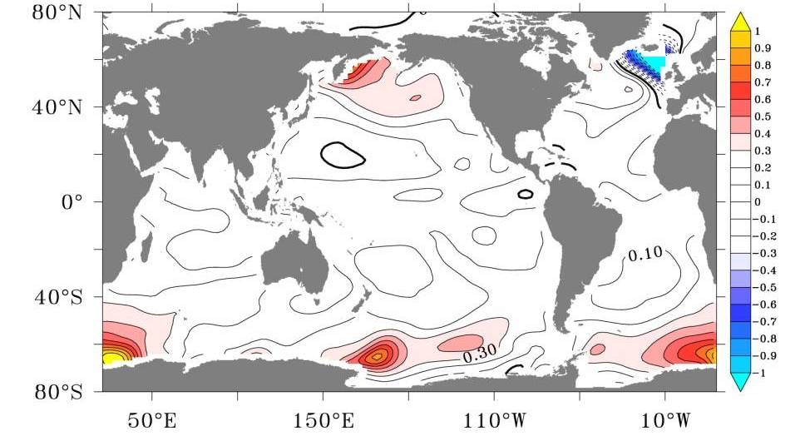
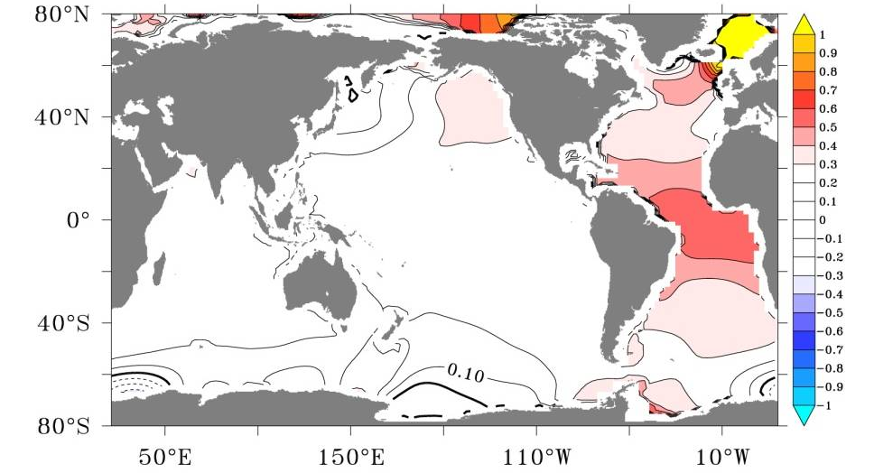
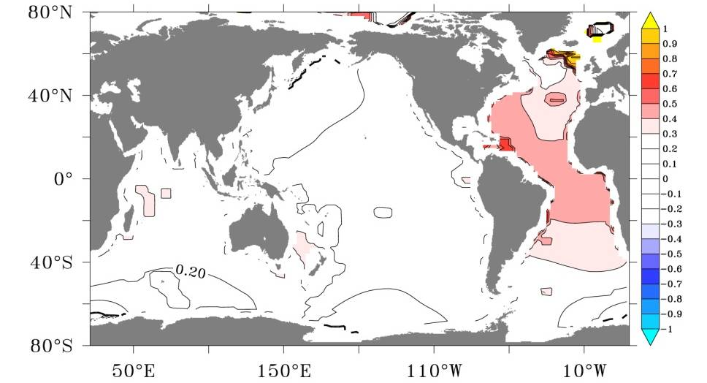
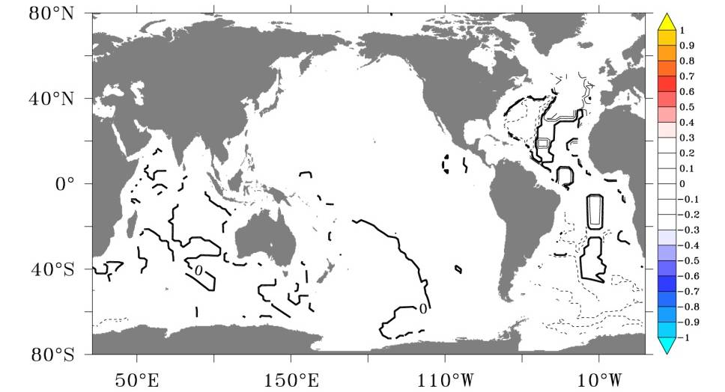
Residuals in 2CO2TED
SST
T(40-1km)
T(1km-3km)
T(3km-5km)

Slide 41
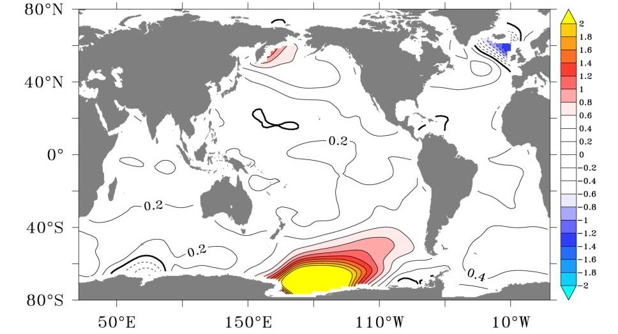
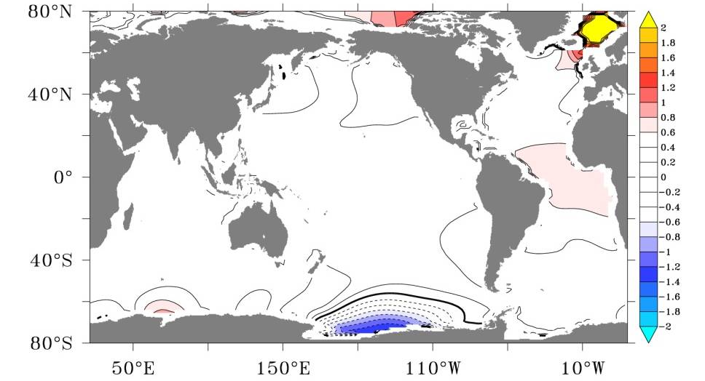
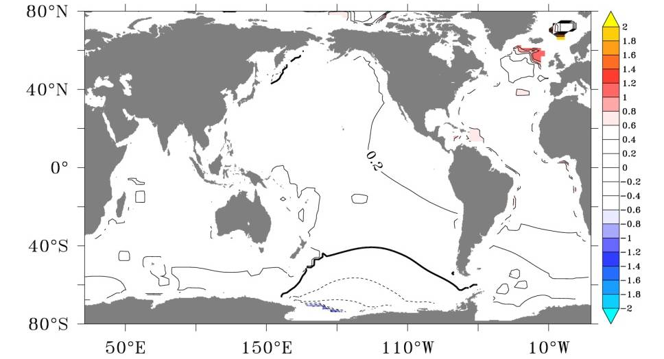

Residuals in 4CO2TD
SST
T(40-1km)
T(1km-3km)
T(3km-5km)

Slide 42
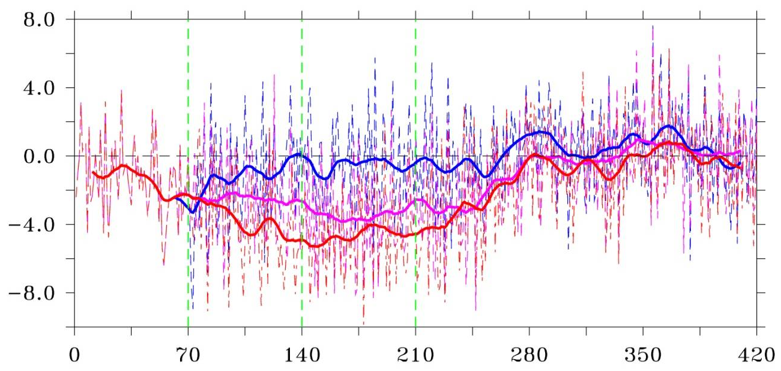
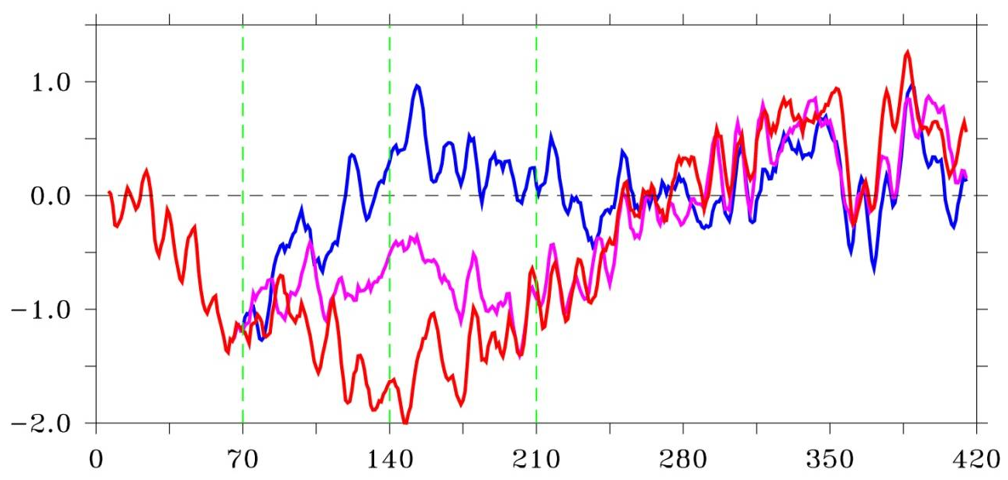
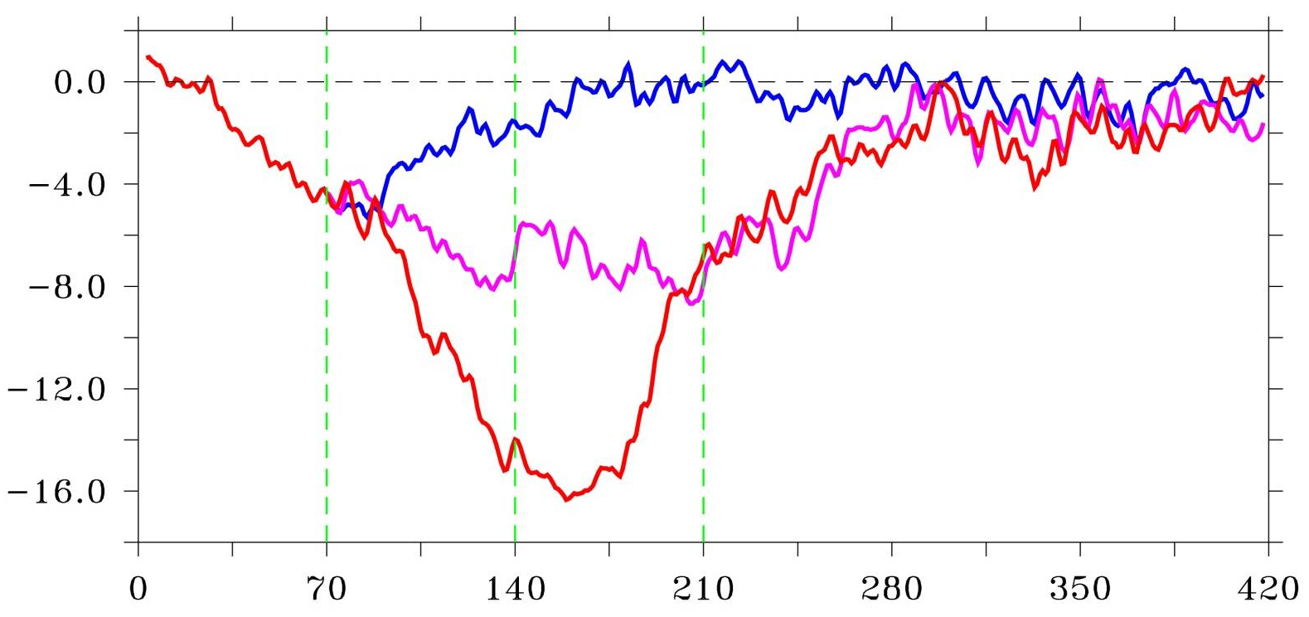
Walker Circulation and STC and AMOC
Δω at 500hp (hPa/day)
Equatorial Cell
AMOC
Notes:
How to define the delta_W?
500hPa:
Hadley Cell?

Slide 43
Conclusion and Implication
Ocean delays the recovery and changes the reversibility of the climate system;
Time scale: 20 Ys for surface ocean; >100 Ys for upper ocean; > 500 Ys for deep ocean;
Earlier action for better recover

Slide 44
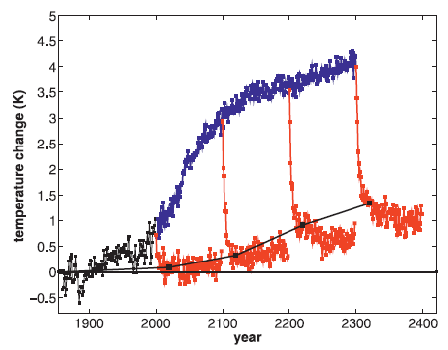
Sensitivity of SAT to the Slow Ocean
Stabilized 2xCO2
A1B (1%)
Forcing
Historical
Forcing
Recalcitrant component
Held et al., 2010: Probing the Fast and Slow Components of Global Warming by Returning Abruptly to Preindustrial Forcing. J. Climate, 2418-2427.

Slide 45

Time Evolution of SAT and Precipitation
Wu et al., 2010: Temporary acceleration of the hydrological cycle in response to a CO2 rampdown. GRL, 37, L12705.
Hydrological sensitivity
1%/K during transient warming
1.6%/K during stabilization period

Slide 46

Nonlinearity and Hysteresis
Water Vapour Content (WVC): Linear Hydrological Cycle (HC): Hysteresis
(Wu et al., 2010)

Slide 47

Precipitation in Response to Radiative Forcing
Notes:
Temporal evolution of climate change from HadCM3L simulations: global and annual mean changes in
(a) surface air temperature (SAT) and (b) precipitation from the simulation with step‐function changes in atmospheric CO2
(CO2_step) and solar intensity (Solar_step); (c) global and annual mean changes in SAT (red line), precipitation (green line),
and prescribed atmospheric CO2 concentrations (black line) from the simulation with 2% annual change in atmospheric CO2
(CO2_ramp); (d) global and annual mean ocean heat uptake from the simulations of CO2_step, Solar_step, and CO2_ramp.
The ocean heat uptake was calculated from the time‐series of annual mean ocean heat content by integrating ocean temperature
downward from the ocean surface to the bottom of the ocean. A reduction in atmospheric CO2 concentration leads to a
short‐term increase in global precipitation but this increase is not observed for the simulation where similar negative radiative
forcing is applied as a reduction of solar intensity. The different response of precipitation occurs despite the fact that
the change of ocean heat uptake is nearly the same in response to the change of CO2 and solar forcings.

Slide 48

Hysteresis
Notes:
HadCM3L results from the simulation with 2% annual change in atmospheric CO2 (CO2_ramp): (a) global and
annual mean changes in surface air temperature (SAT) as a function of atmospheric CO2; (b) global and annual mean
changes in ocean temperature as a function of atmospheric CO2 (the ocean temperature change is the change in ocean temperature
that is averaged from the ocean surface to the bottom of the ocean); (c) global and annual mean changes in precipitation
as a function of atmospheric CO2; (d) global and annual mean changes in precipitation as a function of global and
annual mean changes in SAT. Red dots represent the first 70‐year simulation phase with 2% annual CO2 increase (ramp_up)
and time moves forward from the lower left to the upper right. Blue dots represent the subsequent 70‐year period with 2%
annual CO2 decrease (ramp_down) and time moves forward from the upper right to the lower left. Black dots represent the
following 150‐years with the constant control CO2 concentration and time moves forward from the upper right to the lower
left. The simulation states when atmospheric CO2 reaches 1 × CO2 and 4 × CO2 concentrations are marked with yellow
circles. Due to the ocean thermal inertia one atmospheric CO2 state corresponds to two different states of temperature
and precipitation, and due to the precipitation sensitivity to atmospheric CO2 content, one temperature state corresponds
to two different precipitation states.

Slide 49

Hysteresis in Surface Energy Budget
Hydrological cycle hysteresis mainly due to ocean heat uptake

Slide 50
Time Evolution of SAT and Precipitation
Hydrological sensitivity: 1.3-1.5%/K

Slide 51
Nonlinearity and Hysteresis
WVC vs. △SAT: Linear HC: △P vs. △SAT: Hysteresis

Slide 52

Surface Energy Budget

Slide 53

Summary
Timescale for equilibrium response
  100s-1000s years
  Sensitive to the sign of external forcing
Timescale for climate recovery
  Earlier action for better recover
Reversibility of climate change
  Very long time, hysteresis, unpredictable and irreversible
Thanks

