Slide 1
Lecture 2: Physical Properties of Seawater Descriptive Physical Oceanography
杨海军（YANG Haijun）复旦大学大气与海洋科学系
Department of Atmospheric and Oceanic Sciences, Fudan University
Email: yanghj@fudan.edu.cn
This powerpoint was prepared for purposes of this lecture and course only. It contains graphics from copyrighted books, journals and other products. Please do not use without acknowledgment of these sources.

Slide 2
Readings:
Emery, Talley and Pickard: Chapter 3. Sections 3.1 to 3.9.
Emery, Talley and Pickard: Chapter 4. Sections 4.2 to 4.6.
Outlines
Pressure and Depth
Temperature, potential temperature and heat
Salinity and conductivity, Density and potential density

Slide 3
Vocabulary
Units (单位)
Officially we should be using mks units for everything. In reality, we often use cgs since our velocities are on the order of cm/sec rather than m/sec. We usually refer to depths in meters, and distances in kilometers. Most publications use decibars (分巴) for pressure rather than Pascals. We usually use degrees Celsius rather than Kelvin, but care should be taken when doing heat calculations. Salinity officially has no units. In general be careful about units when doing calculations.

Slide 4
Pressure and Depth
Definition
Pressure is the force per unit area exerted by water (or air in the atmosphere) on either side of the unit area.
Unit
The units of force (mass length / time²) (Newton's Law F = ma). The units of pressure: (force / length²) or (mass /[length time²]).
cgs: dynes/cm².
mks: N/m² and 1 Pascal = 1 N/m².
Atmospheric pressure is usually measured in bars. 1 bar = 10⁶ dynes/cm² = 10⁵ Pascal.
Ocean pressure is usually measured in decibars. 1 dbar = 10⁻¹ bar = 10⁵ dyne/cm² = 10⁴ Pascal.
Notes:
Description
The force due to pressure comes from the difference in pressure from one point to another - i.e. the “pressure gradient force" since the gradient is the change over distance. The force is in the direction from high to low pressure, hence we say the force is oriented "down the pressure gradient".

Slide 5
Pressure and Depth
In the ocean, the downward force of gravity is balanced mostly by an upward pressure gradient force. That is, the water is not accelerating downwards - instead it is kept from collapsing by the upward pressure gradient. Therefore pressure increases with increasing depth.
Notes:
P=rou*g*h

Slide 6
Pressure and Depth
The pressure at a given depth depends on the mass of water lying above that depth. If the pressure change is 100 decibars (100 dbar), gravity g = 9.8 m/s², and density is 1025 kg/m³, then the depth change is 99.55 meter.
The total vertical variation in pressure in the ocean is thus from near zero (surface) to 10,000 dbar (deepest).
Notes:
1 dbar ~ 1 m
Hydrostatic equation given in class.
P=rou*g*h

Slide 7
Pressure and Depth
Horizontal pressure gradients drive the horizontal flows in the ocean. The horizontal variation in pressure in the ocean is due entirely to variations in the mass distribution. Where the water column above a given depth (or rather geopotential surface, parallel to the geoid) is heavier because it is either heavier or thicker or both, the pressure will be greater.
Notes:
(which are much much stronger than the vertical flows)

Slide 8
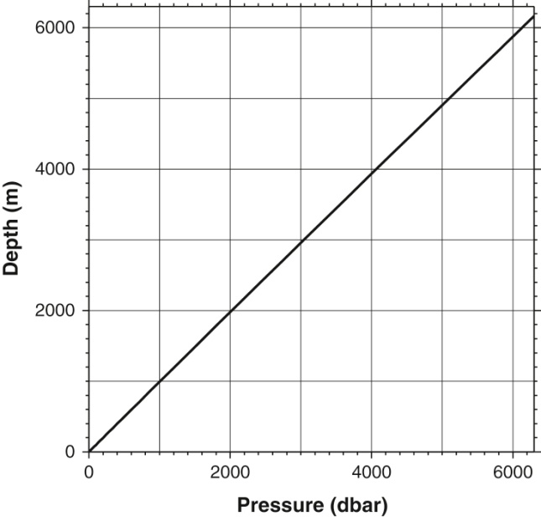
Pressure and Depth
The horizontal pressure differences which drive the ocean currents are on the order of a decibar over hundreds or thousands of kilometers, that is, much smaller than the change in pressure with depth.
The relation between depth and pressure, using a station in the northwest Pacific at 41°53’N, 146°18’W. Calculated from a CTD profile near Japan.
Notes:
(which are much much stronger than the vertical flows)

Slide 9
Temperature
Definition
Temperature is a thermodynamic property of a fluid, and is due to the activity of molecules and atoms in the fluid. The more the activity (energy), the higher the temperature. Temperature is a measure of the heat content. Heat and temperature are related through the specific heat. When the heat content is zero (no activity), the temperature is absolute zero (on the Kelvin scale).
Unit
ºC. For heat content and heat transport calculations, using the Kelvin scale. 0ºC = 273.16 K. A change of 1 ºC is the same as a change of 1 deg K.

Slide 10
Temperature
How is temperature measured?
Reversing mercury thermometers, invented by Negretti and Zamba in 1874. Accuracy is 0.004ºC and precision is 0.002ºC.
Thermistors for electronic instruments (热敏电阻温度计), including replacement for reversing thermometer pairs. Quality varies significantly. The best thermistors commonly used in oceanographic instruments have and accuracy of 0.002ºC and precision of 0.0005-0.001ºC.
Notes:
Accuracy: different from true value
Precision: can feel the most of the changes
http://www.theweatherprediction.com/habyhints/246/
http://en.wikipedia.org/wiki/Accuracy_and_precision

Slide 11
Accuracy （准确） and Precision（精确）
High accuracy low precision
High precision low accuracy

Slide 12
Heat
Heat per unit volume is computed from temperature using Q = density*specific heat*T where Q is heat/volume and T is temperature in degrees Kelvin. (When calculating heat within the ocean, where pressure is non-zero, use potential temperature.) mks units of heat are joules (i.e. an energy unit). Heat change is in Watts (i.e. joules/s). Heat flux is in W/m².

Slide 13
Heat
To change the temperature by 1ºC in a column of water which is 100 m thick and 1 m² on the top and bottom, over a period of 30 days, requires what heat flux? The density of seawater is about 1025 kg/m³ and the specific heat is about 3850 J/(kgºC). The heat flux into the volume must then be density*specific heat*(delta T)*volume/(delta t) where T is temperature and t is time. This gives a heat change of 152 W. The heat flux through the surface area of 1m² is thus 152 W/m².

Slide 14
Potential temperature（位温）
Pressure in the ocean increases greatly downward. A parcel of water moving from one pressure to another will be compressed or expanded. When a parcel of water is compressed adiabatically (绝热), that is, without exchange of heat, its temperature increases. When a parcel is expanded adiabatically, its temperature decreases.

Slide 15
Potential temperature
The change in temperature which occurs solely due to compression or expansion is not of interest to us - it does not represent a change in heat content of the fluid. Therefore if we wish to compare the temperature of water at one pressure with water at another pressure, we should remove this effect of adiabatic compression/expansion.

Slide 16
Potential temperature
Definition
"Potential temperature" is the temperature which a water parcel has when moved adiabatically to another pressure. In the ocean, we commonly use the sea surface as our "reference" pressure for potential temperature - we compare the temperatures of parcels as if they have been moved, without mixing or diffusion, to the sea surface. Since pressure is lowest at the sea surface, potential temperature (computed at surface pressure) is ALWAYS lower than the actual temperature unless the water is lying at the sea surface.

Slide 17
Distribution of Surface Temperature
Surface temperature is dominated by net heating in the tropics and cooling at higher latitudes. The total range of temperature is from the seawater freezing point up to about 30ºC. Land temperatures have a much larger range. A number of factors contribute to limiting the maximum ocean temperature - a convincing argument has been made for the role of clouds in blocking incoming solar radiation. Atmospheric convection becomes very vigorous when ocean temperatures exceed about 27ºC.
Notes:
About earth temperature, read Philander book: Our Affairs with El Nino. Chp ?

Slide 18
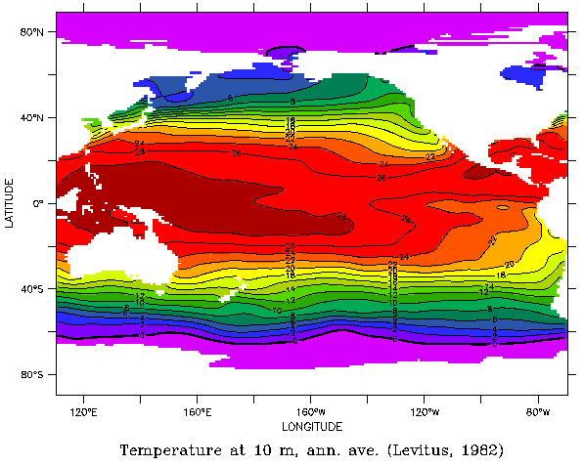
Pacific Sea Surface Temperature (Levitus annual mean)

Slide 19
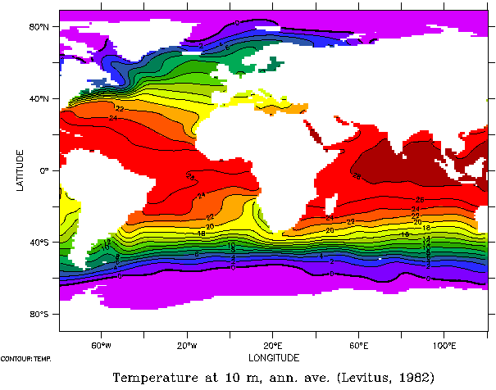
Atlantic-Indian Sea Surface Temperature (Levitus annual mean)

Slide 20
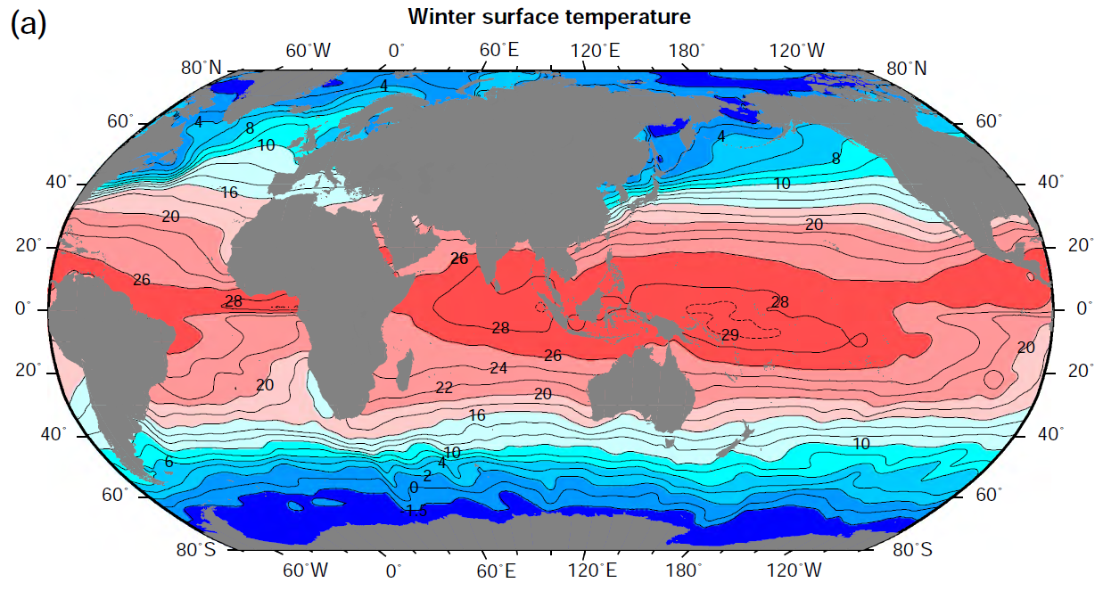
Global Sea Surface Temperature in Winter

Slide 21
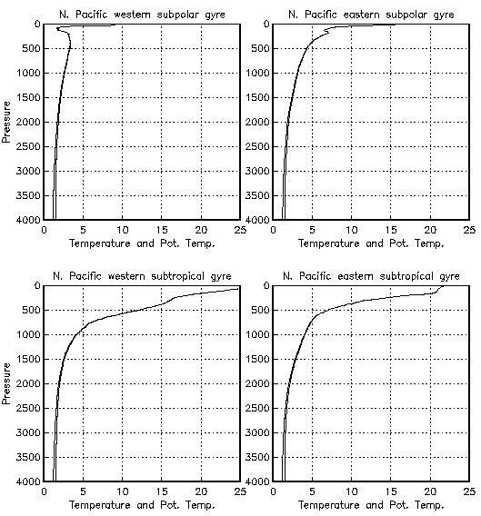
Vertical profiles of Temperature, Potential temperature

Slide 22
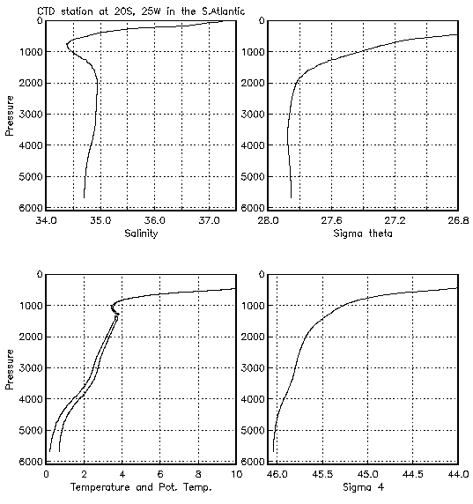
South Atlantic (20S, 5W): Salinity, Temperature, Potential temperature, Sigma theta, Sigma 4
Notes:
What is Sigma-4?

Slide 23
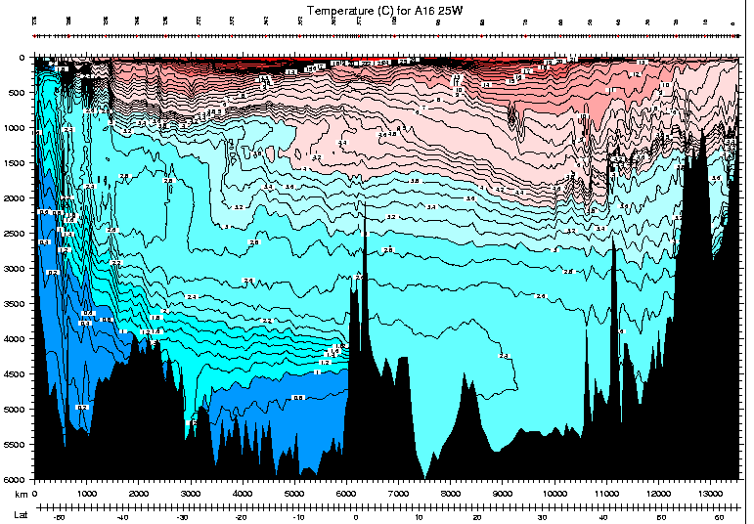
Meridional section of temperature: Atlantic 25°W
Notes:
The potential temperature sections show warm water at the surface to cold down below. Warm waters reach a bit deeper in the bowls of the subtropical gyres. Coldest deep water extending northward from Antarctica. Large rise in isotherms south of 40S is associated with the Antarctic Circumpolar Current. The potential temperature inversion layer in the South Atlantic must be balanced by salinity since on these large scales true density inversions are never seen.

Slide 24
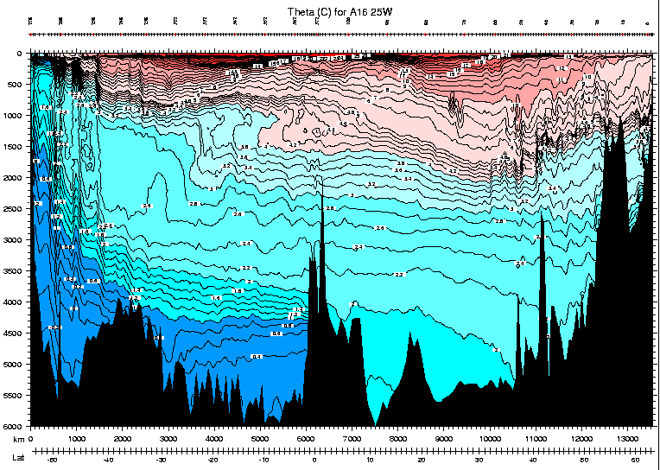
Meridional sections of potential temperature: Atlantic 25°W

Slide 25
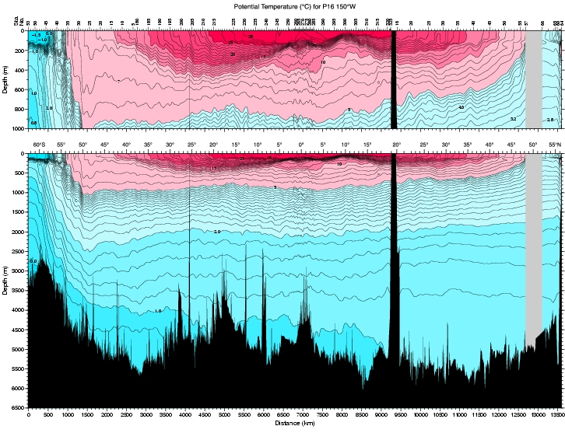
Meridional sections of potential temperature: Pacific 150°W

Slide 26
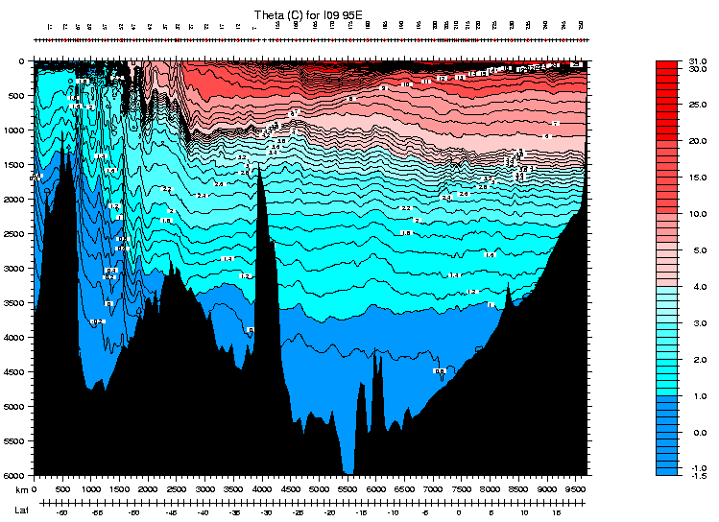
Meridional sections of potential temperature: Indian 95°E

Slide 27
Salinity (盐度)
Definition
Salinity is roughly the number of grams of dissolved matter per kilogram of seawater. This was the original definition, and at one time salinity was determined by evaporating the water and weighing the residual.
Notes:
The dissolved matter in seawater affects its density, hence the importance of measuring salinity

Slide 28
Salinity (盐度)
Unit
In the original definition, salinity units were ‰ (parts per thousand). This was replaced by the "practical salinity unit" or psu. Salinity is unitless, as the measurement is now based on conductivity and is not precisely related to the mass of dissolved material.

Slide 29
Salinity (盐度)
The total amount of salt in the world oceans does not change except on the longest geological time scales. However, the salinity does change, in response to freshwater inputs from rain and runoff, and freshwater removal through evaporation.

Slide 30
How is salinity measured?
Evaporate and weigh residual (oldest method)
Determine amount of chlorine (氯), bromine (溴) and iodine (碘) to give “chlorinity (含氯量)”, through titration (滴定) with silver nitrate (硝酸银). Then relate salinity to chlorinity: S = 1.80655 X Chlorinity. This is now referred to as the absolute salinity (S_{A}). Accuracy is 0.025 (less than 2 places). This method was used until the International Geophysical Year in 1957.
Measure conductivity (传导率).

Slide 31
Distribution of salinity and conductivity
Surface salinity is dominated by net evaporation in the subtropical regions, and net precipitation/runoff at higher latitudes and in the tropics. The range of salinity in the open ocean is about 31 to 38. Higher values are found in the Mediterranean and Red Seas, and Persian Gulf. Lower values are found at river outflows and near melting ice edges. (Salinity in coastal areas can be much lower.)

Slide 32
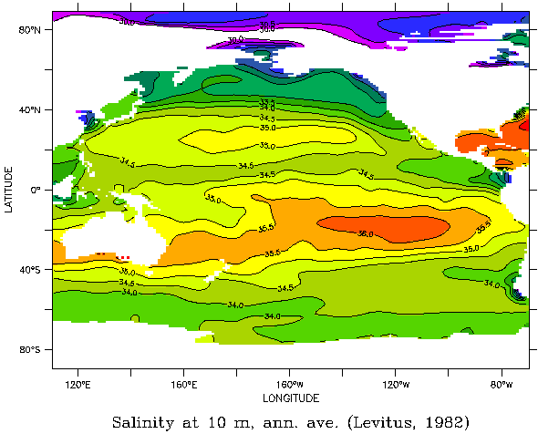
Pacific Sea Surface Salinity (Levitus annual mean)

Slide 33
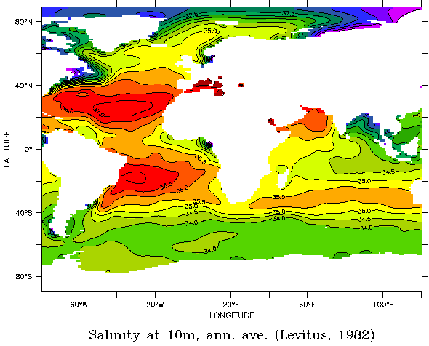
Atlantic and Indian Sea Surface Salinity (Levitus annual mean)

Slide 34
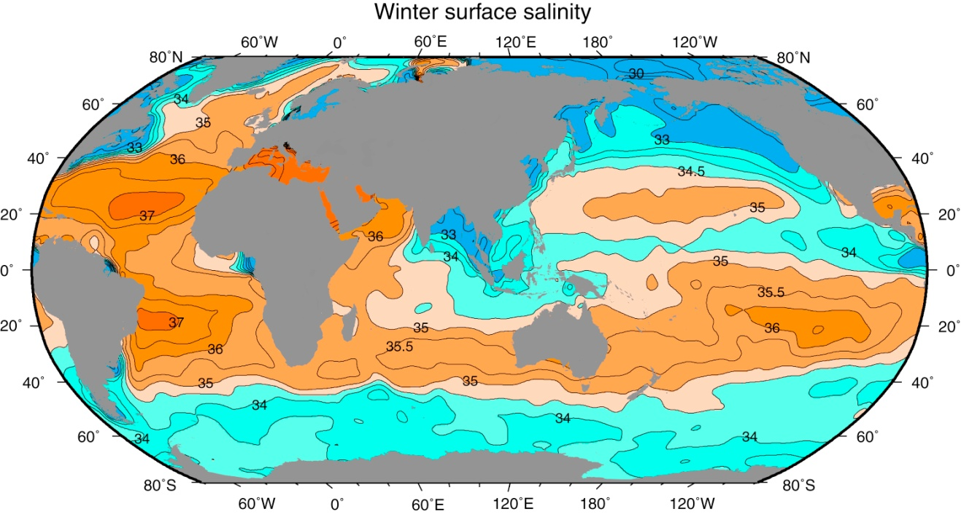
Global Sea Surface Salinity in Winter

Slide 35
Gulf of Alaska (northeast Pacific): Temperature, Salinity, Conductivity,

Slide 36
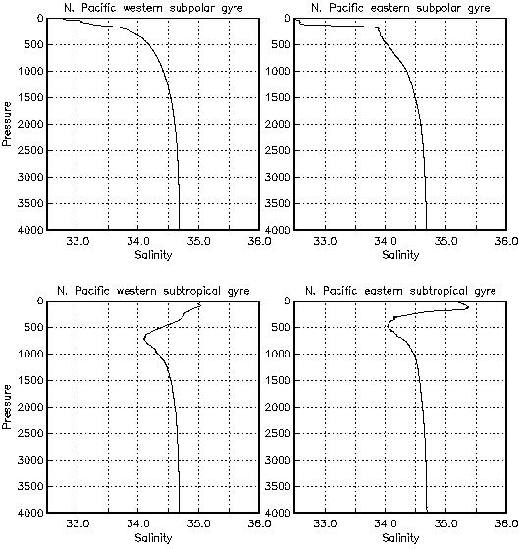
Subtropical and Subpolar North Pacific salinity
These show that salinity in the subpolar regions is lowest at the sea surface and increases monotonically downward. In the subtropical regions, the low salinity from the higher latitudes is found at depth, and the surface waters are more saline due to evaporation in the subtropics. Salinity profiles for the other ocean basins are similar, but differ much from one another than do the temperature profiles. Please look carefully at the vertical sections presented next for each ocean.

Slide 37
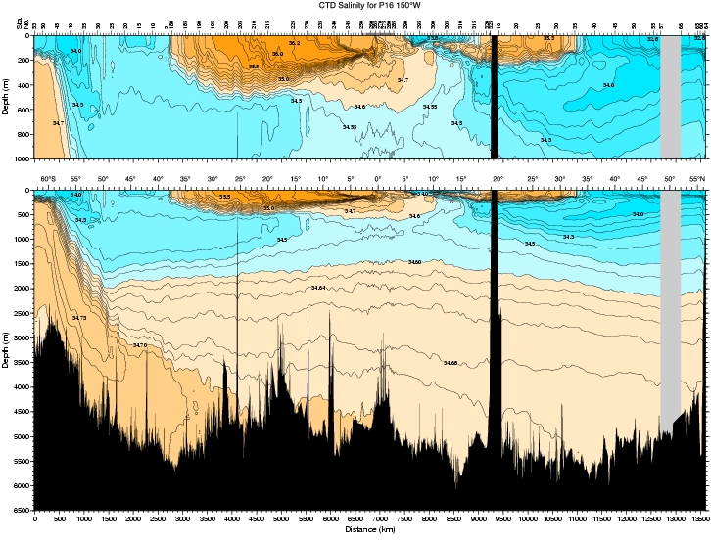
Meridional section of salinity: Pacific 150°W

Slide 38
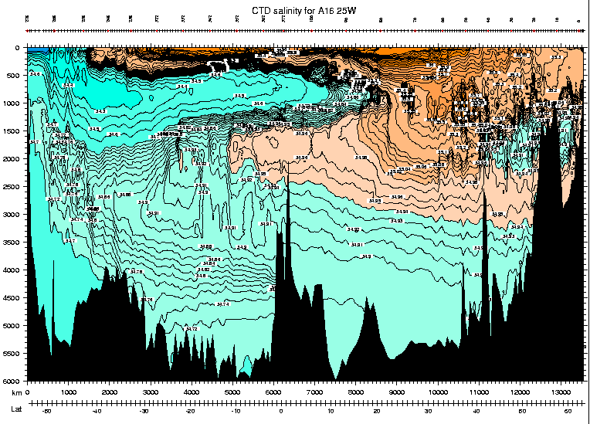
Meridional section of salinity: Atlantic 25°W

Slide 39
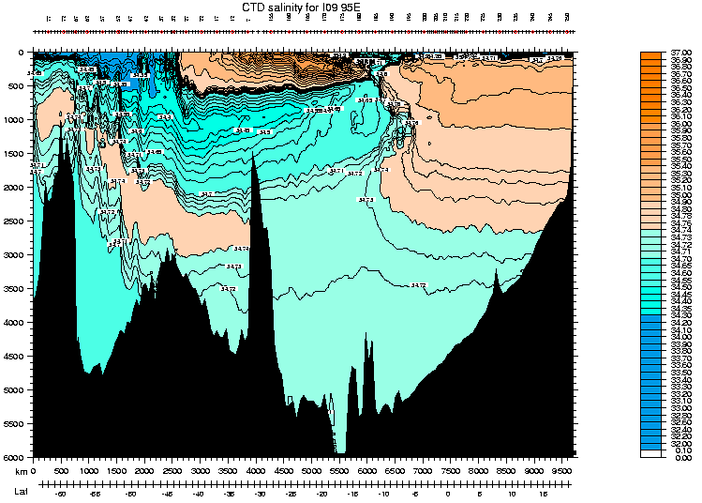
Meridional section of salinity: Indian 95°E

Slide 40
Density
Definition
Seawater density depends on temperature, salinity and pressure. Colder water is denser. Saltier water is denser. High pressure increases density. The dependence is nonlinear. An empirical equation of state is used, based on very careful laboratory measurements.
Unit: Mass/volume.
mks: kg/m³.
cgs: g/cm³.

Slide 41
Density
Discussion
Freshwater density is 1000 kg/m³. Typical densities for seawater are only slightly higher: 1020 to 1050 kg/m³, with most of this range being due to pressure. The range of densities at the sea surface is about 1020 to 1029 kg/m³.
Other expressions for density: sigma (s, t, p) = density - 1000. alpha (specific volume) = 1/density.

Slide 42
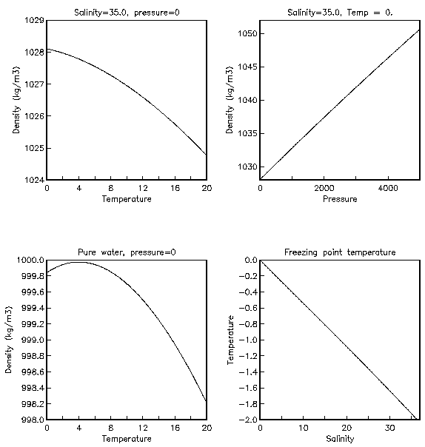
Density depends nonlinearly on temperature & salinity
Fresh water (S=0) at atmospheric pressure (p=0) has maximum density at temperature 4°C. (Thus colder fresh water is less dense, which has implications for lake overturn and ice floating.) As salinity is increased, the density maximum moves to lower temperature. At a salinity of about 24.7, the maximum density is at the freezing point.

Slide 43
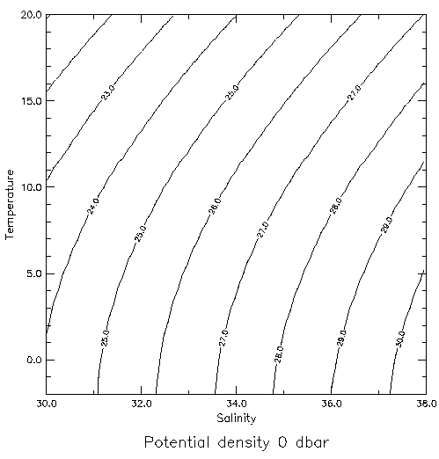
The nonlinearity of the equation of state is apparent in contours of constant density in the plane of temperature and salinity (at constant pressure) - they are curved. They are concave towards higher salinity and lower temperature.

Slide 44
Potential Density（位势密度）
Seawater is compressible, although not as compressible as a gas. As a water parcel compresses, the molecules are crushed together and the density increases. (At the same time, and for a completely different reason, compression causes the temperature to increase which very slightly offsets the density increase due to compression.)

Slide 45
Potential Density
Most variation in seawater is caused by pressure variation. This has little to do with the source of water, and if we wish to trace a water parcel from one place to another, one depth to another, we prefer to remove the pressure dependence. (This is in analogy with temperature; we also remove the pressure dependence in the temperature.)

Slide 46
Potential Density
Defined as the density a parcel has when moved adiabatically to a reference pressure.
If the reference pressure is the sea surface, then we compute the potential temperature of the parcel, and evaluate the density at pressure 0 dbar. The measured salinity is used as it has very little pressure dependence
Sigma 0: surface; Sigma 1: 1000dbar;
Sigma 2, 3, 4: 2000,3000,4000 dbar
Notes:
We can also use any other pressure as a reference. We refer to potential density at the sea surface as "sigma sub theta" (Greek in class - sorry about the notes), if potential temperature is used, and "sigma sub t" if measured temperature is used. The latter is an outdated method. We refer to potential density referenced to 1000 dbar as "sigma sub 1", to 2000 dbar as "sigma sub 2", to 3000 dbar as "sigma sub 3" and so on, following the nomenclature introduced by Lynn and Reid (1973); in these cases, potential temperature relative to the reference pressure is used in evaluating the potential density
Cold water is more compressible than warm water. That is, it is easier to deform a cold parcel than a warm parcel. Therefore cold water becomes denser than warm water when they are both submerged to the same pressure. Therefore various reference pressures are necessary. We use a pressure which is relatively close to the depth we are interested in studying. The compressibility effect is apparent when we look at contours of density at say 4000 dbar compared with those at 0 dbar.
The dependence of compressibility on temperature can be important. For instance, water spilling out of the Mediterranean through the Strait of Gibraltar is extremely salty and rather warm, compared with water spilling into the Atlantic from the Greenland Sea over the Greenland-Iceland ridge. They both have about the same density at their sills. However, the warm, saline Mediterranean water does not compress as well as the Greenland Sea water, and does not reach the ocean bottom. (There is also a difference in how the two types of water entrain other waters as they plunge downwards, so this is not a straightforward explanation.)

Slide 47
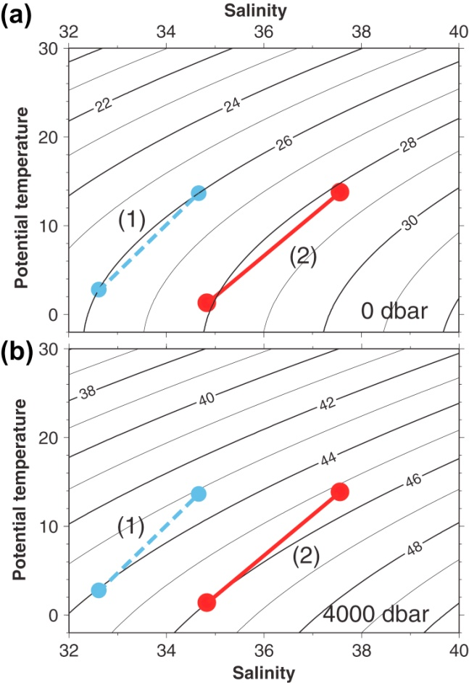
Potential Density at Different Reference Pressure
Potential density relative to
(a) 0 dbar and
(b) 4000 dbar
as a function of potential temperature (relative to 0 dbar) and salinity.
Parcels labeled 1 have the same density at the sea surface. The parcels labeled 2 represents Mediterranean (saltier) and Nordic Seas (fresher) source waters at their sills.

Slide 48
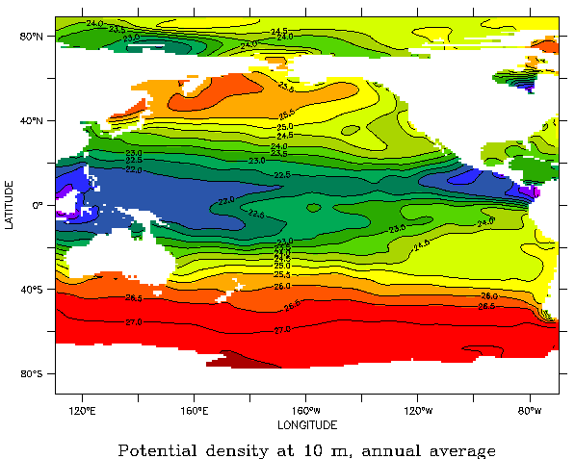
Pacific Sea Surface Density (Levitus annual mean [kg/m³-1000]).

Slide 49
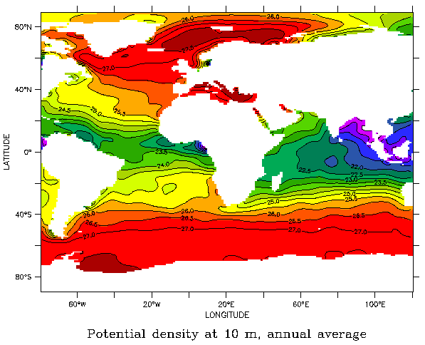
Atlantic-Indian Sea Surface Density (Levitus annual mean).

Slide 50
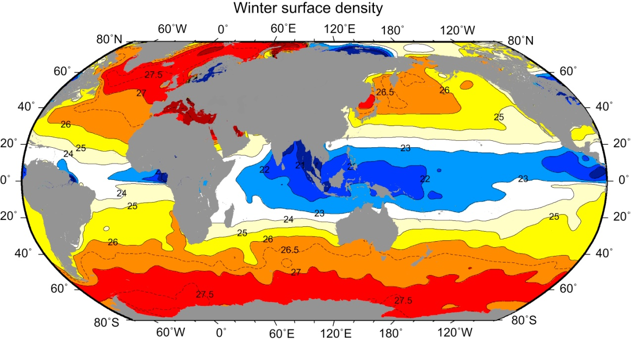
Global Sea Surface Density in Winter

Slide 51
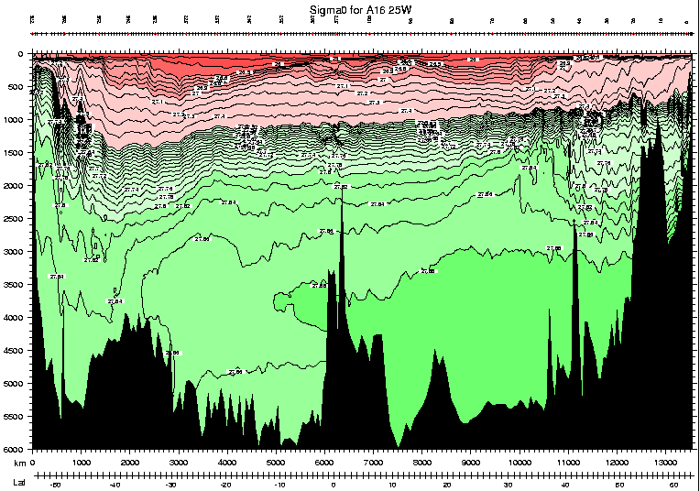
Sigma 0 for Atlantic at 25°W. Note the deep inversion of sigma theta with depth in the South Atlantic due to use of surface pressure for referencing the density. There is a deep inversion here.

Slide 52
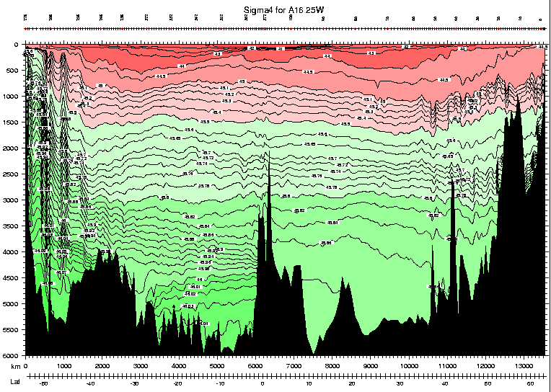
Sigma 4 for Atlantic at 25°W. There is no such deep inversion in sigma 4 since a more appropriate, local, reference pressure is used, when compared to sigma 0

Slide 53
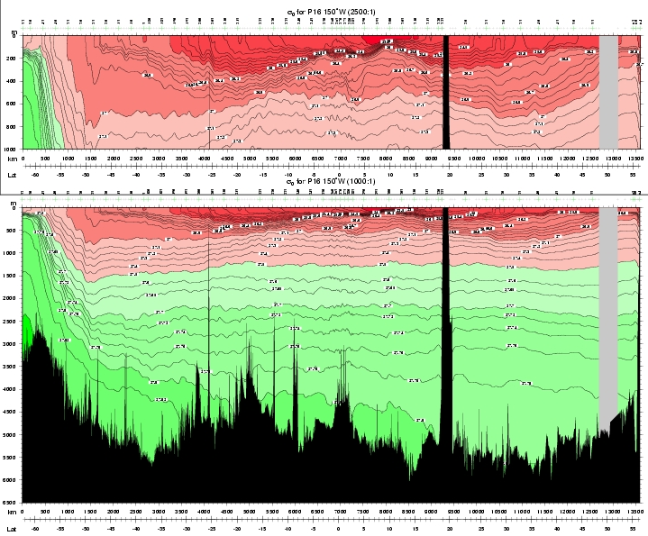
Sigma 0 for Pacific at 150°W.

Slide 54
Sigma 4 for Pacific at 150°W.

Slide 55
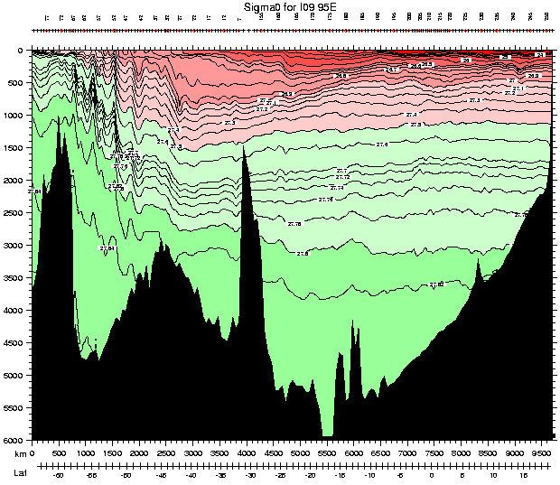
Sigma 0 for Indian at 95°E.

Slide 56
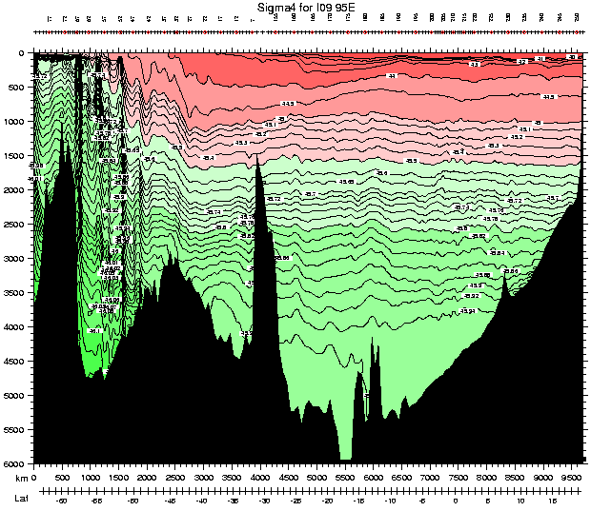
Sigma 4 for Indian at 95°E.

Slide 57
Sound in the Sea
The speed of sound in water is approximately 1500 m/sec. It depends on pressure and on temperature. The higher the pressure, the higher the sound speed (in a sense, the water is more "rigid" and so the speed increases). The higher the temperature, the higher the sound speed. In most areas of the ocean, the warm water at the surface and the high pressure at the bottom produce a sound speed profile which is maximum at the surface and bottom, with a minimum in between. This sound speed minimum is referred to as the SOFAR channel. Where temperature is low or inverted near the surface, then there is no surface maximum in sound speed and the SOFAR channel is found at the sea surface (typical of the subpolar and polar regions).
SOund Fixing and Ranging (SOFAR) (声波定位和测距通道)
Notes:
SOund Fixing and Ranging (SOFAR)

Slide 58
Sound Speed
Where there is a sound speed minimum, it functions as a wave guide.

Slide 59
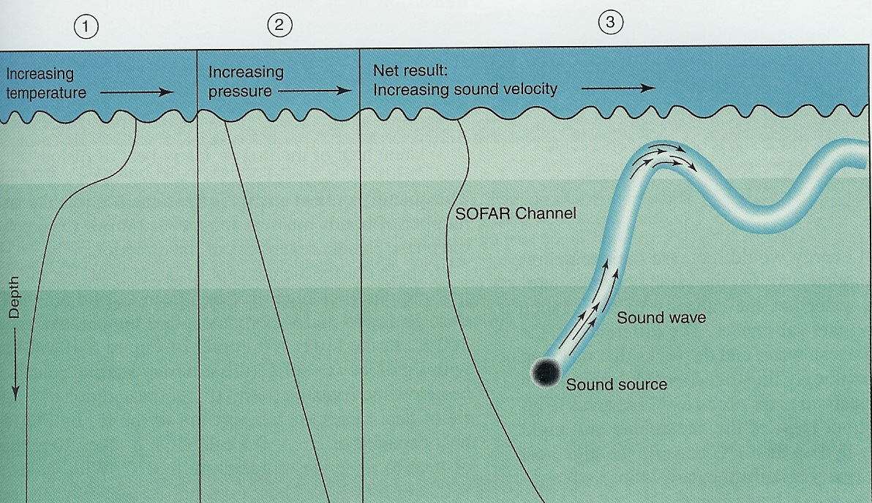
SOFAR Movie

Slide 61
Light in the Sea
Light is absorbed in much shorter distances in the sea than in the atmosphere.
We are concerned here with short-wave energy of wavelengths from about 0.4 to 0.8 µm (1 µm = 10⁻⁶ m), i.e. from the violet to the red of the visible spectrum. When this short-wave energy penetrates into the sea, some of it is scattered but most is absorbed and causes the temperature of the water to rise. This is the major source of supply of heat to the oceans.
Notes:
The behavior of visible light in water is different from that in air. Light is absorbed in much shorter distances in the sea than in the atmosphere. We are concerned here with short-wave energy of wavelengths from about 0.4 to 0.8 µm (1 µm = 10-6 m), i.e. from the violet to the red of the visible spectrum. When this short-wave energy penetrates into the sea, some of it is scattered but most is absorbed and causes the temperature of the water to rise. This is the major source of supply of heat to the oceans. The vertical attenuation of the energy is progressive as the radiation passes down through the sea and is different for different wavelengths. The progressive decrease in energy penetrating downward is expressed by an exponential law, Iz = Io exp (- kz), where Io is the radiation intensity penetrating through the surface, Iz is the remaining intensity at a depth z meters below the surface and k is the vertical attenuation coefficient of the water. The effects of depth and of attenuation coefficient are shown in Table 3.2. The coefficient k depends mainly on the absorption of light in the water and to a lesser extent on scattering.

Slide 62
Light in the Sea
The vertical attenuation of the energy is progressive as the radiation passes down through the sea and is different for different wavelengths. The progressive decrease in energy penetrating downward is expressed by an exponential law,
I_{z} = I_{o} exp (- kz),
where I_{o} is the radiation intensity penetrating through the surface, I_{z} is the remaining intensity at a depth Z meters below the surface and k is the vertical attenuation coefficient of the water.
Notes:
The behavior of visible light in water is different from that in air. Light is absorbed in much shorter distances in the sea than in the atmosphere. We are concerned here with short-wave energy of wavelengths from about 0.4 to 0.8 µm (1 µm = 10-6 m), i.e. from the violet to the red of the visible spectrum. When this short-wave energy penetrates into the sea, some of it is scattered but most is absorbed and causes the temperature of the water to rise. This is the major source of supply of heat to the oceans. The vertical attenuation of the energy is progressive as the radiation passes down through the sea and is different for different wavelengths. The progressive decrease in energy penetrating downward is expressed by an exponential law, Iz = Io exp (- kz), where Io is the radiation intensity penetrating through the surface, Iz is the remaining intensity at a depth z meters below the surface and k is the vertical attenuation coefficient of the water. The effects of depth and of attenuation coefficient are shown in Table 3.2. The coefficient k depends mainly on the absorption of light in the water and to a lesser extent on scattering.

Slide 63
Light Penetrating
The effects of depth and of attenuation coefficient are shown below. The coefficient k depends mainly on the absorption of light in the water and to a lesser extent on scattering.
Depth (m) | Vertical attenuation coefficient k (m⁻¹) |  |  | Clearest ocean water | Turbid coastal water
 | 0.02 | 0.2 | 2
0 | I₀=100% | 100% | 100% | 100% | 100%
1 | I_{z}=98 | 82 | 14 | 45 | 18
2 | 96 | 67 | 2 | 39 | 8
10 | 82 | 14 | 0 | 22 | 0
50 | 37 | 0 | 0 | 5 | 0
100 | 14 | 0 | 0 | 0.5 | 0
Amount of light penetrating to specified depths in seawater as a percentage of that entering through the surface

Slide 64
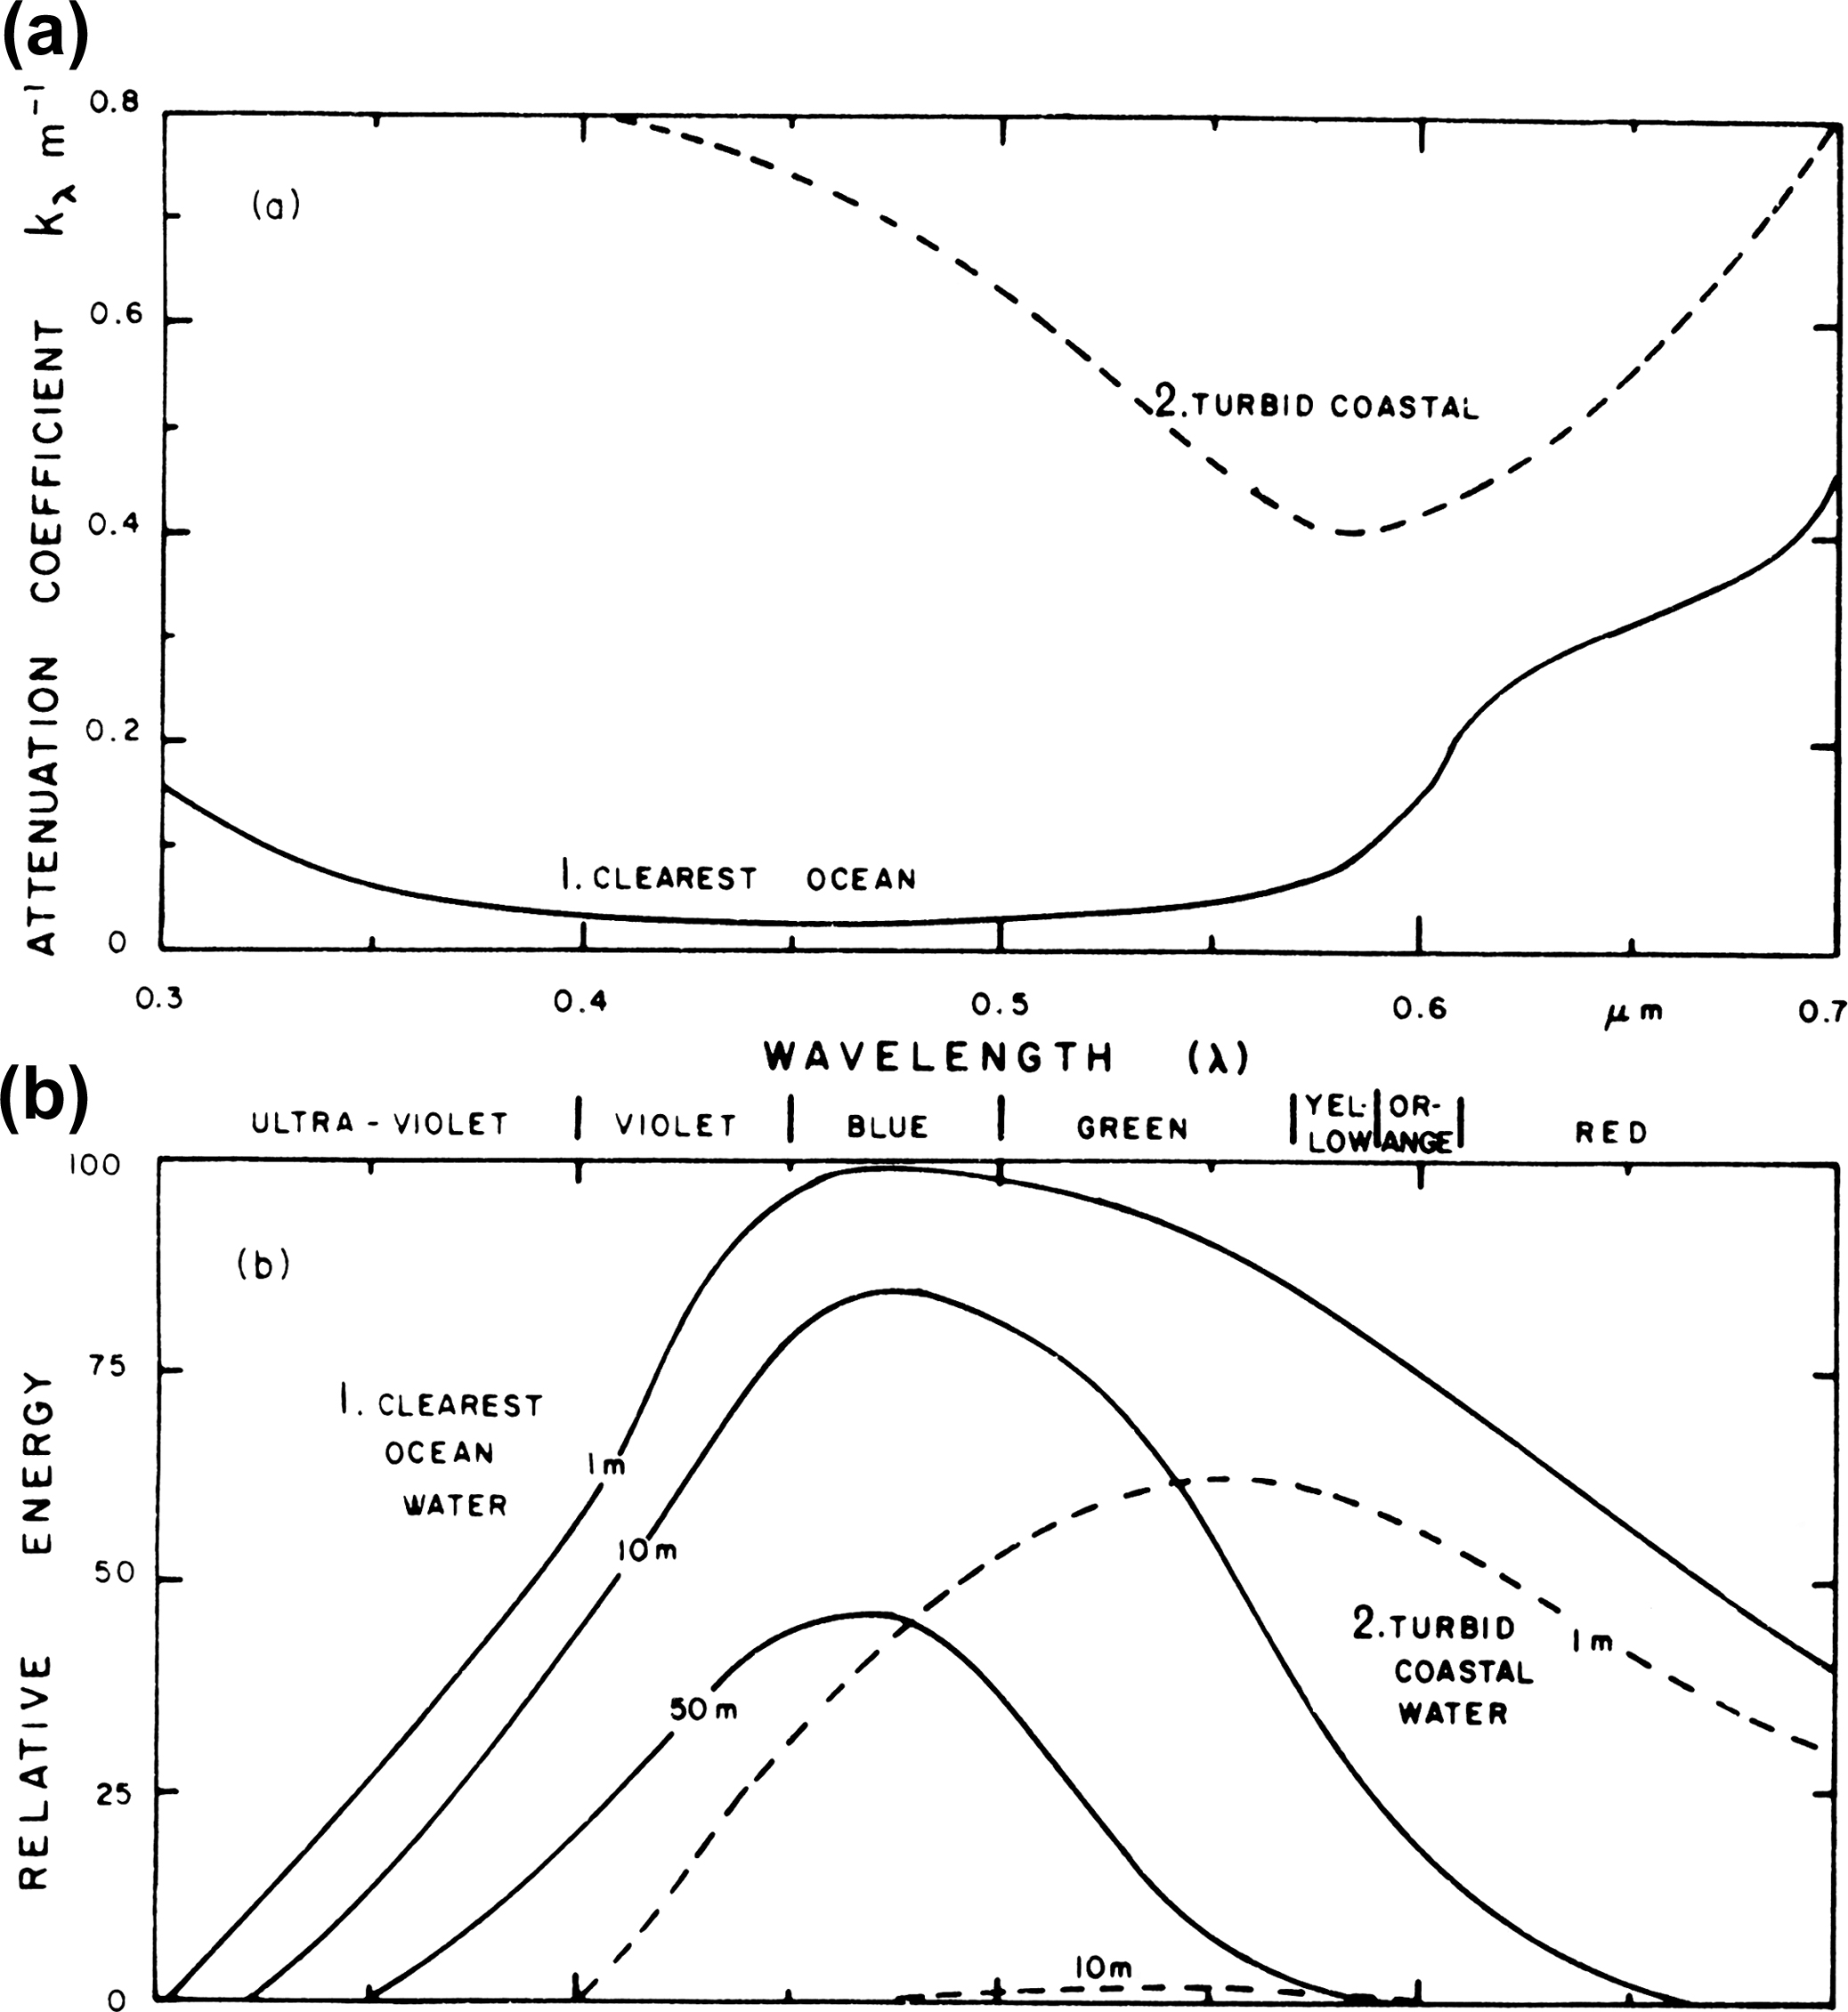
Light in the Sea
For clear ocean water (a, curve 1) k is minimum at about 0.45 µm wavelength so that blue light is attenuated least.
The increased absorption is more important in and beyond the red end of the spectrum where more energy is present in the sun’s radiation.
The maximum penetration is in the blue while penetration by yellow and red is much less
In more turbid waters, the least attenuation is in the yellow part of the spectrum
Notes:
For seawater, the coefficient k varies considerably with wavelength. For clear ocean water (Fig. 3.7 a, curve 1) k is minimum at about 0.45 µm wavelength so that blue light is attenuated least (penetrates best). At shorter wavelengths (toward the ultra-violet) and at longer wavelengths (in the red and infra-red) the attenuation is much greater and penetration correspondingly less. The increased attenuation in the ultra-violet is not important to the heat budget of the oceans because the amount of energy reaching sea level at such short wavelengths is small. The increased absorption is more important in and beyond the red end of the spectrum where more energy is present in the sun’s radiation. Virtually all of the energy at wavelengths shorter than the visible is absorbed in the top meter of water, while the energy at wavelengths 1.5 µm or greater is absorbed in the top few centimeters. In Fig. 3.7 b (full lines) are shown the relative amounts of energy penetrating clear ocean water to 1, 10 and 50 m as a function of wavelength. The maximum penetration is in the blue while penetration by yellow and red is much less.
In more turbid waters, e.g. near the coast, all wavelengths are attenuated more than in clear water, i.e. k is larger as shown by curve 2 in Fig. 3.7 a, and the least attenuation is in the yellow part of the spectrum. The dashed lines in Fig. 3.7 b show the relative penetration of energy for turbid coastal water. The energy penetrating to 1 m is less and to 10 m much less than through clear water, and the maximum penetration is shifted to the yellow. (The energy reaching 50 m in this turbid water is too small to show on the scale of this graph.)
In clear ocean water the superior penetration of blue and green light is evident both visually when diving and also in color photographs taken underwater by natural light. Red or yellow objects appear darker in color or even black as they are viewed at increasing depths because the light at the red end of the spectrum has been absorbed in the upper layers and little is left to be reflected by the object. Blue or green objects retain their color to greater depths. In clear ocean water there is enough light at 50 to 100 m to permit a diver to work, but in turbid coastal waters almost all of the energy may have been absorbed by 10 m depth.
The above remarks have emphasized the penetration of particular wavelengths. The energy from the sun is composed of a range (spectrum) of wavelengths and, as far as the heat budget is concerned (see Chapter 5), the important quantity is the sum of energy at all wavelengths penetrating into the water. The last two columns of Table 3.2 indicate the range of penetrations found in actual seawater.
In addition to its significance for the heat budget, the penetration of radiation into the sea is of interest to biologists in connection with the photosynthetic activity of phytoplankton and algae and with the behavior of zooplankton and fish. Some of the methods for measuring the attenuation or transmission of radiation through the sea are described in Section 6.8. The presence of plankton and sediment in seawater changes the penetration depth of solar radiation, and hence the depth at which the sun's heat is absorbed. This leads to changes in the way that the surface mixed layer develops. There are significant and permanent geographical variations in this vertical distribution of absorption, since some regions of the world ocean have much higher biological productivity than others.

Slide 65
Tracers
Seawater properties are valuable tools for tracing water parcels as differing water mass formation processes imprint different amounts of various properties on the water parcels.
Some tracers are biogenic and hence non-conservative. These include oxygen and the various nutrients, all discussed very briefly here.
Some useful tracers are inert but with time-dependent inputs, such as chlorofluorocarbons.
Some useful tracers have decay times and decay products, which can serve as a useful measure of age. The latter are referred to as transient tracers, and are not discussed here.

Slide 66
Tracers
Non-conservative tracer: Oxygen, Nitrate and phosphate, Dissolved silica
Transient tracers: chlorofluorocarbons, tritium, helium-3 and carbon-14. CFC's and tritium are strictly anthropogenic.

Slide 67
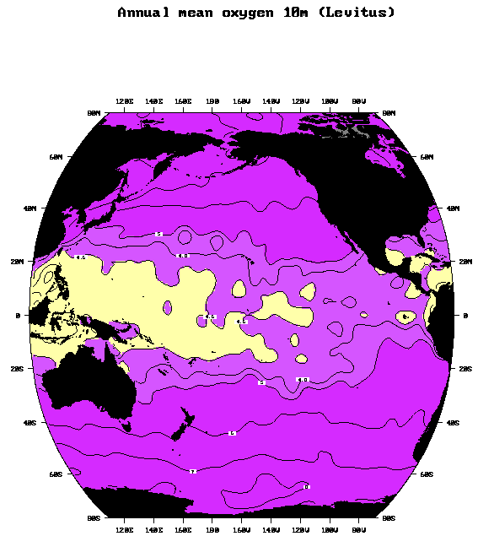
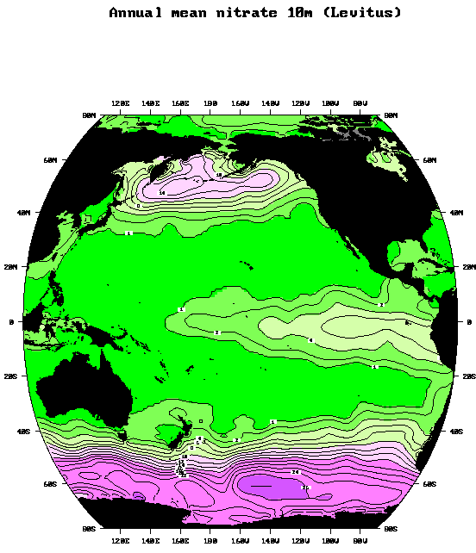

Slide 68
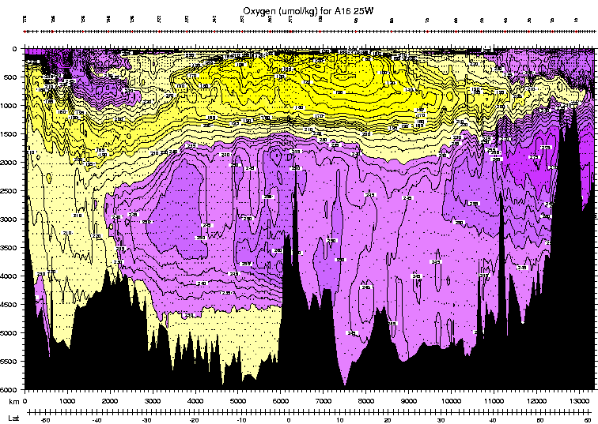

Slide 69
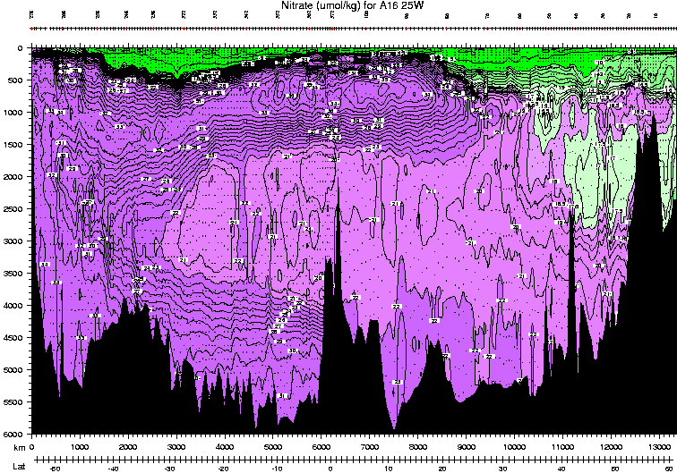

Slide 70
Questions (Due in 2 weeks)
Seawater properties
What properties of seawater determine its density?
What is the pressure at the bottom of the ocean relative to sea surface pressure? What unit of pressure is very similar to 1 meter?
What is the appropriate temperature scale to use for heat content?
What happens to the temperature of a parcel of water (or any fluid or gas) when it is compressed adiabatically? What quantity describes the effect of compression on temperature? How does this quantity differ from the measured temperature? (Is it larger or smaller at depth?)
What are the two effects of adiabatic compression on density? What quantity is used to minimize the effect of compression on density?

Slide 71
Questions
Seawater properties
What is salinity ?
What unique properties of seawater arise from non-linearity in the equation of state?
What are the significant differences between freezing pure water and freezing seawater?
Fresh water has a density maximum at a temperature above the freezing point, which allows ice to float. Is this also true for sea water? Why does ice formed from sea water float?
Why is there a sound speed minimum in the middle of the water column?

Slide 72
Calculation
A simplified formula for the speed of sound in water is: C = 1449 + 4.6T - 0.055T² + 1.4(S-35) + 0.017D (m/s) where T is temperature (ºC), S is salinity and D is depth in meters. Suppose an experiment is set up to measure the mean ocean temperature with a sound source and reciever located 5,000 km apart. Assume the sound path follows a mean depth of 1000m, where the mean salinity is 35 psu.
If the travel time between source and reciever is 56 minutes and 28.25 seconds, what is the mean temperature of the water?
Suppose the water between the sound source and reciever were to warm by 0.15 ºC. What would be the change in the acoustic travel time?
Suppose, instead, that a warm eddy drifted into the sound path. The eddy has a width of 200 km and a temperature anomaly of 1 ºC at 1000m. What is the change in acoustic travel time? *

Slide 73
Calculation
A 5m deep swimming pool is filled with seawater so that the level is 1 cm below the rim (e.g. 4.99 m of water). If the water is well mixed and initially at 10ºC and 35 PSU. If the water is uniformly heated, how hot would the water be when it started leaking over the rim? How much heat (J/m²) is required to heat the water to this point? If the heating rate is 100 W/m², how long would this take?
(Hints: using the simple equation of state: ρ-ρ₀=[-a(T-T₀)+b(S-S₀)], Where ρ₀=1027kg/m³, T₀=10ºC, S₀=35psu, a=0.15kg/m³, b=0.78kg/m³)

Slide 74
Learning about the Ocean, the Climate and the Nature

