Slide 1
Lecture 3: Typical Distributions of Water Characteristics in the Oceans Descriptive Physical Oceanography
杨海军（YANG Haijun）复旦大学大气与海洋科学系
Department of Atmospheric and Oceanic Sciences, Fudan University
Email: yanghj@fudan.edu.cn
This powerpoint was prepared for purposes of this lecture and course only. It contains graphics from copyrighted books, journals and other products. Please do not use without acknowledgment of these sources.

Slide 2
Readings
Emery, Talley and Pickard: Chapter 4
Key Concepts
Stratification
Thermocline
Mixed Layer
Ventilation

Slide 3
3.1 Introduction
Data Collection and Analysis
in situ (within the water column) observations by ship. A typical research cruise may include a number of oceanographic stations (sometimes called hydrographic stations) at which the ship is stopped and water properties are measured from the surface to depth.
Mooring platforms. Time series plots
Moving platforms. Merchant vessels, XBTs (expendable bathythermographs) and XCTDs (expendable conductivity-temperature probes)
Drifting surface buoys
Satellites
Notes:
In the past few decades, there has been a revolution in ocean observing, with the advent of nearly global satellite observations to augment the sparse observations within the ocean. Nevertheless, there is a problem with observing the ocean entirely from satellites since water is nearly opaque. Thus, optical satellite sensors that have begun to observe the atmosphere from top to bottom can only see the ocean's surface. To see properties in the interior of the ocean, it is necessary to make in situ measurements, that is, with instruments in the water. Radar altimeters do respond to the vertical integral of the ocean density and, in conjunction with satellites that measure the Earth’s gravity field, can be used to compute geostrophic ocean surface currents.
Classically, beginning hundreds of years ago, in situ oceanographic observations have been made from ships with properties measured or samples collected at depths below the ship. A typical research cruise may include a number of oceanographic stations (sometimes called hydrographic stations) at which the ship is stopped and water properties are measured from the surface to depth. For each station the measurements are then plotted as vertical profiles, i.e. graphs of temperature, salinity, oxygen, nutrients, velocity, etc., against depth or pressure. The vertical profiles from stations along a line may then be put together to form a vertical section of water properties, or the data from a selected depth or density surface may be plotted and contoured to make a map of the horizontal distribution of the property at that depth or density. Originally, the plotting and contouring were done by hand, but now the raw data are acquired by or entered into a computer, converted from engineering units to physical units, calibrated, checked for consistency, and then plotted using programs designed for the purpose. Most of these programs are some form of interpolation and smoothing. Years ago, printed data reports were routinely generated from any field experiment. Today computer data collection has greatly increased the volume of the data and it is no longer efficient to distribute most data in a printed volume. Instead many scientists distribute their data on computer media or online, along with data products including plots, derived quantities and syntheses with other data sets.
Other types of physical oceanographic data collected routinely by research ships include underway measurements of surface properties like temperature, salinity and sometimes dissolved gases, underway measurement of water velocities in the upper layer of the ocean, bottom depth using sonar, and precise navigation information. Expendable profilers make it possible to collect upper layer property profiles while the ship is underway.
Many "in situ" (within the water column) data are now collected from platforms other than research vessels, especially with the widespread use of satellite communication and precise navigation. Research vessels do not often revisit specific regions, and so little information about how the ocean currents or properties change with time (temporal variations) is collected from them. Observations taken at one location over a period of time are called "time series”. In the past, time series were sometimes collected from an oceanographic research ship occupying an anchor station for a day, a week or longer, or else returning to the same station, time after time, to measure the water properties there. Such routine observations continue to be made for fisheries purposes by most coastal countries, yielding decades of information about oceanographic conditions near coastlines. For many decades in the mid-twentieth century, a nearly global network of weather ships revisited the same scattered deep-sea locations each month, making weather observations, and importantly for oceanography, collecting vertical profiles of temperature, salinity and other properties. These historical records provide information for studying climate changes. With the advent of satellite observations that replaced the need for direct weather observations, the oceanographic weather stations were discontinued. Only a few deep-sea sites near islands where research ships can be based are still continued. Other present examples of time series measurements made from research ships include specialized ships that measure properties in the surface layer (waves, bubbles, and near-surface circulation).
Moving platforms other than research vessels include the merchant vessels, which ply the oceans on long voyages along regular routes and at regular intervals. Merchant mariners have been helping researchers since the 1970s by making temperature and sometimes salinity measurements with expendable profilers that reach down to 400, 800 or 1,500 m (expendable bathythermographs or XBTs, and expendable conductivity-temperature probes or XCTDs). XBTs have become an effective technique for monitoring the time/space changes in the upper-layer thermal variability of the ocean without the high cost of research vessels. Although the XBT is less accurate than a research vessel profiler, many phenomena have strong enough signals to be resolved by XBT data. These phenomena generally exhibit spatial and temporal variability that can only be cost-effectively monitored with such XBT programs.
Merchant vessel routes are limited geographically, covering areas such as the North Atlantic and North Pacific very well, but leaving large regions, particularly in the southern hemisphere, uncovered. Regular profiling from depth to the sea surface from autonomous subsurface floats is increasingly augmenting XBT profiling from merchant vessels. Within the next decade, such subsurface floats will cover most of the ocean.
Surface properties themselves are not all measured well from satellites. A nearly global network of drifting surface buoys also reports surface properties - air temperature, sea surface temperature, sometimes air pressure and other quantities - on a continuous and regular basis.
There are also instruments measuring velocity, temperature and sometimes other property measurements within the ocean, moored at specific sites for months to years. Most moorings used for exploratory research purposes are deployed for about a year or more and must be recovered to retrieve their data. Quasi-permanent moorings are now being placed around the world, particularly in the tropics, in order to monitor large variations in climate such as El Nino. Data from these permanent locations are relayed back via satellite and can be accessed for analysis in real time.
With these types of remote measurements, data can be collected over a long period of time, whereas it would be very expensive to send research ships to these locations repeatedly. The disadvantage is that the data collected remotely are difficult to calibrate against precise standards, and so research ship data are collected to provide the highest accuracy and precision.
After the collection of data and subsequent data processing (conversion to geophysical units and careful calibration using precise standards or reference materials) and initial plotting, the really interesting part starts. The oceanographer sits down, generally with a computer, with the basic data sets, plots, a set of data analysis techniques, and a thorough knowledge of basic oceanographic processes to try to determine why the properties are as they are. Among the processes that may be acting are horizontal flow, sinking or upwelling, mixing, diffusion, heat flow through the surface, precipitation etc. No set analysis method is suitable for all situations. The oceanographer does exactly what a detective does in trying to solve a crime, assembling the data (clues) that can be found and then deducing what really happened and what forces (motives) may be relevant. Each may have all the clues needed, or may lack vital ones, or may be looking at the wrong ones. The oceanographer has one advantage over the detective: additional observations can sometimes be collected (although at great expense if a research ship is required), whereas the criminal may not be so obliging as to keep repeating the crime.
"Synoptic" data, that is, those collected within a short time period, are analyzed to provide a “snapshot” of the oceanographic properties or long-term average circulation (after smoothing the data in space, since long spatial scales correspond generally with long time scales). Time series data are plotted and analyzed statistically in various ways to see if there are daily (diurnal) or seasonal or longer-term variations if the data sets are long enough. Generally surface-forced diurnal variations are only appreciable to depths of several tens of meters and seasonal ones to 100 to 300 m. At greater depths variations take place only over periods of months, years or possibly centuries.
It should be pointed out that a single oceanographic profile or measurement relies on the assumption that, over the time of the measurement, the ocean processes of interest are constant, that is, that the measurements are "synoptic”. The time for a typical shallow station (~ 1,500 m) is about an hour while deep stations (> 3,000 m) can take up to 3-4 hours. While the station is in progress, internal waves (riding on the stratification within the ocean much as surface waves ride on the ocean's surface) move the density surfaces up and down, while surface waves rock the ship and move the profiler up and down slightly. For study of the large-scale, long-term averaged ocean circulation, one does not therefore read much significance into variations that occur over small vertical distances, and the assumption of synopticity for a single profile is valid. In fact for many oceanographic cruises, which may take up to a month to complete, the assumption is made that the station data collected is for a single period. Similarly studies that employ measurements made by different research vessels assume that the structure being analyzed has not changed in the interval between the two or more ship surveys. Thus for every analysis, the researcher must consider how much sampling is needed for the particular process being studied - if the study is of internal waves, then measurements are needed every few minutes; if the study is of large-scale circulation and properties, the measurements can be made over many years.

Slide 4
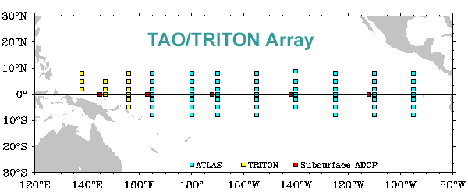
Tropical Atmosphere Ocean (TAO) Array
Motivated by the 1982-1983 El Nino event.
Support from NOAA's Equatorial Pacific Ocean Climate Studies (EPOCS) program
Started in early 1984, ended in Dec 1994. The full array of nearly 70 moorings. During the 10 years, over 400 buoys were deployed on 83 cruises, using 17 different ships from 6 different countries.
The operationally measurements consist of winds, sea surface temperature, relative humidity, air temperature, and subsurface temperature at 10 depths in the upper 500 m. Five moorings along the equator also measure ocean velocity.
http://www.pmel.noaa.gov/tao/proj_over/flash/mainDOC.html

Slide 5
3.1 Introduction
General
Most water characteristics are vertically stratified. Horizontal changes << vertical ones over the same distance. For instance, near the equator the temperature of the water may drop from 25ºC at the surface to 5ºC at a depth of 1 km, but it may be necessary to go 5,000 km north or south from the equator to reach a latitude where the surface temperature has fallen to 5ºC. The average vertical temperature gradient ~ 5,000 times the horizontal one.

Slide 6
3.1 Introduction
General
The more gradual horizontal variations are important: the horizontal density differences actually drive the horizontal circulation, which is much stronger than the vertical circulation.

Slide 7
Pacific annual mean SST

Slide 9
3.1 Introduction
General statistics
75% of the total volume of the ocean water has properties between 0°C and 6°C in temperature and between 34 and 35 psu in salinity.
50% of the total volume of the oceans has properties between 1.3°C and 3.8°C and between 34.6 and 34.7 psu.
Mean temperature of the world ocean is 3.5°C and the mean salinity is 34.6 psu.

Slide 10
3.1 Introduction
Area descriptions
“Zonal” -- the value of a property such as surface temperature may be much the same across the ocean in the east-west (zonal) direction but may change rapidly in the north-south (meridional) direction.
The most marked seasonal changes take place in the temperate zones (approximately 30º to 60ºN or ºS).

Slide 11
3.1 Introduction
Area descriptions
Equatorial refers to the zone within several degrees of the equator
Tropical refers to zones within the tropics (23ºN or ºS of the equator).
Low latitude is used when the equatorial and tropical are to be lumped together in contrast to the high latitudes, which are near the poles, north and south.
Subtropical refers to mid-latitude zones poleward of the tropics.
Polar is used for the Arctic and Antarctic regions.
Subpolar refers to the region between the strictly polar conditions and those of the temperate mid-latitudes.

Slide 12
Polar
Subpolar
Subtropical
Tropical
Equatorial

Slide 13
3.2 Temperature Distribution
Vertical temperature structure
Surface temperature
Upper layer temperature
Thermocline
Temporal variations of temperature in the upper layer and thermocline
Deep water temperature and potential temperature

Slide 14
Vertical Temperature Structure
mixed layer（混合层） or sometimes “surface layer”, an upper zone of 50 to 200 m thickness with potential temperatures similar to those at the surface;
thermocline（温跃层）, extending down to roughly 1,000 m, the potential temperature decreases rapidly;
abyssal（深水层）, between the thermocline and ocean bottom, potential temperature decreases slowly.
Typical temperatures at subtropical latitudes
20°C at the surface, 8°C at 500 m, 5°C at 1,000 m and 1 to 2°C at 4,000 m.
Notes:
Between the surface and ocean bottom, the temperature structure in a given profile can usually be divided into three zones (Fig. 4.2, profile b). Below the sea surface, we show only potential temperature so that the pressure effect on temperature is removed. There is an upper zone of 50 to 200 m thickness with potential temperatures similar to those at the surface, called the "mixed layer" or sometimes "surface layer" if a careful distinction is drawn between completely mixed water and general surface layer water. In the zone below this, extending down to roughly 1,000 m, the potential temperature decreases rapidly (the "thermocline"). In the deepest "abyssal" zone, between the thermocline and ocean bottom, potential temperature decreases slowly. Typical temperatures at subtropical latitudes are 20 °C at the surface, 8 °C at 500 m, 5 °C at 1,000 m and 1 to 2 °C at 4,000 m. All of these values and the actual shape of the temperature profile are strongly a function of latitude, as shown by the three different profiles in Fig. 4.2.
There are some notable additions to this three-layered structure. In all regions, spring and summer warming produces a thin warm layer overlying the winter's mixed layer. In the western subtropical regions and some other regions, there are two thermoclines with a less stratified (isothermal) layer ("thermostad") between them, all within the upper 1,000 m (Fig. 4.2, profile a). In Subpolar and Polar Regions where there is a low salinity surface layer, water in the upper layer can become colder than underlying water. Thus, there can be cold water in the surface layer overlying a warmer layer, which itself overlies the thermocline (still at about 500 to 1,000 m depth) and then abyssal waters underneath (Fig. 4.2, profile c). In some regions another mixed layer is found at the very bottom ("bottom boundary layer"), of up to 100 m thickness.

Slide 15
Vertical Temperature Structure
Fig 3.1 Typical potential temperature (°C)/depth (m) profiles for the open ocean in (a) the tropical western North Pacific (5°N), (b) the subtropical western and eastern North Pacific (24°N), and (c) the subpolar western and eastern North Pacific (47°N).

Slide 16
Vertical Temperature Structure
In all regions, spring and summer warming produces a thin warm layer overlying the winter's mixed layer.
In the western subtropical regions and some other regions, there are two thermoclines with a less stratified (isothermal) layer (thermostad) between them, all within the upper 1,000 m.
In subpolar and polar regions, there is a low salinity surface layer, water in the upper layer can become colder than underlying water. Thus, there can be cold water in the surface layer overlying a warmer layer, which itself overlies the thermocline (still at about 500 to 1,000 m depth) and then abyssal waters underneath .

Slide 17
Fig. 3.2 Surface temperature (°C) of the oceans in winter (January, February, March north of the equator; July, August, September south of the equator) based on averaged (climatological) data from Levitus and Boyer (1994).
Surface Temperature
Notes:
The ocean and atmosphere interact at the sea surface, with the atmosphere and ocean circulation and mixing setting the sea surface temperature (SST; Fig. 3.2) while the ocean's SST provides the temperature forcing at the bottom of the atmosphere.
This SST is based on historical measurements of SST from ships and buoys and does not include any estimates from infrared satellite data. SST ranges from slightly more than 29 °C in the warmest regions of the tropics to freezing temperature (about -1.8 °C) in ice-forming regions, with seasonal variations especially apparent at mid to high latitudes.
The temperature distribution at the surface of the open ocean is approximately zonal, with the curves of constant temperature (isotherms) running roughly east-west (Fig. 3.2). (The map projection used in this and some subsequent figures shows the ocean with areas between parallels of latitude being approximately correct, rather than being grossly exaggerated at high latitudes as they are in the Mercator projection.) Near the coast where the currents are diverted by the boundaries, the isotherms may swing more nearly north and south. Also, along the eastern boundaries of the oceans, surface temperatures are often lower due to upwelling of subsurface cool water, e.g. along the west coast of North America in summer, causing the isotherms to trend equatorward. Upwelling also causes lower surface temperatures in the eastern equatorial Pacific and Atlantic.

Slide 18
Satellite View
There have been significant improvements in mapping SST with the advent of satellite remote sensing, which can now produce daily maps of SST for most of the oceans with quite high spatial resolution.
The satellite sensors that give the highest spatial resolution (about 4 km globally and 1 km locally) measure infrared radiation emitted from the Earth's surface, but the presence of clouds obscures the surface by absorbing the infrared signal.

Slide 19
Satellite View
The structure of ocean currents, fronts, eddies and meanders are more apparent in these SST images than they are in the averages of ship SST measurements used for Fig. 3.2, which covers a month over many years rather than a single month. In addition the infrared satellite sensor sees radiation emitted from the 10 micron “thin skin” of the ocean while the ships and buoys measure an SST somewhat below the surface (0.5 – 3.0 m).

Slide 20
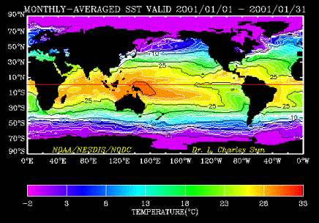
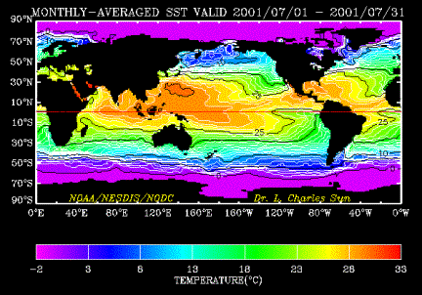
Satellite View
Fig. 3.4 (a) January and (b) July of 2001 mean monthly satellite infrared sea surface temperature (°C). The 5 km, 1 day resolution of the AVHRR data (as in Fig. 3.4 c) has been averaged here to 54 km and 1 month resolution.
Notes:
1978.7.7-10.10 第一颗海洋遥感卫星

Slide 21
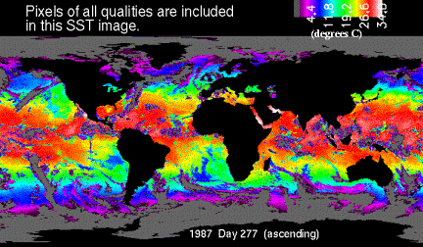
Satellite View
Fig. 3.4 (c) Daily SST image for Oct. 4, 1987, showing the cloud cover in gray. The spatial resolution is 5 km.

Slide 22
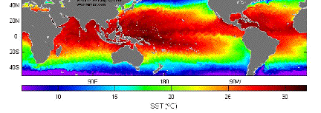
Satellite View
Tropical Rainfall Mapping Mission (TRMM) Microwave Imager (TMI) -- another satellite instrument, that measures lower frequency emissions from the sea surface (microwaves), is now providing all-weather maps of SST, but with a 25 km resolution. Fig. 3.5 The global SST map for Oct. 23, 2003.
The TRMM satellite was designed to study rainfall measurement variability in the tropics, so its orbit is more restricted in latitude range than is the satellite that produces the infrared images of Fig. 3.4. Global maps are easily computed for a single day from the TMI since the sensor can “see” through clouds and does not suffer from the cloud contamination seen in the infrared.
The drawback with the passive microwave SST data is its lower spatial resolution of 25 km instead of 4 km with the thermal infrared. The 4 km resolution of the global thermal infrared is derived from a 1 km inherent resolution in the infrared sensor. Thus, there is a very big difference in spatial resolution between the passive microwave and thermal infrared sensors.

Slide 23
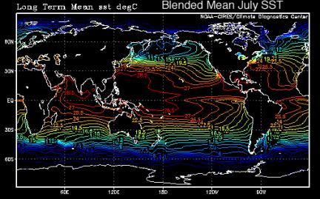
“Blended” Analysis
Ship and oceanographic station data are required on an ongoing basis for calibration of all of these satellite SST measurements. For climatological time scale studies ship and buoy SSTs can be mixed with satellite SSTs, resulting in a “blended” analysis (Fig. 3.6).
Notes:
This blended SST has found wide application in studies of climate scale (months to years) variability in the atmosphere-ocean coupled system.

Slide 24
Upper Layer Temperature
Mixed Layer (混合层):
Within the upper zone of the ocean, properties are sometimes very well mixed vertically, particularly at the end of the night (diurnal cycle) and in winter (seasonal cycle).
This layer is mixed by the wind and by cooling at the sea surface. It is unmixed by warming and precipitation at the sea surface and by circulations within the mixed layer that move adjacent mixed waters of different properties over each other.

Slide 25
Upper Layer Temperature
Mixed Layer (混合层):
As a rule of thumb, wind-stirred mixed layers do not extend much deeper than 100 - 150 m and can reach this depth only at the end of winter. On the other hand, infrequent vigorous cooling or evaporation at the sea surface can cause the mixed layer to deepen locally to several hundred meters, or even to more than 1,000 m in some very special subpolar and polar locations at brief times (hours) in late winter.
Mixed layers in summer may be as thin as a 1 – 2 meter, overlying a set of remnant thin mixed layers from previous days with storms and thicker remnant mixed layers from winter.

Slide 26
Upper Layer Temperature
Mixed Layer (混合层):
Since the mixed layer is the surface layer that connects the ocean and atmosphere, and since SST is the main way that the ocean forces the atmosphere, observations of the mixed layer and understanding how it develops seasonally and on climate time scales is important for modeling and understanding climate. (SOLAS program)

Slide 27
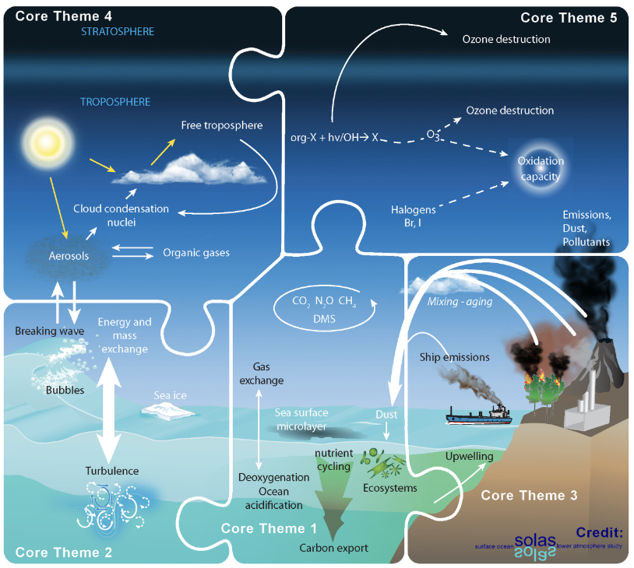
Surface Ocean – Lower Atmosphere Study (SOLAS)
Core Theme 1: Greenhouse gases and the oceans
Core Theme 2: Air-sea interface and fluxes of mass and energy
Core Theme 3: Atmospheric deposition and ocean biogeochemistry
Core Theme 4: Interconnections between marine ecosystems, aerosols, and clouds
Core Theme 5: Ocean biogeochemical control on atmospheric chemistry
To achieve quantitative understanding of the key biogeochemical - physical interactions and feedbacks between the ocean and atmosphere, and of how this coupled system affects and is affected by climate and environmental change

Slide 28
Mixed Layer
A common criterion: the depth at which the water is 0.125 σ_{θ} denser than at the surface.
In tropical and mid-latitudes, the mixed layer can be based on temperature, but at higher latitudes, it is common to find a subsurface temperature maximum lying underneath a low salinity surface layer, and so a temperature-based mixed layer definition is not useful.
Notes:
A given vertical profile will not usually exhibit a thick completely mixed layer of uniform temperature, salinity and density. Most often, there will be small steps, nearly discontinuities, in the profiles due to daily restratification and remixing, and also layers sliding in from nearby. For a careful study of the mixed layer, the investigator assigns the mixed layer depth based on examination of every vertical profile. However, for general use, for instance in averages of any temperature profiles which are then used to initialize a numerical model, or for use in upper ocean property mapping for fisheries, climate prediction or navigational use, it is not possible to examine each separate profile. Functional definitions of mixed layer depth have been developed, based on finding a set density difference between the surface observation and deeper observations. In tropical and mid-latitudes, these definitions can also be based on temperature, but at higher latitudes, it is common to find a subsurface temperature maximum lying underneath a low salinity surface layer, and so a temperature-based mixed layer definition is not useful. A common mixed layer depth criterion is the depth at which the water is 0.125 σθ denser than at the surface.
Numerical (computer) ocean models and especially those that couple to atmospheric models require good mixed layer models. These usually differ from the models used for the ocean interior because mixed layer variations in temperature, salinity and density occur over very small vertical intervals (meters). The purpose of a mixed layer model is to determine how deep the mixed layer will mix and what its final temperature, salinity and density will be for a given surface cooling or wind stress, and how it will restratify for a given heating. The inputs for mixed layer models are the initial ocean stratification (often determined in a previous time step in the model), wind stress, air temperature, a model of how the sun's radiation penetrates into the ocean, a model of how the ocean radiates heat back to the atmosphere, a model of how the ocean evaporates (which both cools the surface layer and increases its salinity), and a model of how the ocean mixes within the mixed layer (See Chapter 5 for a discussion of air-sea heat fluxes).
Mixed layer development is affected by the amount of turbulence in the surface layer. This turbulence is generated by breaking surface and internal waves, generated by the wind, and therefore decreases with increasing depth. Mixed layer development can also be affected by "Langmuir cells", which are transient helical circulations (in the vertical plane) aligned parallel to the wind. These create the "wind rows" sometimes seen at the sea surface under the wind, where the water is pushed together, or converges, in the Langmuir cells, which reach to about 50 m depth and 50 m width, and which can create turbulence that affects mixing in the mixed layer.
The other dynamical phenomenon present in the near-surface layer is the Ekman response to the wind forcing, which creates a flow at the ocean's surface off to the right of the wind in the northern hemisphere (and to the left in the southern hemisphere), because of the Coriolis force (see Chapter 8). Turbulence in the surface layer acts like friction. In the northern hemisphere, each thin layer within the surface layer pushes the one below it a little more to the right, and with a little smaller velocity than the layer above. This creates an "Ekman spiral" of decreasing velocities with increasing depth. The whole spiral occurs within the top 50 m or so of the ocean. If all of the velocities are added together, the net effect is that this "Ekman layer" moves at exactly right angles to the wind direction – to the right in the northern hemisphere and to the left in the southern hemisphere. Ekman velocities are small and do not generate turbulence. Thus they have no effect on mixed layer development and are themselves affected by the upper layer turbulence but not by the mixed layer stratification itself. The Ekman response is crucial however for conveying the effect of the wind to the ocean, for development of the large-scale and long time-scale ocean circulation, as also described in Chapter 8.
Ekman Layer and Ekman spiral: within the top 50 m or so of the ocean. Ekman velocities are small and do not generate turbulence. Thus they have no effect on mixed layer development and are themselves affected by the upper layer turbulence but not by the mixed layer stratification itself. The Ekman response is crucial however for conveying the effect of the wind to the ocean, for development of the large-scale and long time-scale ocean circulation.

Slide 29
Thermocline (温跃层)
Below the surface layer, temperature begins to decrease rapidly with depth. The region of higher vertical temperature gradient is called the “thermocline”.
It is often hard to define precisely the depth limits, particularly the lower limit, of the thermocline. However, in low and middle latitudes it is clear that a thermocline is present all the time at depths between 200 and 1,000 m. This is referred to as the main or permanent thermocline.

Slide 30
Thermocline (温跃层)
In polar and sub-polar waters where the surface waters may be colder than the deep waters, there is often no permanent thermocline, but there is usually a permanent “halocline” (high vertical salinity gradient) and associated permanent “pycnocline” (high vertical density gradient).
There are two complementary concepts of the thermocline, one based on vertical processes only, and the other based on horizontal circulation of the waters that form the thermocline away from where they outcrop as mixed layers in winter. Both concepts are important and work together (continued to next).

Slide 31
Thermocline
The vertical processes -- downward transfer of heat from the sea surface and either upwelling or downwelling.
One might expect that as the upper waters are warmest, heat would be transferred downward by diffusion despite the inhibiting effect of the stability in the pycnocline/thermocline, and that the temperature difference between the upper and lower layers would eventually disappear. However, the deeper cold waters are fed continuously from the sea surface at higher latitudes (deep and bottom water formation regions, mainly in the northernmost North Atlantic and Greenland Sea and in various regions around Antarctica).

Slide 32
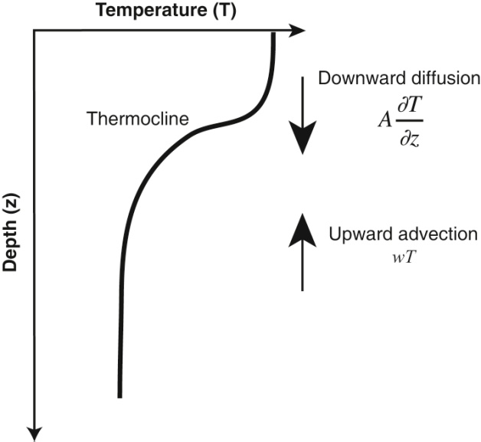
Thermocline
Vertical processes that can maintain the thermocline in a simplified 1-D model.

Slide 33
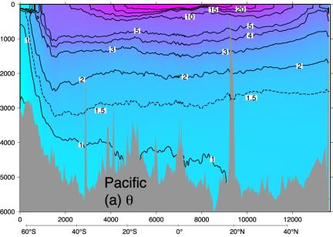
Stommel Thermocline Theory

Slide 34
Stommel Thermocline Theory
These deep inflows maintain the temperature difference between the warm surface waters and cold deep waters. The deep waters upwell and warm up through downward diffusion of heat. If upwelling from the very bottom layers up to near the surface occurs through the whole ocean, the upward speed would be 0.5 to 3.0 cm/day. Unfortunately these speeds are too small to measure well with present instruments and so we are not able to test the hypothesis directly.
The result of the downward vertical diffusion of heat balanced by this persistent upwelling of the deepest cold waters results in an exponential vertical profile of temperature (Stommel, 1958; Munk, 1960), which approximates the shape of the permanent thermocline.

Slide 35
LPS Thermocline Theory
A second, more horizontal, and complementary process for maintaining the thermocline/pycnocline was suggested by Iselin (1939) and further developed by Luyten, Pedlosky and Stommel (1983). (LPS)
The waters that make up the thermocline at a given location (latitude/longitude) originate at the sea surface far away, with the colder waters coming from higher.

Slide 36
LPS Thermocline Theory

Slide 37
Subduction --- Thermocline
Taking a northern hemisphere point of view, in subtropical regions, where the main circulation is around gyres with strong northward-flowing western boundary currents and slow southward flow across the rest of the ocean, cold surface waters come from the north. As they move south, they "subduct" beneath the warmer waters to the south (using Luyten et al.'s term, borrowed from plate tectonics).

Slide 38
LPS: Ventilation Thermocline Theory
The ocean subduction process builds up the temperature, salinity and density structure of the main pycnocline (thermocline) in the subtropical gyres. This structure is then modified and smoothed by the downward diffusion of heat and deep upwelling.

Slide 39
Thermocline
There are both seasonal and diurnal thermocline that are not permanent.
“Seasonal thermocline” that forms only at mid-latitudes and then only in the summer. In winter it is mixed away.
At all latitudes there is a very shallow diurnal thermocline that develops with solar heating of the surface layer. This diurnal thermocline also experiences seasonal variations.

Slide 40
Thermocline
Temperature and salinity are almost completely controlled by processes at the sea surface (with the exception of weak geothermal heating at the ocean floor, which can slightly increase water temperature).

Slide 41
Thermocline
Therefore vertical variations in temperature and salinity at a given location reflect (1) the distant sea surface location where the water at a given depth started and (2) mixing that smoothes out differences. The process of setting properties at the sea surface is called “ventilation (通风)" since it occurs where ocean layers breathe, in a sense.

Slide 42
Thermocline
Ventilation regions are clearly also important for air-sea gas exchange – oxygen (O₂) enters the ocean here and carbon dioxide (CO₂) may leave or enter, depending on the difference between the ocean and atmosphere's carbon dioxide.

Slide 43
Temporal variations of temperature in the upper layer and thermocline
The temperature in the upper zone and into the thermocline varies seasonally, particularly in mid-latitudes. The layer between the surface and a depth of 25 to 200 m is usually at much the same temperature as the surface water because of mixing due to wind and waves as described above. In winter the surface temperature is low, waves are large, and the mixed layer is deep and may extend to the main thermocline. In summer the surface temperature rises, the water becomes more stable, and a seasonal thermocline often develops in the upper zone. The thermoclines are of high vertical stability (they are essentially the pycnoclines), and separate the waters of the upper layer and deeper zones.

Slide 44
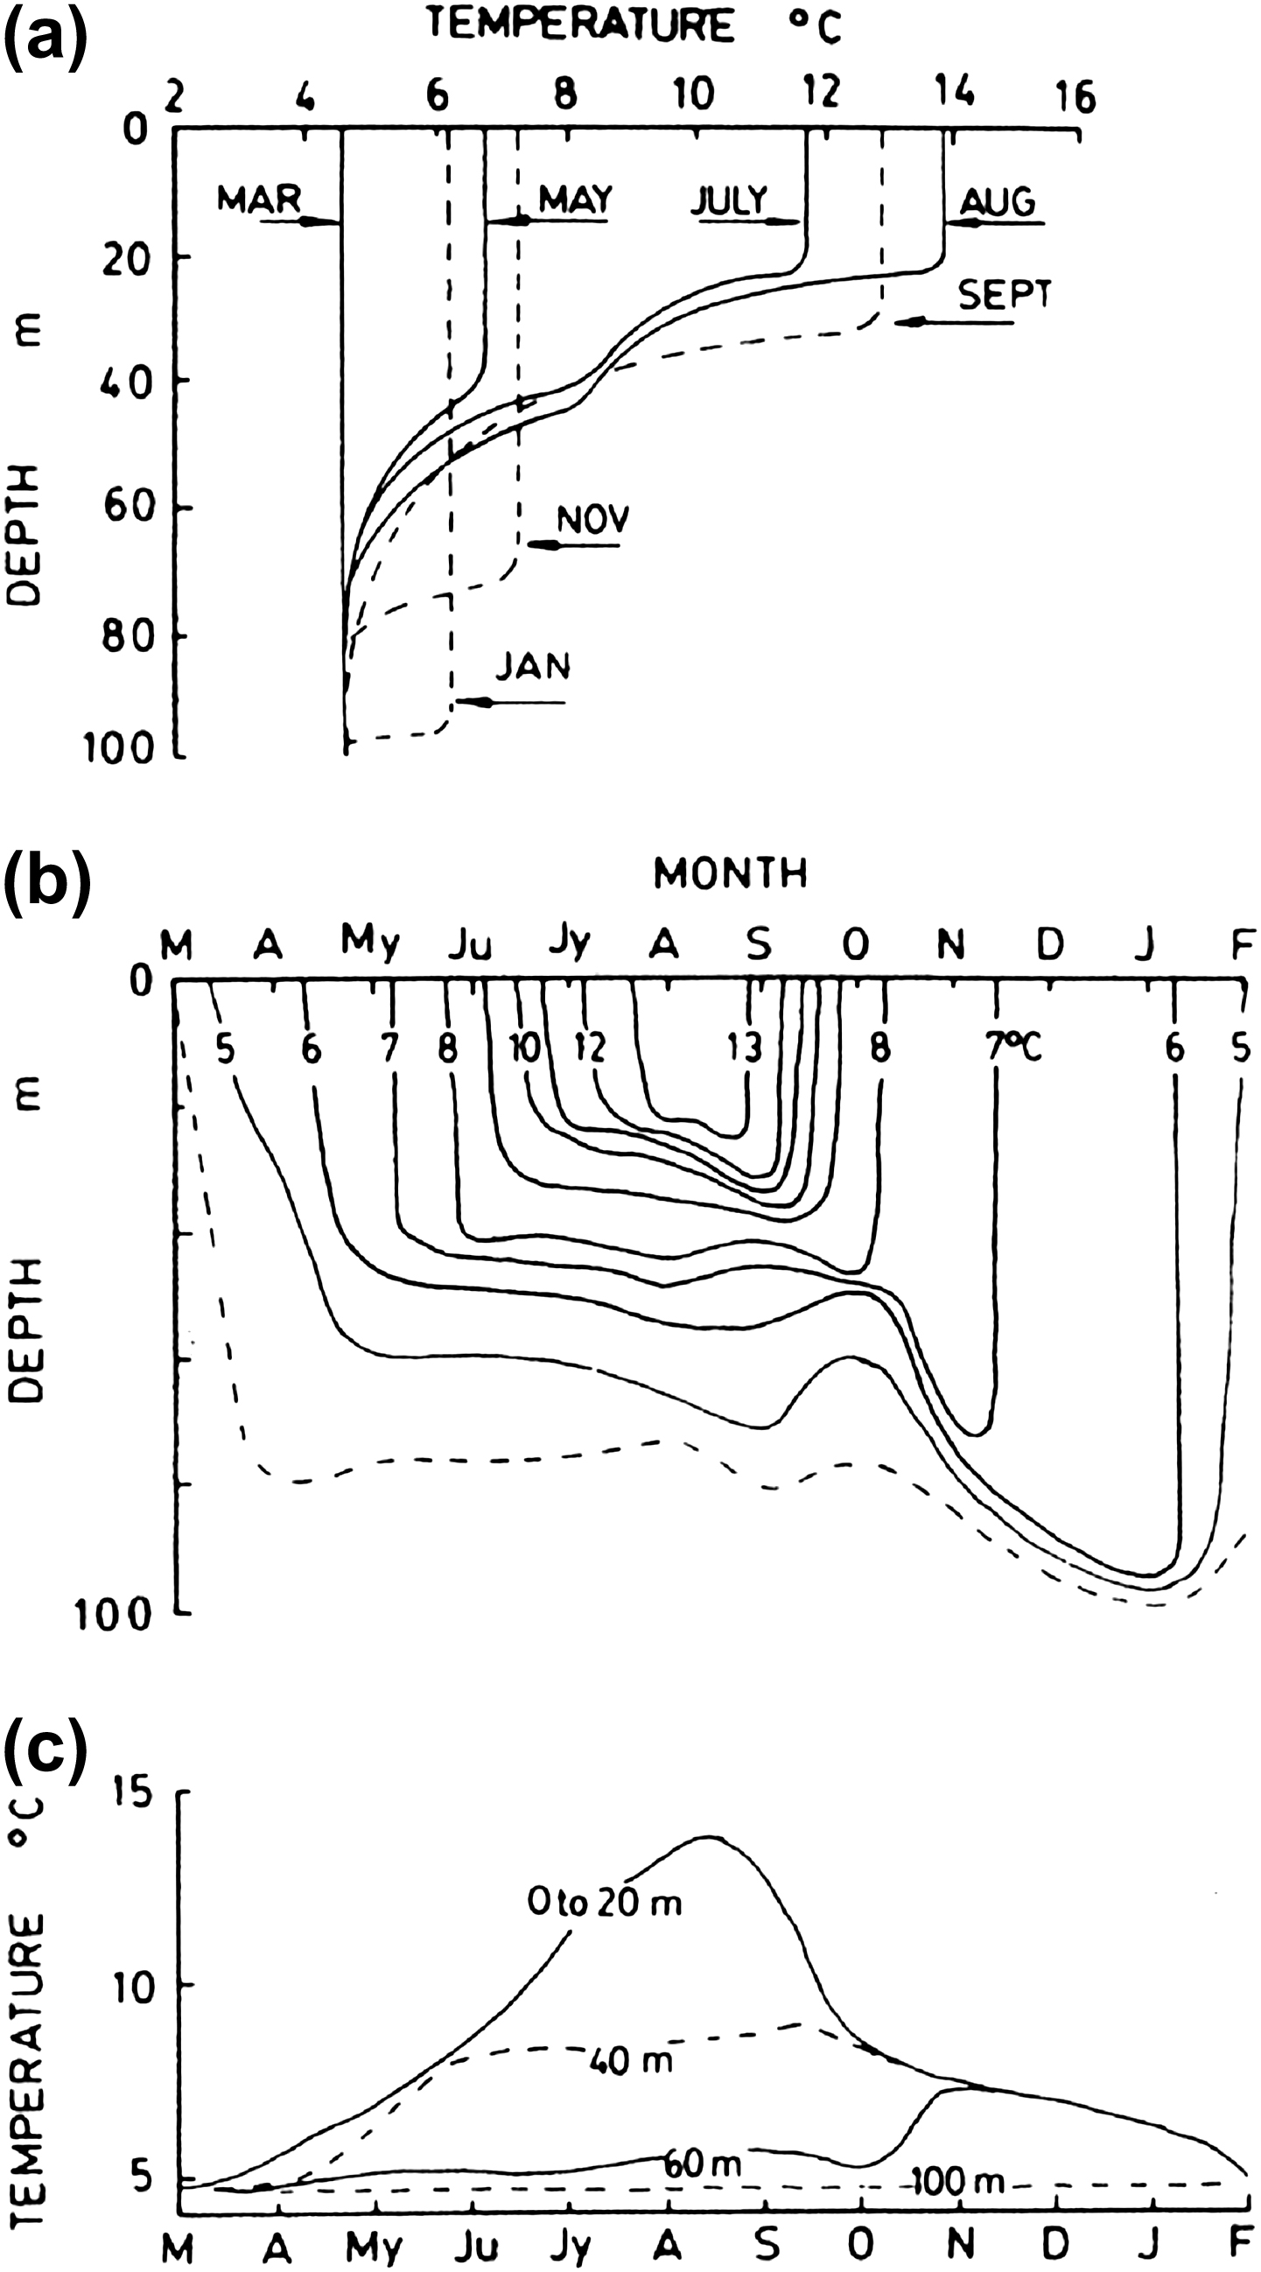
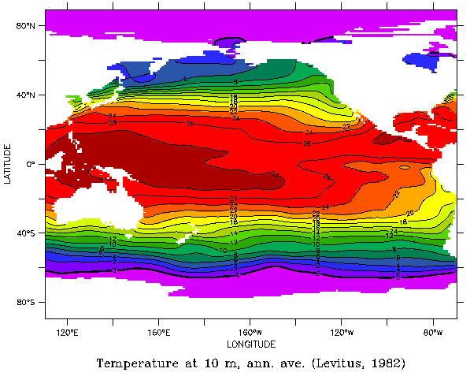
Seasonal Thermocline
Fig. 3.7. Growth and decay of the seasonal thermocline at 50°N, 145°W in the eastern North Pacific as (a) vertical temperature profiles, (b) time series of isothermal contours, and (c) a time series of temperatures at depths shown.
Notes:
From March to August the temperature gradually increases due to absorption of solar energy. A mixed layer from the surface down to 30 m is evident all the time. After August there is a net loss of heat from the sea while continued wind mixing erodes away the seasonal thermocline until the isothermal condition of March is approached again. Note that this month is not that with the maximum outgoing heat exchange but rather is the last month before seasonal heating begins; therefore total heat content is lowest in March. In tropical and subtropical locations, the summer mixed layer may be even thinner.
The same data may be presented in alternative forms - as a time-series showing the depths of the isotherms during the year (Fig 3.7b).
In Fig. 3.7a the permanent thermocline appears as a maximum gradient region in the temperature/depth profiles. In Fig. 3.7 b the thermocline appears as a crowding of the isotherms, which rises from about 50 m in May to 30 m in August and then descends to 100 m in January. In Fig. 3.7 c the thermocline appears as a wide separation of the 20-m and 60-m isobaths between May and October, and between the 60-m and 100-m isobaths after that as the thermocline descends.

Slide 45
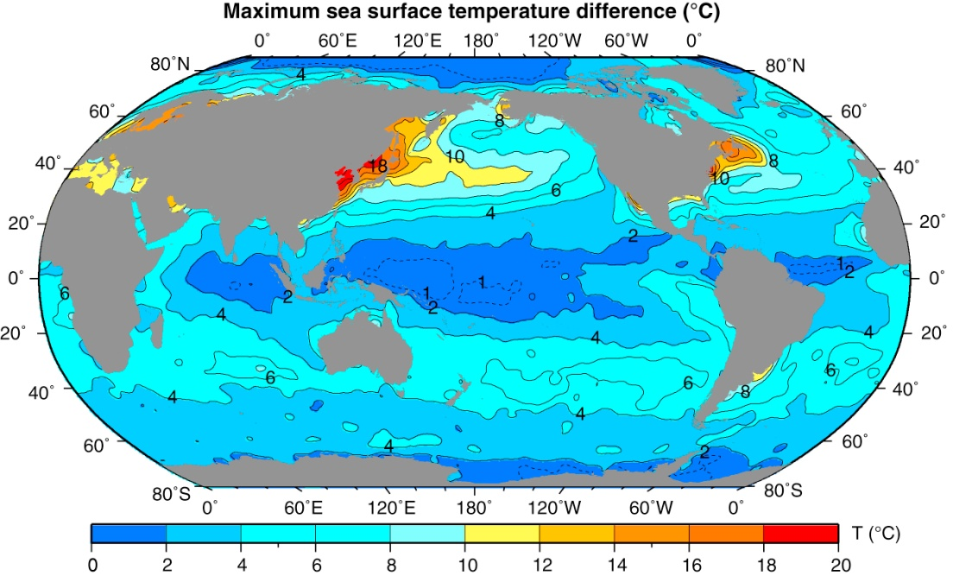
Annual Range of SST
Figure 3.8 shows the annual range of surface temperature over the Pacific ), based on monthly climatological temperatures from the World Ocean Atlas (WOA05) (NODC, 2005a, 2009).
Annual variations at the surface rise from 1-2°C at the equator to between 5 – 10°C at 40°latitude in the open ocean and then decrease toward the polar regions (due to the heat required in the melting or freezing processes where sea-ice occurs). Near the coast, larger annual variations (10 -20°C) occur in sheltered areas and particularly in the northwest of the northern oceans.
These annual variations in temperature decrease with depth and are rarely perceptible below 100-300 m.
The maximum temperature at the surface occurs at the end of the warming season, in August/September in the northern hemisphere, and the minimum at the end of the cooling season, during February/March.
Below the surface, the time of occurrence of the maxima and minima are delayed by as much as 2 months relative to the times at the surface.
Notes:
Diurnal variations of SST had been thought to be small (<0.4 °C) but recent observations in the open ocean have revealed that larger variations occur frequently although they may be quite localized. The assumption of small diurnal variations was based primarily on the fact that most oceanographic methods did not resolve them. The temporal continuity of satellite SST measurements (see Section 6.9) reveals frequently larger SST variations. Such measurements, verified by in situ observations from a moored buoy in the Sargasso Sea over a period of two years (Stramma et al., 1986) have shown that diurnal variations to 1°C are common with occasionally higher values, up to 3 ° to 4 °C. These values of 1 °C or more are observed in conditions of high insolation (solar radiation) and low wind speed and are generally limited to the upper few meters of water. Similar values have been observed elsewhere in the North Atlantic and in the Indian Ocean. In sheltered and shallow waters along the coast, values of 2 ° to 3 °C are common. It should be noted that much of the daily heat input from solar radiation is used to evaporate water, leaving only part available for raising its temperature. Where there is ice in the water, most of the incoming heat will be used to melt it, so that diurnal variations will be smaller.

Slide 46
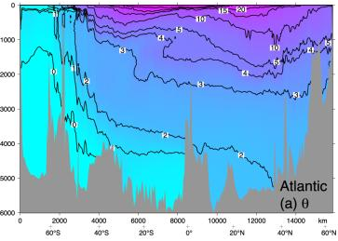
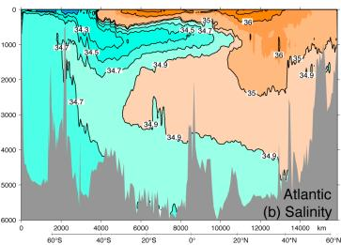
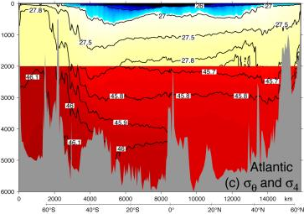
Fig. 3.10. (a) Potential temperature (°C), (b) salinity (psu), (c) potential density σ_{θ} (top) potential density σ₄ (bottom) (kg m⁻³) in the Atlantic Ocean at longitude 20 -25°W. Data from the World Ocean Circulation Experiment
Notes:
The distribution of potential temperature plotted as a vertical section from south to north in each ocean (Figs. 4.10 a, 4.11 a, 4.12 a) has some typical features. First the warmest water is in the upper ocean with the highest temperatures in the tropics. In the subtropics, the warm water fills bowl-shaped regions, which define the upper ocean circulations of westward flow on the equatorward side of the bowls and eastward flow on the poleward side of the bowls. Potential temperature decreases downward through the thermocline and into much more uniform, colder temperatures at depth. The coldest water is found at the surface at high latitudes, supported by low salinity. The coldest water on these sections is in the south in the Antarctic, since the northern ends of the sections do not extend into the Arctic. In the Antarctic, the cold isotherms slope steeply downward between 60 ° and 50 °S. This marks the eastward flow of the Antarctic Circumpolar Current (chapter 9).
It is important to recognize that these vertical temperature sections are not symmetric about the equator and there are distinct differences between the northern and southern hemispheres. The cold surface waters are much more extensive in the south while even the two bowls of higher temperature are not symmetric with the southern bowl being more extensive than its northern counterpart. Cold waters do not extend as deeply in the north as they do in the south. These observations are characteristic of all three oceans but are best developed in the Atlantic.

Slide 47
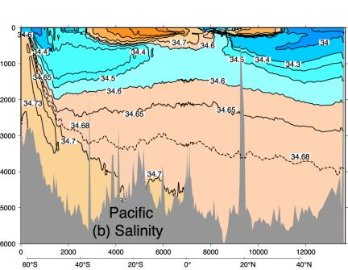
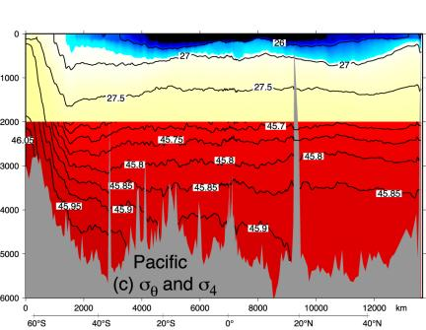
Fig. 3.11. (a) Potential temperature (°C), (b) salinity (psu), (c) potential density σ_{θ} (top) and potential density σ₄ (bottom) (kg m⁻³) in the Pacific Ocean at longitude 150°W. Data from the World Ocean Circulation Experiment.

Slide 48
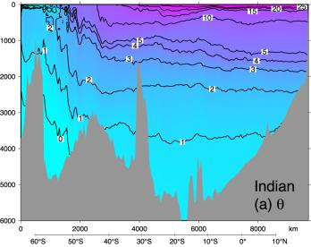
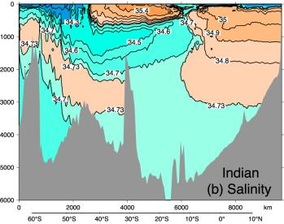
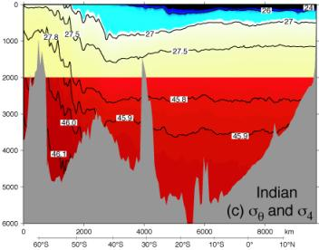
Fig. 3.12. (a) Potential temperature (°C), (b) salinity (psu), (c) potential density σ_{θ}, (top) and potential density σ₄ (bottom) (kg m⁻³) in the Indian Ocean at longitude 90°E. Data from the World Ocean Circulation Experiment.

Slide 49
3.3 Salinity Distribution
Surface salinity
Upper layer salinity
*Intermediate depth salinity
*Deep water salinity
*Temporal variations of salinity

Slide 50
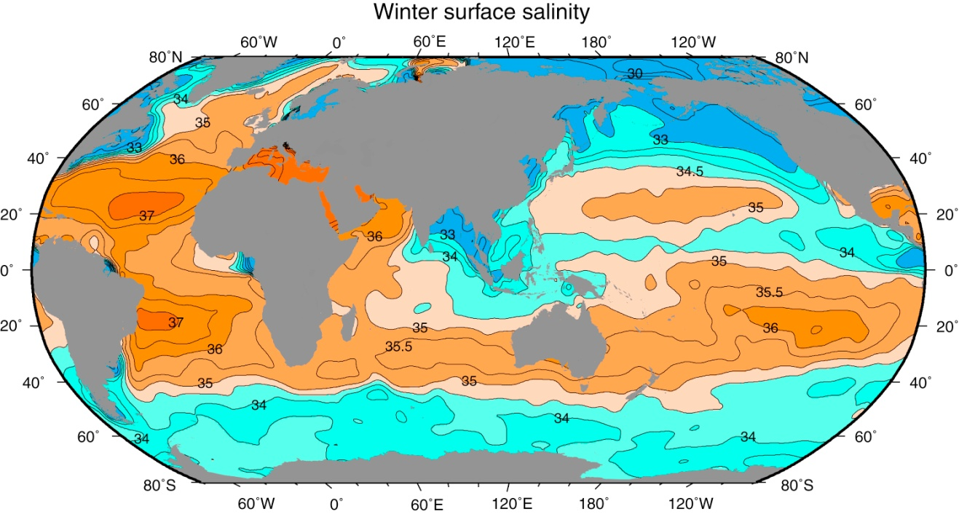
Surface Salinity
Fig. 3.13. Surface salinity (psu) in winter (JFM in NH; JAS in SH) based on averaged (climatological) data from Levitus and Boyer (1994).
The surface salinity is basically zonal although not as clearly as the SST. Salinity varies from low in rainy belts in the tropics, to high in the evaporation regions of mid-latitudes, around 25°N and °S to low surface salinities in the rainier subpolar regions. This meridional variation is also apparent in the east-west averages of surface salinity (Fig. 3.3).

Slide 51
Surface Salinity
Surface salinity range in the open ocean: 33 -- 37 psu.
Lower values occur locally near coasts where large rivers empty and in the polar regions where the ice melts.
Higher values occur in regions of high evaporation such as the eastern Mediterranean (39 psu) and the Red Sea (41 psu), both due to excessive evaporation.
On average, the North Atlantic is the most saline ocean at the surface (35.5 psu), the South Atlantic and South Pacific less so (about 35.2 psu) and the North Pacific the least saline (34.2 psu).

Slide 52
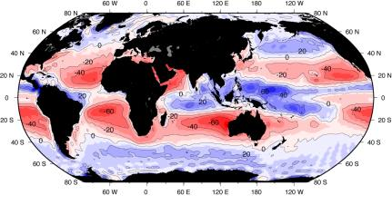
E-P
Fig. 3.14. Map of the difference between evaporation and precipitation (E-P) based on data from the NCEP, in cm/year.
Surface salinity is determined climatologically by the opposing effects of evaporation (increasing it) and precipitation, runoff, and ice melt (decreasing it). The salinity maxima of Figs. 3.3 and 3.13 are in the trade wind regions where the annual evaporation (E) exceeds precipitation (P), so that (E-P) is positive (Fig. 3.14). Just north of the equator, precipitation is high and surface salinity is lower because of the Intertropical Convergence Zone (ITCZ) in the atmosphere.

Slide 53
Salinity and E-P
In the Atlantic the E-P map shows maxima that are close to the eastern side of the ocean basin while the surface salinity map shows maxima at these latitudes that are biased in location towards the western side of the ocean.
Similar but weaker features are seen in the Pacific. The displacement of the salinity and E-P maxima results from the circulation of the surface waters, so that salinity is highest at the end of the passage of waters through the E-P maximum.

Slide 54
Upper Layer Salinity
The vertical salinity distribution cannot be summarized quite as simply as the temperature distribution. It is possible to have either high or low salinity in the warm upper layers.
Because of the less important role in dictating the density structure, salinity is a more passive tracer than temperature, reflecting the flow directions of water masses by their salinity signatures (minima or maxima).

Slide 55
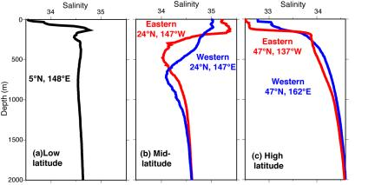
Upper Layer Salinity
Fig. 3.15. Typical salinity (psu) profiles for the tropical, subtropical and subpolar regions of the North Pacific.
In subtropical regions there is high salinity near the sea surface due to subtropical evaporation and a decrease downwards
In the tropics there is often slightly lower salinity at the sea surface than in the subtropics, and a sharp subsurface salinity maximum at 100 to 200 m depth, close to the top of the thermocline. This maximum comes from the high salinity surface water in the subtropics (Figs. 3.1, 3.7), which flows equatorward and downward beneath the fresher, warmer tropical surface water.
In high-latitude regions, where there is much river runoff, high precipitation and/or seasonal ice melt, there is generally low salinity at the sea surface. A rapid increase of salinity, the "halocline", lies between the upper, low-salinity water and the deeper, more saline water.
Notes:
In subtropical regions there is high salinity near the sea surface due to subtropical evaporation and a decrease downwards to a salinity minimum in the vertical at 600 to 1,000 m (Fig. 3.15, 3.10 b, 3.11 b, 3.12 b). The salinity then increases downward to a maximum at 1,500 to 2,000 m, with the exact depths of the vertical minimum and maximum depending on the ocean. (In the Pacific the maximum salinity is at the bottom.) In the tropics there is often slightly lower salinity at the sea surface than in the subtropics, and a sharp subsurface salinity maximum at 100 to 200 m depth, close to the top of the thermocline. This maximum comes from the high salinity surface water in the subtropics (Figs. 3.1, 3.7), which flows equatorward and downward beneath the fresher, warmer tropical surface water.
In high-latitude regions, where there is much river runoff, high precipitation and/or seasonal ice melt, there is generally low salinity at the sea surface. A rapid increase of salinity, the "halocline", lies between the upper, low-salinity water and the deeper, more saline water. Here the pycnocline is determined by the salinity distribution rather than by temperature. This is such a strong effect in the subpolar North Pacific that a relatively fresh surface layer overlying a halocline dominates the entire region. In the Arctic and Antarctic and other regions of ice formation, ice melt in spring creates a similarly freshened surface layer. Conditions in the polar and subpolar regions are such that the temperature is essentially uniformly cold throughout the year and the primary changes are in terms of salinity. In these regions salinity is the dominant factor in determining changes in density and vertical density stratification.
This low salinity surface layer in regions like the subpolar North Pacific and around Antarctica makes it possible for the temperature profile to contain a minimum near the sea surface, with a warmer layer below

Slide 56
3.4 Density Distribution
Density at the sea surface and in the upper layer
Pycnocline
Depth distribution of potential density

Slide 57
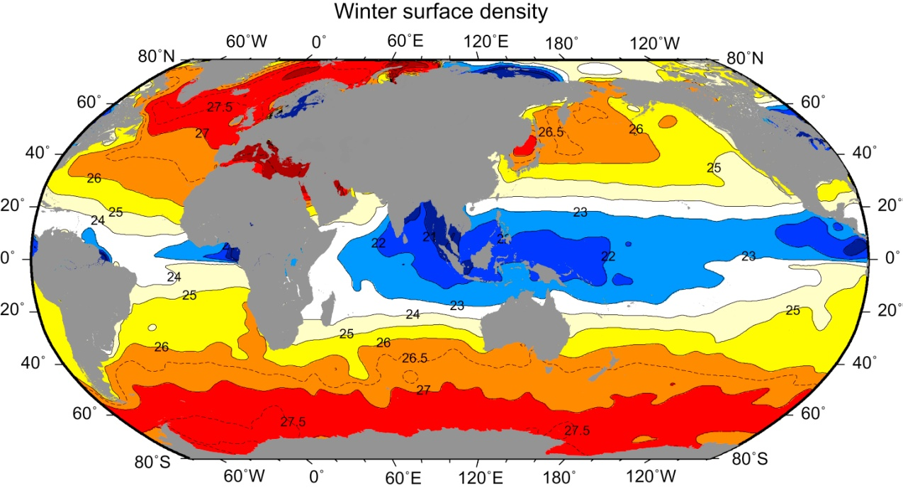
Surface Density
Fig. 3.16 Surface density (σ_{θ}; kg m⁻³) in winter.
The density of sea-water at the ocean surface increases from about 22 σ_{θ} near the equator to 26 – 28 σ_{θ} at 50-60° latitude, and beyond this it decreases slightly (Figs. 3.3 and 3.16), due to lower salinity at higher latitudes.
Surface densities at high latitudes in the Antarctic and North Atlantic are higher than in the North Pacific because the North Pacific is the freshest open ocean region.

Slide 58
Surface and Upper Layer Density
Surface density determines the depth to which waters will sink as they move away from their ventilation ("outcrop") region. In late winter, surface waters reach their local density maximum as the cooling season draws to a close. Late-winter density is associated with the deepest mixed layers. As the warming season begins (March in the NH, September in the SH), the dense winter mixed layer is "capped" by warmer water at the surface. The capped winter waters move (advect) away from the winter ventilation region. If they move into a region where the winter surface waters were less dense, then they sink beneath the local surface layers, and will not be re-opened to the atmosphere during the next winter. This is a primary mechanism for moving surface waters into the ocean interior ("subduction" process).

Slide 59
Surface and Upper Layer Density
Longer time-scale variations in surface density can affect the amount of intermediate and deep waters that form, and the overall size of the regions that are impacted by them. During major climate changes associated with glacial/interglacial periods, surface density distributions must have been strongly altered, resulting in very different deep water distributions.

Slide 60
Surface and Upper Layer Density
Winter mixed layer depths vary from tens of meters to hundreds of meters, depending on the region. In the tropics, winter mixed layer depths may be less than 50 m. Winter mixed layer depths are greatest in the subpolar North Atlantic, reaching more than 1000 meters in the Labrador Sea, and in the southern hemisphere around the northern edge of the major current that circles Antarctica, at a latitude of about 50°S, reaching up to about 500 m thickness.

Slide 61
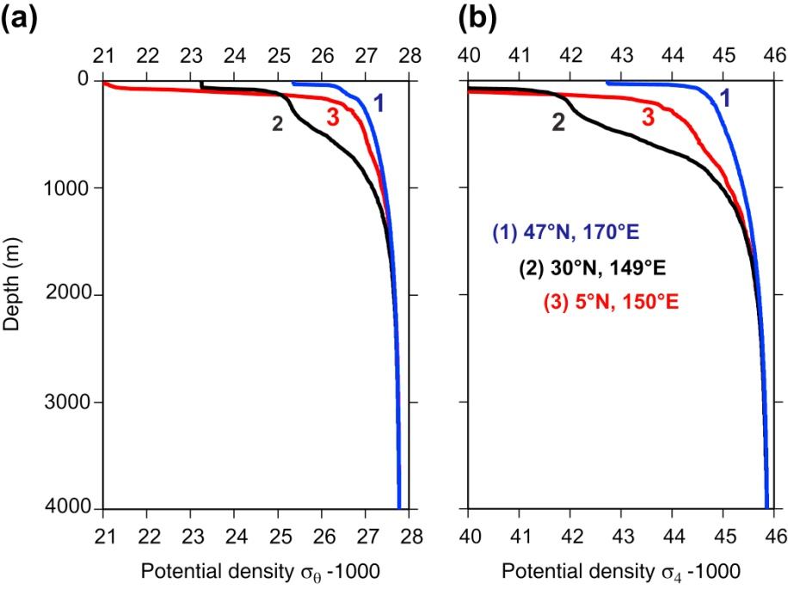
Pycnocline（密度跃层）
Density must increase with depth in a system in equilibrium. Ocean density does not increase uniformly with depth. There is usually a shallow upper layer of nearly uniform density, then a layer where the density increases rapidly with depth, called the pycnocline, analogous to the thermocline. Below this is the deep zone where the density increases more slowly with depth.
There is little variation with latitude of the deep water density. As a consequence, in high latitudes where the surface density rises to 27 σ_{θ} or more there is a smaller increase of density with depth than in the low latitudes and the pycnocline is weaker.
Notes:
Density must increase with depth in a system in equilibrium. While potential temperature and salinity together determine density, individually they can have maxima and minima in the vertical, as long as the water density increases with depth. The only exceptions to the monotonic increase of density with increasing depth occur at very short time scales - the time scale for overturn. As soon as dense water flows over light, or a surface layer density is increased above that of the underlying water, the water column will be unstable and will overturn. Ocean density does not increase uniformly with depth, however. There is usually a shallow upper layer of nearly uniform density, then a layer where the density increases rapidly with depth, called the pycnocline, analogous to the thermocline (section 4.2.3). Below this is the deep zone where the density increases more slowly with depth (Fig. 4.10, 4.11, 4.12, 4.17). There is little variation with latitude of the deep water density. As a consequence, in high latitudes where the surface density rises to 27 σθ or more there is a smaller increase of density with depth than in the low latitudes and the pycnocline is weaker.
The double thermocline structure described above in section 4.2 is mirrored in density as well, because of the strong dependence of ocean density on temperature. Layers of lower vertical density gradients are called "pycnostads", in contrast to the pyncnocline(s). In all regions, there is a seasonal pycnocline in the warm seasons, resulting from seasonal warming and/or ice melt, overlying the remnant of the winter mixed layer, which thus forms a pycnostad in non-winter seasons. A permanent double pycnocline, with a pycnostad lying between the pycnoclines, is a common feature of subtropical regions.

Slide 62
Vertical Structure of Potential Density
Potential density distributions with depth are simpler than temperature and salinity simply because the water column must be vertically stable.
Meridional section of potential density: bowls in the upper to intermediate ocean in the subtropics, and a large upward slope towards the southern (Antarctic) end of the section. The large increase in density from equator to pole is associated with these bowls and the Antarctic isopycnal sloping. Below about 2,000 m, the total range of potential density is small, 27.6 -- 27.9 σ_{θ}.
Notes:
Potential density distributions with depth are simpler than temperature and salinity simply because the water column must be vertically stable, and hence there are no large-scale inversions in density if the appropriate reference density is used, as described in section 3.6 (Fig. 4.17). The main variations in potential density with depth as a function of horizontal location are associated therefore with large-scale currents, as will be described in chapter 8 when the geostrophic balance is considered. When potential density is displayed in a vertical section through the north-south length of the ocean (Figures 4.10, 4.11, 4.12), the main features are bowls in the upper to intermediate ocean in the subtropics, and a large upward slope towards the southern (Antarctic) end of the section. The large increase in density from equator to pole is associated with these bowls and the Antarctic isopycnal sloping. Below about 2,000 m, the total range of potential density is small, from about 27.6 to 27.9 σθ (45.6 to 46.2 σ4, which is potential density relative to 4,000 dbar).
The importance of using potential density referenced to high pressures when considering the stability of deep waters is very clear in the Atlantic section of (Fig. 4.10 c, d). Potential density σθ, referenced to the sea surface, shows a maximum in the tropics and North Atlantic at a depth of about 4,000 m suggesting a problem with vertical stability. Potential density σθ is also higher in the North Atlantic than in the South Atlantic. However, potential density σ4, referenced to 4,000 dbar, shows properly that the deep ocean is stably stratified, and that the Antarctic deep waters are denser than the North Atlantic deep waters.
There is a strong preference for flow to be along surfaces of constant potential density, which are nearly horizontal. In the upper layers we can regard this as to be along surfaces of constant σθ. For instance, the processes that give ocean waters their particular properties act almost exclusively at the surface, and one can trace the origin of even the deepest water back to a region of formation at the surface somewhere. Since deep ocean water is of high density, it must have formed at high latitudes where cold, high density water is found at the surface. After formation it spreads down along almost constant density surfaces. The sinking is combined with horizontal motion so that the water actually moves in a direction only slightly inclined to the horizontal. Even in the regions of largest isopycnal slopes, for instance in the southern part of Fig. 8.??, the slopes are no more than several kilometers down over several hundred kilometers horizontally.
Even though there is large-scale structure in the deep ocean's salinity field (for instance in the Atlantic in Fig. 11.? temperature dominates the density structure in the deep ocean. Salinity is important for the density structure near the sea surface at high latitudes where precipitation or ice melt create a low salinity surface layer, for instance in the Arctic, in the region next to Antarctica, and in the subpolar North Pacific and coastal subpolar North Atlantic. In shallow coastal waters, fjords and estuaries, salinity is often the controlling factor in determining density at all depths, while the temperature variations are of secondary importance. The information in Table 3.1 is useful in estimating the relative effects of temperature and salinity changes on density in a particular situation.
In much of the ocean, the density profile with increasing depth appears nearly exponential, asymptoting to a nearly constant value in the deep ocean (Fig. 4.17 North Pacific profile). However, in some regions where deep waters from very different sources are juxtaposed, there is a weak pycnocline (higher density variation) between them. Such regions are most commonly found in the subtropical southern hemisphere where dense Antarctic waters flow northward in a thick layer under slightly less dense deep waters flowing southward from the North Atlantic, Pacific and Indian (Fig. 4.17 South Atlantic profile). The genesis and meeting of these water masses is described in detail in chapter 7.

Slide 63
Vertical Structure of Potential Density
Flow tends to be along surfaces of constant potential density, which are nearly horizontal. In the upper layers we can regard this as to be along surfaces of constant σ_{θ}. Since deep ocean water is of high density, it must have formed at high latitudes where cold, high density water is found at the surface. After formation it spreads down along almost constant density surfaces. The sinking is combined with horizontal motion so that the water actually moves in a direction only slightly inclined to the horizontal.

Slide 64
Vertical Structure of Potential Density
Salinity is important for the density structure near the sea surface at high latitudes where precipitation or ice melt create a low salinity surface layer, for instance in the Arctic, in the region next to Antarctica, and in the subpolar North Pacific and coastal subpolar North Atlantic. In shallow coastal waters, fjords and estuaries, salinity is often the controlling factor in determining density at all depths, while the temperature variations are of secondary importance.

Slide 65
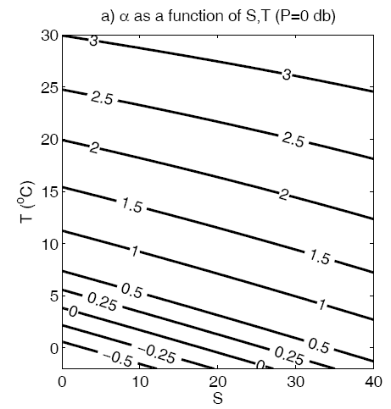
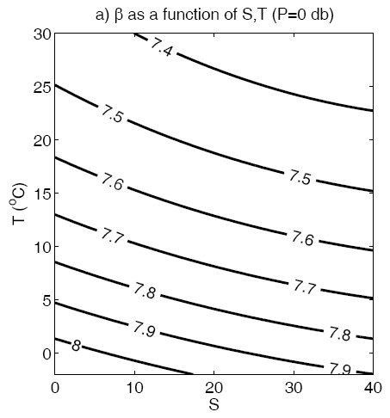
Thermal expansion VS. Saline contraction
10⁻⁴ per °C
10⁻⁴ per PSU
Feistel, R, 2005, Numerical implementation and oceanographic application of the thermodynamic potential of seawater. Ocean Science. 1, 9-16.

Slide 66
Thermal expansion VS. Saline contraction
 | Levitus Global |  | Foam Atlantic
 | 60N | EQ. | 60N | EQ.
TEMP (C) | 5.5 | 27.2 | 9.2 | 27
S (PSU) | 32.4 | 34.8 | 34.7 | 35.6
Rho (kg/cm^3) | 25.56 | 22.5 | 26.85 | 23.17
Rho(TEMP+5,S) change | 24.84 | 20.81 | 25.91 | 21.48
 | -0.72 | -1.69 | -0.94 | -1.69
Rho(TEMP,S-2) change | 23.98 | 21 | 25.29 | 21.66
 | -1.58 | -1.5 | -1.56 | -1.57
Rho(TEMP-5,S) change | 25.98 | 24.01 | 27.53 | 24.68
 | 0.42 | 1.6 | 0.68 | 1.51
Rho(TEMP,S+2) change | 27.14 | 24.01 | 28.41 | 24.67
 | 1.58 | 1.6 | 1.56 | 1.5
Thermal expansion nearly doubles from equator to North Atlantic
Saline contraction hardly changes from equator to North Atlantic.
Saline contraction is nearly 2 times thermal expansion in equator.
Saline contraction is nearly 4 times thermal expansion in North Atlantic.
Wang et al., 2010: Seawater density variations in the North Atlantic and the Atlantic meridional overturning circulation. Climate Dynamics, doi:10.1007/s00382-009-0560-5.

Slide 67
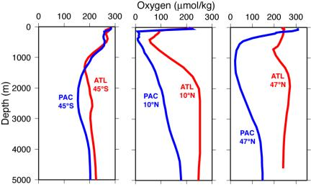
Dissolved Oxygen
Fig. 3.18. Profiles of dissolved oxygen (µmol/kg) from the Atlantic and Pacific Oceans. Data from the World Ocean Circulation Experiment
Notes:
Seawater contains dissolved gases, including oxygen and carbon dioxide. There are also other dissolved gases, but we will confine our remarks to these two in this section. Some of the transient tracers are dissolved gases and are described in section 4.6. Carbon dioxide content is much more complicated than oxygen because there are a number of forms of carbon in the ocean, with processes that cycle carbon from one form to another. No description is given here. The student is referred to texts on biogeochemical cycles (e.g. Broecker and Peng, 1982) to learn about and appreciate the carbon cycle. This cycle is important because carbon dioxide is a greenhouse gas. The ocean is an important part of the global (atmosphere/land/ocean) cycle of carbon dioxide.
Dissolved oxygen content has been used as an important tracer of ocean circulation and an indicator of the time that has passed since a water parcel was at the sea surface ("ventilated"). Dissolved oxygen content and how it is observed are described in section 3.7. The range of oxygen values found in the sea is from 0 to 350 µmol/kg (0 to 8 ml/l), but a large proportion of values fall within the more limited range from 40 to 260 µmol/kg (0 to 6 ml/l). The atmosphere is the main source of oxygen dissolved in seawater and at the surface the water is usually very close to being saturated. Sometimes, in the upper 10 to 20 m, the water is supersaturated with oxygen, which is a by product of the photosynthesis by marine plants. Supersaturation also occurs near the sea surface if the water warms up through solar radiation that penetrates 10's of meters into the ocean. (If the actual sea surface becomes warmer, it will lose its excess oxygen to the atmosphere, so supersaturation is not found right at the sea surface.) Sometimes surface waters are undersaturated – this occurs rarely, in winter if mixing of the surface layer is especially intense, entraining underlying older, less saturated waters. (The equilibration time of surface waters, meaning the time required to restore the waters to 100% saturation, is a few days to a few weeks and is a function of wind speed and temperature.) Below the surface layers, the oxygen saturation is less than 100% because oxygen is consumed by living organisms and by the bacterial oxidation of detritus. Low values of dissolved oxygen in the sea are often taken to indicate that the water has been away from the surface for a long time, the oxygen having been depleted by the biological and detrital chemical demands.
Figure 4.18 shows typical dissolved oxygen profiles for the Atlantic and the Pacific for three latitude zones. Figs. 4.19, 4.20 and 4.21 show oxygen along a south-north section for each ocean. Common features are: (1) the high values close to the surface, (2) an oxygen minimum at 500 to 2,500 m, (3) the relatively high values below 1,500 m in the Atlantic (North Atlantic Deep Water), (4) low values in the North Pacific beneath the surface layer and (5) more similar subsurface distributions in the southern latitudes in both oceans. Distributions in the Indian Ocean are similar to those in the Pacific (south and tropics). The lower values in the deep water of the Pacific compared with the Atlantic indicate that the Pacific water has been away from the surface for a much longer time. In some regions of extremely low oxygen such as the Black Sea and the bottom of the Cariaco Trench (off Venezuela in the Caribbean), hydrogen sulphide is present, from the reduction of sulphate ion by bacteria. This indicates that the water has been stagnant there for a long time.

Slide 68
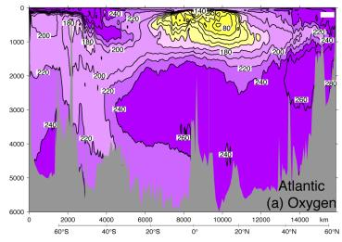
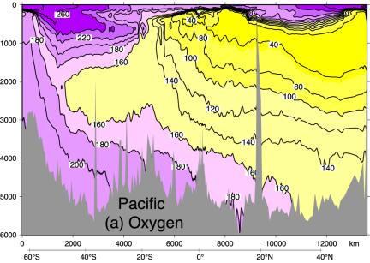
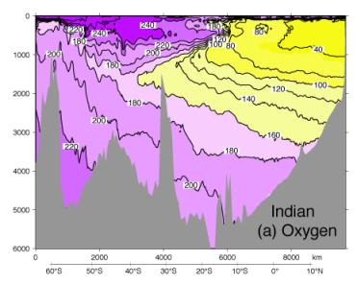
Fig. 3.19. Oxygen (µmol/kg) for (a) the Pacific, (b) the Atlantic and (c) the Indian Ocean. (Data from the World Ocean Circulation Experiment.)
Notes:
The oxygen minimum through the world oceans at mid-depth, overlying higher oxygen at the bottom, results from at least several mechanisms. One is that minimal circulation and mixing does not replace the oxygen that is consumed. A second is that biological detritus accumulates in this region because of the increase of density with depth (stability) and uses up the oxygen. A third argument is that the bottom waters in each of the oceans are relatively high in oxygen because of their surface source in the Antarctic. In the Atlantic, deep waters from the northern North Atlantic are also high in oxygen. These bottom and deepwater oxygen values are lower than surface values because they have been away from the sea surface for a long time. Then, recalling the discussion of the main thermocline (section 4.2.3), we again have downward diffusion of the near surface higher oxygen values balanced by the upward advection of lower oxygen waters. To this we must add the biological/chemical consumption of the oxygen. This results in an oxygen minimum at mid-depth rather than the exponential type of profile obtained for temperature and density.
A conspicuous oxygen minimum with a different origin is apparent in the upper ocean in vertical sections from the tropics in the eastern tropical Pacific (Fig. 4.18, Fig. 4.20) and in the northwestern Indian Ocean. These shallow oxygen minima result from very high biological productivity in the surface waters in these regions. Bacterial consumption of the large amount of sinking detritus from these surface waters is large and consumes almost all of the available oxygen within the upper 300 to 400 meters of the ocean.
As the production and utilization of oxygen in the sea are essentially biochemical matters they will not be pursued further here, but it must be remembered that whenever oxygen is considered as a water property it must be used with caution since it is non-conservative. Still, in many instances the oxygen content is found to be broadly indicative of the age of the water mass with which it is associated.

Slide 69
Questions (Due in 2-week)
How deep is a typical mixed layer if mixed by wind? How deep can it reach if driven by cooling?
What are the typical vertical temperature and salinity profiles in the subtropical and subpolar regions of the North Pacific?
What are the dominant regions of net evaporation in the ocean?
What are the key components of the Mixed Layer heat budget?
Is the North Atlantic Ocean saltier or fresher on average than the Pacific? Why?
What regions of the ocean are characterized by large differences from summer to winter? What regions have the least seasonal variability?
Please describe the two processes that maintain the thermocline.

Slide 70
Learning about the Ocean, the Climate and the Nature

