Slide 1
Lecture 4: Water Mass Formation, Ventilation and Subduction
Descriptive Physical Oceanography
杨海军（YANG Haijun）复旦大学大气与海洋科学系
Department of Atmospheric and Oceanic Sciences, Fudan University
Email: yanghj@fudan.edu.cn
This powerpoint was prepared for purposes of this lecture and course only. It contains graphics from copyrighted books, journals and other products. Please do not use without acknowledgment of these sources.

Slide 2
Reading
“Regional Oceanography: An Introduction” by Tomczak and Godfrey, Chapter 5
Key Concepts
Ventilation
Subduction

Slide 3
Concepts
“age” means the time since a parcel of water was last at the surface and in contact with the atmosphere.
“Ventilation” means breathing. As applied to the ocean it means that water is in contact with the sea surface where it exchanges gases with the atmosphere and then moves into the ocean interior.

Slide 4
Concepts
“Turnover time” is the amount of time it takes to replenish a reservoir, such as an ocean or a layer or a water mass in the ocean.
“Residence time” is the time a particle spends in a reservoir; The maximum residence time is equal to turnover time.

Slide 5
Concepts
Ocean's role in climate on time scales of decades to millennia.
Read:
  Wunsch C., P. Heimbach, 2008. How long to oceanic tracer and proxy equilibrium? Quat. Sci. Revs., 27, 637-651.
  http://ocean.mit.edu/~cwunsch/papersonline/final_published_tracer_timescales.pdf

Slide 6
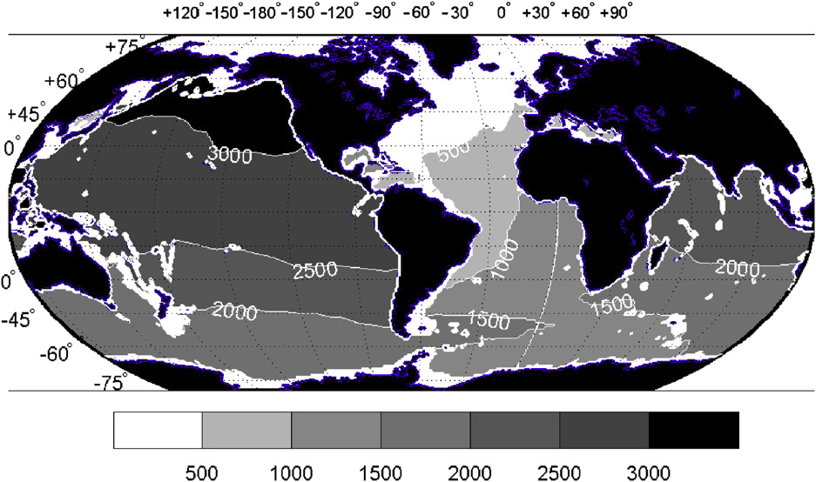
Tracer Time Scale
Time, t90, at which the globally input tracer achieves 90% of its equilibrium value at 1975 m. Values exceeding 2000 years are from extrapolation and are a lower bound on the true value. As with the concentration charts, isolated regions with t90=0 are below the bottom topography of the model.

Slide 7
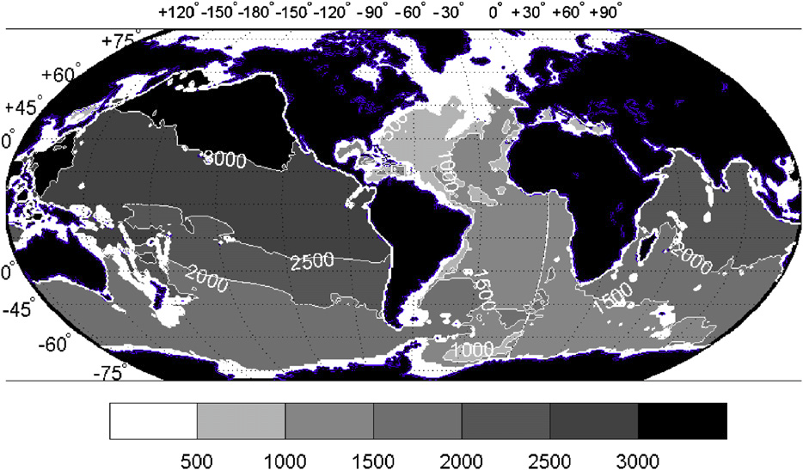
Tracer Time Scale
Same as before except at 3950 m. Note the measurable gradients persisting in the deep Southern Ocean

Slide 8
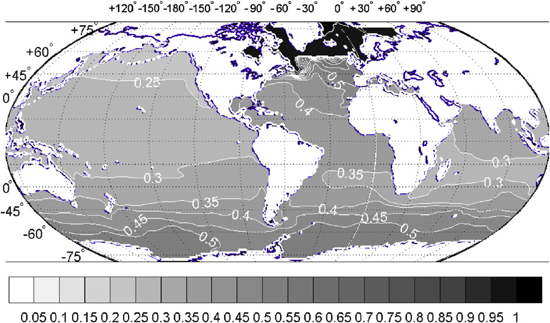
Tracer Time Scale
Tracer concentration at the end of 2000 years at 5m (middle of the model top layer) from an injection confined to the high latitude North Atlantic. The visually sharp boundary remaining at the southern edge of the injection region exists because of the comparatively weak diffusion and strong
northward advection at the sea surface preventing major penetration of the tracer to the south. North Pacific values remain very low.

Slide 9
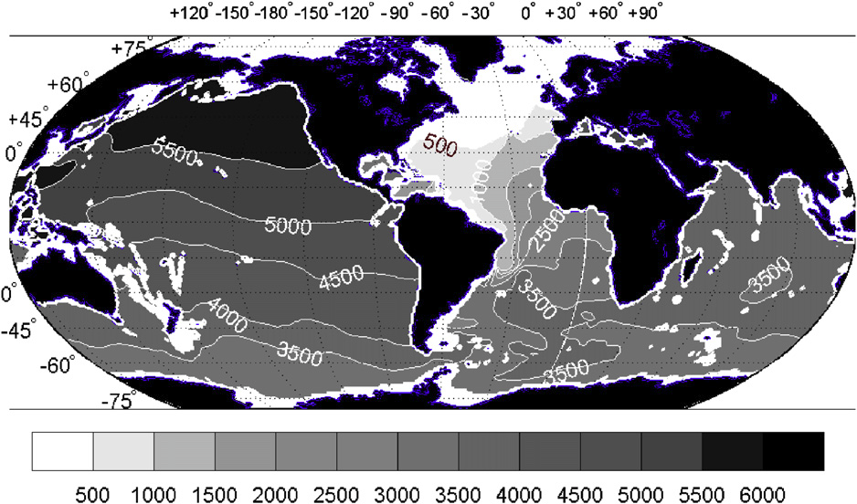
Tracer Time Scale
Value of t90 at 1975m for the high latitude North Atlantic injection experiment
Notes:
Fig. 10. Value of t90 at 1975m for the high latitude North Atlantic (Fig. 1) injection experiment. As before, any values beyond 2000 years are extrapolations and will underestimate the true value. The model has numerical difficulties near the Rio Grande Rise and the anomalous area east of Brazil is one where the concentration is rising very slowly and the extrapolation is unduly influenced by the short-time scale noise. For this computation, the concentrations were smoothed over 500 years prior to extrapolation. Because of the limited area of injection, t90 exceeds, sometimes greatly, the values in the global input experiment.

Slide 10
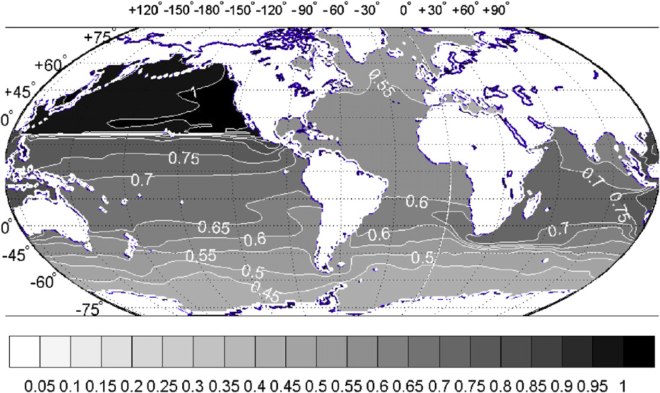
Tracer Time Scale
Tracer concentration at 15m at the end time from injection in the North Pacific

Slide 11
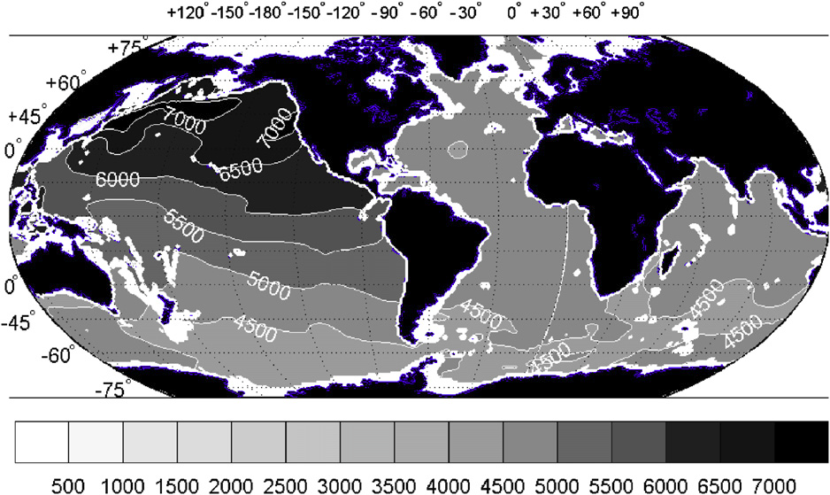
Tracer Time Scale
The t90 at 1975m from the North Pacific injection experiment. Times remain much longer in the abyssal Pacific than in the Atlantic, despite the surface North Pacific injection

Slide 12
4.1 Introduction
Heat and salt exchange with the atmosphere: < 150m.
Water parcel’s temperature and salinity do not change until it rises back up to the surface again, usually many years later.
Residence times of deeper waters: ~100 years if no mixing.
Water masses are created by surface processes in specific locations, which then sink and mix slowly with other water masses as they move along.
Notes:
Most of the heat and salt exchange with the atmosphere occurs at the ocean surface in a layer which during most of the year is less than 150 m deep. Once a water parcel is removed from the surface layer its temperature and salinity do not change until it rises back up to the surface again, usually many years later.
Residence times of deeper waters at hundreds of years, lack of mixing. Yet mixing is not entirely absent.
Water masses with well-defined temperature and salinity characteristics are created by surface processes in specific locations, which then sink and mix slowly with other water masses as they move along.
The analysis of water mass movements and mixing can assist in understanding the deep oceanic circulation
The best hope to achieve a complete description of the circulation in the ocean at all depths is to combine water mass analysis with our knowledge of the constraints on possible flows posed by geostrophy and Ekman dynamics.

Slide 13
4.1 Introduction
The analysis of water mass movements and mixing can assist in understanding the deep oceanic circulation
To achieve a complete description of the circulation: water mass analysis + dynamics (geostrophy and Ekman dynamics).
Wunsch, C: The ocean and climate. http://puddle.mit.edu/~cwunsch/
Notes:
Most of the heat and salt exchange with the atmosphere occurs at the ocean surface in a layer which during most of the year is less than 150 m deep. Once a water parcel is removed from the surface layer its temperature and salinity do not change until it rises back up to the surface again, usually many years later.
Residence times of deeper waters at hundreds of years, lack of mixing. Yet mixing is not entirely absent.
Water masses with well-defined temperature and salinity characteristics are created by surface processes in specific locations, which then sink and mix slowly with other water masses as they move along.
The analysis of water mass movements and mixing can assist in understanding the deep oceanic circulation
The best hope to achieve a complete description of the circulation in the ocean at all depths is to combine water mass analysis with our knowledge of the constraints on possible flows posed by geostrophy and Ekman dynamics.

Slide 14
4.2 Water Masses（水团）
Water mass as a body of water with a common formation history.
An example: Antarctic Bottom Water, cooling of surface water near the Antarctic continent, particularly in the Weddell Sea. All water which originates from this process shares the same formation history . It is found in all oceans well beyond its formation region, extending even into the northern hemisphere.
Common names of known water masses usually relate to their major area of residence.

Slide 15
Water Masses
Important: exclusive occupation of an oceanic region by a single water mass occurs only in the formation regions.
Several water masses are usually present at an oceanic location. It is possible to determine the percentage contribution of all water masses to a given water sample, because the water mass elements retain their properties, in particular their potential temperature and their salinity, when leaving the formation region. Water masses can therefore be identified by plotting temperature against salinity in a so-called T-S diagram.

Slide 16
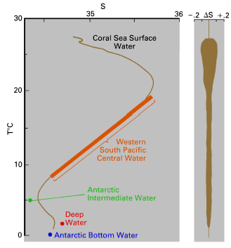
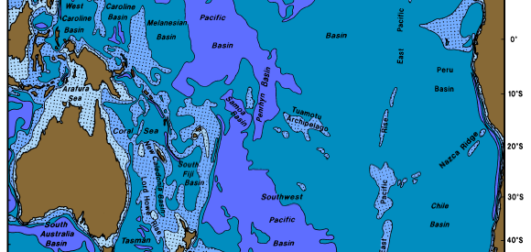
4.3 T-S Diagrams
Mean T-S diagram and standard deviation ∆S of salinity in the eastern Coral Sea, in comparison to water mass definitions in the south Pacific Ocean.
Notes:
Large dots and the heavy line indicate water mass properties in the formation regions, which for all but Surface Water are located far outside the Coral Sea. The standard deviation was determined by comparing stations in the region with a space average and does not include variability in time. Similar standard deviations can be derived for temperature and other properties. Based on Tomczak and Hao (1989).
It is seen that the properties of Central Water in the Coral Sea correspond closely to those in its formation region, indicating that little mixing with other water masses occurred along its way. In contrast, the intermediate and deep water masses are not present with their original T-S values; their properties are modified by mixing with water above and below, and their presence is indicated by salinity or temperature extrema in the vicinity of the T-S combinations found in their formation regions.

Slide 17
4.4 Mixed Layer Depth
Mixed Layer Depth (MLD)
Based on Temperature: The depth where the temperature differed from surface temperature by more than 0.5°C. MLD=Depth(SST-0.5)
Based on Density: The depth where the density differed from the surface density by more than 0.25 (0.125).
Notes:
Most water masses are formed at the ocean surface. This is a region of strong mixing, which produces uniformity of properties above a layer of rapid property change.
Oceanographers refer to the surface layer with uniform hydrographic properties as the surface mixed layer. This layer is an essential element of heat and freshwater transfer between the atmosphere and the ocean. It usually occupies the uppermost 50 - 150 m or so but can reach much deeper in winter when cooling at the sea surface produces convective overturning of water, releasing heat stored in the ocean to the atmosphere.
During spring and summer the mixed layer absorbs heat (moderating the earth's seasonal temperature extremes by storing heat until the following autumn and winter), and the deep mixed layer from the previous winter is covered by a shallow layer of warm, light water. During this time mixing does not reach very deep, being achieved only by the action of wind waves.
Below the layer of active mixing is a zone of rapid transition, where (in most situations) temperature decreases rapidly with depth. This transition layer is called the seasonal thermocline. Being the bottom of the surface mixed layer, it is shallow in spring and summer, deep in autumn, and disappears in winter. In the tropics, winter cooling is not strong enough to destroy the seasonal thermocline, and a shallow feature sometimes called the tropical (permanent) thermocline is maintained throughout the year.
Mixed layer dynamics are quite complex. The point of interest here is that turbulent energy levels in the winter mixed layer drop drastically, by a factor of 1000 or more, after it is covered by lighter water during spring - mixing then becomes so slight that the water characteristics established before the turbulence falls off become "frozen". These layers of "fossilized mixing", which retain their signatures for long time spans, are the source layers of most water masses, and their generation is the essence of water mass formation.

Slide 18
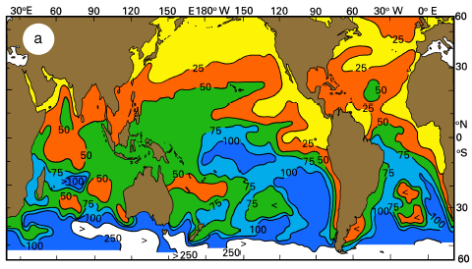
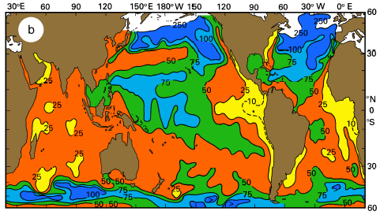
Seasonal Change in MLD
August - October
February - April
Mean depth of the surface isothermal layer (m). (a) August - October, (b) February -April. Contouring levels are 10 m (dashed line), 25 m, 50 m, 75 m, 100 m, 250 m. Adapted from Sprintall and Tomczak (1990).

Slide 19
4.5 Thermocline
Seasonal thermocline (mid to high latitudes)
Permanent (tropical) thermocline ( < 1000m)
  Transition zone: the interface of our 1.5 layered model.
  The upper temperature limit: > 20°C in the tropics, just above 15°C in temperate regions;
  The lower limit temperatures: rather uniform around 4 - 6°C depending on the particular ocean
Notes:
Most water masses are formed at the ocean surface. This is a region of strong mixing, which produces uniformity of properties above a layer of rapid property change.
Oceanographers refer to the surface layer with uniform hydrographic properties as the surface mixed layer. This layer is an essential element of heat and freshwater transfer between the atmosphere and the ocean. It usually occupies the uppermost 50 - 150 m or so but can reach much deeper in winter when cooling at the sea surface produces convective overturning of water, releasing heat stored in the ocean to the atmosphere.
During spring and summer the mixed layer absorbs heat (moderating the earth's seasonal temperature extremes by storing heat until the following autumn and winter), and the deep mixed layer from the previous winter is covered by a shallow layer of warm, light water. During this time mixing does not reach very deep, being achieved only by the action of wind waves.
Below the layer of active mixing is a zone of rapid transition, where (in most situations) temperature decreases rapidly with depth. This transition layer is called the seasonal thermocline. Being the bottom of the surface mixed layer, it is shallow in spring and summer, deep in autumn, and disappears in winter. In the tropics, winter cooling is not strong enough to destroy the seasonal thermocline, and a shallow feature sometimes called the tropical (permanent) thermocline is maintained throughout the year.
Mixed layer dynamics are quite complex. The point of interest here is that turbulent energy levels in the winter mixed layer drop drastically, by a factor of 1000 or more, after it is covered by lighter water during spring - mixing then becomes so slight that the water characteristics established before the turbulence falls off become "frozen". These layers of "fossilized mixing", which retain their signatures for long time spans, are the source layers of most water masses, and their generation is the essence of water mass formation.

Slide 20
Thermocline in the Equatorial Pacific
Climatological annual mean upper ocean temperature (°C) averaged between 5°S-5°N from Levitus data (1955-2003). The black line shows the location of the 20°C isotherm (Z₂₀), and the green line shows the location of the maximum vertical temperature gradient (Z_{tc}).

Slide 21
4.6 Subduction（下潜）
Maintains the permanent thermocline and prevents its erosion from mixing with the waters below and above.
Responsible for the formation of the water masses in the permanent thermocline.
Its intensity varies with the seasons: Ekman pumping + seasonal thermocline

Slide 22
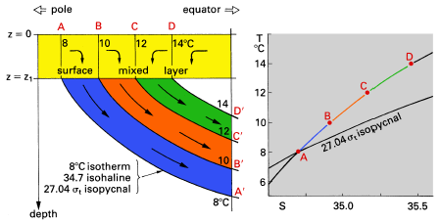
Subduction
Sketch of water mass formation by subduction in the Subtropical Convergence. The T-S diagram shows both the meridional variation of temperature and salinity between stations A and D, and the vertical variation equatorward of station D from the surface down along the line A‘B’C‘D’.
Notes:
Water masses subducted into the thermocline are commonly known as Central Water.
The term was introduced sixty years ago to differentiate between thermocline water of the
central north Atlantic Ocean (now known as North Atlantic Central Water) and water from
the shelf area to the west. It is now used to identify thermocline water masses in all three
oceans.

Slide 23
Subduction
In Spring and summer: Ekman downwelling
In late autumn and winter: Surface water downward due to convection and Ekman downwelling
The properties of the water subducted into the permanent thermocline are determined by the surface water properties during late winter only.
Although subduction is a permanent process, water mass formation occurs only in late autumn and winter.
Notes:
If, for example, in late autumn and winter the bottom of the mixed layer (z1 in Figure 4.3) progresses downward faster than the surface water moves downward as a result of Ekman pumping, water pumped from the surface during summer is caught by the expanding surface mixed layer before it can escape into the permanent thermocline, and the properties of the water subducted into the permanent thermocline are determined by the surface water properties during late winter only.
Although subduction is a permanent process, water mass formation occurs only in late autumn and winter. This can be verified by comparing the properties of the surface mixed layer in the Subtropical Convergence with those of the permanent thermocline in the tropics, i.e. by comparing T-S diagrams along the lines ABCD and A'B'C'D' in Figure 4.3.

Slide 24
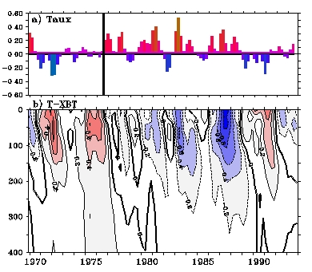
Wind and Subduction

Slide 25
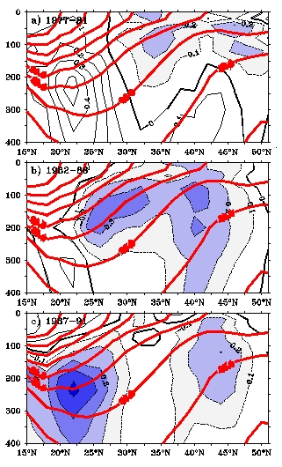
Subduction
Depth-Latitude View

Slide 26
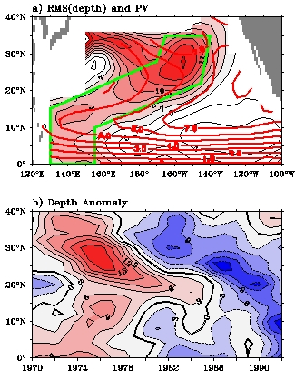
Subduction
Latitude-Longitude View
Latitude-Time View

Slide 27
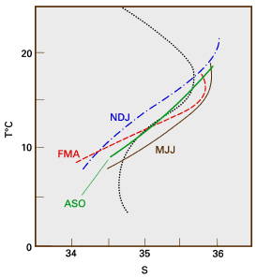
Subduction
A comparison of T-S diagrams across the Subtropical Convergence (STC), along 102.5°E between 30°S-45°S, and across the permanent thermocline at 20°S.
T-S diagrams across the STC are shown for August -October (ASO), November -January (NDJ), February -April (FMA), May – July (MJJ). The remaining curve is the vertical T-S diagram at 20°S. Adapted from Sprintall and Tomczak (1993).
Two T-S diagrams are nearly identical in late winter (August- October) but differ during all other seasons.

Slide 28
Isopycnal Mixing and Diapycnal Mixing
Mixing across isopycnal surfaces << mixing on isopycnal surfaces.
  Diapycnal mixing << Isopycnal mixing
In general, and over vast ocean regions, it is safe to neglect diapycnal mixing as a first guess for the oceanic circulation.
Exception: western boundary currents, the Equatorial Undercurrent, and frontal regions where the diapycnal mixing, contributes significantly to the exchange of properties.

Slide 29
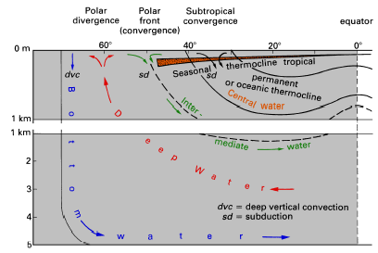
Summary
Meridional section through a hypothetical ocean, showing the permanent thermocline, the seasonal and tropical thermoclines, the various surface convergences and divergences, and the major water masses. Note the scale change at 1000 m depth, which underestimates the volume of Deep and Bottom Water. On the other hand, the importance of the tropics does not come out in this graph since it does not show the convergence of meridians towards the poles.
Notes:
Figure 4.5 summarizes the discussion of thermoclines and subduction. Intermediate Water, which spreads just below the permanent thermocline, is also produced by subduction. Although the driving agent is not Ekman pumping but mixing and convection in the region between two strong currents the mechanism is the same, movement along isopycnal surfaces towards the equator.

Slide 30
Questions (Due in 2-week)
Which season is the most important to the properties of the water in the permanent thermocline? Why?
Look at Figure in slide 25, why are the meridional variations of temperature and salinity between stations A and D similar to the vertical variations of T & S from the surface down along the line A'B'C'D'.

Slide 31
Calculations
The sketch behind is a meridional section of the subtropical Ocean. Both points A and B are at the ocean surface. Point C is located at a depth of 400 m. L (the distance between points A & B) is 3,000 km. The line BC approximates the slope of the isopycnal surfaces in the this region.
  Diapycnal Diffusivity is 0.001 m²/s.
  Isopycnal Diffusivity is 1000 m²/s.
Determine the appropriate time scales for isopycnal ventilation and diapycnal ventilation at point C. Assuming no mean advection, which surface point (A or B) will most determine the property values at C?
Suppose this region is characterized by a northward mean flow u=1cm/s. The mean vertical velocity is downwelling of about w=-10 cm/day.
  Calculate the advective time scale between points B and C.
  Calculate the advective time scale between points A and C?
If you were to construct a simple model of a property balance at C, rank the importance of each of the above 4 terms for that budget.
(Hints: consider temperature equation: dT/dt ~ Kv d²T/dz² ~ Khd²T/dx² ~ udT/dx ~wdT/dz)

Slide 32
3000km
SP
B
u
A
EQ
w
400m
Subduction
Isopycnal surface
u
C

Slide 33

Learning about the Ocean, the Climate and the Nature

