Slide 1
Lecture 5: Water, Salt and Heat Budgets of the Oceans Descriptive Physical Oceanography
杨海军（YANG Haijun）复旦大学大气与海洋科学系
Department of Atmospheric and Oceanic Sciences, Fudan University
Email: yanghj@fudan.edu.cn
This powerpoint was prepared for purposes of this lecture and course only. It contains graphics from copyrighted books, journals and other products. Please do not use without acknowledgment of these sources.

Slide 2
Readings
Emery, Talley and Pickard: Chapter 5
Key Concepts
Conservation of Volume
Conservation of Salt
Heat Budget

Slide 3
5.1 Conservation of Volume（体积守恒）
The principle: the compressibility of water is small.
If water is flowing into a closed, full container at a certain rate it must be flowing out somewhere else at the same rate or the level in the container must increase.
The conservation of volume ~ the conservation of mass, since for macroscopic applications we consider the ocean as incompressible.
Notes:
"Containers" such as bays, fjords, etc., in the oceans are not closed in the sense of having lids (except when frozen over), but if one observes that the mean sea level in a bay remains constant (i.e. after averaging out the waves and tides) then the bay is equivalent to a closed container. One might say that this principle is just common sense. This may be true but nonetheless it is science too, and can lead to interesting results.
For example, many of the fjords of Norway, western Canada and Chile have large rivers flowing into their inland ends, but on average the mean sea level in them remains constant. We conclude from the continuity of volume that there must be outflow elsewhere since evaporation is very unlikely to be large enough to balance the inflow. The only likely place is at the seaward end, and if we measure the currents there we find that in fact there is a net outflow of the surface layer. When we actually measure the outflow, we might find that there is a much greater volume flowing out to the sea than is coming in from the river. If conservation of volume is to apply there must be another inflow; the current measurements show that this is from the sea below the out-flowing surface layer. The reason for this situation is that the river water, being fresh and therefore less dense than the sea-water of the fjord, stays in the surface layers as it flows toward the sea. However, it picks up seawater from below en route and the outflowing surface layer includes not only the river water but also the extra salt water picked up. The latter is often in much greater volume than the river water. The surface outflow to the sea is therefore correspondingly greater than the inflow from the river. In addition, the salt water, which has been picked up and flushed out of the fjord, must be replaced; this is the cause of the subsurface inflow from the sea.

Slide 4
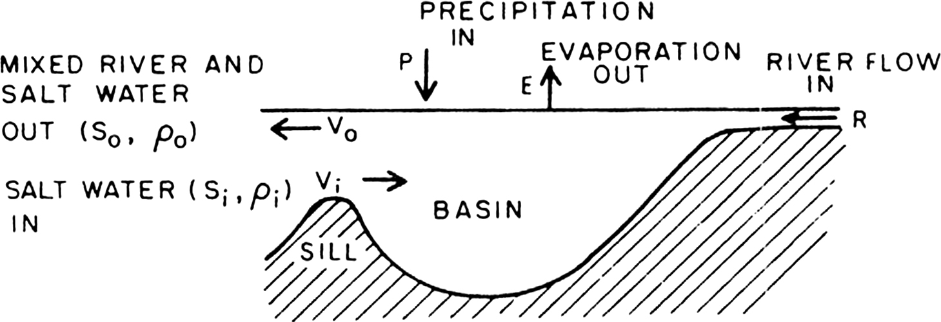
Conservation of Volume in a Closed Box
The conservation of volume :
V_{i} + R + P = V_{o} + E (5.1)
Where, Precipitation (P), river runoff (R) and evaporation (E). Rearranged (5.1) as
V_{o} - V_{i} = (R + P) - E ≡ F (5.2)
Here V: volume transport, unit: (m³/s). The V subscripts o and i are volume transports out and in respectively.
Notes:
This is an example of a steady-state situation in which some or all of the parts of a system may be in action but at no point is there any change of motion (or of a property) with time.
The symbol R is the river runoff as a volume transport that adds water into the basin. The symbols P and E are the precipitation and evaporation for each point and are therefore expressed in m/s. (They are often reported in cm/year.) The symbol A is the area over which the precipitation and evaporation happen. F (for "F"reshwater) is defined by the right side of (5.2), which is why the symbol "≡" is used. The left side of (5.1) is the volume transport into the fjord. The right side of (5.1) is the volume transport out. The second equation simply says that the net volume flow of salt water balances the net volume flow of fresh water (when averaged over a suitable time period).

Slide 5
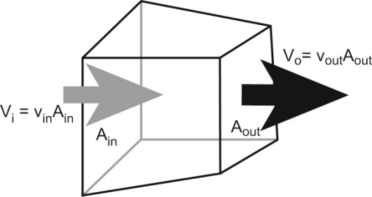
Open Ocean Continuity
For interior ocean, R=zero. If the top of the box is inside the ocean, P=E=0. Then the volume balance:
V_{o} - V_{i} = 0 (5.3)
Transport into the box must equal the transport out of the box.
In practice, V_{o,i} >> P or E , so (5.3) is almost valid even for boxes that include the surface.
Notes:
We can extend this thinking about flow into and out of a closed box into the open ocean. Here we think of a hypothetical closed box, with sides and a top and bottom (Fig. 5.2). We can then apply the same balance (5.1) to this box.
This seems like a very intuitive result, so not that interesting, but the continuity equation has been critical in solving many complex problems in ocean circulation. It is one law that applies to any and all situations and must be maintained regardless of how complex the system becomes.

Slide 6
5.2 Conservation of Salt（盐分守恒）
Principle
for all practical purposes, assume that the average salinity of the oceans is a constant, at least over periods of tens or even hundreds of years.
Vi • ri • Si = Vo • ro • So (5.4)
where Vi and Vo are the volume transports of the inflowing and outflowing seawater, Si and So are their salinities, and ri and ro their densities. This is the equation for salt transport and states that no salt is gained or lost inside the box.
Notes:
The principle of conservation of salt is based on the nearly accurate assumption that the total mass of dissolved salts in the ocean is constant. When one first learns that the rivers of the world contribute to the sea a total of about 3 x 10¹² kg of dissolved solids per year, the conservation of salt seems to be contradicted. In principle it is, but in practice it is violated only to a very limited extent. The ocean is very large. The total amount of dissolved salt in the ocean is 5 x 10¹⁹ kg. Therefore the amount of salt brought into the ocean each year by the world’s rivers increases the average ocean salinity by about one part in 17 million per year. We can only measure salinity to an accuracy of about ±0.001, or about 500 parts in 17 million if we assume the mean ocean salinity to be about 35 psu. In other words, the oceans would increase in salinity each year by an amount which is only one five-hundredth of our best accuracy of measurement if we neglect removal of salt for the moment. Salt is actually removed from the ocean in the form of evaporites, so salinity actually increases even more slowly if at all over geological time. So for all practical purposes we can assume that the average salinity of the oceans is a constant, at least over periods of tens or even hundreds of years.
Furthermore, when we apply the principle of salt conservation to a limited volume where there is no significant input of salt by rivers, the principle applies even more precisely. It is this apparent contradiction of principles due to very different time scales that confused the early Greek philosophers about the salinity of the ocean as compared to the fresh water of the rivers feeding into them. Rather than realizing that the very long term accumulation of salts from these rivers caused the ocean’s salinity these philosophers postulated that there were “salt fountains” at the bottom of the ocean. As recently as the 19th century Matthew Maury still believed that salt fountains were responsible for the ocean’s salinity.
The conservation of salt has been demonstrated above for the World Ocean as a whole, but in practice it is usually applied to smaller bodies of water. It is especially easy to understand when applied to bodies of water that have only limited connection with the main ocean, e.g. the Mediterranean Sea, a bay, or a fjord, as will be demonstrated shortly. Conservation of salt in such water bodies is sometimes taken for granted, but strictly speaking it should be verified before being used. (And in fact, there could be variations in salinity within a given closed region. When this happens, then there must be an opposite change in salinity somewhere else since the total amount of salt in the oceans is conserved.) That is, before we use the principle we should determine from observations that the salinity distribution does not change significantly over the period of study. At the same time, there is nothing to prevent us from assuming the principle in order to draw some (tentative) deductions. But we must then remember that until conservation of salt has been demonstrated, the deductions, which depend on it, are subject to doubt.

Slide 7
5.2 Conservation of Salt
Principle
Since the two densities will be the same within 3% at the most (the difference between ocean and fresh water) the r’s in practice nearly cancel, leaving:
Vi • Si = Vo • So (5.5)
Notes:
The principle of conservation of salt is based on the nearly accurate assumption that the total mass of dissolved salts in the ocean is constant. When one first learns that the rivers of the world contribute to the sea a total of about 3 x 10¹² kg of dissolved solids per year, the conservation of salt seems to be contradicted. In principle it is, but in practice it is violated only to a very limited extent. The ocean is very large. The total amount of dissolved salt in the ocean is 5 x 10¹⁹ kg. Therefore the amount of salt brought into the ocean each year by the world’s rivers increases the average ocean salinity by about one part in 17 million per year. We can only measure salinity to an accuracy of about ±0.001, or about 500 parts in 17 million if we assume the mean ocean salinity to be about 35 psu. In other words, the oceans would increase in salinity each year by an amount which is only one five-hundredth of our best accuracy of measurement if we neglect removal of salt for the moment. Salt is actually removed from the ocean in the form of evaporites, so salinity actually increases even more slowly if at all over geological time. So for all practical purposes we can assume that the average salinity of the oceans is a constant, at least over periods of tens or even hundreds of years.
Furthermore, when we apply the principle of salt conservation to a limited volume where there is no significant input of salt by rivers, the principle applies even more precisely. It is this apparent contradiction of principles due to very different time scales that confused the early Greek philosophers about the salinity of the ocean as compared to the fresh water of the rivers feeding into them. Rather than realizing that the very long term accumulation of salts from these rivers caused the ocean’s salinity these philosophers postulated that there were “salt fountains” at the bottom of the ocean. As recently as the 19th century Matthew Maury still believed that salt fountains were responsible for the ocean’s salinity.
The conservation of salt has been demonstrated above for the World Ocean as a whole, but in practice it is usually applied to smaller bodies of water. It is especially easy to understand when applied to bodies of water that have only limited connection with the main ocean, e.g. the Mediterranean Sea, a bay, or a fjord, as will be demonstrated shortly. Conservation of salt in such water bodies is sometimes taken for granted, but strictly speaking it should be verified before being used. (And in fact, there could be variations in salinity within a given closed region. When this happens, then there must be an opposite change in salinity somewhere else since the total amount of salt in the oceans is conserved.) That is, before we use the principle we should determine from observations that the salinity distribution does not change significantly over the period of study. At the same time, there is nothing to prevent us from assuming the principle in order to draw some (tentative) deductions. But we must then remember that until conservation of salt has been demonstrated, the deductions, which depend on it, are subject to doubt.

Slide 8
Conservation of Salt
Combined with (5.2) to give Knudsen’s relations (Knudsen, 1900):
Vi = F • So/(Si - So) and Vo = F • Si/(Si - So) (5.6)
where F = R + P – E. Equation (5.6) is useful if we know F and measure the salinities. If we know the transports and salinities through measurements, then we can calculate F:
F = Vi • (Si /So - 1) or F = Vo • (1 – So /Si ) (5.7)
This is the equation for freshwater transport and expresses how much freshwater is gained or lost inside the box..
Notes:
One can draw some qualitative conclusions from (5.6) and (5.7). If both So and Si are large, they must be similar because there is an upper limit to S in the ocean. Therefore (Si - So) must be small and both So/(Si - So) and Si /(Si - So) must be large. Therefore Vi and Vo must be large compared with F, the excess of fresh water inflow over evaporation. That is, for large volume exchanges (large flushing rate), the salinity change will be small for a given amount of evaporation or precipitation. On the other hand, if the salinity difference between inflow and outflow is large (So much less or much more than Si), then the exchange rate (Vi and Vo) is small for the same size F. Thus the body of water in the first case will be better flushed and less likely to be stagnant than in the second case.
Equations (5.6) and (5.7) can be applied to any region, especially including marginal seas, estuaries, and fjords where inflow and outflow salinities are easily assigned. If F is positive (negative) (more runoff and precipitation than evaporation /more evaporation), then the marginal sea is considered to be "positive (negative). For the open ocean where salinity and velocity vary continuously, it is more useful to write all of these equations as integrals, so that salt and freshwater transports are expressed as surface integrals of vS and v (S/So – 1) over the whole region being considered (e.g. Wijffels et al., 1992)

Slide 9
5.3 Examples of the two conservation principles
Fig. 5.3. Schematic diagram of inflow and outflow characteristics for:
(a) Mediterranean Sea, (b) Black Sea.
Notes:
博斯普鲁斯海峡,伊斯坦布尔海峡，爱琴海

Slide 10
The Mediterranean Sea
E > (R + P), F < 0, a net loss of fresh water, salty water (37.8 psu) at surface, sinks
Salty water flows out of the Mediterranean at about sill depth into the North Atlantic at about 600 m. There must be inflow of less salty (36.1 psu) water from the North Atlantic.
Notes:
(The units for inflow Vi can be converted to 5.5 x 10⁴ km³/year.

Slide 11
The Mediterranean Sea
Si/(Si-So) ~ 25, ➔ Vi and Vo ~ 25F. The average value Vi = 1.75 x 10⁶ m³/s ➔ Vo = l.68 x 10⁶ m³/s and F = -7 x 10⁴ m³/s. At this rate it would take about 70 years to fill the Mediterranean (3.8 x 10⁶ km³/Vi). This is roughly mean residence time, or called flushing time or turnover time.
The salty outflow to the deeper parts of the North Atlantic is an important source of salinity for the mid-depth waters of the North Atlantic
Notes:
(The units for inflow Vi can be converted to 5.5 x 10⁴ km³/year.

Slide 12
The Black Sea
F > 0, Si ~ 35 psu, So ~ 17 psu.
So/(Si-So) ~ 1-2 ➔ Vi, Vo ~ F.
Measured: Vi = 6 x 10³ m³/s and Vo = 13 x 10³ m³/s, ➔ F = 6.5 x 10³ m³/s.
Vi = 0.02 x 10⁴ km³/year. Black Sea volume= 0.6 x 10⁶ km³ /Vi
So residence time = 3,000 years. (Amazing!) This dramatic contrast demonstrates the very strong influence of local climate conditions on these marginal seas.
Notes:
The physical reason for the ventilation of the Mediterranean is that quantities of deep water are formed by winter evaporation and cooling at the surface in the north. In the Black Sea, the salinity and density of the upper water is too low, because of precipitation and river runoff, for even severe winter cooling to make it dense enough to sink to replace deep water. Regional climate dictates residence time.

Slide 13
Contrast
Mediterranean: The physical reason for the ventilation is that quantities of deep water are formed by winter evaporation and cooling at the surface in the north.
Black Sea: the salinity and density of the upper water is too low, because of precipitation and river runoff, for even severe winter cooling to make it dense enough to sink to replace deep water. Regional climate dictates residence time.

Slide 14
Contrast
Mediterranean: oxygen content > 160 μmol/kg (>4 ml/l).
Black Sea: water below 200 m has no dissolved oxygen but much hydrogen sulphide (over 6 ml/l).
Mediterranean: described as well flushed or well ventilated
Black Sea: stagnant below 95 m.

Slide 15
Seawater properties: Radiation, Flux, Advection, Diffusion
Radiation: short-wave solar radiation and long wave back radiation
Advection: the movement of a fluid "parcel" carries stuff such as heat and salt with it.
Convection: when referring to vertical motion. velocity, (m/sec).
Notes:
Flux is important when there is a difference between the flux into a closed volume and the flux out of the same closed volume. The change in flux has to be related to a change in properties within the closed box. This change in flux through a box is called flux divergence (if more comes out than goes in) or flux convergence (if less comes out than goes in).
eddy diffusivity, in which turbulent "eddies" at small scales accomplish the diffusion. Eddy diffusivity is much higher than molecular diffusivity and thus has much greater impact on the properties at large spatial scales

Slide 16
Seawater properties: Radiation, Flux, Advection, Diffusion
Flux: transport per unit area. heat flux is expressed as Watts/m².
Diffusion : like flux convergence and divergence, but it happens at extremely small spatial scales.
More simply said, if there is more stuff at one location than at another, it will flux towards the lesser concentration. But the concentration will only change if there is a flux convergence or divergence.
Eddy diffusivity: Fluids such as water and air are highly turbulent,
Notes:
Flux is important when there is a difference between the flux into a closed volume and the flux out of the same closed volume. The change in flux has to be related to a change in properties within the closed box. This change in flux through a box is called flux divergence (if more comes out than goes in) or flux convergence (if less comes out than goes in).
eddy diffusivity, in which turbulent "eddies" at small scales accomplish the diffusion. Eddy diffusivity is much higher than molecular diffusivity and thus has much greater impact on the properties at large spatial scales

Slide 17
5.4 Conservation of Heat Energy: Heat Budget
Heat-budget terms
The heat budget for a particular body of water:
Qt = Qs + Qb + Qh + Qe + Qv (5.8)
where Qt is the total rate of gain or loss of heat of the body of water ("t" refers to time).
Notes:
Other sources of heat inflow, such as that from the earth’s interior, change of kinetic energy of waves into heat in the surf, heat from chemical or nuclear reactions, etc., are all small and can be neglected relative to the terms listed above.

Slide 18
5.4 Conservation of Heat Energy: Heat Budget
Heat-budget terms
Qs = rate of inflow of solar energy through the sea surface (short-wave radiation),
Qb = net rate of heat loss by the sea as long-wave radiation to the atmosphere and space (back radiation),
Qh = rate of heat loss/gain through the sea surface by conduction (the sensible heat flux),
Qe = rate of heat loss/gain by evaporation/condensation (the latent heat flux),
Qv = rate of heat loss/gain by a water body due to currents (the advective term).
Notes:
Other sources of heat inflow, such as that from the earth’s interior, change of kinetic energy of waves into heat in the surf, heat from chemical or nuclear reactions, etc., are all small and can be neglected relative to the terms listed above.

Slide 19
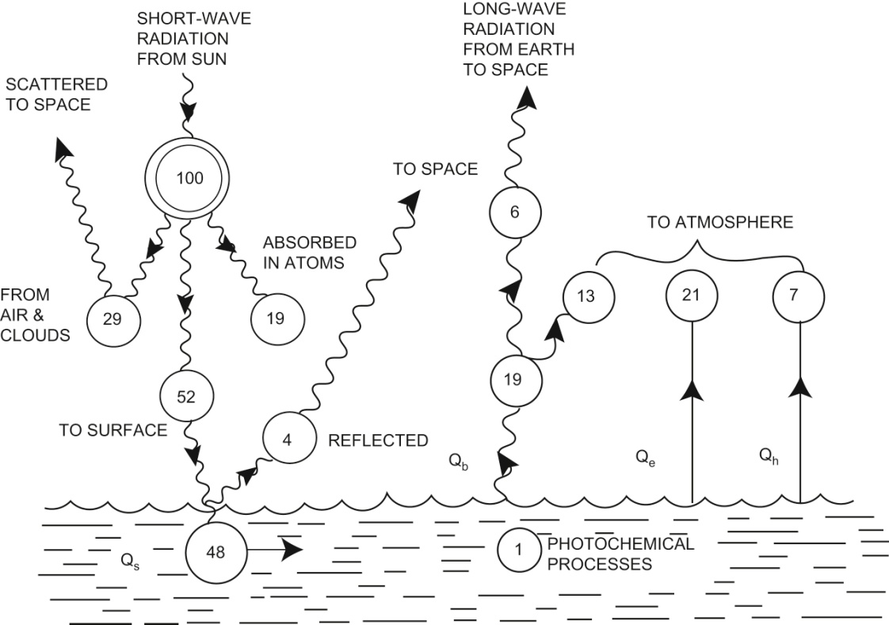
Fig. 5.5. Distribution of 100 units of incoming short-wave radiation from the sun to the earth's atmosphere and surface long-term world averages

Slide 20
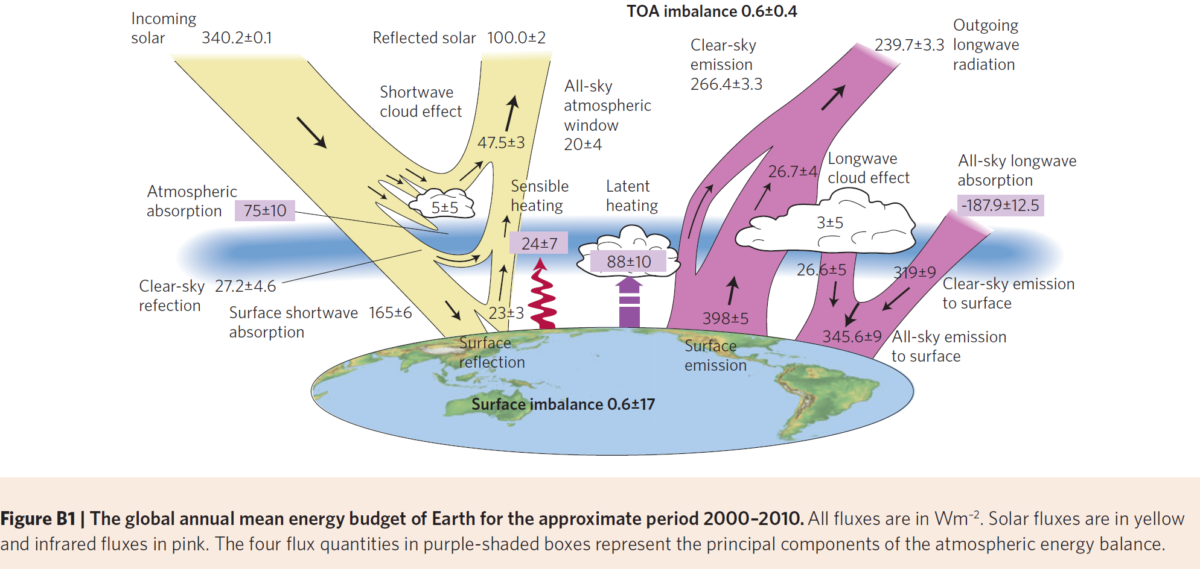
Global Energy Balance

Slide 21
Heat Budget
Positive (negative) sign represent a heat gain (loss) by (from) the water.
In practice, solar heat flux Qs > 0; back-radiation Qb < 0. Latent heat flux Qe almost always < 0. Sensible heat flux Qh can be negative or positive depending on the sign of the temperature difference between the air and water. Advective heat flux Qv depends on the difference in temperature between the water flowing into the region and water flowing out of the region.

Slide 22
Heat Budget
For steady state and the world ocean as a whole, Qt = 0, Qv = 0. The equation for the oceans in this case simplifies to:
Qs + Qb + Qh + Qe = Qsfc = 0. (5.9)
The largest component Qs > 0.
The second largest term Qe < 0, has large seasonal variations, with winter losses > 240 W/m² in the northwestern North Atlantic.
The smallest term Qh < 0, having maximum values in the northwestern North Atlantic and North Pacific.
The smallest variations Qb < 0

Slide 23
Shortwave Radiation (Qs)
The bulk formula based on traditional observations of cloud cover:
Qs = (1-α)Qc(1 - 0.62C + 0.0019θ_{N}), (5.10)
where Qc is the incoming clear-sky solar radiation (measured above the atmosphere in units of W/m² and referred to as the "solar constant", C is the monthly mean fractional cloud cover, α is the albedo (fraction of radiation that is reflected), and θ_{N} is the noon solar elevation in degrees. In practical calculations, Qs is not allowed to exceed Qc.

Slide 24
Factors
Incoming clear-sky solar radiation Qc. the solar constant is about 1,365 to 1,372 W/m², perpendicular to the sun’s rays.
Reflection (albedo 反照率). partially reflected upwards both from the atmosphere (clouds and water vapor) and from the Earth's surface. The albedo α is the ratio of the radiation that is reflected from the surface to the incoming radiation, expressed in percent.
Clouds. reflected, absorbed or scattered by clouds.
Absorption. absorption of solar radiation in the atmosphere in the absence of clouds, depends on the elevation θ_{N} of the sun. The absorption is due to the combined effect of gas molecules, dust in the atmosphere, to water vapor, etc
Notes:
The albedo is also often called reflectance. The amount of reflectance depends on what type of surface is reflecting. The reflectance for water (most of the ocean) is about 10 - 12 % but can be higher or lower depending on the suspended matter. The albedo of sea ice can be much higher but depends strongly on ice type and whether it has snow cover. The reflectance for new ice can be as low as 5 - 20% (see section ?? for sea ice formation stages) while the albedo for first year ice can be as high as 60%. The albedo for multiyear ice without snow cover is about 70%. The reflectance for snow is between 60% and 90%, and that for multiyear ice is about 45%. Land surface reflectance depends on vegetation and ranges between 0.5% and 30 %. Clouds also reflect solar radiation and contribute greatly to the albedo of the whole earth system.

Slide 25
TABLE 5.1 Reflection coefficient (albedo) and transmission coefficient (x 100) for sea water
Sun’s elevation: 90° 60° 30°20° 10° 5°
Amount reflected (%): 2 3 6 12 35 40
Amount into water (%): 98 97 94 88 65 60

Slide 26
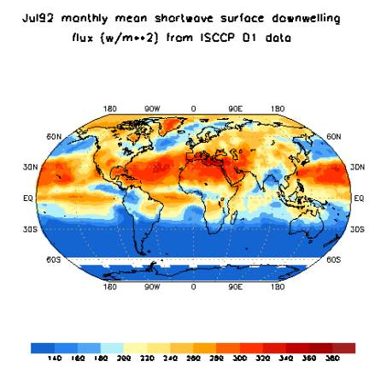
Observed short-wave radiation
Fig. 5.6 July 1992 Monthly Mean Shortwave Radiation from ISCCP. For surface radiation.
Satellite-based shortwave radiation estimates. International Satellite Cloud Climatology Project (ISCCP), and the Atmospheric Radiation Monitoring or ARM program). The top of the atmosphere radiation is measured through the Earth Radiation Budget Experiment (ERBE). These products are combined in the Surface Radiation Budget Program at NASA

Slide 27
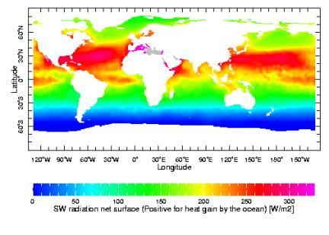
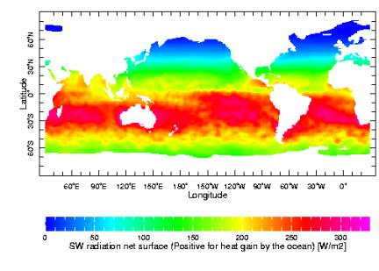
Fig. 5.7 Mean (a) July and (b) January Shortwave Radiation from the SOC Climatology
It should be emphasized that the SOC climatological map and the ISCCP July 1992 map are very different realizations of the shortwave radiation. ISCCP is for a single year and is based on global satellite data, both polar-orbiting and geostationary, while the SOC field is computed from ship measurements taken by merchant vessels over many years. Thus, the SOC climatology represents an average shortwave radiation for the month indicated. The reader should be careful in interpreting each of these different realizations of the shortwave radiation and insure that it is properly applied.
Notes:
Note the similarities between the patterns in these two fields as well as the differences. The SOC climatology, computed from mostly routine weather observations collected on merchant ships over a long time period, covers the ocean areas. The ISCCP estimate, computed from Earth orbiting satellite data, covers both the oceans and the land. In the Atlantic the SOC and ISCCP patterns are very similar, while in the Indian Ocean they are very different. The SOC shortwave flux is much greater in the Arabian Sea (the northwestern side of the Indian Ocean) than is shown in the ISCCP map. In addition, the ISCCP map shows much lower values in the Bay of Bengal in the northeastern Indian Ocean than are found in the SOC climatology. The Pacific patterns are similar but the amplitudes in the South Pacific are smaller in the ISCCP map than in the SOC climatology. The polar regions are poorly covered in both maps, the SOC climatology because of the paucity of ship traffic in polar regions, and the ISCCP map due to an emphasis in the estimate of shortwave radiation on geostationary satellite data which does not resolve the polar regions.
The mean July influx of solar radiation at the earth’s surface is shown in Figs. 5.7 and 5.8a, assuming an average atmospheric transmission and no clouds, as a function of latitude. The main features are: (1) the highest values occur at about 30 °N latitude, (2) there is no short-wave input at high latitudes during the polar winter, and (3) the amount of energy input is greater in the southern hemisphere than in the northern. The reason for the last is simply that the earth, in its elliptical orbit, is nearer to the sun during the southern summer than during the northern one.
It should be emphasized that the SOC climatological map and the ISCCP July 1992 map are very different realizations of the shortwave radiation. ISCCP is for a single year and is based on global satellite data, both polar-orbiting and geostationary, while the SOC field is computed from ship measurements taken by merchant vessels over many years. Thus, the SOC climatology represents an average shortwave radiation for the month indicated. The reader should be careful in interpreting each of these different realizations of the shortwave radiation and insure that it is properly applied.

Slide 28
Absorption of short-wave radiation in the sea
Short-wave radiation is not absorbed in the ocean's surface (approximately 10 µm thin skin) layer, but instead penetrates to about 1 – 100 m depending on wind stirring and incident shortwave flux magnitudes, with an exponential decrease with depth.
The short-wave penetration affects the way that the mixed layer restratifies after being mixed by wind or cooling. It also penetrates below the mixed layer in many regions, particularly at low latitudes.

Slide 29
Absorption of short-wave radiation in the sea
Allows for growth of phytoplankton, the ocean's chlorophyll-producing plants, in the near-surface euphotic zone (sunlit zone).
In clear water the e-folding depth for attenuation of the light is about 50 m. In water with a heavy load of sediments or biological particles, for instance during major plankton blooms, the radiation is absorbed much closer to the sea surface, with an e-folding scale of less than 5 m.
When more of the solar radiation is absorbed close to the surface, the surface temperature increases faster than where the water is clear. The heating rate can differ by a factor of 100.

Slide 30
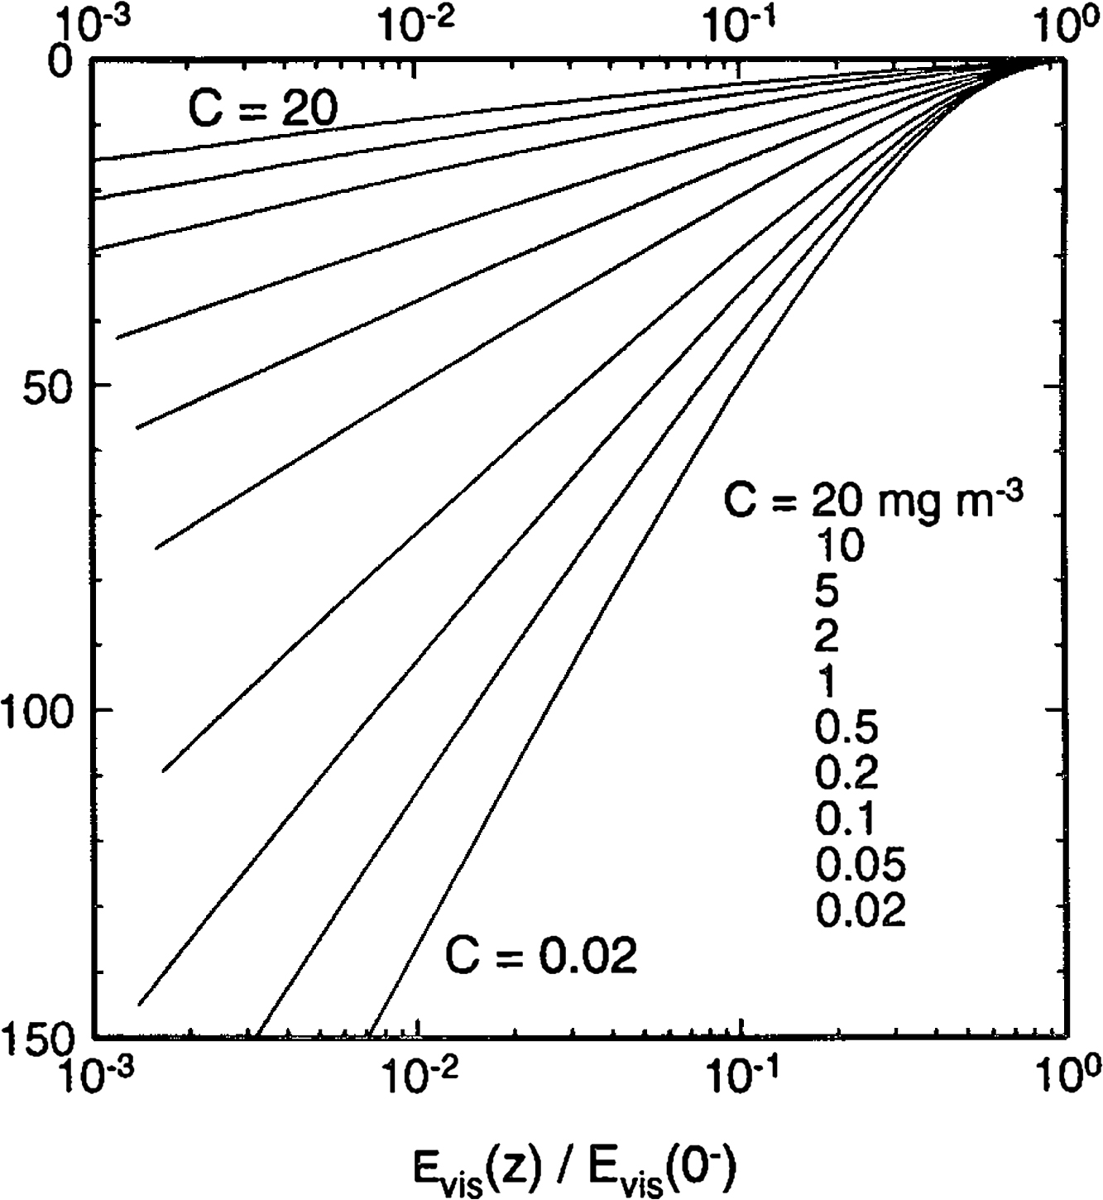
Fig. 5.8. Absorption of shortwave radiation as a function of depth (m) and chlorophyll concentration, C (mg m⁻³). The vertical axis is depth (m). The horizontal axis is the ratio of the amount of radiation at depth z to the amount of radiation just below the sea surface, at depth “0". Note that the horizontal axis is a log axis, on which exponential decay would appear as a straight line. (From Morel and Antoine, 1994)

Slide 31
Longwave Radiation (Qb)
Qb is the net amount of energy lost or gained by the sea as long-wave radiation. The back radiation is the difference between the energy radiated outward from the sea surface and the long-wave radiation received by the sea from the atmosphere.
Qb < 0. Empirical bulk formula (Josey et al., 1999):
Qb = ε σ_{SB} Tw⁴ (0.39 – 0.05e^{1/2}) (1 - kC² ) + 4εσ_{SB}Tw³ (Tw - TA). (5.11)
Here ε is the emittance of the sea surface (0.98), σ_{SB} is the Stefan-Boltzmann constant (5.67 x 10⁻⁸ W m⁻² K⁻⁴), Tw is the surface water temperature in Kelvin, TA is the air temperature in Kelvin, which is usually measured on a ship near the bridge that may be as much as 8 - 10 m above the sea surface. At the surface, e is the water vapor pressure, k is a cloud cover coefficient which is determined empirically and which increases with latitude, and C is the fractional cloud cover.

Slide 32
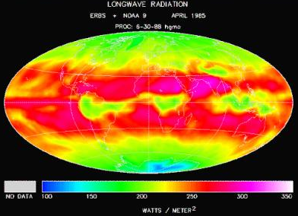
Fig. 5.9 ERBE Long-wave Radiation for April, 1985
Satellite–based long-wave radiation estimates (Surface Radiation Budget Program at NASA) also use a bulk formula similar to (5.11), but with different cloudiness and emittance parameterizations. Maximum outgoing long-wave radiation dominates the mid-latitudes in all ocean regions broken only by equatorial minima that are clearly related to adjacent land. In the Atlantic, this equatorial long-wave minimum extends northeastward from South America. In the Indian Ocean, there is a weak equatorial minimum in the western and central Indian. A strong equatorial minimum occurs in the Indonesian region and extends into the western Pacific. Maxima are found in the off-equatorial tropical Indian and Atlantic Oceans and eastern South Pacific. The North Pacific exhibits a small minimum band at these latitudes.
Notes:
In this calculation, cloud estimates are taken from ISCCP, as for shortwave radiation. Ocean surface and lower atmosphere temperatures are derived from satellite observations.

Slide 33
Factors affecting long-wave radiation
Stefan-Boltzmann constant σ_{SB}, Tw
Cloud cover. reduce the long-wave back radiation from the sea to space.
Tw – Ta (small)

Slide 34
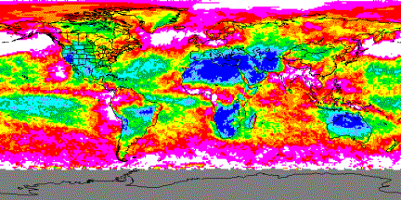
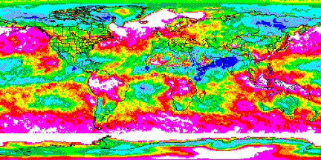
Cloud cover at daytime and nighttime
Fig. 5.10 Day-time Cloudiness for January 7, 2000 from MODIS
Fig. 5.11 Nighttime Cloudiness for January 3, 2000 from MODIS
Notes:
To give the reader some appreciation for the global cloud cover, we present a daytime global image of cloud cover from NASA's MODIS instrument in Fig. 5.11 for Jan. 7, 2000. High clouds are indicated by the white, pink and red colors while minimum cloud levels are indicated by the dark blue tones. A few well-known conditions are quickly apparent. The Polar Regions are dominated by high cloudiness values, while most of Africa, Australia, and the western U.S. exhibit minimum cloud covers. High cloudiness occurs in southern West Africa, the west coasts of North and South America and in the high latitude portions of the North Pacific and North Atlantic.

Slide 35
Penetration Depth of Longwave Radiation
Water is nearly opaque to long-wave radiation. Absorbed in top mm.
Similarly, the outward long-wave radiation is determined by the temperature of the literal surface or skin temperature of the sea, < 1 mm
Notes:
The incoming long-wave radiation from the atmosphere is absorbed in the top millimeters, unlike incoming shortwave radiation that penetrates much deeper

Slide 36
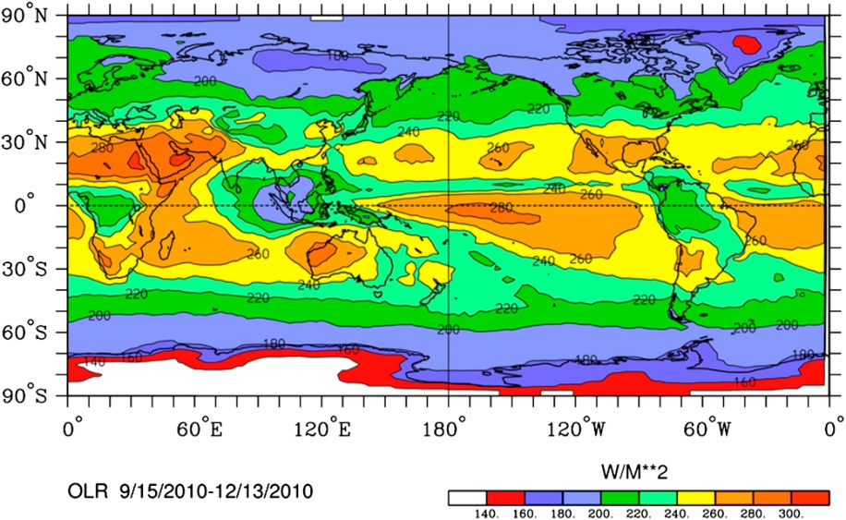
Observed Outgoing Longwave Radiation (OLR)
Fig. 5.12 Outgoing Long-wave Radiation from NOAA for Sep. 15 – Dec. 13, 2010
“OLR” refers to the sum of all the long-wave electromagnetic energy, or infrared radiation at wavelengths ranging from 5 to 100 µm, that escapes from the top of the Earth's atmosphere back into space.
Notes:
Most of this long-wave energy is emitted from the surface of the ocean while some of it is emitted by the land.
The OLR can be computed from infrared satellite data and is generated as a regular product by the NOAA from their polar-orbiting satellites.
An example is given here in Fig. 5.12. There are some clear similarities with Fig. 5.9 even though the earlier map is for April, 1985 and from the ERBE instruments. The southern hemisphere maximum begins east of Australia in the South Pacific, crosses Australia, the Indian Ocean, southern Africa, the South Atlantic and finally terminates in eastern Brazil, where it turns north to join a maximum in the northern hemisphere that also appears to circle the globe. Magnitudes are similar for both ERBE and the NOAA OLR product

Slide 37
Effect of ice and snow cover on the radiation budget
First of all, ice cover significantly reduces heat exchange between the ocean and atmosphere -- 1 meter of ice will almost totally insulate the ocean. However, sea ice is always moving and is full of leads (breaks of open water). Ocean heat loss in leads is intense, and new ice forms quickly.

Slide 38
Effect of ice and snow cover on the radiation budget
Therefore heat budgets in ice-covered areas must take account of ice type, thickness and concentration (per cent coverage). Where there is ice cover, the heat flux into the water column becomes
Q = k(Tw – Ts)/h (5.12)
where k is the ice conductivity, Tw is the water temperature just below the ice, Ts is the temperature at the upper surface of the ice, and h is the ice thickness.

Slide 39
Effect of ice and snow cover on the radiation budget
The water temperature can be taken to be at the freezing point. The surface temperature of the ice and its thickness are more difficult to determine without local measurements.
The type and thickness of ice is harder to estimate, but there are various approaches for obtaining information about the distribution of new, first-year and multi-year ice that are then translated to estimates of ice thickness.

Slide 40
Effect of ice and snow cover on the radiation budget
Second, ice is highly reflective (high albedo), much more so than water (lower albedo). This mostly impacts the incoming short-wave radiation. For a water surface, the average reflection is relatively small (10 to 15%, or albedo of 0.1 to 0.15). For ice or snow, the proportion of short-wave radiation reflected is much larger (50 to 80 %). Ice reflectivity also depends on whether there is snow cover on the ice (increased albedo), or pools of melt water (reduced albedo).

Slide 41
Effect of ice and snow cover on the radiation budget
However, the size of the Qb loss term is much the same for ice as for water (due to the relative similarity of surface temperature), and the result is a smaller net gain (Qs - Qb) by ice and snow surfaces than by water. Consequently, once ice forms it tends to be maintained, and once it starts to melt it might retreat quickly. This is called "ice-albedo feedback", since there is a positive reinforcement of ice formation once it starts to form.
http://homepages.ucalgary.ca/~fcaf/seaice.htm

Slide 42
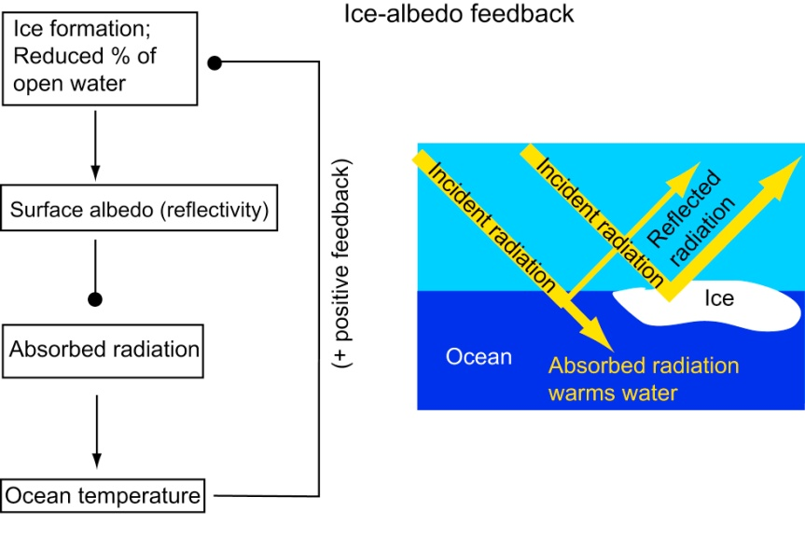
Ice-albedo Feedback
In the feedback diagram, arrowheads (closed circles) indicate that an increase in one parameter results in an increase (decrease) in the second parameter. The net result is a positive feedback, in which increased sea ice cover results in ocean cooling that then increases the ice cover still more.

Slide 43
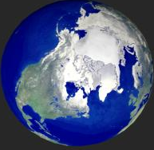
Fig. 5.13 Winter Arctic Sea Ice Cover
The ice balance in a region such as the Arctic Ocean is therefore relatively delicate. If the sea-ice were melted all the way at a given time, the increased net heat gain (Qs - Qb) might maintain the Arctic Ocean free of ice. On the other hand, this could increase evaporation, which would increase precipitation in the high north latitude bands, hence increasing snow cover and high latitude albedo, which would have the effect of cooling rather than warming.
Notes:
Greenland
Liu JP’s PNAS paper on ICE based on model results, disappear?

Slide 44
Evaporative or Latent Heat Flux (Qe)
Evaporation requires a supply of heat from an outside source or from the remaining liquid. Therefore evaporation, besides implying loss of water volume, also implies loss of heat. The rate of heat loss is
Qe = F_{e} • L (5.13)
where F_{e} is the rate of evaporation of water in kg sec⁻¹ m⁻² and L is the latent heat of evaporation (vaporization) in kilojoules (1 kJ = 10³ J). For pure water, L depends on the temperature of the water T in °C: L = (2,494 - 2.2 T) kJ/kg. At 10 °C, the latent heat is about 2,472 kJ/kg, which is larger than its value of 2274 kJ/kg (540 cal/gm) at the boiling point.
Notes:
Thus, while one can see steam after the boiling point is reached, there is more volume being evaporated at temperatures well below boiling.

Slide 45
Evaporation Fe
A semi-empirical ("bulk") formula:
Fe = ρ C_{e} u (q_{s} - q_{a}). (5.14)
Here ρ is the density of air, C_{e} is the transfer coefficient for latent heat, u is the wind speed in meters per second at 10 m height, q_{s} is 98% of the saturated specific humidity at the sea surface temperature, and q_{a} is the measured specific humidity.
The average F_{e} from the sea surface ~ 120 cm/yr, i.e. the equivalent of the sea surface sinking by that amount. F_{e}: 30-40 cm/yr in high latitudes to maxima of 200 cm/yr in the tropics associated with the trade winds. This decreases to about 130 cm/yr at the equator where the mean wind speeds are lower.

Slide 46
Latent Heat Flux (Qe)
The empirical ("bulk") formula, in W/m²,
Qe = F_{e} • L = ρ C_{e} u (q_{s} - q_{a}) L. (5.15)
In most regions of the ocean, q_{s} > q_{a}, so Qe > 0 ➔ heat loss from the sea due to evaporation.
The heat loss due to evaporation occurs from the topmost layer of the sea, like long-wave radiation and unlike short-wave radiation heat gain.
Notes:
Only in a few regions is the reverse the case, when the air temperature is greater than the sea temperature and the humidity is sufficient to cause condensation of water-vapor from the air into the sea. This results in a loss of heat from the air into the sea. The Grand Banks off Newfoundland and the coastal seas off northern California are examples of regions where the heat flow Qe is into the sea (numerically positive). The fogs that occur in these regions are the result of cooling of the atmosphere.
Unlike the shortwave and long-wave terms discussed above there is no straightforward estimate of latent heat exchange from satellite observations. Therefore the latent flux must be estimated from in situ measurements as will be presented later.
In fact, as long as the sea temperature is more than about 0.3 K greater than the air temperature, there will be a loss of heat from the sea due to evaporation.

Slide 47
Heat Conduction or Sensible Heat Flux (Qh)
Sensible heat flux, arises from a vertical variation (gradient) in temperature in the air just above the sea. If temperature decreases upward (downward), heat will be conducted away from (into) the sea. The rate of loss or gain of heat is proportional to the air's temperature gradient, and to the heat conductivity (for which we use an eddy diffusivity or conductivity, A_{h}):
Qh = - A_{h} • c_{p}• dT/dz (5.16)
Notes:
The vertical gradient of temperature is measured as a difference between the sea surface temperature and the air temperature.

Slide 48
Heat Conduction or Sensible Heat Flux (Qh)
Eddy conductivity depends on wind speed. The bulk formula is, in W/m² :
Qh = ρ c_{p} C_{h} u (T_{s} – (T_{a} + γz)). (5.17)
where ρ is the air density, C_{h} is the transfer coefficient for sensible heat (derived from the eddy conductivity), T_{s} is the surface temperature of the ocean, T_{a} is the air temperature, z is the height where T_{a} is measured, and γ is the adiabatic lapse rate of the air, which accounts for changes in air temperature due to simple changes in height and pressure.
Notes:
The vertical gradient of temperature is measured as a difference between the sea surface temperature and the air temperature.

Slide 49
Dependence of the latent and sensible heat transfer coefficients on stability and wind speed
The transfer coefficients C_{e} and C_{h} (or drag coefficients), depend on whether the ocean is warmer or colder than the atmosphere, and if the atmosphere is undergoing deep or vigorous convection.

Slide 50
Dependence of the latent and sensible heat transfer coefficients on stability and wind speed
If the sea is warmer than the air above it, there will be a loss of heat from the sea because of the direction of the temperature gradient. However, larger-scale atmospheric convection will increase the heat transfer away from the sea surface. Convection occurs because the air near the warm sea gets heated, expands, and rises, carrying heat away rapidly.
If the sea is cooler than the air, convection does not occur. Therefore for the same temperature difference between sea and air, the rate of heat loss when the sea is warmer is greater than the rate of gain when the sea is cooler.

Slide 51
TABLE 5.2 Some values for the sensible heat transfer coefficient, C_{h}, as functions of (T_{s} -T_{a}) and wind speed u (Smith, 1988)
Wind speed u in m/s
___________________________________________________
(T_{s} - T_{a}) (K) 2 5 10 20
-10 0.75 0.96
-3 0.62 0.93 0.99
-1 0.34 0.87 0.98 1.00
+1 1.30 1.10 1.02 1.00
+3 1.50 1.19 1.06 1.01
+10 1.87 1.35 1.13 1.03
___________________________________________________
As wind speed increases, values for Ch tend toward unity. The reason for the large range in Ch at low wind speeds is related to the stability of the air over the sea. For example, for (Ts - Ta) = - 1 K, i.e. for the sea cooler than the air (Ts < Ta), the stability in the air is positive. This inhibits heat conduction and so the transfer coefficient is small. When the sea is warmer than the air, e.g. (Ts - Ta) = + 1 K, the air is unstable and heat conduction away from the sea is promoted, so the transfer coefficient is larger than 1. The blank areas in the table are for highly stable conditions (unusual) where Smith’s analysis breaks down.

Slide 52
5.5 Geographic distribution of the heat-budget terms
The Southampton Oceanography Centre climatology (Josey et al., 1999), which is based on the COADS data set, is used.
This data product includes monthly averaged values of each of the heat flux terms. These monthly averages were computed by taking all of the measured fluxes from a given month and averaging them together, over all of the many years of the data set. The "annual mean" is the average of these monthly means. (This average of monthly values to make the annual mean is used instead of an average of all of the data, since there are usually a lot more data collected in some seasons, such as summer, than in others, such as winter. If the data were all simply averaged together, the result would have a large bias towards the well-sampled months). Cloud cover over the oceans from da Silva et al. (1994) using surface observations is also shown since it has a large impact on the shortwave and longwave radiation.

Slide 53
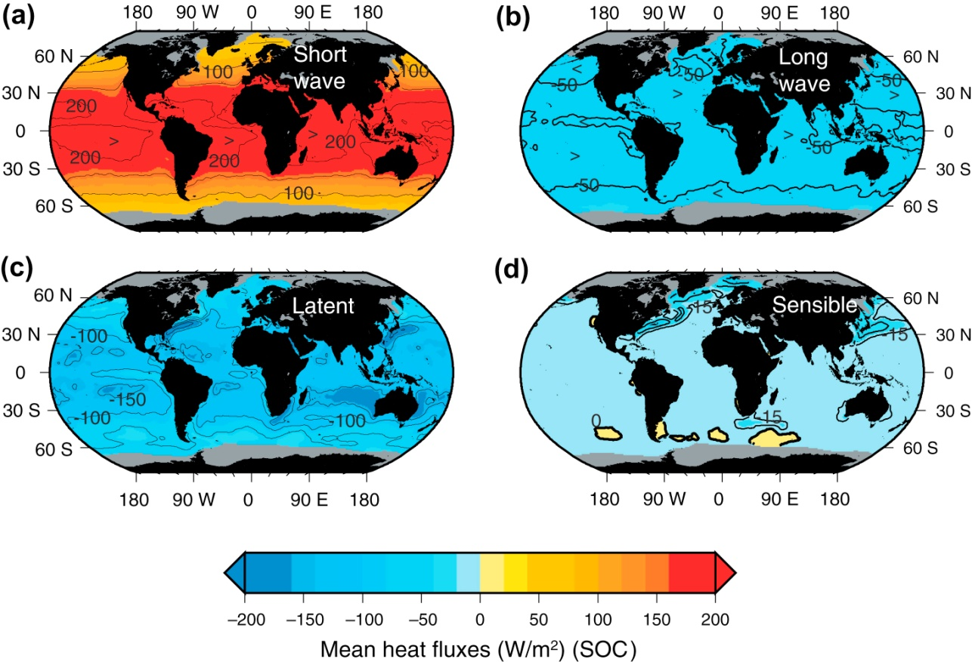
Fig. 5.14. Annual average heat fluxes (W/m²). (a) Shortwave heat flux Qs. (b) Longwave (back radiation) heat flux Qb. (c) Evaporative heat flux Qe. (d) Sensible heat flux Qh. Positive (yellows and reds) – heat gain by the sea; negative (blues) – heat loss by the sea. Contour intervals are 50W/m² in a and c, 25W/m² in b, and 15 W/m² in d. (Southampton Oceanography Centre climatology: Grist and Josey, 2003)
Annual Mean Heat Fluxes
Notes:
The four components of the air-sea heat flux are shown in Fig. 5.14. Basically heat is added to ocean through shortwave radiation (incoming sunlight) and lost from the ocean through the other three components. The shortwave radiation depends mainly on latitude. It adds 50 to 150 W/m2 of heat to the ocean in subpolar latitudes, and 150 to almost 250 W/m2 in the subtropics and tropics. Shortwave radiation does vary from exact dependence on latitude. The highest shortwave flux, of almost 250 W/m2, is in patches in the eastern tropical Pacific and the western tropical Indian Ocean along the Arabian Peninsula. Lower tropical shortwave heat gain is found in wide regions in the eastern parts of the oceans. For instance, in the eastern Pacific, the 200 W/m2 contours bulge towards the equator in both the North and South Pacific. This occurs in the eastern South Atlantic also. These variations in shortwave radiation cannot be due to orbital variations or the input of solar radiation at the top of the atmosphere. They must be due to varying cloud cover (Fig. 5.15). Higher shortwave radiation in the tropics occurs where there are fewer clouds. Less shortwave radiation reaches the sea where there is extensive cloud cover.
Longwave radiation results in net heat loss from the ocean (Fig. 5.14b), even though there is some longwave radiation into the ocean from the atmosphere. The radiation heat loss centers around 50 W/m2 over much of the earth. Long-wave radiation (Fig. 5.14b, Fig. 20) does not have a large range of values because it depends on the absolute temperature (Kelvin and not Celsius). The relative changes in temperature are just a small fraction of the total temperature. The relative humidity also does not change much over the sea. For instance, a seasonal change of sea temperature from 10° to 20°C changes the outward radiation proportional to the ratio 2934/2834 or about 1.15, i.e. only a 15% increase. At the same time the atmospheric radiation inward would increase and reduce the net rate of loss below this figure. The small seasonal and geographic changes of Qb are in contrast to the large seasonal changes of Qs. Variations in longwave radiation with latitude follow cloud cover (see the seasonal maps below in Fig. 5.18) rather than surface temperature. Longwave radiative heat loss is highest in the subtropics (more than 50 W/m2) where the cloud cover is smaller than in the equatorial and subpolar regions.
Latent heat flux (Fig. 5.14c, Fig. 5.16) is the largest heat loss component at all latitudes. It is strongest (more than 100 W/m2 heat loss) in the subtropical regions of low cloud cover, where dry air descends from aloft onto the oceans. Variations from west to east in the stormy regions of the western North Atlantic and western North Pacific are associated with dry winds blowing off the continents, creating greater latent heat flux. Latent heat loss also depends mildly on temperature since warmer water evaporates more easily than colder water.
Sensible heat flux (Fig. 5.14d, Fig. 5.16) is the smallest of all of the components. It is small (-15 to 0 W/m2) over most of the ocean. It is slightly larger in the western North Atlantic and western North Pacific, where latent heat loss is also large. This is because the air-sea temperature contrast is large in these regions, where cold air blows off the continent over the warm western boundary currents. Sensible heat loss is more important in winter in some regions than is apparent from these maps of the mean components. (The seasonal variations of all components are shown in the next section.) A small amount of heat gain from sensible heat exchange is shown in the Antarctic, but the reader should understand that the data are especially poor there.

Slide 54
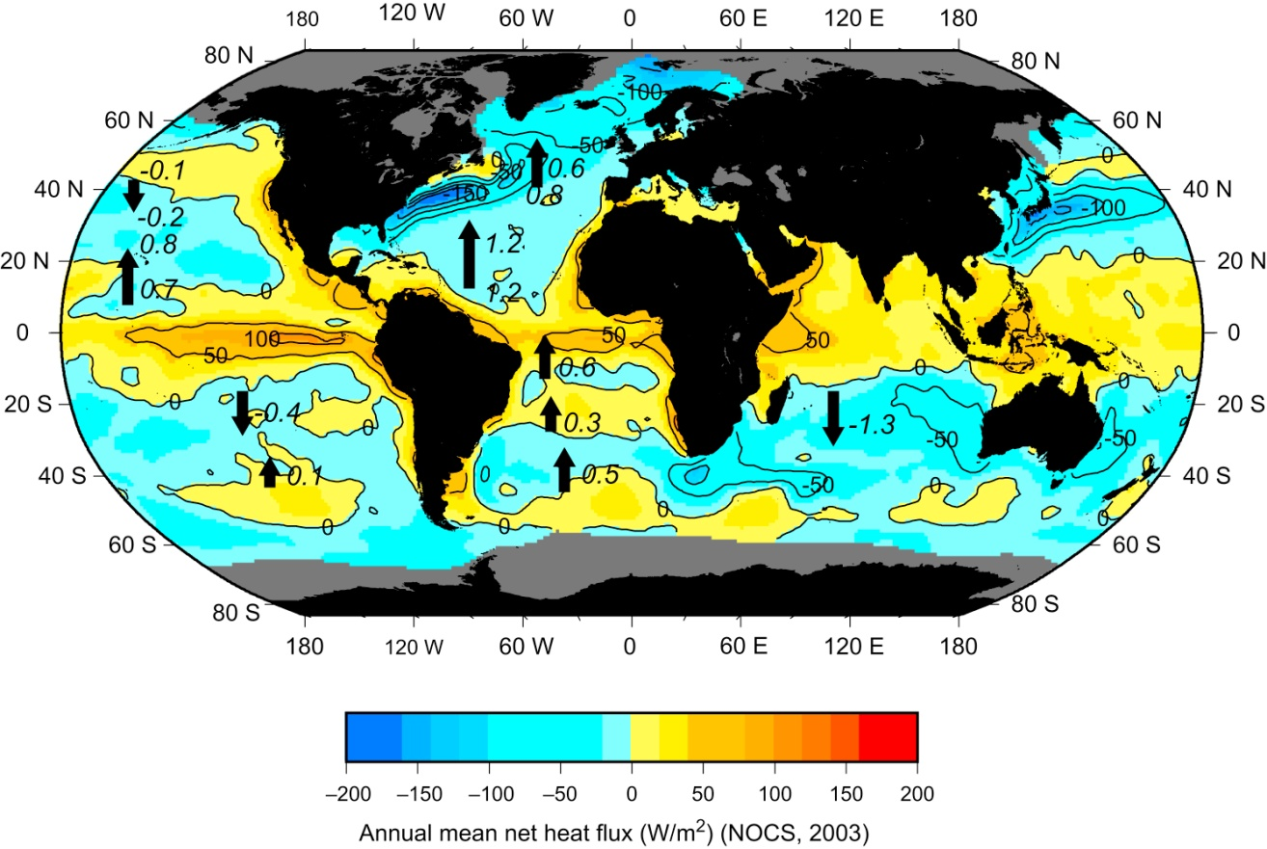
Fig. 5.15. Annual average net heat flux (W/m²). Positive: heat gain by the sea. Negative: heat loss by the sea. (Southampton Oceanography Centre climatology: Grist and Josey, 2003)
Annual Mean Net Heat Flux
Notes:
The total air-sea heat flux (Fig. 5.15) is the sum of the four components of Fig. 5.15. The ocean gains heat in the tropics and loses heat at higher latitudes. The most heat is gained along the equator, especially in the eastern Pacific. Regions of net heat gain spread away from the equator on the eastern sides of the oceans, in the regions where colder water is upwelled to the surface. Patches of heat gain are found in the Antarctic, corresponding to regions where the sensible heat flux is into the ocean in Fig. 5.15d, but where there are also almost no winter data to balance observations of summer heat gains.
The greatest mean annual heat losses occur in the Gulf Stream region of the North Atlantic, the Kuroshio of the North Pacific, and in the Nordic Seas north of Iceland and west of Norway. Other notable regions of heat loss are in the Agulhas Current southeast of Africa, and in the boundary regions on both sides of Australia.

Slide 55
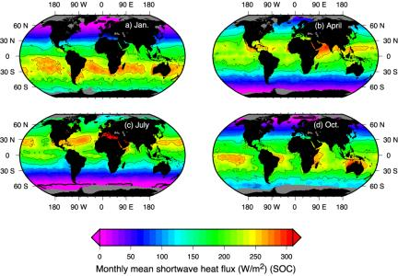
Fig. 5.17 Monthly mean shortwave radiation (W/m²) for a. January, b. April, c. July and d. October from Grist and Josey (2003).
Monthly Mean Shortwave Radiation
Notes:
The march of the seasons from summer to winter is apparent in the shortwave radiation maps (Fig. 5.17), with much more shortwave radiation reaching the summertime hemisphere (shown by the maps in January in the southern hemisphere and July in the northern hemisphere). The maximum shortwave heat flux in summer in the northern and southern hemispheres differs because the earth's orbit around the sun is elliptical. The earth is closer to the sun in January, so the radiation is higher then. This is during the summer in the southern hemisphere. The differences in winter shortwave radiation are harder to see on the maps, but the northern hemisphere receives more radiation in winter than does the southern hemisphere. Other east-west differences in radiation result from cloud cover (Fig. 5.18).

Slide 56
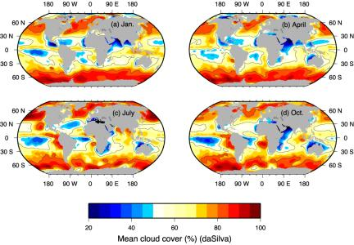
Fig. 5.18. Cloud cover (%) for a. January, b. April, c. July and d. October. Data are from the climatology of da Silva et al. (1994), based on surface observations.
Monthly Mean Cloud Cover

Slide 57
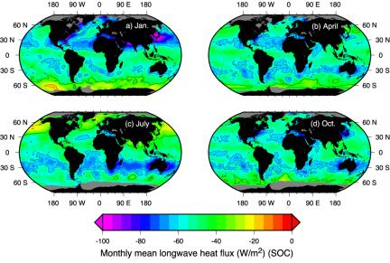
Fig. 5.19 Monthly mean longwave heat flux (W/m²) for a. January, b. April, c. July and d. October from Grist and Josey (2003)
Monthly Mean Longwave Radiation
Notes:
For longwave radiation, seasonal variations are small, just as geographical variations are small (section 5.6.1), because the radiation variations depend only weakly on temperature. Within these small variations, longwave radiation is larger in the winter hemisphere than in the summer hemisphere. That is, in January, the band of large longwave radiation around 30°N is stronger than the band around 30°S. The opposite is true in July. The April and October longwave radiation maps are similar to each other and the southern and northern hemispheres have similar patterns. (In specific regions though there are differences: the Mediterranean and Japan Seas have stronger longwave radiation in the April, which is at the end of the northern hemisphere winter. The coastal regions of Australia have stronger longwave radiation in October, which is the end of the southern hemisphere winter.) The longwave radiation patterns in all of these months look much like the cloud cover maps (Fig. 5.18), although obviously not in minute detail.

Slide 58
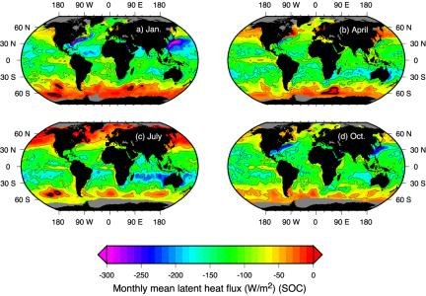
Fig. 5.20 Monthly mean latent heat flux (W/m²) for a. January, b. April, c. July and d. October from Grist and Josey (2003).
Monthly Mean Latent Heat Flux
Notes:
Latent heat loss through the seasons is strongest (most negative) in the winter, building up to its winter strength in the fall. The summer latent heat loss is much smaller. The northern hemisphere's western boundary currents (Gulf Stream and Kuroshio) are clearly marked by their large latent heat loss in fall and winter (October and January here). Southern hemisphere latent heat loss is less associated with the western boundary currents and more associated with the central subtropical gyres. (These are regions of high evaporation that lead to the high salinity surface layers in the subtropical gyres seen in chapter 4.)

Slide 59
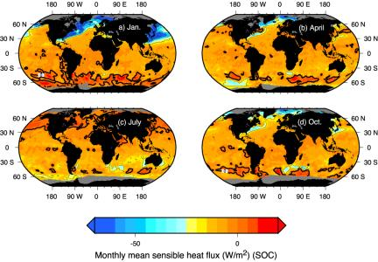
Fig. 5.21 Monthly mean sensible heat flux (W/m2) for a. January, b. April, c. July and d. October from Grist and Josey (2003).
Monthly Mean Sensible Heat Flux
Notes:
Despite the relatively small size and impact of sensible (conductive) heat flux overall, seasonal variations (Fig. 5.21) are striking. These changes are associated with a change in the sign of the temperature difference between the ocean and overlying air. Sensible heat flux causes heat loss in winter (January in the northern hemisphere, July in the southern hemisphere here). Significant heat loss is found in the western boundary current regions, of more than 100 W/m2. Sensible heat flux actually heats the ocean in higher latitudes in summer, when the air temperature is higher than the water temperature. The net sensible heat flux in section 5.6.1 (Fig. 5.14d) is the sum of these summer-winter contributions and is small overall.

Slide 60
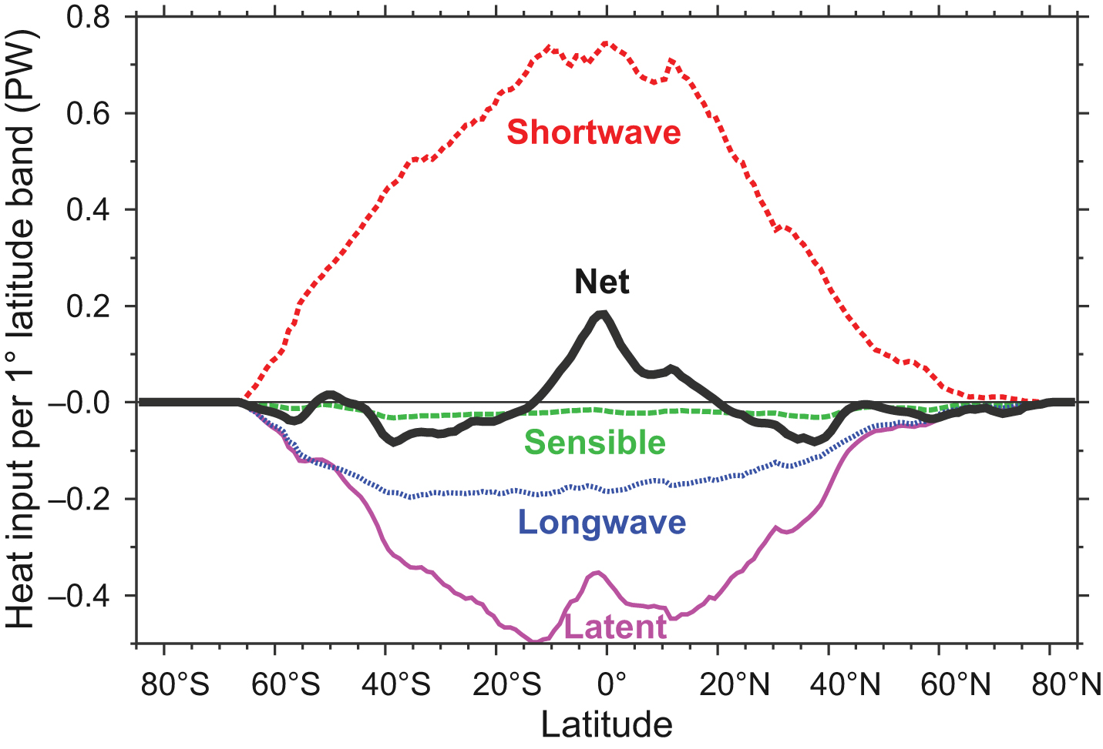
Fig. 5.16. Heat input through the sea surface (where 1 PW = 10¹⁵ W) (world ocean) for 1° latitude bands for all components of heat flux. (SOC climatology: Grist and Josey, 2003)
Net Heat Flux through Sea Surface
Notes:
The local values of each term in the heat budget and the total heat flux can be summed all the way around the earth in each latitude band (Fig. 5.16). The numbers used in this figure are the heat gain or loss in each 1° latitude/longitude square multiplied by the area of the square. Then all the heat gains or losses for a single latitude are added together to get the total heat gain or loss in Watts for each latitude band. The total (net) heat gain or loss in each latitude band (Fig. 5.16b) is the sum of these four. As was apparent in the maps in Fig. 5.14, shortwave radiation heats the ocean while the other three components cool it. Latent heat loss is the largest of these three heat losses, but longwave radiation is also significant. The sensible heat contribution is very small. All of the components are larger in the southern hemisphere than in the northern hemisphere. This might be mainly because there is more ocean area in the southern hemisphere. Shortwave radiation is also slightly skewed because the earth is closer to the sun in January, which is the summertime in the southern hemisphere (section 5.6.2). The net heat exchange is positive (heating) in the low latitudes and negative (cooling) at higher latitudes. The net heat flux is also skewed, with slightly more heating in the low-latitude southern hemisphere. The net heat flux distribution requires that there be a transport of excess heat from low to high latitudes (section 5.7).

Slide 61
5.6 Meridional (south-north) heat transport
For the world as a whole, and averaged over the year, a net heat gain from the equator to about 30°S/°N and a net loss beyond this.
Since average temperatures over the Earth remain substantially constant, we conclude that there must be a net advective flux of heat towards both poles. This poleward heat flux is carried by both the ocean and atmosphere. These transport warm water or air toward the pole and cooler water or air toward the equator, although not symmetrically in all oceans.

Slide 62
5.6 Meridional (south-north) heat transport
As there is no indication that the oceans as a whole are getting warmer or cooler we expect an exact balance between heat gain and loss when summed over all of the ocean area.
In practice the terms don’t cancel exactly because of errors in the bulk formulae and insufficient observations. Some groups that analyze surface heat flux terms force them to cancel by adjusting the bulk formulae while others produce flux fields that do not balance. Improvement is coming but is very slow because the remaining errors amount to about 10 W/m², and are difficult to reduce.

Slide 63
5.6 Meridional (south-north) heat transport
Indirect, from the surface heat fluxes
∫ (Qs-Qb-Qh-Qe)dx
Indirect, from the heat exchange of the whole earth's system at the top of the atmosphere.
∫ (Qs-Qb)dx – M(atmos.)
Direct, Based on measuring velocity and temperature of the ocean.
∫ ∫ (vT)dxdz

Slide 64
Figure 5.22. Net south-north heat transports (PW) from direct estimates, superimposed on the map of annual average heat flux. Black: estimates from "inverse models" from many sources (summaries in Bryden and Imawaki, 2001; Talley, 2003). Red: Talley (2003). Positive transports are northward.
Net Surface Heat Flux and Transport

Slide 65
Meridional heat transport
The poleward heat transports for the world’s oceans, from both the indirect estimate integrating the net surface heat fluxes in the Southampton Oceanography Centre's climatology and from a recent summary of direct estimates by Macdonald (1998), are presented in Figs. 5.22 and 5.23.
In the North Atlantic, North Pacific, and combined South Pacific and Indian Oceans (together because they are connected north of Australia), the net ocean heat transport is poleward, as expected from arguments based on the global heat budget (Fig. 5.15 and 5.16).

Slide 66
Meridional heat transport
A counterintuitive result is that the heat transport throughout the Atlantic, including the South Atlantic, is northward. This is because there is so much heat loss in the northern North Atlantic (Norwegian, Greenland Seas). To feed this heat loss, there must be a net northward flow of upper ocean water throughout the length of the Atlantic, which is returned southward by deeper colder water.
In all oceans, the subtropical gyre circulation in just the upper ocean carries heat poleward. This part of the heat transport in the South Atlantic is not strong enough to overcome the northward heat transport due to the top-to-bottom overturn. The Pacific Ocean does not have a top-to-bottom overturn, and so there is an asymmetry between the Pacific and Atlantic heat transports

Slide 67
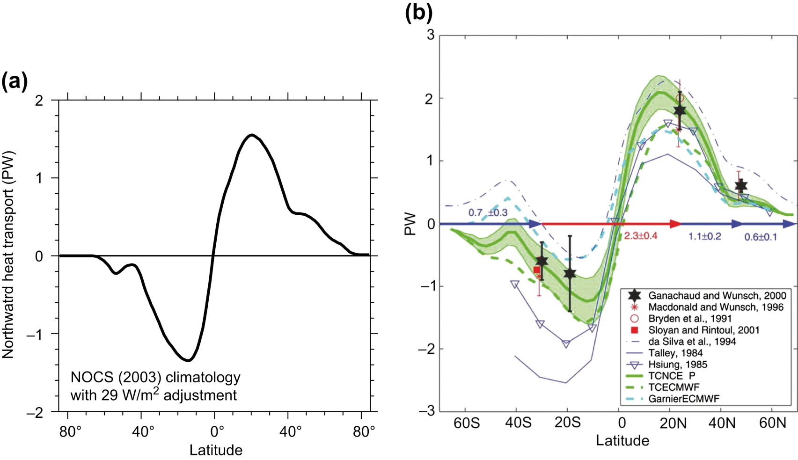
Uncertainty in Meridional Heat Transport
Figure 5.23 Poleward heat transport (W) for the world’s oceans (annual mean). (a) Indirect estimate (light curve) summed from the net air–sea heat fluxes of Figures 5.12 and 5.13. Data are from the NOCS climatology, adjusted for net zero flux in the annual mean. Data from Grist and Josey (2003). A similar figure, based on the Large and Yeager (2009) heat fluxes is reproduced in the online supplement (Figure S5.9). (b) Summary of various direct estimates (points with error bars) and indirect estimates. The direct estimates are based on ocean velocity and temperature measurements. The range of estimates illustrates the overall uncertainty of heat transport calculations. © American Meteorological Society. Reprinted with permission. Source: From Ganachaud and Wunsch (2003).

Slide 68
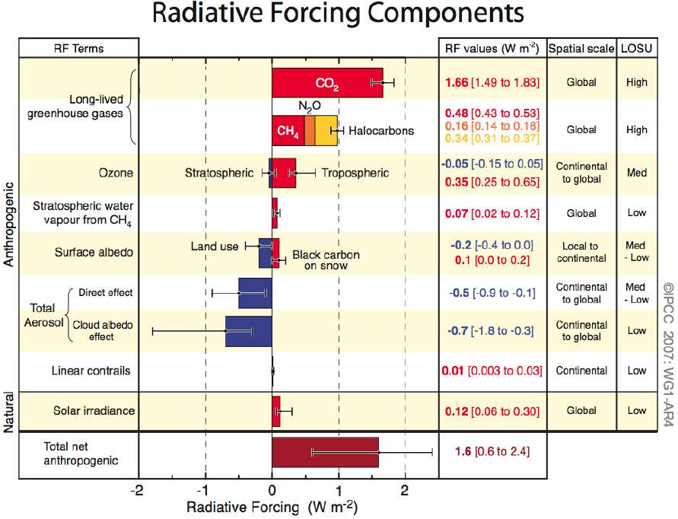
CO2 (1750-present): 1.66 (1.49 – 1.83) W/m² (IPCC-AR4) 2xCO2 : 3– 4 W/m² Closure error at TOA: 3PW → 6-7 W/m² Closure error at sea: 1PW → 2– 2.5 W/m²
Notes:
[In Fig. 5.23a we include an "adjusted" meridional heat transport curve that balances exactly, with zero transport in both the north and south, achieved by adding 2.5W/m2 at every grid point. The meridional transport in Grist and Josey (2003) is nearly but not exactly in balance (dark curve in Fig. 5.17), since it is based on observations with constraints applied and an allowed error on the order of 5W/m2. The adjusted (light) curve is within the error of their calculation. We present the adjustment to convey pedagogically that the true net transports sum to zero, but caution that the heavy curve is the best estimate that has been made from the original data sets. Why is it assumed that the net transports should sum to almost zero? The global heat budget must almost exactly balance, that is, there is almost no net heat gain or loss for the whole earth. Major climate change on the order of 1° to 5°C, such as global warming or a shift into an ice age, would result from a net heat gain or loss on the order of 1 to 10 W/m2 , calculated for a 1000 m thick layer of water over 100 or 10 years, respectively. It is also well known that global warming associated with a doubling of CO2 in the atmosphere corresponds to a net change in heat flux of 4 W/m2.]
Regarding the heat transport patterns in Figs. 5.4 and 5.22, showing northward transport throughout the Atlantic and poleward transport in the Pacific and Indian, Henry Stommel (personal communication) told an interesting story. One of the last studies by Georg Wüst was a study of all the north-south fluxes of all properties in the South Atlantic. Although Wüst (1957) computed and published the fluxes of oxygen, salinity, nutrients, etc. he did not include meridional heat flux, which is the easiest to compute since only temperature profiles are required. Stommel suspected that Wüst computed the heat flux and it appeared to go in the wrong direction, namely from the south to north (towards the equator) as we see in both Figs. 5.4 and 5.22. This violated his intuition, which required the heat to flow from the tropical north to the colder polar south. To verify his suspicion, Stommel sought out former students of Wüst’s. He managed to locate a German Admiral Noodt who wrote to say that, yes, Prof. Wüst did not publish the heat flux because it appeared that it “flew in the wrong direction” (sic). This view did not change until the 1970’s when new studies (Bennett, 1976) clearly displayed that the meridional heat flux in the South Atlantic is northward.

Slide 69
Questions (Due in 2-week)
What factors determine the heat budget terms, Qs, Qb, Qe and Qh, respectively? Make clear the importance of each factor of each term.
What are the ranges of the magnitude of the four terms? For each term, please specify the location and value of the maximum and minimum center, based on Fig.5.17-5.21.

Slide 70
Calculation

Slide 71
Calculation
The Bohai sea (渤海), its volume is about 1.6 x 10³ km³, the mean depth is about 20 m and the maximum depth is 70m. The Bohai sea is connected with the Yellow sea through the Bohai strait (115km long, 105.6km wide , 30-74m deep). Due to the land river runoff, the mean salinity is about 30 psu. Suppose the annual surface outflow through the Bohai strait is 7 x 10³ m³/s, with the mean salinity of 30 psu, the annual subsurface inflow is 6 x 10³m³/s, with the salinity of 35 psu, estimate the annual net fresh water flux and the turnover time of the Bohai sea.
http://fvcom.smast.umassd.edu/research_projects/Bohai/index.html
http://www.hwcc.com.cn/newsdisplay/newsdisplay.asp?Id=21874 Discussion! (doesn’t work any more)

Slide 72
Learning about the Ocean, the Climate and the Nature

