Slide 1
Lecture 6: Basic Equations of Motion, Mixing Descriptive Physical Oceanography
杨海军（YANG Haijun）复旦大学大气与海洋科学系
Department of Atmospheric and Oceanic Sciences, Fudan University
Email: yanghj@fudan.edu.cn
This powerpoint was prepared for purposes of this lecture and course only. It contains graphics from copyrighted books, journals and other products. Please do not use without acknowledgment of these sources.

Slide 2
Continuity (mass conservation)
Reading:
Emery, Talley, Pickard chp. 5.1
Steward chapter 7.7 (more formal)
Force balance
Reading:
Emery, Talley, Pickard chp. 8.2 (skip 8.2.3)
Key Concepts
Pressure gradient force
Viscosity

Slide 3
Equations for Fluid Mechanics
Mass conservation
Newton’s Law (F = ma) (3 equations)
Equation of state (for oceanography, dependence of density on temperature, salinity and pressure)
Equations for temperature and salinity change in terms of external forcing, or alternatively an equation for density change in terms of external forcing

Slide 4
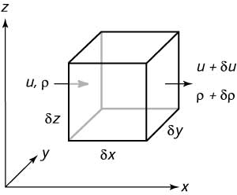
Continuity
Refer to Steward chapter 7.7
Mass flow in = ρuδzδy; Mass flow out = (ρ+δρ)(u+δu)δzδy
Mass flux = (mass flow out) − (mass flow in) = (ρδu+uδρ+δρδu)δzδy

Slide 5
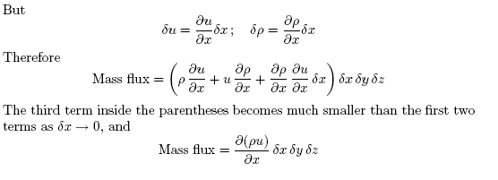
Continuity

Slide 6
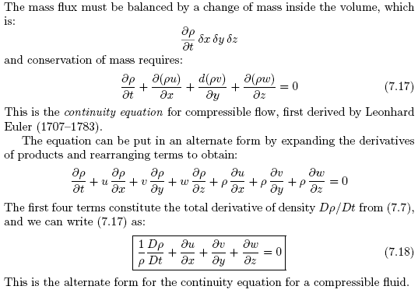
Continuity Equation（连续方程）

Slide 7
The Boussinesq Approximation
Density is nearly constant in the ocean (Joseph Boussinesq, 1842–1929). The assumption greatly simplifies the equations of motion. Boussinesq’s assumption requires that:
Fluid V << Sound speed C
Phase speed of waves << C.
The vertical scale of the motion H < C²/g.
Notes:
1. Velocities in the ocean must be small compared to the speed of sound c. This ensures that velocity does not change the density. As velocity approaches the speed of sound, the velocity field can produces large changes of density such as shock waves
2. Sound speed in incompressible flows is infinite, and we must assume the fluid is compressible when discussing sound in the ocean. Thus the approximation is not true for sound. All other waves in the ocean have speeds small compared to sound.
3. This ensures that as pressure increases with depth in the ocean, the increase in pressure produces only small changes in density.
The approximations are true for oceanic flows, and they ensure that oceanic flows are incompressible. See Kundu (1990: 79 and 112), Gill (1982: 85), Batchelor (1967: 167), or other texts on fluid dynamics for a more complete description of the approximation.

Slide 8
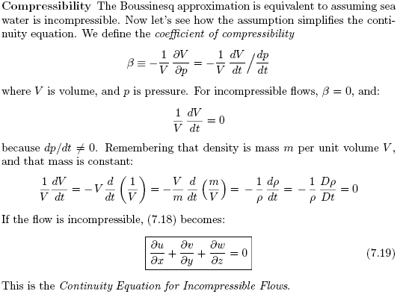
Continuity Equation for Incompressible Flows

Slide 9
Force Balance
Newton’s law
F = ma
This is a vector equation, with 3 equations for each of the three directions (x, y and z)
ma = F (for fluids)
Divide by volume, so express in terms of density ρ and force per unit volume ℑ:
ρa = ς
What are the forces that act on the fluid?

Slide 10
Forces Acting on Geophysical Fluid
Gravity
Pressure gradient force
Friction (dissipation) (viscous force)

Slide 11
Gravity
Towards center of Earth

Slide 12
Pressure Gradient Force (PGF)

Slide 13
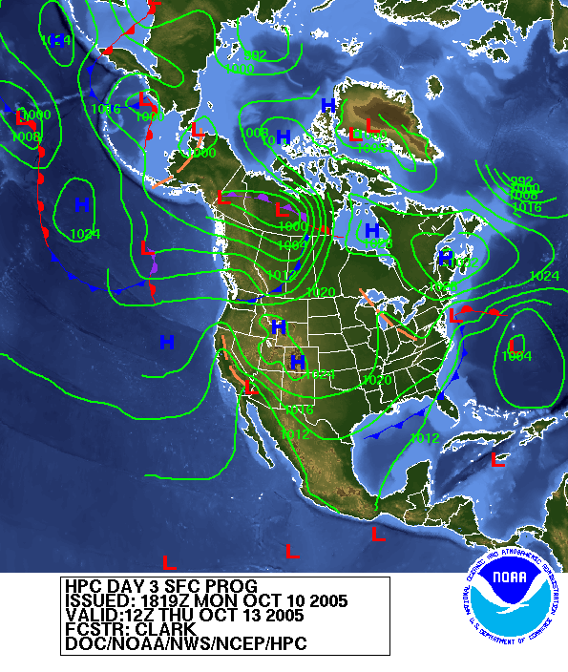
Example of pressure gradients Surface pressure map (in the atmosphere, we can simply measure the pressure at the surface)

Slide 14
PGF in Ocean?
Small deviations of sea surface drive all flows - usually much less than 1 meter height.
Gulf Stream example
1 meter height
Equivalent to pressure of 1 dbar = 10⁻¹ atm, since water density is ~ 1000 kg/m³
1 atm = 10 m of water = 1000 hpa = 10⁶ dy/cm²
1 m
height
100 km width

Slide 15
Compute Acceleration due to PGF
Take the example of the Gulf Stream and compute the velocity after 1 year of acceleration.
You’ll find it’s ridiculously large. Why can such a large pressure gradient be maintained without large velocities? (Earth’s rotation - Coriolis)

Slide 16
PGF in Ocean
Pressure gradient is very difficult to measure directly.
Can oceanographers measure the horizontal pressure gradients that matter for large-scale ocean flow? NO. Why not, meteorologists use barometers? Meteorologists can do it because air is so light that it doesn't matter if one barometer is on the floor and the adjacent one is slightly higher or lower. But water is so dense that putting one barometer on a 10 cm high rock by accident may reverse the estimated horizontal pressure gradient.
This raises a fundamental point: how do we find a flat surface/plane in the ocean?

Slide 17
Mixing
Random motion of molecules carries stuff around
Fick’s Law – Flux: F=−κ∇Q,
κ is diffusion coefficient with unit of cm²/s.
Diffusion: ∇F=−κ∇²Q

Slide 18
Acceleration due to Viscosity

Slide 19
Viscosity
Viscosity: apply same Fick’s Law concept to velocity. So viscosity affects flow if there is a convergence of flux of momentum.
Molecular (kinematic) viscosity:
x-momentum dissipation = υ(∂²u/∂x² + ∂²u/∂y² + ∂²u/∂z² )
υ ~ 10⁻⁶ – 10⁻⁵ m²/sec
The time scale, from the acceleration term, is on the order of the squared length scale divided by the viscosity (L²/υ). For even a small volume of fluid, for instance velocities in a stirred coffee cup, this time scale would be, say, (10 cm)²/(0.01 cm²/sec), or 10⁴ sec (3 hrs).

Slide 20
Viscosity
Eddy viscosity:
x-momentum dissipation = A_{H}(∂²u/∂x² + ∂²u/∂y²) + A_{V} (∂²u/∂z² )
A_{V} ~ 1 x 10⁻⁵ m²/sec ; A_{H} ~ 1 -- 10⁴ m²/sec.
A_{H} /υ ~ 10¹⁰

Slide 21
Diffusive Timescale and Spatial Scale
Suppose: dQ/dt ~ −κ∇²Q ➔ 1/T ~ κ/L²
We have to measure κ to answer some questions:
How far (L) does stuff diffuse in time T?
L = sqrt(κT)
If stuff has diffused to L, how long (T) would it take?
T = L²/κ

Slide 22
Completed Force Balance (no rotation)
$$\frac{∂u}{∂t}+u\frac{∂u}{∂x}+v\frac{∂u}{∂y}+w\frac{∂u}{∂z}=−\frac{1}{ρ}\frac{∂p}{∂x}+\frac{∂}{∂x}\left(A_{H}\frac{∂u}{∂x}\right)+\frac{∂}{∂y}\left(A_{H}\frac{∂u}{∂y}\right)+\frac{∂}{∂z}\left(A_{V}\frac{∂u}{∂z}\right)$$
$$\frac{∂v}{∂t}+u\frac{∂v}{∂x}+v\frac{∂v}{∂y}+w\frac{∂v}{∂z}=−\frac{1}{ρ}\frac{∂p}{∂y}+\frac{∂}{∂x}\left(A_{H}\frac{∂v}{∂x}\right)+\frac{∂}{∂y}\left(A_{H}\frac{∂v}{∂y}\right)+\frac{∂}{∂z}\left(A_{V}\frac{∂v}{∂z}\right)$$
$$\frac{∂w}{∂t}+u\frac{∂w}{∂x}+v\frac{∂w}{∂y}+w\frac{∂w}{∂z}=−\frac{1}{ρ}\frac{∂p}{∂z}−g+\frac{∂}{∂x}\left(A_{H}\frac{∂w}{∂x}\right)+\frac{∂}{∂y}\left(A_{H}\frac{∂w}{∂y}\right)+\frac{∂}{∂z}\left(A_{V}\frac{∂w}{∂z}\right)$$

Slide 23
What balances the PGF?
In the Gulf Stream, of width L, d²u/dx² ~ Δu/L²
Friction: κ Δu/L² = (0.02)(100)/(100×10⁵)² = 10⁻¹⁴ cm/s² << PGF
Even if using eddy viscosity κ_{eddy} = 10⁸, this quantity is 10⁻⁴ cm/s² << PGF
Therefore, in horizontal force balance |PGF| >> |Friction|.
What balances the PGF? Something must be here if the flow is steady.

Slide 24
Equations for Temperature, Salinity, Density
Temperature: advection, heating, cooling, mixing (diffusion and double diffusion)
Salinity: advection, evaporation, precipitation/runoff, brine rejection during ice formation, mixing (diffusion and double diffusion)
Density: related to temperature and salinity through the equation of state.
Often we just write an equation for density change and ignore separate temperature, salinity

Slide 25
Equations for Temperature, Salinity
$$\frac{∂T}{∂t}+u\frac{∂T}{∂x}+v\frac{∂T}{∂y}+w\frac{∂T}{∂z}=Q_{sfc}+\frac{∂}{∂x}\left(K_{H}\frac{∂T}{∂x}\right)+\frac{∂}{∂y}\left(K_{H}\frac{∂T}{∂y}\right)+\frac{∂}{∂z}\left(K_{V}\frac{∂T}{∂z}\right)$$
$$\frac{∂S}{∂t}+u\frac{∂S}{∂x}+v\frac{∂S}{∂y}+w\frac{∂S}{∂z}={FW}_{sfc}+\frac{∂}{∂x}\left(K_{H}\frac{∂S}{∂x}\right)+\frac{∂}{∂y}\left(K_{H}\frac{∂S}{∂y}\right)+\frac{∂}{∂z}\left(K_{V}\frac{∂S}{∂z}\right)$$

Slide 26
Questions (Due in 2-week)
Suppose a current is flowing through a passage between an island and the mainland. Suppose it is completely uniform (same velocity at all points as it enters the passage), and steady.
If it is flowing at 10 cm/sec as it enters the passage, and 5 cm/sec as it leaves the passage, what can you say about the geometry of the passage? Assume there is no evaporation or precipitation or runoff in the passage.
If the passage is 2 km wide and 50 meters deep at its entry, how large is it at the exit?
Compute the volume transport of the current.
What are the principle driving forces for the ocean?
What do oceanographers use pressure measurements for?

Slide 27
Questions
Calculate the hydrostatic pressure at 5 km depth. Calculate the hydrostatic pressure at 8 km depth. Assume the density of seawater is constant at 1030 kg/m³ and that seawater is incompressible. (You will have seen that this assumption is pretty good, but not exact, when you looked at properties of seawater.)
Why do oceanographers have to use indirect methods to infer the pressure gradient force that drives meso-scale and large-scale flows?
In Arctic, surface temperature varies seasonally (T = 86400 x 180 ~ 10⁷ sec). Heat diffuses at kappa = 10⁻³ cm²/s. How deep (L) is the seasonal temperature change noticed? L = sqrt(kappa * T) = sqrt(10⁷ 10⁻⁷) = 1 m.
How long must it take for seasonal temperature variation to penetrate 10 m? T = L²/kappa = (10⁶)/10⁻³ = 10⁹ sec = 30 years!

Slide 28
Learning about the Ocean, the Climate and the Nature

