Slide 1
Lecture 7: Fluid Flow with Rotation or Geostrophy Descriptive Physical Oceanography
杨海军（YANG Haijun）复旦大学大气与海洋科学系
Department of Atmospheric and Oceanic Sciences, Fudan University
Email: yanghj@fudan.edu.cn
This powerpoint was prepared for purposes of this lecture and course only. It contains graphics from copyrighted books, journals and other products. Please do not use without acknowledgment of these sources.

Slide 2
Rotation (centrifugal and coriolis):
Emery, Talley and Pickard, chapter 8.2.3
R. Stewart's online book, chapter 7.6.
Tomczak and Godfrey chapter 3 - pages 29-35.
Inertial motion:
Emery, Talley and Pickard, chapter 8.4.1
R. Stewart's online book, chapter 9.1.
Geostrophy and dynamic height:
Emery, Talley and Pickard, chapter 8.5.1 to 8.5.3
R. Stewart's online book, chapter 10.3, 10.5.
Tomczak and Godfrey chapter 3 - pages 29-35.

Slide 3
Concepts
Centrifugal force
Coriolis force
Inertial motion
Geostrophic balance
Thermal wind
Dynamic height

Slide 4
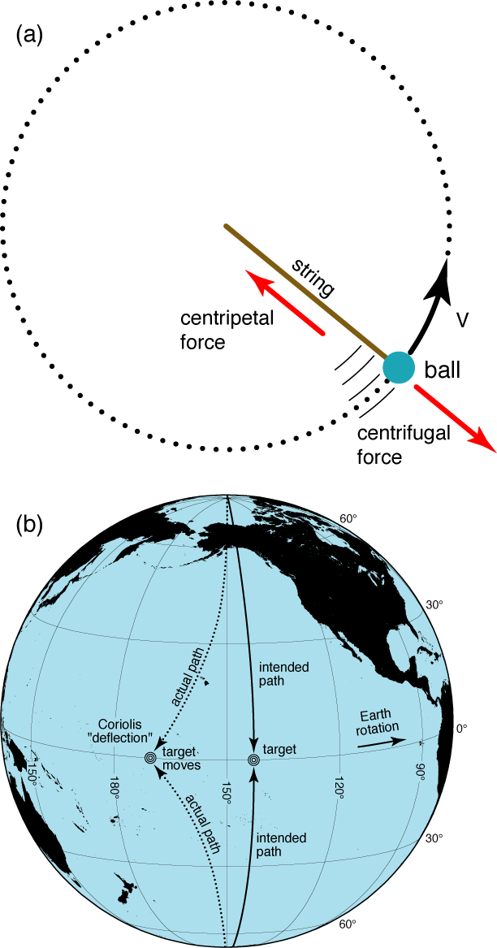
Centrifugal Force (离心力)
Centrifugal acceleration = Ω²R
where R is radius and omega is the angular speed omega = 2*pi/T where T is the time of one full rotation.
Notes:
If the solid earth were a true sphere, the motionless ocean would be 20 km deeper at the equator than at the pole. We don't see anything like this. Therefore we conclude: the solid earth itself is spheroidal, with the equatorial radius about 20 km larger than the polar radius.
Thus: the horizontal gravity + horizontal centrifugal force = 0. So we can neglect centrifugal force because the earth itself is spheroidal

Slide 5
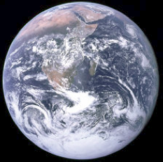
Effect of Centrifugal Force on Earth and Ocean
Radius:
Equatorial 6,378.135 km
Polar 6,356.750 km
Mean 6,372.795 km
For the earth: The radius $r=6000 km$, $Ω=\left(\frac{2π}{86400}\right)s$, $Ω^{2}r=3.17cm/s^{2}$. This would be the centrifugal force at the equator, where it is maximum. At the poles, it is of course 0, since the radius to the axis of rotation is 0 there. (So the actual force is $Ω^{2}r\cos{φ}$) Compare this centrifugal force with gravity acceleration of $980 cm/s^{2}$. Therefore on the earth, you weigh 0.3% less at the equator than at the pole.

Slide 6
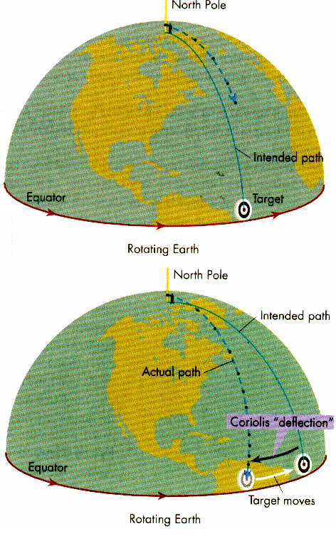
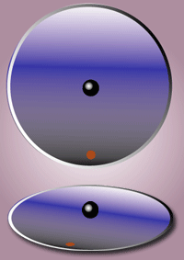
Coriolis Effect
Notes:
Difference of these two

Slide 7
Coriolis Force（地转偏向力）
Additional terms in momentum equations
x-momentum equation:
$−2Ω\sin{φ}v=−fv$
y-momentum equation:
$2Ω\sin{φ}u=fu$

Slide 8
Final Equations of Motion
$$\frac{∂u}{∂t}+u\frac{∂u}{∂x}+v\frac{∂u}{∂y}+w\frac{∂u}{∂z}−fv=−\frac{1}{ρ}\frac{∂p}{∂x}+\frac{∂}{∂x}\left(A_{H}\frac{∂u}{∂x}\right)+\frac{∂}{∂y}\left(A_{H}\frac{∂u}{∂y}\right)+\frac{∂}{∂z}\left(A_{V}\frac{∂u}{∂z}\right)$$
$$\frac{∂v}{∂t}+u\frac{∂v}{∂x}+v\frac{∂v}{∂y}+w\frac{∂v}{∂z}+fu=−\frac{1}{ρ}\frac{∂p}{∂y}+\frac{∂}{∂x}\left(A_{H}\frac{∂v}{∂x}\right)+\frac{∂}{∂y}\left(A_{H}\frac{∂v}{∂y}\right)+\frac{∂}{∂z}\left(A_{V}\frac{∂v}{∂z}\right)$$
$$\frac{∂w}{∂t}+u\frac{∂w}{∂x}+v\frac{∂w}{∂y}+w\frac{∂w}{∂z}=−\frac{1}{ρ}\frac{∂p}{∂z}−g+\frac{∂}{∂x}\left(A_{H}\frac{∂w}{∂x}\right)+\frac{∂}{∂y}\left(A_{H}\frac{∂w}{∂y}\right)+\frac{∂}{∂z}\left(A_{V}\frac{∂w}{∂z}\right)$$

Slide 9
Inertial Currents
If Coriolis is the only force, acceleration is always to the right of the motion. So the motion veers.
Equations are
Period $T=\frac{2π}{f}=12hr/sin⁡(φ)$
$$\frac{∂u}{∂t}=2Ωsinφv=fv$$
$$\frac{∂v}{∂t}=−2Ωsinφu=−fu$$
Notes:
(1) No APE; (2) KE = Const; (3) To the right: anticyclonic in the NH

Slide 10
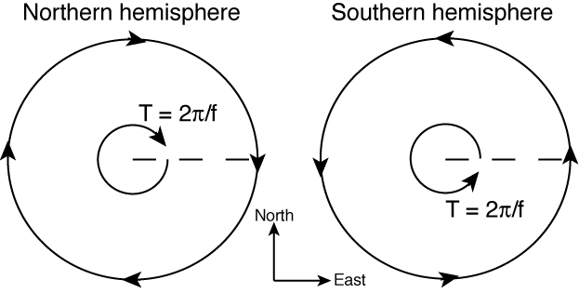
Inertial Currents (Inertial Circle)（惯性流）
Balance of Coriolis and acceleration terms

Slide 11
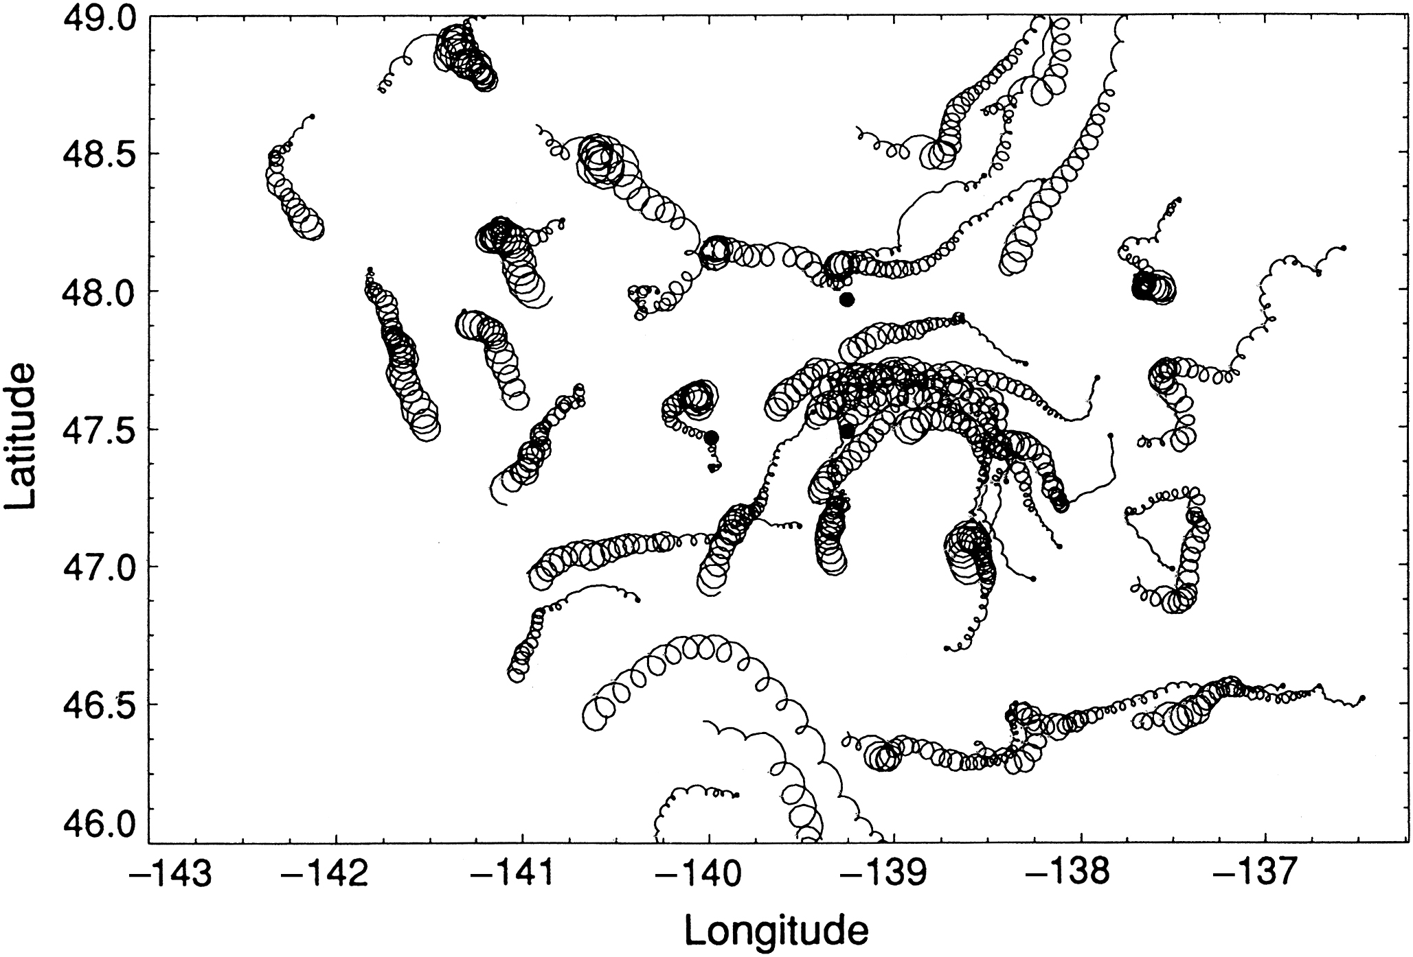
Inertial Currents: Observations
We see motion like this very frequently in moored current meter records - at the local "inertial period" which is $12hr/sin⁡(φ)$
What is the inertial period at different latitudes? (pole, 45°, 30 °, equator).

Slide 12
Final Equations of Motion
$$\frac{∂u}{∂t}+u\frac{∂u}{∂x}+v\frac{∂u}{∂y}+w\frac{∂u}{∂z}−fv=−\frac{1}{ρ}\frac{∂p}{∂x}+\frac{∂}{∂x}\left(A_{H}\frac{∂u}{∂x}\right)+\frac{∂}{∂y}\left(A_{H}\frac{∂u}{∂y}\right)+\frac{∂}{∂z}\left(A_{V}\frac{∂u}{∂z}\right)$$
$$\frac{∂v}{∂t}+u\frac{∂v}{∂x}+v\frac{∂v}{∂y}+w\frac{∂v}{∂z}+fu=−\frac{1}{ρ}\frac{∂p}{∂y}+\frac{∂}{∂x}\left(A_{H}\frac{∂v}{∂x}\right)+\frac{∂}{∂y}\left(A_{H}\frac{∂v}{∂y}\right)+\frac{∂}{∂z}\left(A_{V}\frac{∂v}{∂z}\right)$$

Slide 13
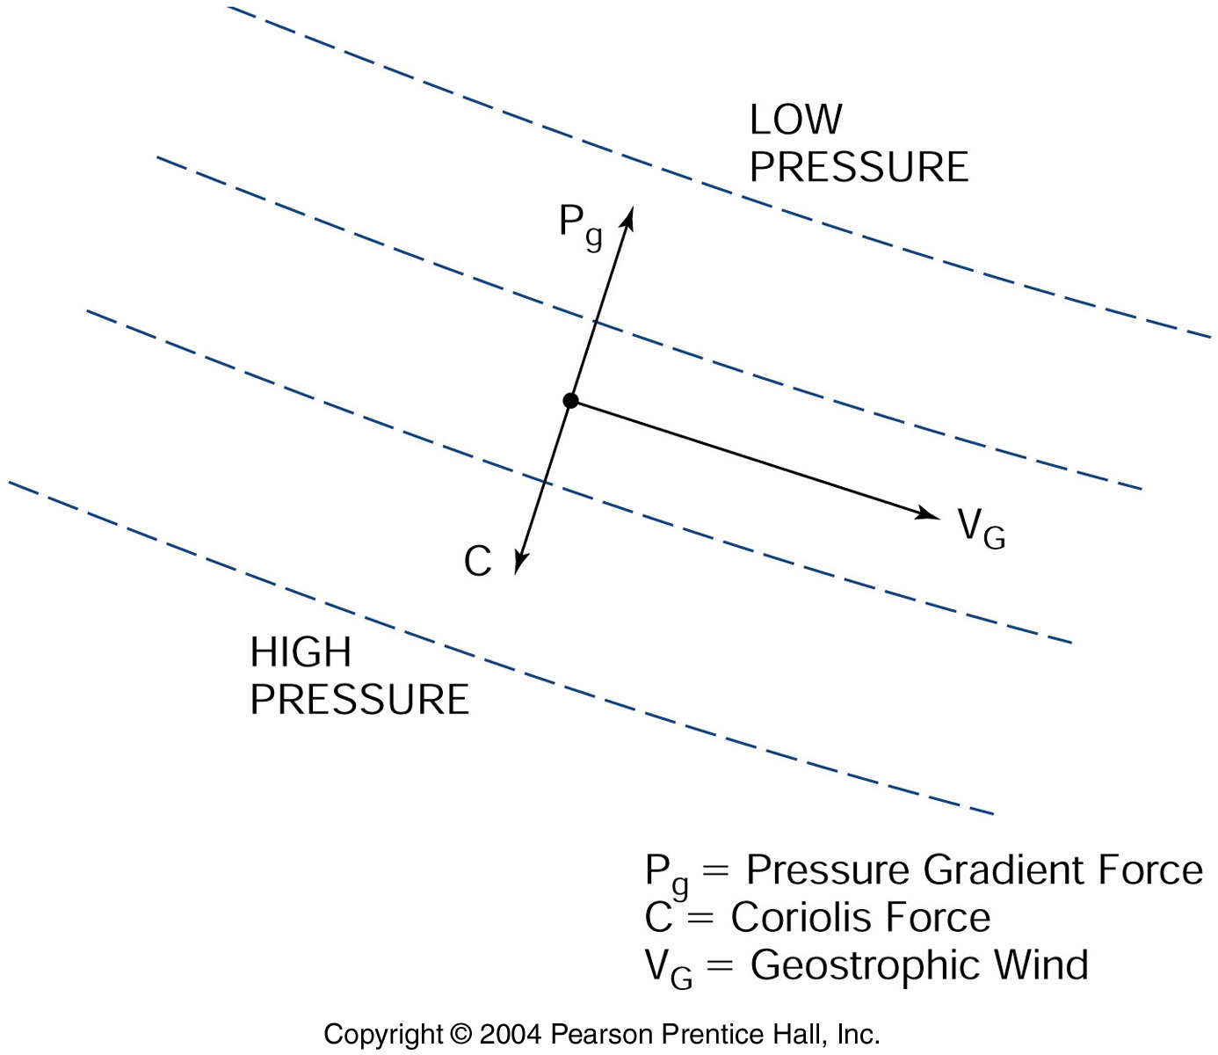
Geostrophic Flow: PGF Balanced by Coriolis Force

Slide 14
Side View

Slide 15
Geostrophic Balance
$$−fv=−\frac{1}{ρ}\frac{∂p}{∂x}$$
Geostrophic balance
Hydrostatic balance
$$+fu=−\frac{1}{ρ}\frac{∂p}{∂y}$$
$$0=−\frac{1}{ρ}\frac{∂p}{∂z}−g$$
Gulf Stream:
PGF acceleration =$g\frac{Δh}{Δx}={10}^{3}∙{10}^{2}/(100∙{10}^{5})={10}^{−2}cm/s^{2}$ to the west.
Coriolis force acceleration = $2Ω\left(\sin{45}\right)v=2∙\left(\frac{2π}{86400}\right)∙0.707∙100={10}^{−2}cm/s^{2}$ to the east.
They balance!

Slide 16
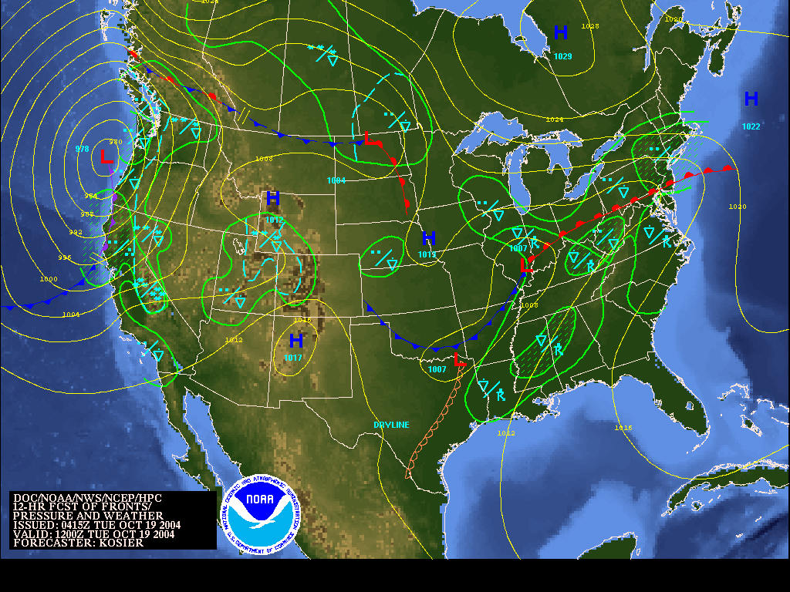
NWS daily weather map
cyclonic
anticyclonic
Notes:
On a weathermap around a high pressure center:
PGF is outward
If Coriolis force balances PGF, then CF is inward
Therefore the flow is clockwise around the high in the northern hemisphere. Meteorologists measure pressure at different locations, and then use the balance PGF = (2 omega sin latitude) speed to get the wind speed. This balance is called geostrophic flow. That is, they can interpret the pressure maps for the winds. This is why oceanographers also want to measure pressure, since the same holds in the ocean.

Slide 17
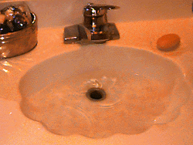
Misunderstanding of Coriolis Force
What about your bathroom sink? Or an equatorial entrepreneur? Can you see the Coriolis effect on the spiral of water?
NO NO NO NO, unless you have an extremely good laboratory!
Notes:
Story in the book “our affair with El Nino” by G. Philander

Slide 18
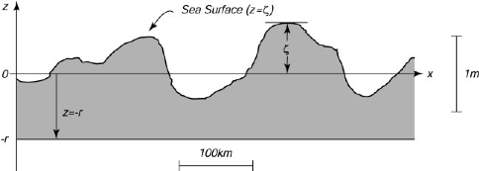
Geostrophic Currents from SSH Measurements
Notes:
But as we've seen before, oceanographers cannot usually measure pressure differences well enough to obtain the PGF that goes with geostrophic flow. Even with satellite altimeters that measure the sea surface height pretty well, the error is still several centimeters (with the limitation being the accuracy of the geoid). So oceanographers measure fluid density rho(x,y,z). They then use the hydrostatic balance to figure out the pressure at each depth, based on the mass of fluid above that depth. That is:
PGFone_depth - PGFanother_depth = (2 omega sin latitude)(speedone_depth - speedanother_depth)
That is, oceanographers use the mass of fluid to figure out the difference in PGF from one depth to another depth, and therefore get the speed at one depth relative to the speed at another depth.

Slide 19
Satellite Altimetry

Slide 20
Thermal Wind（热成风）
Geostrophic flow with vertical shear is often called baroclinic. Geostrophic flow without any vertical shear is often called barotropic. For barotropic flow, the density depends on depth only, and not on horizontal location.
The relation between the geostrophic velocity shear and the horizontal change (gradient) in density is called the thermal wind relation
Notes:
In practical calculations of geostrophic velocity, we must know the absolute pressure difference between two locations horizontally. If we have only the density distribution, we can calculate only the current at one level relative to that at another. To convert these relative currents into absolute currents, which are what we need, we must determine the absolute current or pressure gradient at some level (reference level). One apparently attractive option is to use satellite altimeters to obtain the sea surface height, which would give the pressure distribution and hence geostrophic currents at the sea surface. However, as noted in chapter 6, today's satellite altimeters are not accurate enough due primarily to a lack of detailed knowledge of the shape of the geoid.
A common method has been to assume that the absolute current is zero at some depth (level of no motion). Since currents are generally the strongest at the ocean surface it is useful to assume that the current at the deepest depth is near zero relative to the surface current. In the case of western boundary currents or in the Antarctic Circumpolar Current (ACC) where the currents extend to relatively great depths this is not a good assumption. Still even in these locations the relative geostrophic currents can reveal a lot. The selection of a reference velocity is one of the key problems in using the geostrophic method to compute currents. In the next subsection, we introduce the practical "dynamic" method used widely to calculate geostrophic velocities, and continue the discussion of reference velocity choices.

Slide 21
Thermal Wind
In the upper layers of the northern hemisphere the “light” water (the higher sea surface and hence greater pressure gradient) is on the right of the direction of geostrophic flow.
Mathematically, the thermal wind relations are derived from the geostrophic flow and the hydrostatic balance:
Boussinesq approximation, a constant density ρ_{o} is used in (g/ρ) here
$$−f\frac{∂v}{∂z}=−\frac{∂}{∂z}\left(\frac{1}{ρ}\frac{∂p}{∂x}\right)=\left(\frac{g}{ρ}\right)\frac{∂ρ}{∂x}$$
$$f\frac{∂u}{∂z}=\left(\frac{g}{ρ}\right)\frac{∂ρ}{∂y}$$
Notes:
In practical calculations of geostrophic velocity, we must know the absolute pressure difference between two locations horizontally. If we have only the density distribution, we can calculate only the current at one level relative to that at another. To convert these relative currents into absolute currents, which are what we need, we must determine the absolute current or pressure gradient at some level (reference level). One apparently attractive option is to use satellite altimeters to obtain the sea surface height, which would give the pressure distribution and hence geostrophic currents at the sea surface. However, as noted in chapter 6, today's satellite altimeters are not accurate enough due primarily to a lack of detailed knowledge of the shape of the geoid.
A common method has been to assume that the absolute current is zero at some depth (level of no motion). Since currents are generally the strongest at the ocean surface it is useful to assume that the current at the deepest depth is near zero relative to the surface current. In the case of western boundary currents or in the Antarctic Circumpolar Current (ACC) where the currents extend to relatively great depths this is not a good assumption. Still even in these locations the relative geostrophic currents can reveal a lot. The selection of a reference velocity is one of the key problems in using the geostrophic method to compute currents. In the next subsection, we introduce the practical "dynamic" method used widely to calculate geostrophic velocities, and continue the discussion of reference velocity choices.

Slide 22
Reference Level
If the velocity is known at one depth, then the shear can be used (integrated vertically) to give the velocity at all other depths. The assumed or measured velocity at one depth is called the reference velocity, and its depth is called the "reference depth" or reference level.
Notes:
Geopotential anomaly and dynamic height are closely-related practical functions whose horizontal gradients represent the horizontal pressure gradient force.

Slide 23
Geostrophic Flow Below the Sea Surface
h1
⊗
v1
h2
⊗
v2
h3
ρ_{A}
ρ_{B}
v3
⊗
Schematic of change in PGF with depth, left column (A) is shorter and denser than the right column (B), that is, $ρ_{A}>ρ_{B}$. The horizontal geostrophic velocity V is into the page for this direction of PGF and is strongest at the top, weakening with depth. (If the densities of the two columns were the same, then the PGF and velocity V are the same at all depths.)
Notes:
Farther down in the ocean, we have to consider both the total height of the pile of water above our observation depth and also its density (Fig. 8.20a). That is, the total mass of water above our observation depth is important, since the total mass determines the actual pressure at our observation depth. (This is where the vertical hydrostatic balance is important.) Therefore, if a mound of less dense water lies above us in one location and a shorter column of denser water in another location, the total mass in the two places could be the same. Close to the sea surface, there would be a pressure difference between the two places since the sea surface is higher in one location than in the other, but at depth the pressure difference would vanish because the difference in densities cancels the difference in heights. Therefore there would be a geostrophic flow at the sea surface, which would decrease with depth until it vanishes at our observation depth (h3 in Fig. 8.20a), where the total mass of the two columns of water is the same.

Slide 24
Geopotential
Geopotential is defined from hydrostatic balance
$$dΦ≡gdz=−αdp$$
Where $α$ is specific volume. Units of $Φ$: m²/sec² or J/kg.
Notes:
Geopotential anomaly and dynamic height are closely-related practical functions whose horizontal gradients represent the horizontal pressure gradient force.

Slide 25
Geopotential Height
For two isobaric surfaces $p_{2}$ (upper) and $p_{1}$(lower), the geopotential is
$$Φ=g\int{dz=g\left(z_{2}−z_{1}\right)=−\int{αdp}}$$
Geopotential height is defined as
$$Z={(9.8)}^{−1}\int{gdz}=−{(9.8)}^{−1}\int{αdp}$$
Notes:
Geopotential anomaly and dynamic height are closely-related practical functions whose horizontal gradients represent the horizontal pressure gradient force.

Slide 26
Geopotential Height Anomalies
Most practical calculations, use the specific volume anomaly
$δ=α\left(S, T, p\right)−α\left(35, 0, p\right)$
to compute the geopotential anomaly
$$ΔΦ=−\int{δdp}$$
The geopotential height anomaly is then defined as
$$Z^{′}=−{(9.8)}^{−1}\int{δdp}$$

Slide 27
Steric (比容) Height Anomaly
Geopotential height anomaly is effectively identical to steric height anomaly (Gill and Niiler, 1973)
$$h^{′}=−(1/ρ_{0})\int{ρ′dz}$$
Density anomaly $ρ^{′}=ρ−ρ_{0}$ .

Slide 28
Steric (比容) Height Anomaly
Using hydrostatic balance and defining ρ_{o} as ρ(35,0,p)
$$h^{′}=\int{δρdz}$$
$$h^{′}=\frac{1}{g}\int{δdp}$$
Nearly identical to the geopotential height anomaly Z’, differing only in the appearance of a standard quantity for g.

Slide 29
Dynamic Height（动力高度）
Dynamic height D is closely related to geopotential Φ, differing only in sign and units. In fact many modern publications and common computer subroutines do not distinguish between dynamic height and geopotential anomaly. The traditional unit is the dynamic meter (m²/s²):

Slide 30
Dynamic Height
Dynamic height anomaly is related to geopotential anomaly
$∆D=−\frac{∆Φ}{10}=−\int{\frac{δdp}{10}}$
Its relation to the geopotential height and steric height anomalies is
$$10∆D=9.8Z^{′}=gh′$$
The quantities $∆D$and $Z′$ are often used interchangeably, differing only by 2%. The geopotential height anomaly more closely reflects the actual height variation, so a variation of 1 dyn m would be an actual height variation closer to 1.02 m

Slide 31
Geostrophic Velocities
Geostrophic velocities are calculated from geopotential anomalies, steric height anomalies or dynamic heights, combined with hydrostatic balance. They are
$f\left(v_{2}−v_{1}\right)=10\frac{∂∆D}{∂x}=−\frac{∂∆Φ}{∂x}$
$f\left(u_{2}−u_{1}\right)=−10\frac{∂∆D}{∂y}=\frac{∂∆Φ}{∂y}$
where the dynamic height or geopotential anomalies are integrated vertically from $p_{1}$ to $p_{2}$. The surface $p_{1}$ is the reference level
Notes:
For practical reasons, the level has often been chosen as the maximum common depth of the observations under the assumption that deeper currents are weak relative to the surface and near-surface currents. Values of 500, 1,000, 1,500, 2,000, or 3,000 m have frequently been used. While there are usually currents at these depths, they are generally small, yielding reasonable surface and upper ocean velocities relative to the assumption of no motion at the deeper depth.

Slide 32
Geostrophic Velocities
How is the velocity at the reference level chosen? A common practice is to arbitrarily assume that there is no flow at some deep level (a "level of no motion").
Notes:
For practical reasons, the level has often been chosen as the maximum common depth of the observations under the assumption that deeper currents are weak relative to the surface and near-surface currents. Values of 500, 1,000, 1,500, 2,000, or 3,000 m have frequently been used. While there are usually currents at these depths, they are generally small, yielding reasonable surface and upper ocean velocities relative to the assumption of no motion at the deeper depth.

Slide 33
Example of a section across the Gulf Stream:
Measure temperature and salinity and compute the density. Across the Gulf Stream, we see isopycnals plunging hundreds of meters from on to offshore (towards the east if looking at an east-west section).
As one guess, assume there is no flow at some depth, which means that the PGF = 0 at that depth. This was common practice until about 20 years ago, and the depth assumed with no flow was called the "level of no motion". (In reality, there is almost never such a level, but this is a convenient step for teaching how to compute relative speeds.)
Go upward from that level where PGF = 0 on the west side, which is the cold, dense side and calculate how the pressure decreases as you go up. Then go upward from the PGF=0 level on the east side, which is warm and less dense and calculate the pressure decrease. The pressure will decrease faster on the cold, dense side since the water is heavier and more is subtracted at each step.

Slide 34
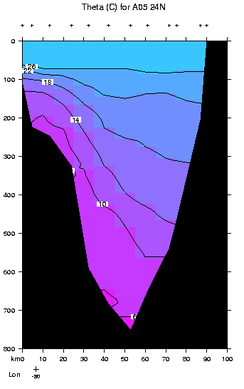
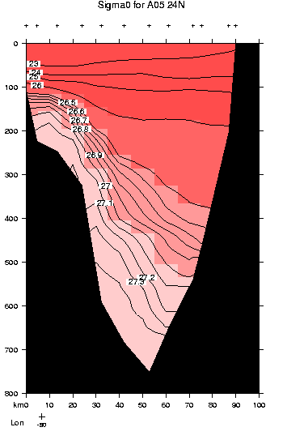
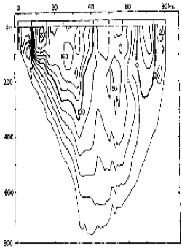
Gulf Stream vertical sections in Florida Strait (west on left)
Roemmich, 1983

Slide 35
Example of a section across the Gulf Stream:
Therefore at a higher level, the nearshore (cold, dense) P < offshore (warm, light) P. Therefore the PGF is westward at all of these higher levels, above the PGF = 0.
If the flow is geostrophic, which we assert, the Coriolis force is eastward. Therefore the flow is northward.
Since the Pressure gradient persists to the very surface, the surface itself must slope upward from west to east so that the pressure is higher offshore. If in fact we could measure the sea surface height relative to the geoid, this is what we would find (and which is found in various interpretations of satellite altimetry data).
Caveat: we don't really know what the PGF is at a given depth; we just assumed PGF = 0 at some depth since we expect from other observations that the flow is much weaker at depth than at the surface in the Gulf Stream. All that we actually know from measuring the density is the relative flow at one depth compared with another - that is, we know the geostrophic velocity shear and not the absolute geostrophic flow.

Slide 36
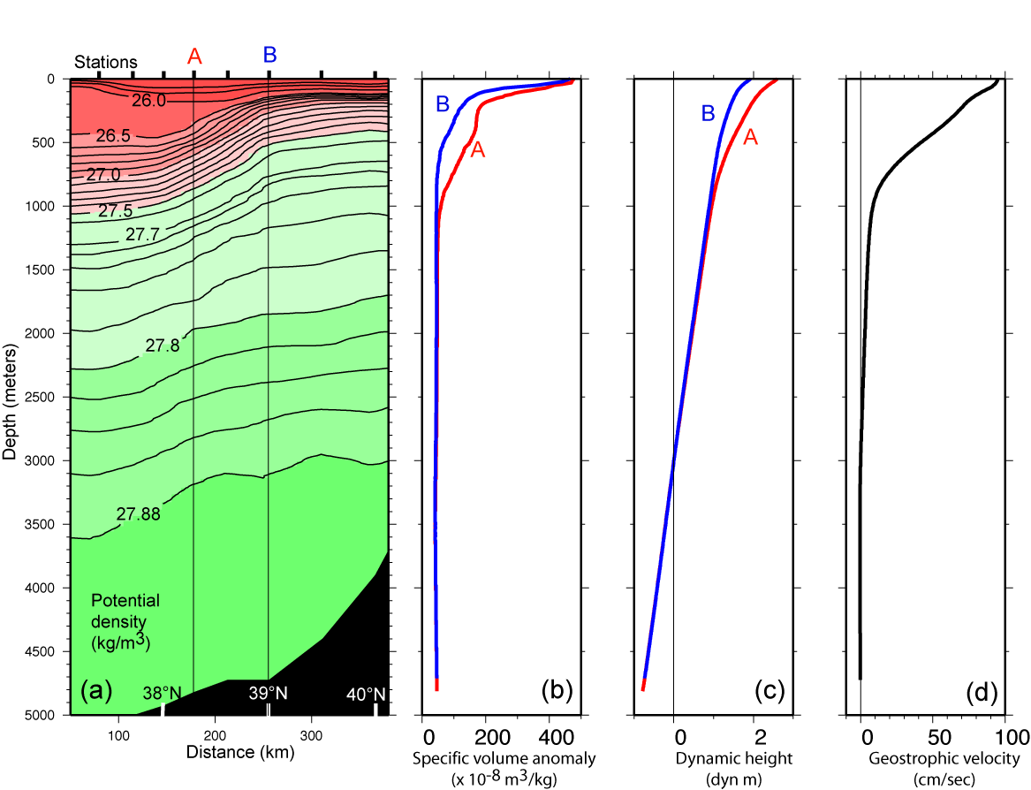
Gulf Stream density, dynamic height and geostrophic velocity

Slide 37
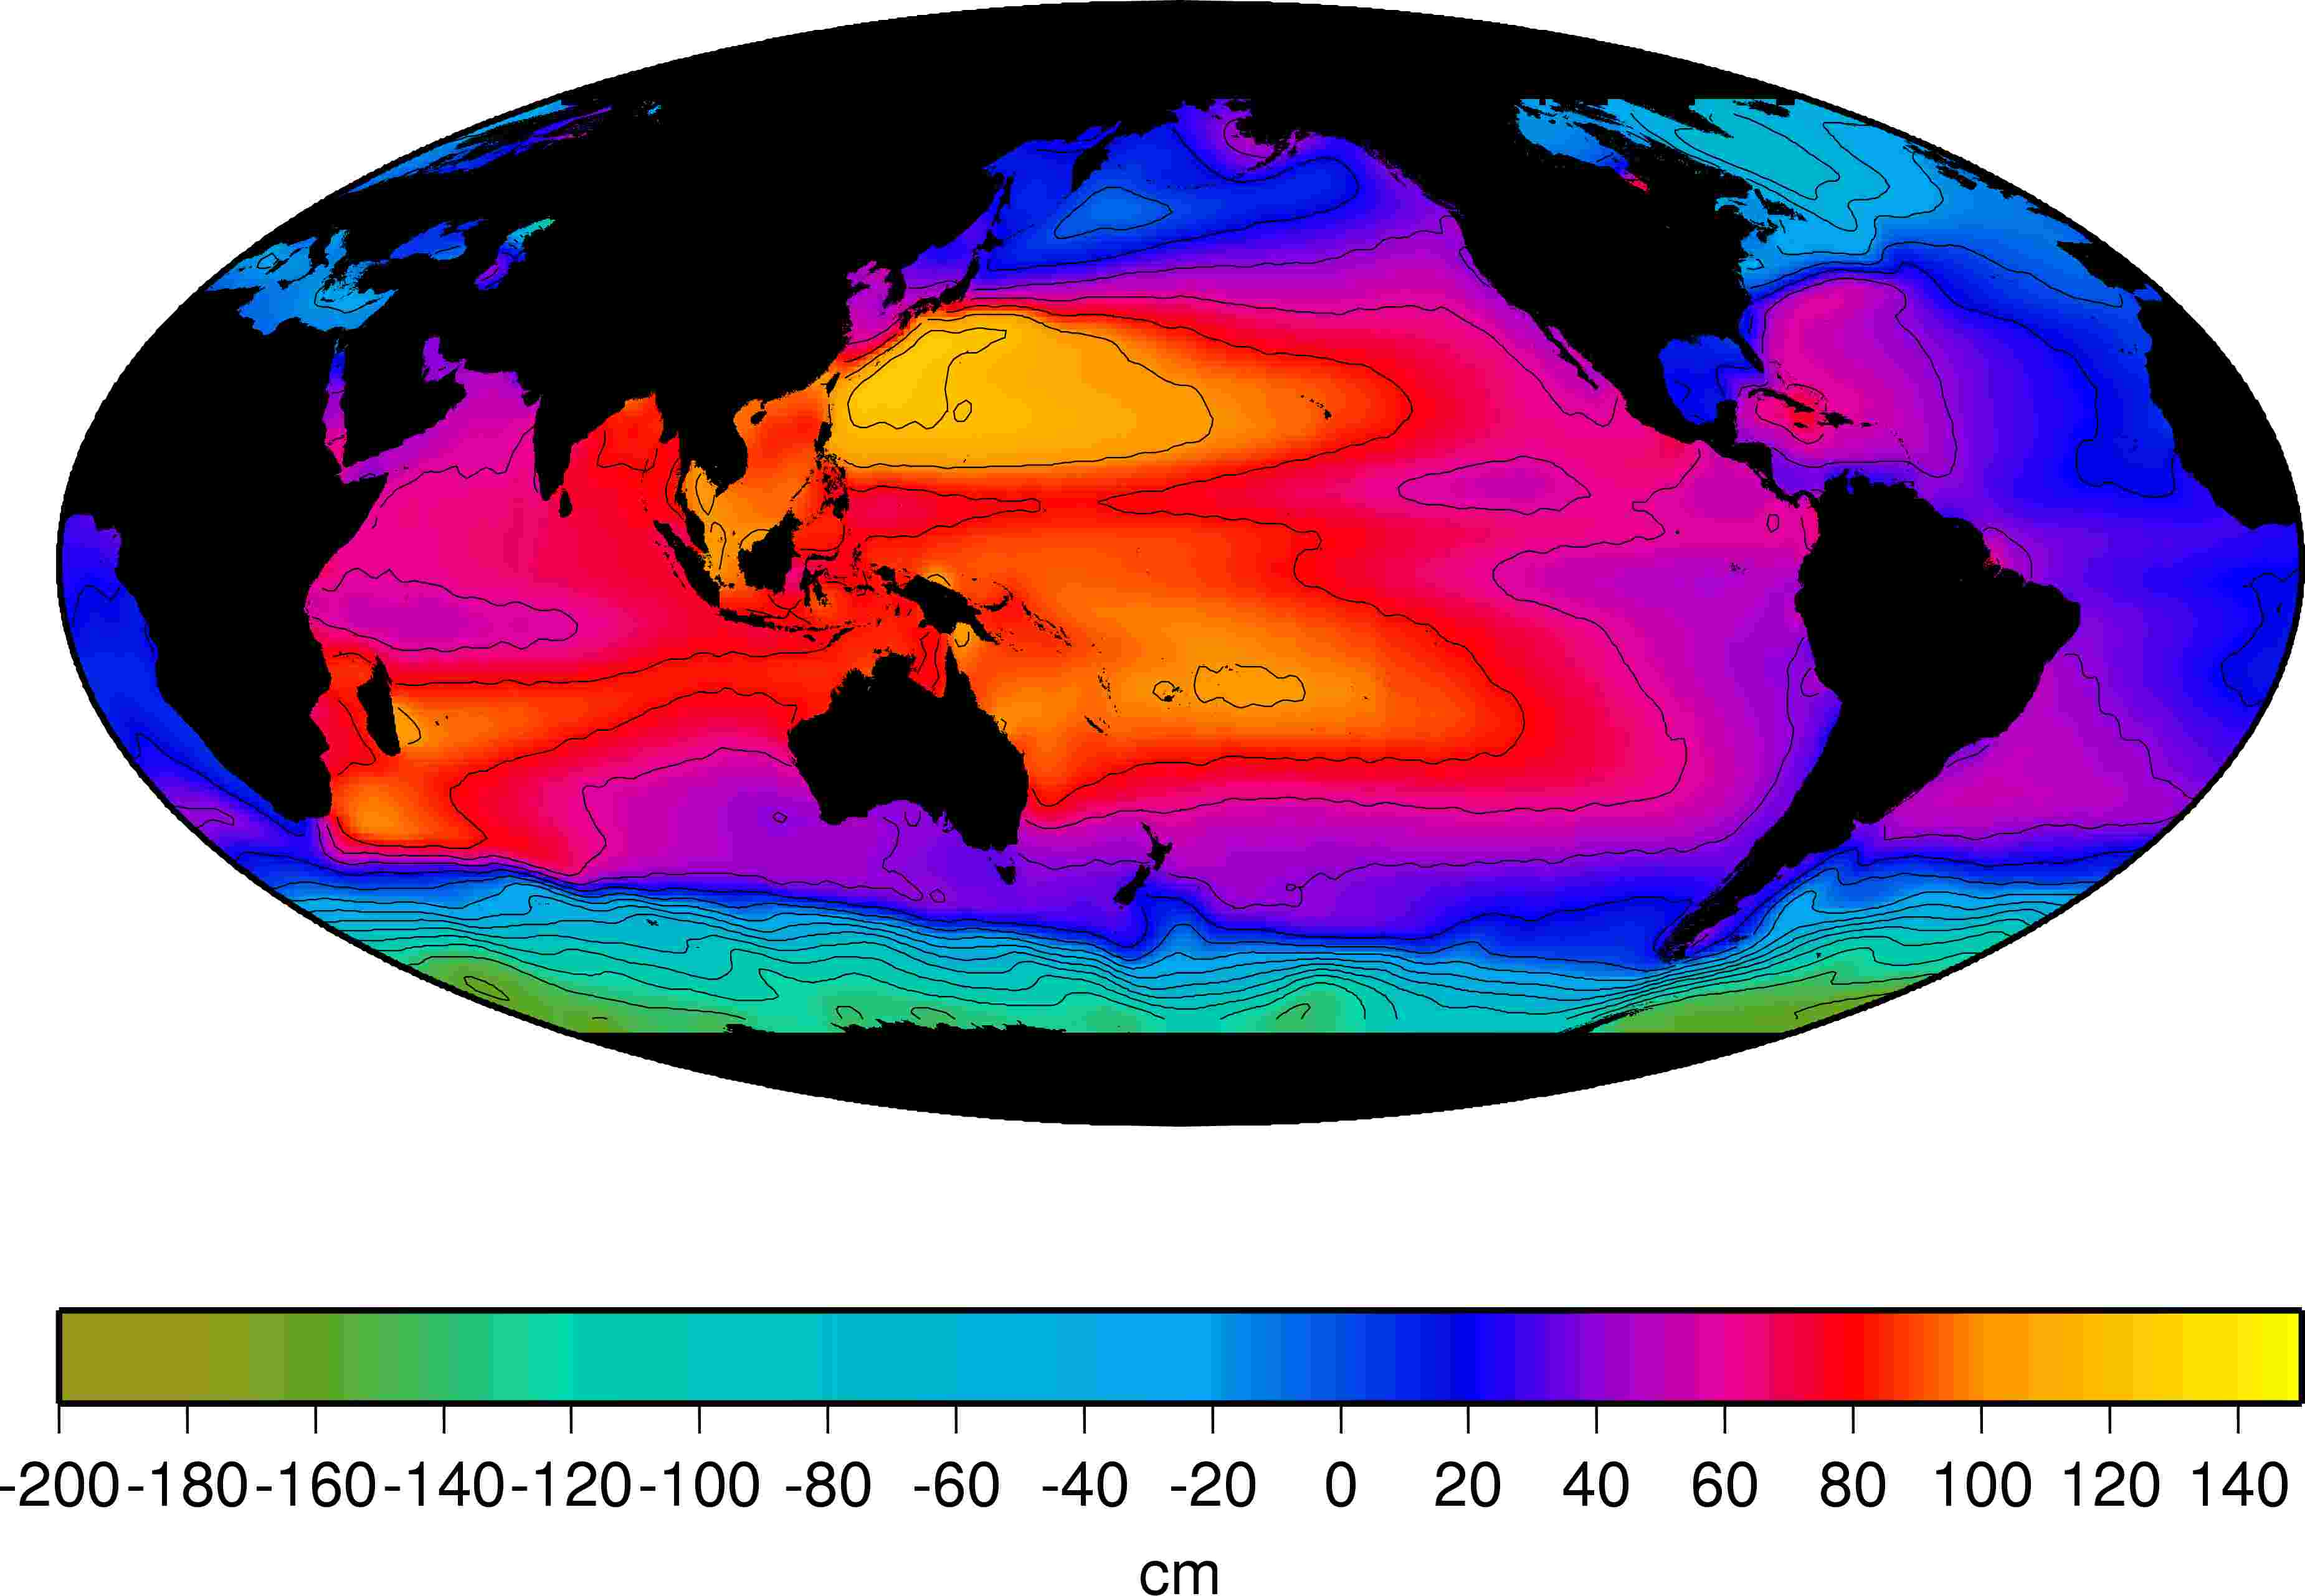
Pacific Steric Height at Sea Surface (Reid, 1998)

Slide 38
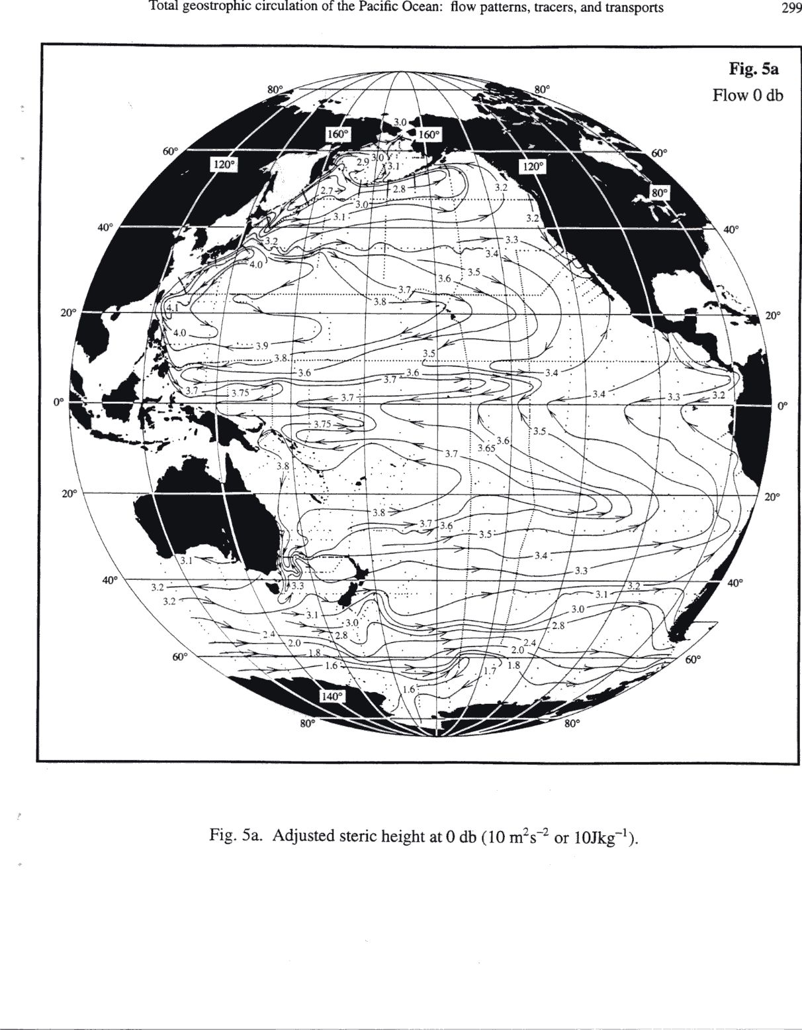
Dynamic Height (meter)

Slide 39
Questions (Due in 2-week)
Work out the period of inertial oscillations at the north pole, 30N, equator, and south pole.
In geostrophic flow, what direction is the Coriolis force in relation to the pressure gradient force? What direction is it in relation to the velocity?
Why do we use a method based on temperature and salinity instead of direct current measurements for most of the ocean?

Slide 40
Questions
What is a "level of no motion"? Why would a "level of known motion" be a better choice for the same kind of calculation? (What can we actually compute about the velocity structure given the density distribution and an assumption of geostrophy?)
The southern hemisphere also has strong boundary currents, like the Gulf Stream and Kuroshio. Off the eastern coast of Africa for instance is the Agulhas Current. The Agulhas Current flows along the coast from north to south (opposite direction to the Gulf Stream). What is the relative pressure onshore and offshore? What do the isopycnals look like in the Agulhas assuming it has the exact same vertical structure as the Gulf Stream (i.e. decreasing velocity with increasing depth)

Slide 41
Calculations
U
PGF
Contour unit: Dynamic Meter
Compute the pressure gradient force associated with the Antarctic Circumpolar Current at the sea surface. What speed do you get for this PGF? Which direction is the PGF and which direction is the flow? (f < 0 for SH)
What is the volume transport in m³ /sec of a current with velocity 10 cm/sec over a width of 200 km and a depth of 5000m?
What dynamic height difference over a width of 100 km is associated with a current speed of 100 cm/sec?

Slide 42
Learning about the Ocean, the Climate and the Nature

