Slide 1
Lecture 9: Dynamics of Ekman Layer Descriptive Physical Oceanography
杨海军（YANG Haijun）复旦大学大气与海洋科学系
Department of Atmospheric and Oceanic Sciences, Fudan University
Email: yanghj@fudan.edu.cn
This powerpoint was prepared for purposes of this lecture and course only. It contains graphics from copyrighted books, journals and other products. Please do not use without acknowledgment of these sources.

Slide 2
Reading:
Emery, Talley and Pickard: Chapter 8.4.3 to 8.4.5
Stewart chapter 9.2,9.3, 9.5
Tomczak and Godfrey chapter 4, pages 39-42
Concepts:
Ekman layer
Ekman transport
Ekman velocity
Ekman pumping

Slide 3
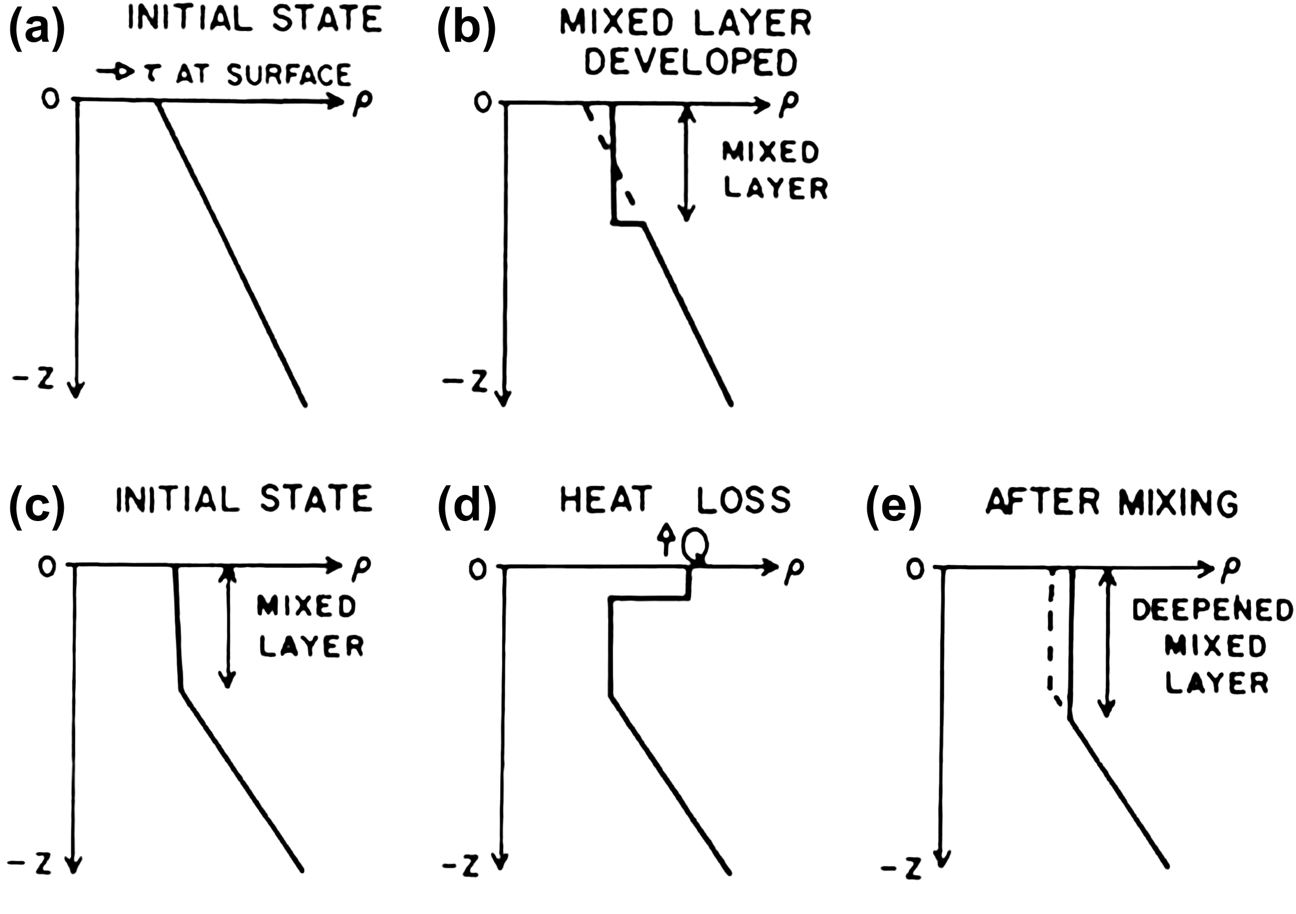
Surface mixed layer: buoyancy and turbulent mixing effects
Mixing by turbulence only
Mixing by heat loss: overturn (convect)
Development of mixed layer depends on turbulence input (wind velocity), heat loss or gain (also salt), and pre-existing stratification
Notes:
The surface mixed layer (section 4.2.2) is a special region for mixing because of the direct forcing from the atmosphere. The “mixed-layer” is seldom completely mixed, so it is sometimes difficult to define. However, we can consider it generally to be the upper boundary layer of the ocean, forced directly by the atmosphere through: (1) surface stress of the wind and (2) buoyancy (heat and freshwater) exchange through the surface. Wind stress generates motion, which is maximum at the surface and decreases with depth, i.e. with vertical shear in the velocity. When the shear is sufficiently large, turbulence develops and mixes the upper layer, creating a substantially uniform density or mixed layer (Fig. 8.4b). The surface stress also causes waves that add turbulent energy to increase mixing, particularly if they break. In addition, Langmuir circulations (Section 8.4.2) can promote mixing, possibly through the full depth of the mixed layer

Slide 4
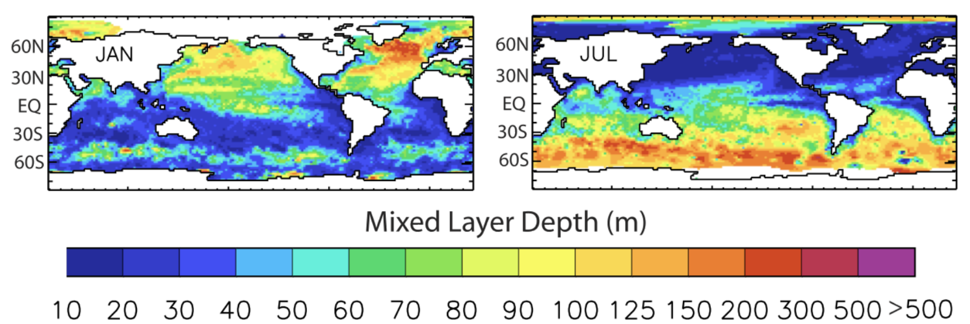
Surface mixed layer: observed mixed layer depth
There is a large seasonal variation in mixed layer depths, with the thickest mixed layers occurring at the end of winter, after an accumulation of months of cooling that deepens the mixed layer. It is usually the end-of-winter mixed layer that matters the most, since it creates the highest densities and brings surface properties down to the greatest depths. common criterion is a density difference of 0.125 σ_{θ}.
_{Talley (2009)}
Notes:
Kara et al. (2003)

Slide 5
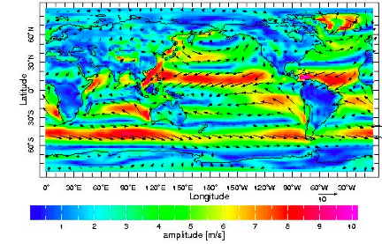
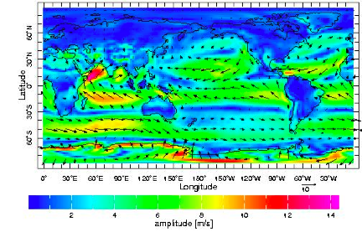
Wind Forcing
Wind velocity vectors (arrows) and zonal wind speed (color), (QSCAT: 2000—2004). (a) Winter (DJF), (b) Summer (JJA).
Notes:
The wind-driven circulation is principally in the upper half of the ocean and is primarily horizontal. The wind blows over the sea surface, exerting stress and causing the water to move within the top 50 meters or so. Flow in this surface layer converges or diverges and forces the much thicker ocean below through changes in vorticity (section 8.6).
The transfer of momentum from the atmosphere to the ocean requires a number of mechanisms, not all of which are clearly understood. Initially the wind excites small capillary waves that propagate in the direction of the wind. Continued wind driven momentum exchange excites a range of surface waves, which then disperse according to their frequency, interact nonlinearly, and create what is known as a “fully developed sea.” As the wind momentum continues to be transferred from the air to the sea, planetary (rotational) processes become involved.
At the same time, the large-scale net effect of this input of atmospheric momentum represents a balance between the Coriolis force and the wind momentum exchange (wind stress) with the ocean. Here we treat this as a consequence of fluid friction, i.e. the air/water frictional stress from the wind acts on the sea surface to cause it to move horizontally, and the communication of this motion downward through the sea by friction causes deeper layers to move in turn. The consequences are on two scales. In the vertical, the direct effect of the wind stress extends through the upper fifty to one hundred meters, discussed in this section. In the horizontal, the basin-scale circulation is an indirect consequence of the upper layer's response to the wind stress, through effects on vorticity (sections 8.6 and 8.7).
This text is concerned primarily with the large-scale circulation and its forcing. The components of the buoyancy fluxes that affect the large-scale ocean properties were presented earlier in chapter 5 on heat and salt budgets. We have not thus far presented the observed wind field. Prior to discussing the processes by which wind stress is conveyed to the ocean, we present these large-scale fields (Fig. 8.9).
The largest scale wind patterns are: easterly trade winds in the tropics and westerly winds poleward of 30° latitude in both hemispheres. In the summer hemispheres in the tropics, the summer monsoon with winds blowing from the ocean to the continent is apparent in all three ocean basins, but is most pronounced in the northwestern Indian Ocean. The opposing monsoon is also evident in the winter hemispheres (DJF in the northern and JJA in the southern hemisphere). In the northern hemisphere winter, the westerly winds are strongly developed around low pressure centers in the North Pacific (Aleutian Low) and North Atlantic (Iceland Low). In the southern hemisphere winter, strong southerlies are apparent around the Antarctic; these are the wintertime catabatic winds. Similar winds are apparent off the Greenland ice cap in northern hemisphere winter.

Slide 6
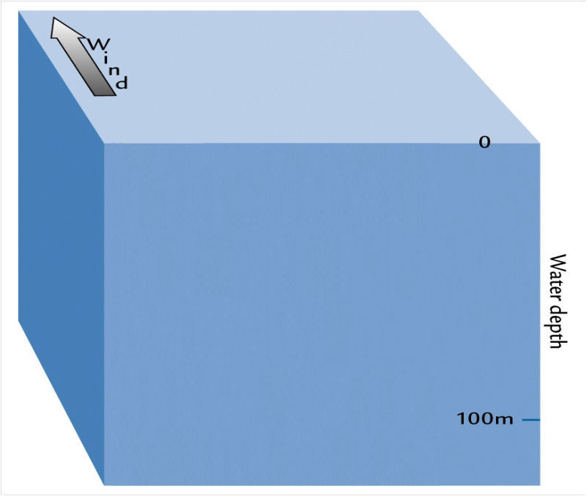
Wind Driven Ekman Layer
Notes:
Why? First of all, because the ocean water, like the wind, is affected by the coriolis force.

Slide 7
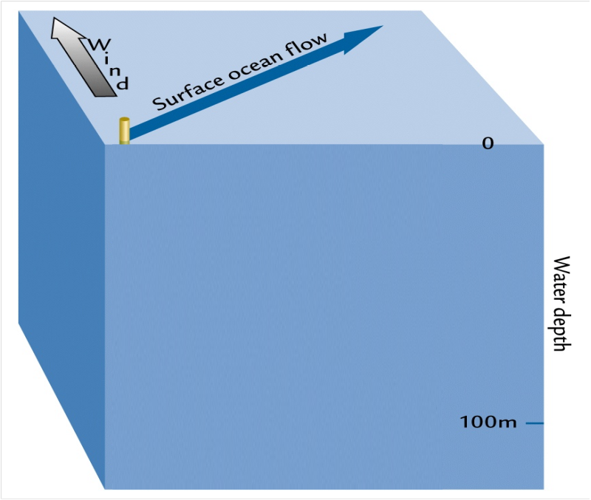
Wind Driven Ekman Layer
Notes:
If the wind tries to push the surface water north, it will actually flow somewhat to the east.

Slide 8
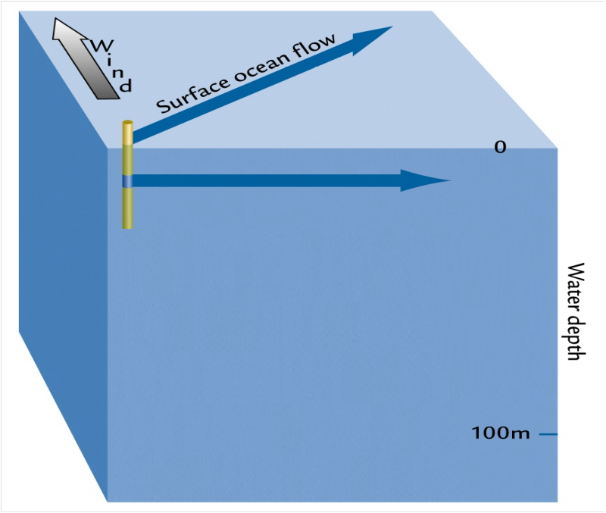
Wind Driven Ekman Layer
Notes:
Because the water below the surface is only moving due to the force of water above it, the water somewhat below the surface will flow in a direction slightly more to the right.

Slide 9
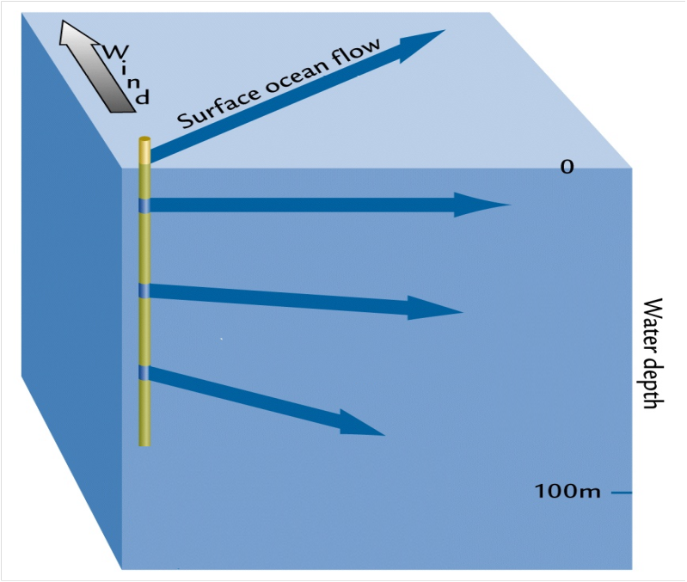
Wind Driven Ekman Layer
Notes:
This process continues to add up as depth increases, resulting in a continuing spiral of flow referred to as an Ekman spiral.

Slide 10
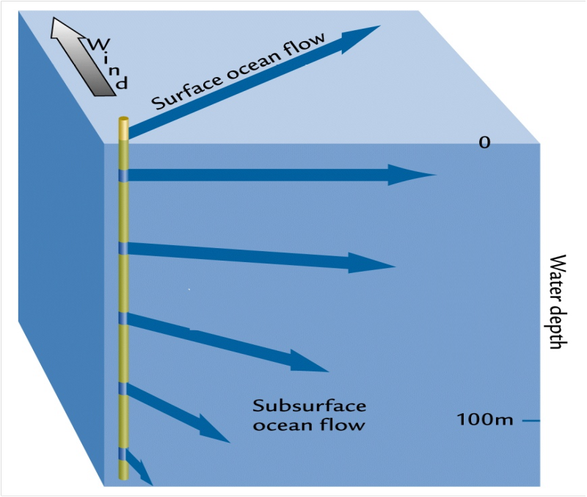
Wind Driven Ekman Layer
Notes:
If the surface 100 m or so of the ocean were not well mixed, flow at 100 m depth would be nearly 180 degrees away from the direction the wind is blowing.

Slide 11
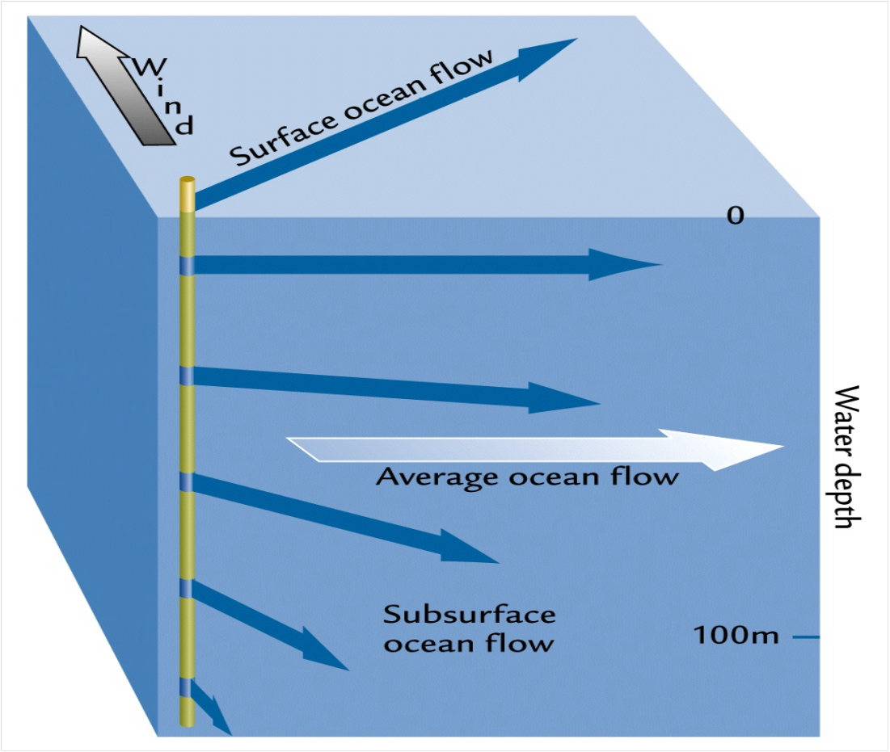
Wind Driven Ekman Layer
Notes:
In reality, we can think of all of this water traveling more-or-less as a unit, but the net water direction is very close to 90 degrees off of the prevailing wind direction.

Slide 12
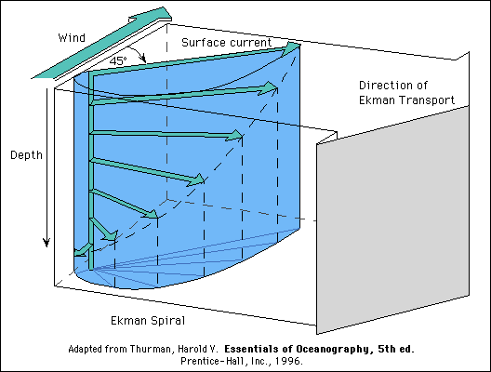
Ekman Layer
This wind-driven frictional layer is called the "Ekman layer", after Walfrid Ekman (1905).
The dynamics: friction + Coriolis acceleration.
The simplest Ekman layer theory assumes a constant vertical eddy viscosity and a homogeneous ocean. There is no pressure gradient force, and acceleration and advection are not included in the most straightforward applications of the theory.
The Ekman response is strongest at the sea surface and decays exponentially downward, disappearing at about 50 meters depth (where the Ekman current is directed oppositely to the Ekman surface current). Therefore, for the open ocean, the wind-driven Ekman layer is unaffected by the ocean bottom.

Slide 13
Ekman Layer Depth
Ekman layer depth is defined in the e-folding depth of the decaying velocity:
$$D_{E}={(2A_{v}/f)}^{1/2}$$
This depth depends on the vertical eddy viscosity Av and latitude φ. Eddy viscosity in the surface mixed layer is 100 to 1,000 times greater than in the interior of the ocean.
From direct observations of Ekman response, $A_{v}=0.01 to 0.05 m^{2}/s$ is a reasonable range for eddy viscosity in the top 20 to 30 m. Using 0.05 m²/sec, the Ekman layer depths at latitudes 10°, 45° and 80° are 63, 31, and 26 m respectively.

Slide 14
Ekman Transport
“Ekman transport” is the vertically summed velocity in the Ekman layer:
${U_{E}=\int{u_{E}\left(z\right)dz; }V}_{E}=\int{v_{E}\left(z\right)dz; }$ Unit: m²/sec.
Ekman transport in terms of the wind stress
$U_{E}=\frac{τ\left(y\right)}{ρf};V_{E}=−\frac{τ\left(x\right)}{ρf}.$
Where $τ\left(x\right)$ and $τ\left(y\right)$ are the wind stresses The transport is to the right of the wind in the northern hemisphere, where the Coriolis parameter f is positive. The Ekman transport is exactly perpendicular to the direction of the wind. The transport and its direction depend only on wind stress and latitude; they are completely independent of eddy viscosity.
Typical size: for wind stress $0.1N/m^{2}$, $U_{E}=1m^{2}/s$. Integrate over width of ocean, say 5000 km, get total transport of $5×{10}^{6} m^{3}/s=5Sv$.

Slide 15
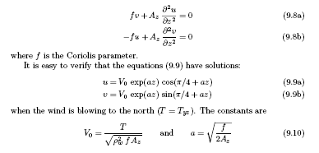
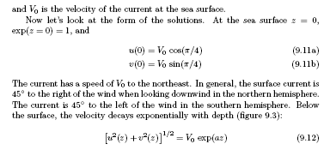
Ekman Velocity

Slide 16
Surface Velocity
For eddy viscosity $A_{v}=0.05 m^{2}/s$,
and wind stress $τ=0.1 N/m^{2}$,
$V_{0}=τ/{(ρ^{2}fA_{v})}^{1/2}≈3cm/s$, at 45ºN

Slide 17
Observations of Ekman layer
Direct current measurements in California Current region revealed excellent Ekman-type spiral (Chereskin, JGR, 1995)
Notes:
Data showing an Ekman-like response in the California Current region (Chereskin, 1995). (a) Progressive vector diagrams (section 7.6.3) at 8 meters, 16 m, 24 m, 32 m and 40 m depth. Because of the way the ADCP measures, the currents are shown relative to a deeper depth, rather than as absolute currents. The wind direction and speed for each day is shown by the small arrows on the 8 m progressive vector curve. (b) Observed mean velocities (left) and two theoretical Ekman spirals (offset) using different eddy diffusivities (274 and 1011 cm2/s). The numbers on the arrows are depths. The large arrow is the mean wind.
For instance, one assumption, that the eddy viscosity in the water column is constant with depth, is probably not true. Eddy viscosity is highest in the upper layers (because of the wind waves generated at the surface and the resulting turbulence) and decreases with depth (as the effect of the waves diminishes). Also, it was assumed that the wind is constant in time, which is rarely the case except approximately in the trade wind regions. The speed with which the Ekman circulation develops depends on latitude, because the Coriolis force depends on latitude. Observations of Ekman spirals and Ekman response are difficult because of the time dependence of the wind. The changing wind causes an inertial response. It takes about one pendulum day for inertial and Langmuir responses to die out and an essentially Ekman circulation to develop.
Ekman layer observations are also difficult because the spiral is thin compared with the usual vertical resolution of current measurements, and because eddy diffusivity is not constant, but is instead very large at the surface because of wind-driven turbulence there, decaying rapidly with depth. Davis et al. (1981) measured currents in the mixed layer in the northeast Pacific. By filtering the data and looking at responses at short and long time scales, they found that the currents at time scales of longer than about 1 day looked like Ekman's theory. Chereskin (1995) measured currents in the mixed layer in the California Current using an Acoustic Doppler Current Profiler (section 6.5.5.1). Because the wind direction there was relatively steady, the Ekman-like response was clear (Fig. 8.15) even without filtering the data. To match an Ekman spiral shape, she found that the eddy diffusivities must be very large at the surface (about 1,000 x 10-4 m2/sec), decaying to about 200 x 10-4 m2/sec at about 30 meters. (In contrast, eddy diffusivities below the surface mixed layer are 0.1 to 1 x 10-4 m2/sec.)

Slide 18
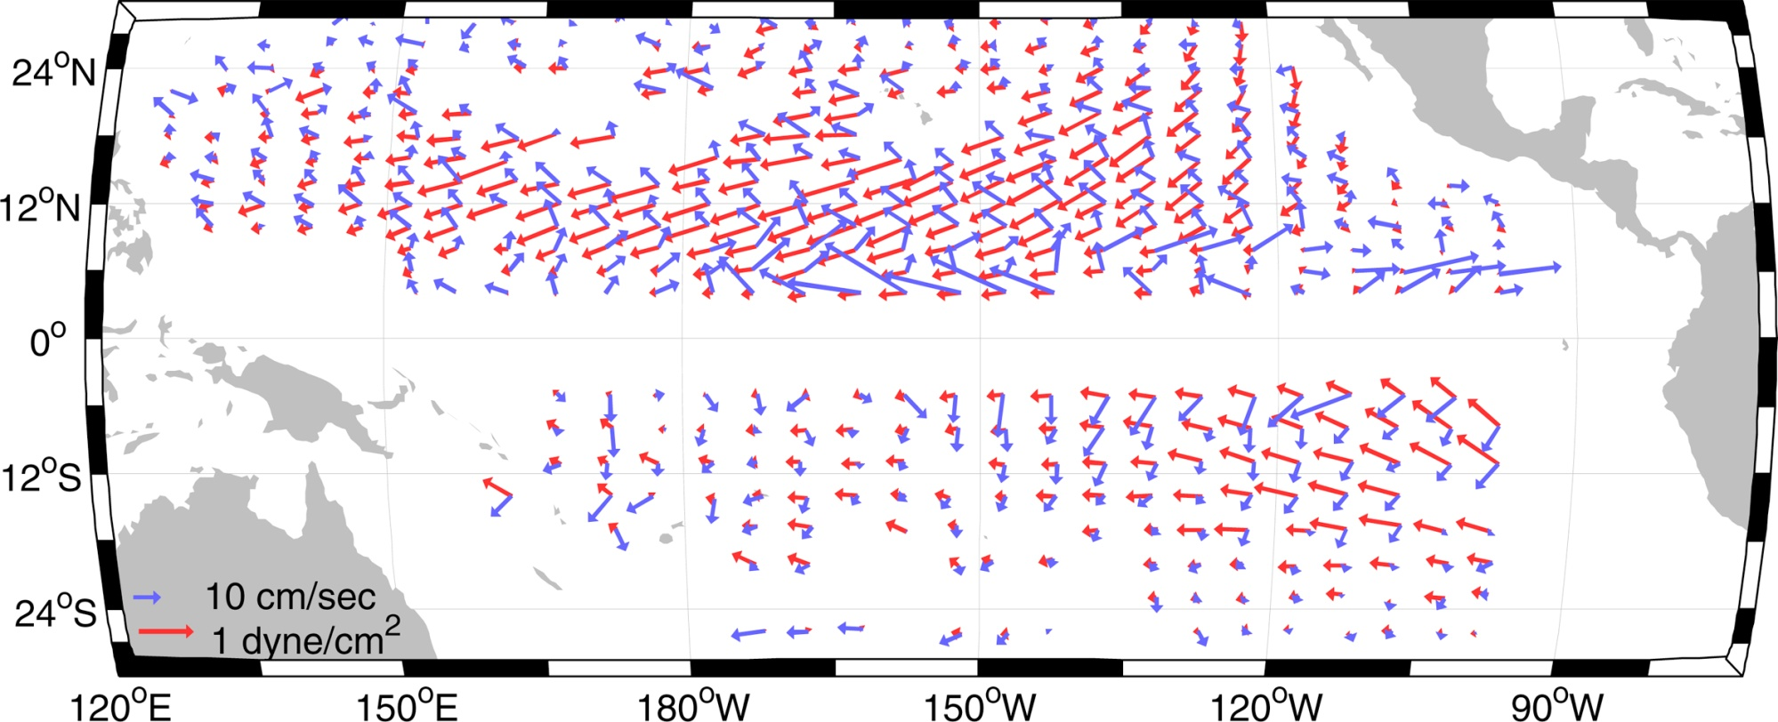
Basinwide demonstration of Ekman balance using surface drifters (Ralph and Niiler, 1999)
Ekman response. Average wind vectors (red) and average ageostrophic current at 15 m depth (blue). The current is calculated from 7 years of surface drifters drogued at 15 m, with the geostrophic current based on average density data from Levitus et al. (1994a) removed. (No arrows were plotted within 5 degrees of the equator because the Coriolis force is small there.) This figure can also be found in the color insert. ©American Meteorological Society. Reprinted with permission. Source: From Ralph and Niiler (1999).
Notes:
Fig. 8.16 Average wind vectors (blue) and average ageostrophic current at 15 meters depth (red) from Ralph and Niiler (1999). The current is calculated from 7 years of surface drifters drogued at 15 meters, with the geostrophic current based on average density data from Levitus (1994) removed. (No arrows were plotted within 5° of the equator because the Coriolis force is small there.)
Confirmation of an Ekman response for a large part of the Pacific Ocean came from the surface drifter program of the 1980s and 1990s. The surface drifters had drogues at 15 meters depth, so well within the Ekman layer. An early publication showed the relation of a few drifter tracks to the wind (McNally et al. 1983). Once there were many years of drifter data, Ralph and Niiler (2000) averaged them and removed the average geostrophic velocity based on the averaged ocean-wide density distribution (next section). They plotted the average 15-meter "ageostrophic" (that is, not geostrophic) current vector and the mean wind vector (Figure 8.16), to show that the 15-meter current is angled to the right of the wind in the northern hemisphere and to the left of the wind in the southern hemisphere

Slide 19
Ekman transport convergence and divergence
The divergence of the Ekman transport is
$${∇∙U}_{E}={∂U_{E}}/{∂x}+{∂V_{E}}/{∂y}$$
$U_{E}$is the vector transport. ${∇∙U}_{E}<0$ ➔ convergent ➔ downwelling. ${∇∙U}_{E}>0$➔ divergent ➔ upwelling.
Relates to the wind stress:
$${∇∙U}_{E}={∂{(τ}_{y}/ρf)}/{∂x}−{∂{(τ}_{x}/ρf)}/{∂y}=k∙∇×[τ/(ρf)]$$
This is the vertical component of the wind stress curl (divided by ρf), τ is the vector wind stress and k is the unit vector in the vertical direction.

Slide 20
Ekman transport convergence and divergence
$${∇∙U}_{E}=k∙∇×[τ/(ρf)]$$
In the NH, f > 0, upwelling into the Ekman layer results from positive wind stress curl, and downwelling out of the Ekman layer results from negative wind stress curl. In the SH, upwelling results from negative wind stress curl, etc. This vertical motion at the base of the Ekman layer: Ekman pumping (Ekman suction).

Slide 21
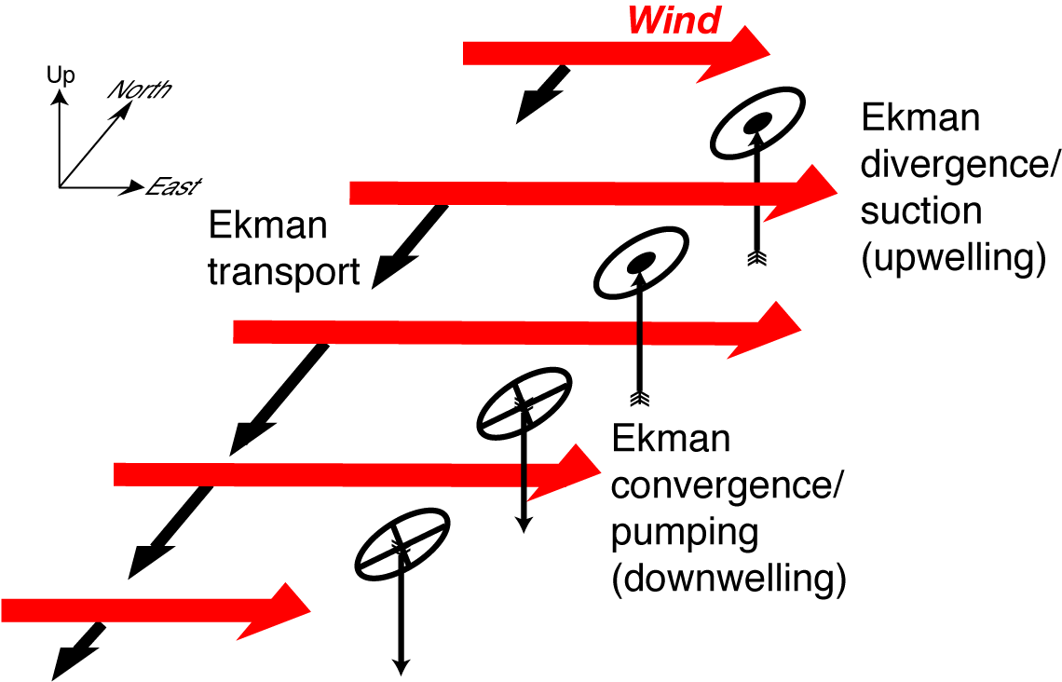
Ekman transport convergence and divergence
Notes:
When the wind stress varies with position, so that Ekman transport varies with position, there can be a convergence or divergence of water within the Ekman layer. The water has to go somewhere, and cannot go up into the atmosphere. Therefore Ekman transport convergence results in downwelling of water out of the Ekman layer and into the upper ocean below. Ekman transport divergence results in upwelling of water into the Ekman layer. This is the mechanism that connects the frictional forcing by wind of the surface layer to the interior, geostrophic ocean circulation (section 8.7).
Divergence and convergence only occur if the transport variation is in the same direction as the transport direction. In Fig. 8.13, with varying zonal (west to east) wind, the Ekman transport is to the right of the wind, and is convergent because the zonal wind varies with latitude. Note that it is not necessary for the Ekman transports to be in opposite directions in order to have divergence or convergence, just that the transports change

Slide 22
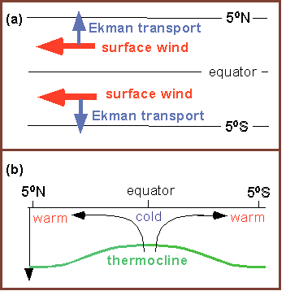
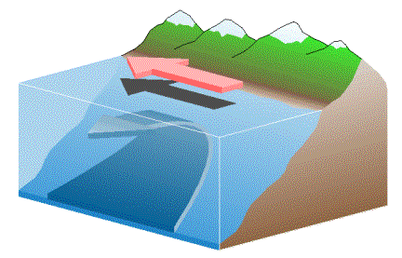
Ekman divergence at equator and at land boundaries
Notes:
At the equator, where the Coriolis parameter changes sign, uniform winds can cause Ekman convergence or divergence (Fig. 8.1a). Right on the equator, there is no Ekman layer since the Coriolis force that would create it is zero (f = 0). However, it has been shown from observations (e.g. Eriksen 1982) that the Coriolis force is important quite close to the equator, within even 1/4° (in the ocean). If the equatorial wind is westward (a trade wind), then the Ekman transport just north of the equator is northward, and the Ekman transport just south of the equator is southward. There must therefore be upwelling into the surface layer on the equator. This is roughly included in (8.19b) because of the variation in f, although (8.19b) is not correct right on the equator where f vanishes. Equatorial circulation is further considered in section 8.8.2.
Coastlines are the other places where Ekman transport divergence or convergence can occur, and are not included in (8.19). If the wind blows along the coastline, or has at least one component of its stress along the coast, then Ekman transport either runs into or comes out of the coast (Fig. 8.14b). This means that there must be either downwelling or upwelling at the coast to feed the Ekman layer. This is the main mechanism for creation and maintenance of coastal upwelling (chapter 14) and eastern boundary currents (section 8.8.1). One such example is the California-Oregon coast, where during most of the year the mean wind includes a component that blows southward along the coast. This causes westward (offshore) Ekman transport, to the right of the wind. This means there must be upwelling at the coast.

Slide 23
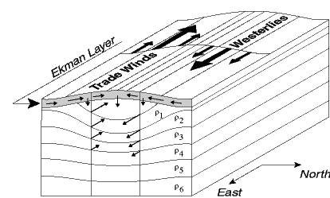
Ekman transport convergence and divergence

Slide 24
Global map of Ekman-induced upwelling (suction) and downwelling (pumping)
Tomczak and Godfrey (2003), ch. 4

Slide 25
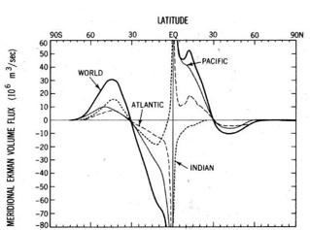
Total Ekman transports (observed) calculated from the Hellerman- Rosenstein (1983) wind stress by Levitus (1998)
Notes:
The Ekman volume fluxes (horizontal and vertical) for each ocean and for the World Ocean (Fig. 8.17) were calculated by Levitus (1988) using the monthly climatological wind stress estimates of Hellerman and Rosenstein (1983). The easterly trade winds (blowing westward) cause poleward horizontal Ekman flows in the tropical Atlantic and Pacific and the westerlies (blowing eastward) cause equatorward flows at higher latitudes. The Pacific fluxes are larger than the Atlantic fluxes mainly because it is so much wider. The Indian fluxes are of the opposite sign compared with the Pacific, Atlantic and total fluxes because of the large annual cycle associated with the monsoon; the westerly winds dominate the annual mean in the equatorial Indian Ocean.
Associated with the convergences and divergences of the horizontal Ekman flows are vertical flows (Ekman pumping; Fig. 8.17b). Between about 40°S and 40°N, downwelling prevails and the winds cause convergent Ekman transport. Poleward of about 40°, there is upwelling caused by divergent Ekman transport. The narrow region of Ekman upwelling at about 5° to 10°N is associated with the Intertropical Convegence Zone in the winds. Not shown is the major upwelling along the equator that must result from the divergent Ekman transports there due to the change of sign in the Coriolis parameter (as seen in Fig. 8.17a). Again the Pacific and Atlantic have similar distributions and the Indian Ocean differs because of its strong annual (monsoonal) variation north of the equator

Slide 26
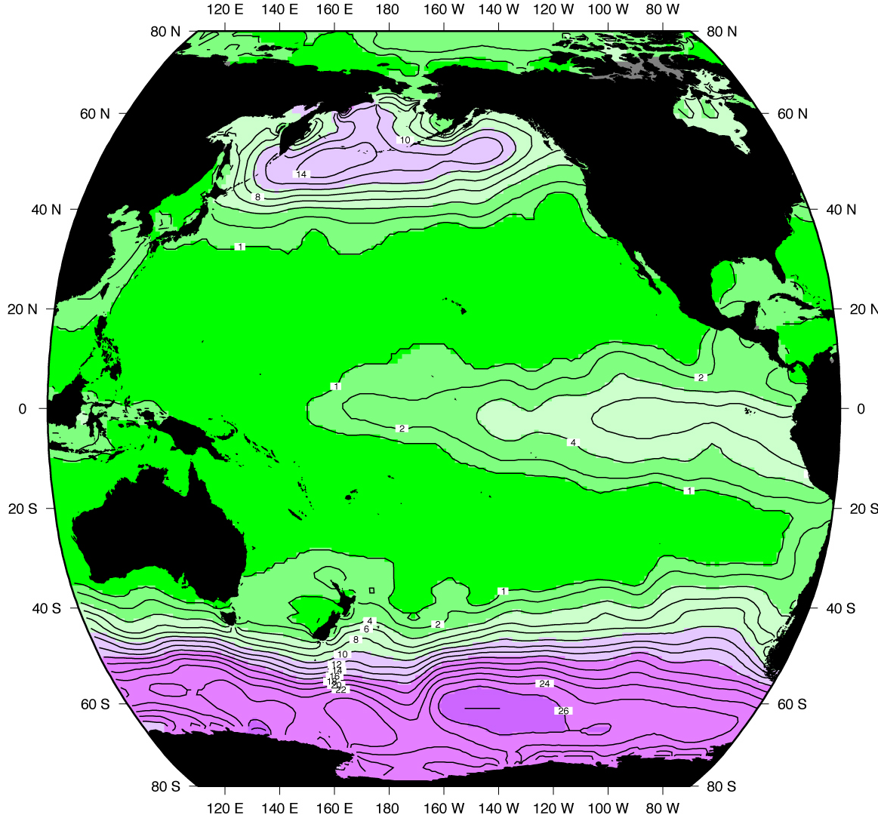
Evidence of Ekman upwelling: surface nitrate concentration
Data from gridded climatology, NODC (Levitus and Boyer, 1994)

Slide 27
Questions and Calculations (Due in 2-week)
If the eddy viscosity were to double, explain if and by how much the (a) Ekman transport, (b) Ekman layer thickness, and (c) surface Ekman velocity would change.
Draw a schematic of an open ocean wind field that produces Ekman convergence in the southern hemisphere.
Compare the Ekman layer thickness and the observed global surface mixed layer thickness. Where would Ekman layers be contained within the winter surface mixed layer and where would they extend below it?
A steady wind field is blowing on a rectangular ocean basin 8000 km wide. At 25ºN, the wind blows from the east at a speed of u₁₀=8 m/s. At 40ºN, the wind blows from the west at a speed of u₁₀=8 m/s. What is the rate of wind-driven Ekman mass convergence between 25ºN and 40ºN (in kg/s)? What is the average Ekman pumping (in cm/s) between 25ºN and 40ºN? [1 degree of latitude = 111.12 km].

Slide 28
Learning about the Ocean, the Climate and the Nature

