Slide 1
Lecture 10: Dynamics: Sverdrup Interior and Western Boundary Currents Descriptive Physical Oceanography
杨海军（YANG Haijun）复旦大学大气与海洋科学系
Department of Atmospheric and Oceanic Sciences, Fudan University
Email: yanghj@fudan.edu.cn
This powerpoint was prepared for purposes of this lecture and course only. It contains graphics from copyrighted books, journals and other products. Please do not use without acknowledgment of these sources.

Slide 2
Reading
Emery, Talley and Pickard: Chapter 8.6, 8.7.1-8.7.5
Stewart chapter 11
Tomczak and Godfrey chapter 4, pages 42-47
Concepts
Vorticity and potential vorticity
Sverdrup balance
Western boundary currents

Slide 3
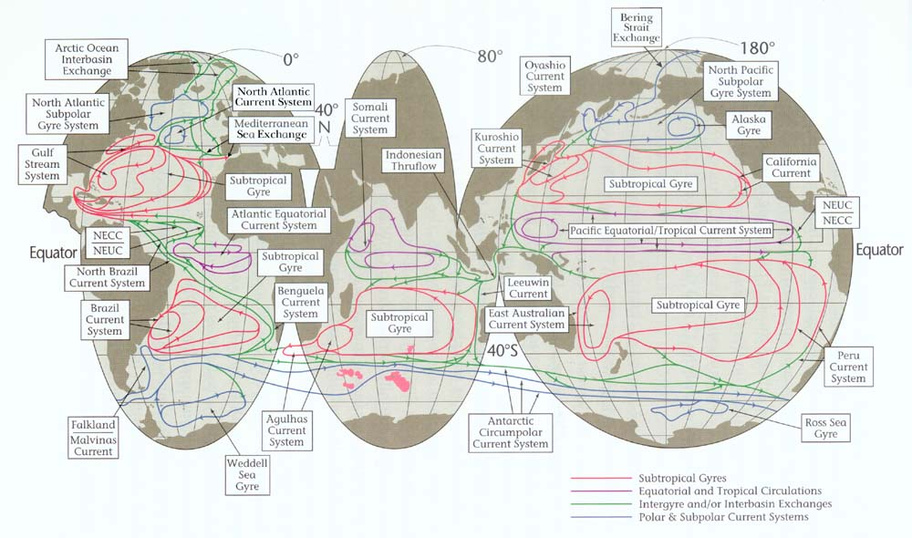
Schematic of Surface Circulation (Schmitz, 1995)

Slide 4
Observed Asymmetry of Gyres
Mid-latitude
westerlies
Tropical trades
what one might expect what one observes
(Stommel figures for circulation assuming perfect trades and westerlies)

Slide 5
Geostrophic Current（地转流）
Ocean currents are mostly geostrophic, which means that the equation for velocity includes only the pressure gradient force and Coriolis force.
The most direct way to look at the impact of external forcings on the geostrophic flows is to consider the fluid vorticity.
Notes:
and does not include the external forcings, such as the wind or heating and cooling, that create the pressure gradient force itself

Slide 6
Vorticity（涡度）
Vorticity is the angular velocity at a point in a fluid.
Vorticity is a vector, and points out of the plane in which the fluid turns.
The sign of vorticity is given by the “right-hand” rule.
If you curl the fingers on your right hand and your thumb points upward, the vorticity is positive. If your thumb points downward, the vorticity is negative.
Notes:
It is easiest to visualize by thinking of a small paddle wheel (蹼轮) immersed in the fluid. If the fluid flow turns the paddle wheel, then it has vorticity.

Slide 7
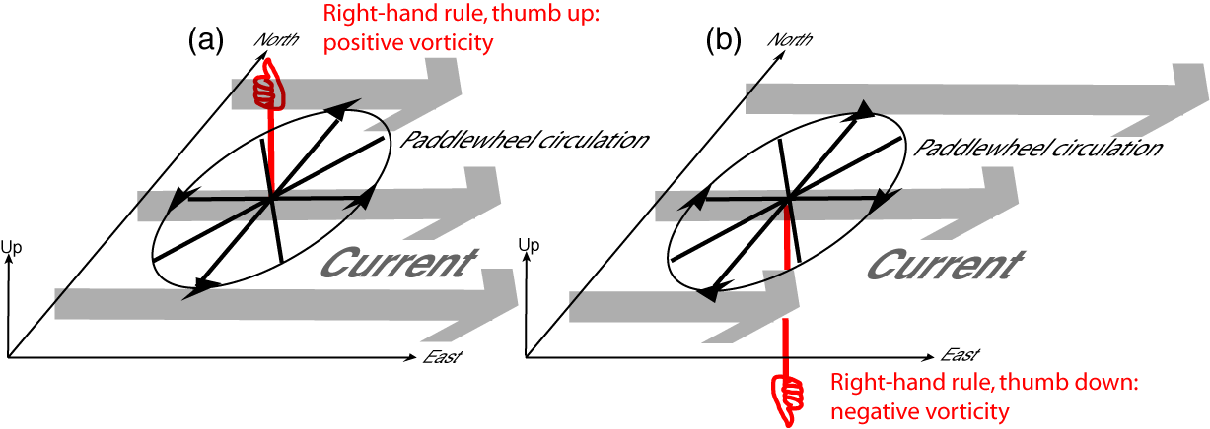
Vorticity
Vorticity > 0 (positive)
Vorticity < 0 (negative)

Slide 8
Vorticity
Vorticity is exactly related to the concept of curl in calculus. The vorticity vector ω is the curl of the velocity vector v,
$ω=∇×v=\overset{⃑}{i}\left(\frac{∂v}{∂z}−\frac{∂w}{∂y}\right)+$ $\overset{⃑}{j}\left(\frac{∂w}{∂x}−\frac{∂u}{∂z}\right)+\overset{⃑}{k}\left(\frac{∂v}{∂x}−\frac{∂u}{∂y}\right)$
where (i, j, k) is the unit vector in Cartesian coordinates (x, y, z) with corresponding velocity components (u, v, w). Vorticity has units of inverse time, for instance, (sec)⁻¹.

Slide 9
Planetary Vorticity（行星涡度）
Fluids also have vorticity simply because of the Earth‘s rotation, e.g., planetary vorticity.
Since geostrophic motion is essentially steady compared with the rotation time of the Earth, planetary vorticity is very important for nearly geostrophic flows.

Slide 10
Planetary Vorticity
The vector planetary vorticity points upward, parallel to the rotation axis of Earth. Its size is twice the angular rotation rate $Ω$ of the Earth:
$$ω_{planetary}=2Ω$$
where $Ω=\frac{2π}{day}=\frac{2π}{86400}=7.27×{10}^{−5}s^{−1}$, so $ω_{planetary}=1.454×{10}^{−4}s^{−1}$.

Slide 11
Relative Vorticity（相对涡度）
The vorticity of the fluid motion itself is called the relative vorticity when it is calculated from the water velocities relative to the Earth's surface (which itself is rotating).
Total vorticity = relative vorticity + planetary vorticity.

Slide 12
Local Vertical Vorticity
For large-scale oceanography and atmospheric science, we almost always use only the local vertical component of the total vorticity because the fluid layers (ocean or atmosphere) are very, very thin compared with the Earth's radius.
The local vertical component of the planetary vorticity is exactly equal to the Coriolis parameter:
$$f=2Ω\sin{φ}$$
where $φ$ is latitude. The local vertical component of the planetary vorticity is therefore maximum and positive at the north pole (j = 90°N) and maximum and negative at the south pole (j = 90°S). $f=0$ at the equator.

Slide 13
Local Vertical Vorticity
The local vertical component of the relative vorticity is
$$ζ=\left(\frac{∂v}{∂x}−\frac{∂u}{∂y}\right)={curl}_{z}V$$
The local vertical component of the absolute vorticity is therefore
$$ζ+f$$

Slide 14
Potential Vorticity (PV)（位势涡度）
Potential vorticity (PV) is dynamically very important quantity. PV takes into account the height of a water column as well as its local spin (vorticity). When considering only the local vertical components, it is
$$Q=\frac{ζ+f}{D}$$
where $D$ is the depth

Slide 15
PV Conservation
Conservation of PV is one of the most important concepts in fluid dynamics
When there are no forces on the fluid, PV is conserved.
A water parcel keeps the value of Q that it obtains wherever a force acted on it.
For instance, parcels of water leaving the ocean surface layer, where they are subject to wind forcing which changes their PV, keep the same value of PV after they enter the ocean interior where forces (primarily friction) are much, much weaker.

Slide 16
PV Conservation
$$Q=\frac{ζ+f}{D}=constant$$
3 quantities can change: relative vorticity $ζ$, the Coriolis parameter $f$, and the thickness $D$. All three can change together, but we learn more about what happens if we consider just 2 of these at a time.

Slide 17
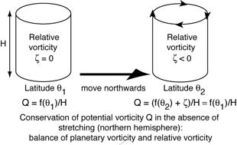
PV Conservation
$$D=constant$$
$$ζ+f=constant$$
If a parcel is moved northwards, $f$ increase, $ζ$ decrease. If$ζ=0$ to start with, then $ζ<0$ to become and the water parcel will rotate clockwise.
If the parcel is moved southwards, $f$ decrease, then $ζ>0$, the parcel will rotate counterclockwise.

Slide 18
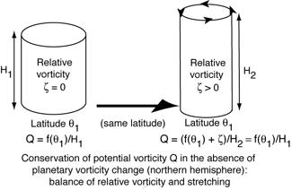
PV Conservation
$$f=constant$$
$$\frac{ζ}{D}=constant$$
$D$ increase ("stretching"), $ζ$ increase, the water parcel will rotate more in the counter-clockwise direction.
$D$ decrease ("squashing"), $ζ$decrease, the water parcel will rotate more in the clockwise direction
(Mesoscale eddies that have high relative vorticity and that do not move far from their initial latitude, Arctic dynamics, or for flows in rotating laboratory tanks.)

Slide 19
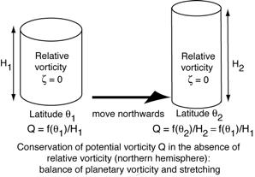
PV Conservation
$$ζ=constant or \sim 0$$
$$\frac{f}{D}=constant$$
This is the PV balance for Sverdrup transport
A northward move, $f$increases, $D$ stretching; A southward move, $f$ decreases, $D$ squash.
(Since neither thickness nor relative vorticity can change without limit, there is an inherent restoring force to northward and southward movements in the ocean and atmosphere. This restoring force creates Rossby waves.)

Slide 20
β-effect
Changes in Coriolis parameter $f$ have such important consequences for ocean currents or stratification, through PV conservation, define the change in Coriolis parameter with northward distance:
$$β=\frac{df}{dy}$$
This is the "β-effect" when talking about how changes in latitude affect currents, or the very large-scale, mainly horizontal waves (Rossby waves) for which the β-effect is the restoring force.

Slide 21
Wind-driven Circulation （风生环流）
The large-scale circulation
Asymmetric,
Swift, narrow currents along the western boundaries, westward intensification
much gentler flow within the vast expanse eastward of these currents.
The Gulf Stream in the Atlantic and the Kuroshio Current in the Pacific

Slide 22
Wind-driven Circulation
The primary originators of the theories
Harald Sverdrup (1947) first explained the mid-ocean vorticity balance, created by variations in Ekman transport, that creates what we now call the "Sverdrup interior" solution.
Henry Stommel (1948) and Walter Munk (1950) provided the first (frictional) explanations for the western boundary currents themselves.
Nicholas Fofonoff (1954) showed how very different the circulation would be without friction.

Slide 23
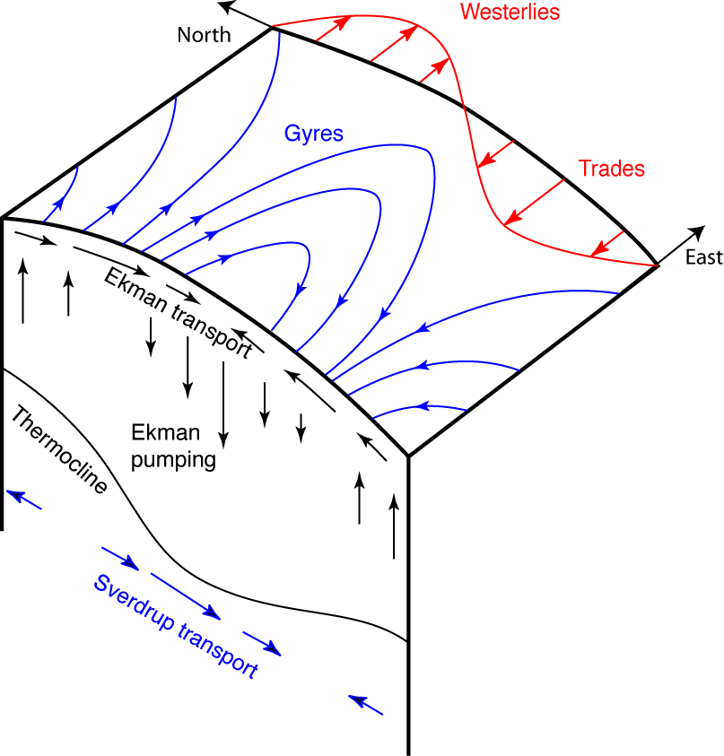
Sverdrup Balance
Wind causes Ekman transport and convergence
Ekman pumping provides squashing or stretching.
Water columns must respond, either through change in relative vorticity or change in planetary vorticity (latitude). They do not spin up in place, but rather change latitude.
Squashing → equatorward Stretching → poleward
Notes:
The gentle interior flow of the oceans, away from the western and eastern boundaries, can be thought of primarily in terms of the meridional (north-south) direction. Examples can be seen in the surface dynamic topography of the subtropical North Atlantic and subtropical North Pacific and South Pacific. In the northern hemisphere, the interior flow is southward, towards the equator. In the southern hemisphere, it is northward, also towards the equator. These gentle interior flows are balanced by a swift compensating flow along the western boundary that returns the water back to its original latitude.
Sverdrup originated the theory of the direction and size of the gentle interior flow, based on vorticity. Let us use the subtropical Pacific as an example. The winds at the sea surface are not spatially uniform. South of about 30°N, the Pacific is dominated by the easterly trade winds. North of this, it is dominated by the westerly winds. These winds cause Ekman transport in the upper 50 meters or so, to the right of the wind (northern hemisphere). Therefore there will be northward Ekman transport under the trade winds, and southward Ekman transport under the westerlies. Moreover, the strength of the wind varies smoothly from the maximum trades to the maximum westerlies, so the Ekman transport varies smoothly from large and northward under the maximum trades to large and southward under the maximum westerlies. All of this causes convergence of the Ekman transport in a wide latitudinal band (approximately 10°N to 40°N in the North Pacific), between the maximum trade wind latitude and maximum westerly wind latitude. Thus throughout the subtropical North Pacific, there is Ekman convergence.
The Ekman convergence means that the surface layer water must go somewhere. In the simplest "Sverdrup balance", the water moves downward. That is, there is downward vertical velocity at the base of the Ekman layer. At the bottom of the ocean, or more likely, at some level between the surface and ocean bottom, there is no vertical velocity. Therefore there is net "squashing" of the water columns in the subtropical region: downward velocity at the top, and zero velocity at some depth. This net squashing is also called Ekman pumping, since the Ekman layer water is being pumped down into the ocean interior.
This squashing of the water columns then changes the vorticity of the water column. The water columns in the center of the ocean are very unlikely to spin up to a high relative vorticity (negative vorticity in this case), and so they change their vorticity by moving towards the equator, just as described in section 8.6 (Fig. 8.29). This results in the southward flow that characterizes the subtropical gyre.
In the southern hemisphere, for instance, the South Pacific, the trade winds at low latitudes and westerly winds at high southern latitudes have associated Ekman transport to the left, and therefore also create convergence throughout the subtropical region. Because of the potential vorticity balance introduced in section 8.6, this results in equatorward flow, just as in the northern hemisphere. Hence there is northward flow throughout the subtropical gyres of the southern hemisphere.
In subpolar regions, such as the northern North Pacific, we do not have alternating wind directions. However, this region does lie north of the maximum in the westerly winds, which is at about 40°N. North of the maximum, the westerly winds decrease. The Ekman transport driven by the westerly winds is southward. It is maximum at about 40°N, and becomes weaker at higher latitude. In order to feed this pattern of Ekman transport (weak at 60°N and becoming increasingly southward by 40°N), there must be upwelling throughout the wide latitude band of the subpolar gyre. This upwelling stretches the water columns. The Ekman upwelling is sometimes referred to as Ekman suction, since water is being pulled out of the interior into the Ekman layer. The stretched water columns then move poleward (section 8.6). In the subpolar North Pacific, this creates the characteristic northward flow of the interior subpolar gyre.
The remaining piece of the Sverdrup balance for the interior ocean flow is to figure out where all of the southward or northward-moving water in the ocean interior can return to its original latitude. It cannot do this in the interior of the ocean. Stommel and Munk both proposed frictional models that show that the return flow occurs on the western boundary. Therefore, we can conclude that the subtropical gyres must be anticyclonic (northern hemisphere: eastward flow on the north side, westward flow on the south side, southward flow throughout the interior, and strong northward flow on the western boundary). The subpolar gyres must be cyclonic.

Slide 24
Ekman transport
Integration for the whole Ekman layer:
$V_{E}=−\frac{τ\left(x\right)}{ρf}$ ➔ $βV_{E}=−\frac{βτ\left(x\right)}{ρf}$
$$U_{E}=\frac{τ\left(y\right)}{ρf}$$

Slide 25
Geostrophic Balance
From the geostrophic equations of motion. It is:
$$f\left(\frac{∂u_{g}}{∂x}+\frac{∂v_{g}}{∂y}\right)+βv_{g}=0$$
From the continuity equation, we know that
$$\frac{∂u_{g}}{∂x}+\frac{∂v_{g}}{∂y}+\frac{∂w}{∂z}=0$$
and so
$βv_{g}=f\frac{∂w}{∂z}$. -- Geostrophic transport

Slide 26
Geostrophic Balance
Integrating from the ocean bottom $\left(z=H\right)$ to the bottom of Ekman layer $\left(z=D_{E}\right)$
$$βV_{g}=\int{βv_{g}dz}=\int{f\frac{∂w}{∂z}dz=f(w\left(z=D_{E}\right)−w\left(z=H\right))}$$
$βV_{g}=fw\left(z=D_{E}\right)$, because usually $w\left(z=H\right)=0$.

Slide 27
Ekman Pumping
The Ekman pumping or suction, based on Ekman layer transports and continuity:
$$\frac{∂u_{E}}{∂x}+\frac{∂v_{E}}{∂y}+\frac{∂w}{∂z}=0$$
Integrating from the bottom of Ekman layer $\left(z=D_{E}\right)$to the ocean surface $\left(z=0\right)$:
$$\int{\frac{∂w}{∂z}dz=−\int{\left(\frac{∂u_{E}}{∂x}+\frac{∂v_{E}}{∂y}\right)dz=}−(\frac{∂U_{E}}{∂x}+\frac{∂V_{E}}{∂y}) }$$
$$w\left(z=0\right)−w\left(z=D_{E}\right)=−(\frac{∂U_{E}}{∂x}+\frac{∂V_{E}}{∂y})$$
$w\left(z=D_{E}\right)=(\frac{∂U_{E}}{∂x}+\frac{∂V_{E}}{∂y})$, because $w\left(z=0\right)=0$.

Slide 28
Ekman Pumping
$$w\left(z=D_{E}\right)=\frac{∂}{∂x}\left(\frac{τ_{y}}{ρf}\right)−\frac{∂}{∂y}\left(\frac{τ_{x}}{ρf}\right)=curl\left(\frac{τ}{ρf}\right)=\frac{curl\left(τ\right)}{ρf}+β\frac{τ_{x}}{ρf^{2}}=\frac{curl\left(τ\right)}{ρf}−\frac{βV_{E}}{f}$$

Slide 29
Sverdrup Balance
Therefore
$$βV_{g}=fw\left(z=D_{E}\right)=f(\frac{curl\left(τ\right)}{ρf}−\frac{βV_{E}}{f})$$
$$βV=β\left(V_{g}+V_{E}\right)=\frac{1}{ρ}curl\left(τ\right)$$
Or
$$βM(y) =curl\left(τ\right)$$
where the meridional mass transport $M\left(y\right)=ρV$ .

Slide 30
Sverdrup Balance
Thus the meridional mass transport in the Sverdrup interior is proportional to the wind stress curl, and independent on the ocean structure itself.
Sverdrup transport = Geostrophic transport + Ekman transport

Slide 31
Sverdrup Balance: Key Points
Applies to the ocean "interior" only and not to the western boundary region;
Applies only if there are eastern and western boundaries (therefore is specific to the ocean and not applicable to the atmosphere);
The currents are geostrophic flow + Ekman transport;

Slide 32
Sverdrup Balance: Key Points
The direction and magnitude of the flow are related to the wind stress through the frictional Ekman layer at the top.
Ekman pumping or suction that creates a vertical velocity, and the resulting adjustments in planetary vorticity required to balance this squashing or stretching;

Slide 33
Sverdrup Balance: Key Points
Does not include the effects of stratification, advection, or friction within the interior (outside the Ekman layer).
Boundary currents are required to close the circulation predicted by the Sverdrup balance. These require either friction (Stommel and Munk solutions), or nonlinear advection (Fofonoff solution), or some combination of these.

Slide 34
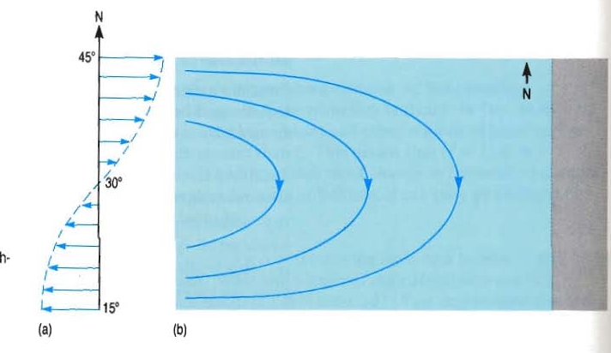
Sverdrup Transport Interior
$$βV=\frac{1}{ρ}curl\left(τ\right)$$
Ekman
Convergence
High Pressure

Slide 35
Sverdrup Transport Interior
$$βV=\frac{1}{ρ}curl\left(τ\right)$$
Ekman
Convergence
High Pressure

Slide 36
Stommel’s Solution: Westward Intensification and Western Boundary Currents
Mid-latitude
westerlies
Tropical trades
In 1949, Henry Stommel added a simple linear friction to Sverdrup’s model to close the circulation in a basin with western and eastern boundaries. By using this friction in the potential vorticity balance, Stommel found that the returning flow must be in a narrow jet along the western boundary.
The left panel: f= constant (no beta-effect). In this solution, potential vorticity cannot be balanced by a change in latitude, so the flow has relative vorticity. The right panel, f ≠ constant (β-effect), the flow is southward throughout the interior (Sverdrup balance), and returns northward in a swift jet. This idealized circulation resembles the Gulf Stream and Kuroshio subtropical gyres
Notes:
Recall that the Sverdrup balance gives the flow in the main part of the ocean basin, but does not predict where the flow will return to the original latitude to rejoin the interior flow. Because the Sverdrup balance applies to the whole ocean basin, the return flow must be in a narrow, swift jet somewhere. By using this friction in the potential vorticity balance, Stommel found that the returning flow must be in a narrow jet along the western boundary (Fig. 8.31 from Stommel's 1957 book).
This would be the solution if the Earth were a rotating, flat disk, and if there were westerlies in the north and trades in the south. In this solution, potential vorticity cannot be balanced by a change in latitude, so the flow has relative vorticity. In the right panel, for the spherical Earth with a b-effect, the flow is southward throughout the interior (Sverdrup balance), and returns northward in a swift jet. This idealized circulation resembles the Gulf Stream and Kuroshio subtropical gyres, in which the Gulf Stream and Kuroshio are the narrow western boundary currents returning all of the southward interior flow back to the north.
Stommel's frictional solution was somewhat unrealistic since the friction was between the western boundary current and the ocean bottom. This put an unnecessary restriction on the wind-driven flow that it reach to the ocean bottom. However, with stratification, it is not at all obvious (and not true) that the circulation should reach this deep. A subsequent study by Walter Munk avoided this problem and nevertheless resulted in a westward intensification, as seen next

Slide 37
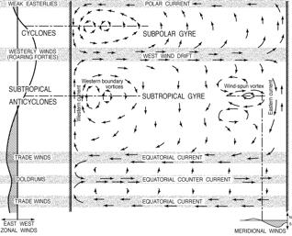
Munk’s Solution: Western Boundary Currents
A few years after Stommel's work, Walter Munk considered the effect on the ocean gyre circulations of more realistic friction, between the currents and the side walls rather than between the currents and the ocean bottom.
His result was very similar to Stommel's, predicting westward intensification of the circulation. A narrow, swift jet along the western boundary returns the Sverdrup interior flow to its original latitude
Munk’s wind-driven circulation solution: zonal wind profiles on left and circulation streamlines in the center. (Munk 1950)

Slide 38
Global map of Ekman upwelling downwelling
Tomczak and Godfrey, ch. 4

Slide 39
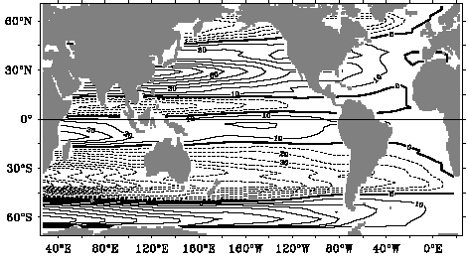
Sverdrup transport deduced from wind stress
$$βV=βψ_{x}=\frac{curl\left(τ\right)}{ρ}→→ψ\left(x\right)=ψ(x_{E}) +\int_{x_{E}}^{x}{curl\left(τ\right)/ρdx}$$

Slide 40
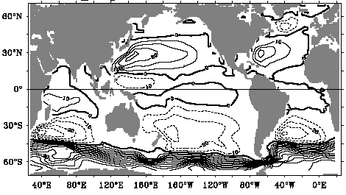
Sverdrup transport deduced from Velocity
$$V_{A}=ψ_{x}→→ψ\left(x\right)=ψ(x_{E}) +\int_{x_{E}}^{x}{V_{A}dx}$$

Slide 41
Schematic of surface circulation (Schmitz, 1995)

Slide 42
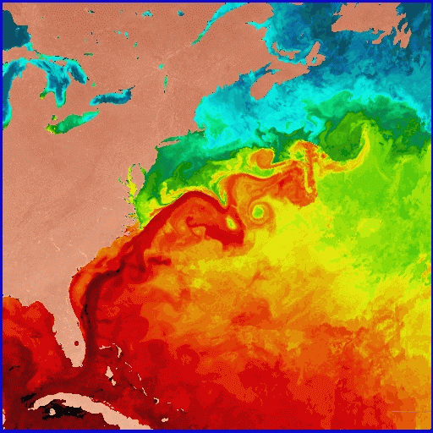
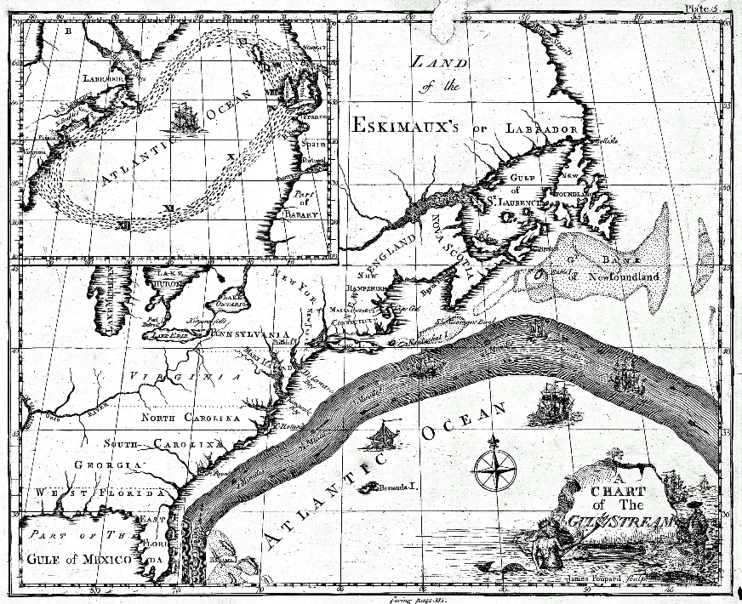
Observed WBC: the Gulf Stream
SST satellite image, from U. Miami RSMAS
Benjamin Franklin’s map (1777)

Slide 43
Actual subtropical gyre circulation (Reid, 1994)
Surface
250 dbar
We notice that the circulation is not the same below the sea surface as at the surface.
Moreover, surface density changes from pole to equator.
So perfect Sverdrup gyre is not accurate. Consider Sverdrup response in stratified ocean.

Slide 44
Questions and Calculations (Due in 2-week)
Name the three contributing factors to potential vorticity.
How does Ekman pumping connect to the Sverdrup interior flow? Explain using potential vorticity arguments.
If the Ekman transport southward across 20N in the Atlantic is 5 Sv and the Sverdrup transport southward across the same latitude is 50 Sv, what is the transport of the western boundary current?
In which parts of the ocean is it currently assumed that the Sverdrup balance is approximately correct? Where is it clearly incorrect?
If the Kuroshio Extension velocity is 10 cm/sec averaged from top to bottom, and the current width is 100km, assuming a depth of 5 km, what is its volume transport? Express transport in Sverdrup. What is its approximate mass transport assuming a constant density (1025kg/m³)?
If the Ekman transport at 30N in the Atlantic is -2 Sv southward and the Ekman transport at 20N is -5 Sv southward, what is the average vertical velocity at the base of the Ekman layers between 20N and 30N? Assume that the Atlantic is 5000 km wide.
Using the vertical velocity calculated for (2), calculate the southward Sverdrup interior transport at the mid-point (25N).
Notes:
What are the common elements of the surface circulation found in the N. Pacific and N. Atlantic?
Name the major surface western boundary currents in these two oceans, indicate which way they flow and what gyre circulation they are a part of. What are typical maximum velocities and dynamic height differences for these boundary currents?
What horizontal and vertical structure is typical of the subtropical gyre?
How deep are the western boundary currents?
How deep is the typical wind-driven gyre, excluding the western boundary current?

Slide 45
Learning about the Ocean, the Climate and the Nature

