Slide 1
Lecture 12: Wind Forcing and N. Pacific Upper Ocean Circulation Descriptive Physical Oceanography
杨海军（YANG Haijun）复旦大学大气与海洋科学系
Department of Atmospheric and Oceanic Sciences, Fudan University
Email: yanghj@fudan.edu.cn
This powerpoint was prepared for purposes of this lecture and course only. It contains graphics from copyrighted books, journals and other products. Please do not use without acknowledgment of these sources.

Slide 2
Reading:
Tomczak and Godfrey text: ch. 8 (pp. 121-130)
Pickard and Emery text: 7.62, 7.65
Outline:
Wind-driven circulation
N. Pacific subtropical gyre
Kuroshio and Kuroshio Extension
Recirculation
North Equatorial Current
California Current
N. Pacific subpolar gyre
Oyashio(亲潮，千岛寒流) and East Kamchatka (堪察加) Currents
Subarctic Front

Slide 3
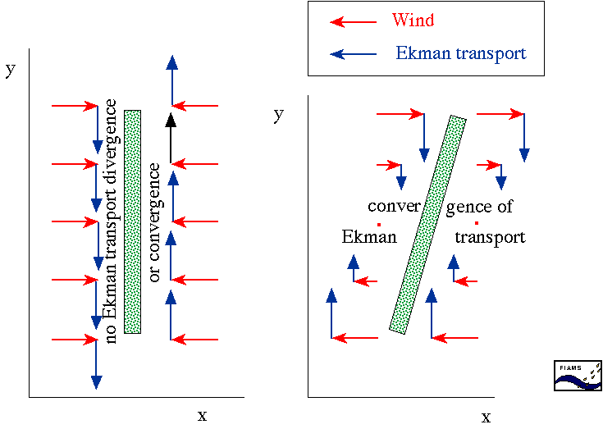
How does Ekman transport drive underlying circulation? Step 1: Ekman convergence or divergence
Tomczak and Godfrey text (2003)

Slide 4
How does Ekman transport drive underlying circulation? Step 2: Potential vorticity and Sverdrup transport
REVIEW
Vorticity: rate of “spin”
Potential vorticity: depends on height of water column and rate of spin. Rate of spin depends on both local spin (non-zero curl of velocity) and earth rotation.
$Q=(f+ζ)/H$
where f is Coriolis, ζ is relative vorticity and H is water column “height”

Slide 5
How does Ekman transport drive underlying circulation? Step 2: Potential vorticity and Sverdrup transport
$Q=(f+ζ)/H$
Sverdrup transport:
if there is Ekman convergence (pumping downward), then H in the potential vorticity is decreased. This must result in a decrease of the numerator, (f + ζ). Since we know from observations (and “scaling”) that relative vorticity does not spin up, the latitude must change so that f change.
If there is a decrease in H, then there is a decrease in latitude - water moves towards the equator.
Sverdrup transport = meridional flow

Slide 6
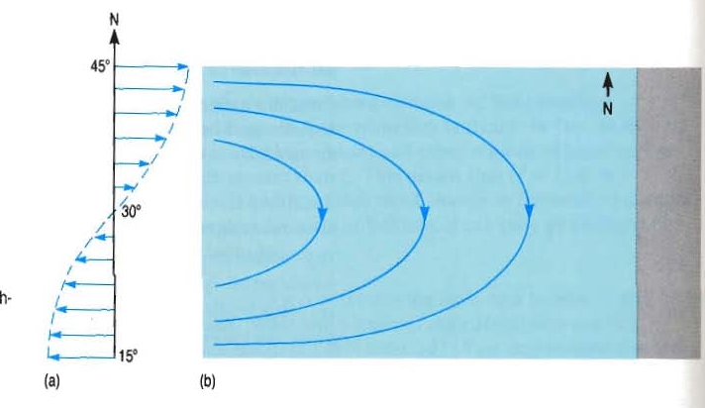
Sverdrup Transport Interior
Ekman
Convergence
High Pressure

Slide 7
North Pacific Features
It has the simplest thermohaline forcing of any of the ocean basins and is thus the best basin to first grasp principles of wind-driven circulation.
There are no deep water sources in the North Pacific and the intermediate water sources are weak.
The N. Pacific is actively ventilated to no more than 2000 meters depth, which coincides with the depth of the wind-driven circulation.

Slide 8
North Pacific Features
Circulation below 2000 m must be thermohaline, but most of the forcing is due to remote deep water formation in the southern ocean and Atlantic.
Weak geothermal forcing in the deep North Pacific might also have an effect on the deep circulation.
Strong ventilation due to surface outcrops in the open North Pacific affects only the top 1000 meters, and is directly tied to the wind-driven circulation

Slide 9
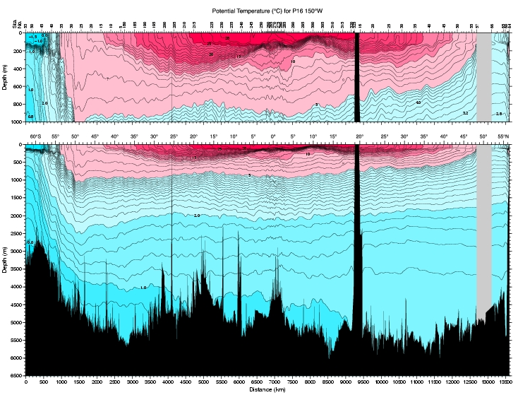
North Pacific

Slide 10
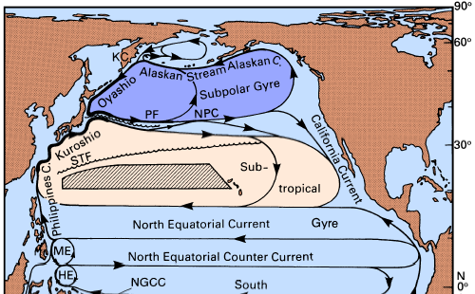
N. Pacific Upper Ocean Circulation (Tomczak and Godfrey)
Notes:
Because the return flow for this interior ocean transport must be in western boundary currents, this produces cyclonic circulation in the north (the subpolar gyre), anticyclonic circulation at mid-latitudes (subtropical gyre), and a meridionally narrow cyclonic circulation centered at 10°N. The western boundary currents associated with these three gyres are: East Kamchatka Current/Oyashio, Kuroshio, and Mindanao Current. These surface circulation patterns are clearly evident in any surface dynamic topography relative to greater depth - e.g. Wyrtki, Reid and Arthur.

Slide 11
Current Nomenclature
The eastward flow of the northern subtropical and southern subpolar gyres is the North Pacific Current. It is not a uniform eastward flow but is punctuated by zonal fronts with somewhat intensified flow which occur at remarkably unchanging latitudes despite strong seasonal and interannual changes in forcing.
The two principal fronts are the Subarctic Front at around 40-42°N and the Subtropical Front at around 30-32°N. It is likely that these are eastward extensions of the separated Oyashio and Kuroshio respectively, but it is also clear that several semi-permanent fronts arise from both of these separated currents.

Slide 12
Current Nomenclature
The westward flow of the southern subtropical gyre and northern tropical gyre is referred to as the North Equatorial Current. The NEC appears to be more intense in the tropical circulation than in the subtropical circulation.
The eastward flow on the south side of the tropical gyre is the North Equatorial Countercurrent; despite its narrowness it is very swift and carries a large transport. The equatorial currents are described in a later lecture.

Slide 13
N. Pacific Subtropical Gyre
Eastward North Pacific Current and the westward North Equatorial Current
Southward interior flow: Sverdrup flow
Northward western boundary current: Kuroshio current
Vertical structures: “Interior” flow extends to about 2000 meters depth

Slide 14
N. Pacific Steric Height: 0, 500, 1000, 2000 db
All from Reid (1997)
At 1000 meters depth, the subtropical gyre differs clearly from the surface gyre - while its northern and western sides appear in the same location as at the surface, its southern boundary is considerably farther north than at the surface, and its eastern portion is weak or non-existent. This poleward shrinkage of the subtropical gyre is a feature of the subtropical gyre in every ocean basin.
Notes:
The wind forcing for the North Pacific consists of westerlies at latitudes north of about 30°N in the mean, and trades to the south. Within the trades occurs the Intertropical Convergence Zone (ITCZ), centered at 10°N. The dominant pattern of atmospheric circulation north of 30N is associated with the Aleutian Low. The mean winds create Ekman divergence north of about 40°N, Ekman convergence between 15°N and 40°N, and Ekman divergence between 5°N and 15°N. These patterns drive Sverdrup transport which is northward in Ekman divergence regions and southward in Ekman convergence regions.
Because the return flow for this interior ocean transport must be in western boundary currents, this produces cyclonic circulation in the north (the subpolar gyre), anticyclonic circulation at mid-latitudes (subtropical gyre), and a meridionally narrow cyclonic circulation centered at 10°N. The western boundary currents associated with these three gyres are: East Kamchatka Current/Oyashio, Kuroshio, and Mindanao Current. These surface circulation patterns are clearly evident in any surface dynamic topography relative to greater depth - e.g. Wyrtki, Reid and Arthur.
At 1000 meters depth, the subtropical gyre differs clearly from the surface gyre - while its northern and western sides appear in the same location as at the surface, its southern boundary is considerably farther north than at the surface, and its eastern portion is weak or non-existent. This poleward shrinkage of the subtropical gyre was first documented by Reid and Arthur and is a feature of the subtropical gyre in every ocean basin.
Vertical changes in the subpolar and tropical cyclonic gyres are not as apparent as in the subtropical gyre, probably because of the very narrow meridional extent of both gyres. The subpolar gyre would extend much farther north but for the presence of Alaska; its extension into the Bering Sea is considerably complicated by the Aleutian Arc. In dynamic topographies, it appears to have little variation in shape with depth although its existence below about 2000 meters is doubtful. The tropical gyre is also very narrow due to the wind pattern which causes it, and its vertical penetration is also not clear

Slide 15
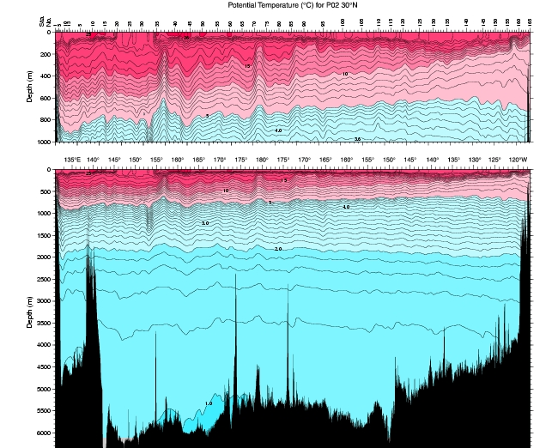
Vertical Section of Subtropical Gyre (along 30°N)
From WHP Pacific Atlas; http://gyre.ucsd.edu/whp_atlas

Slide 16
Kuroshio and Kuroshio Extension
Specifics of Kuroshio current :
Kuroshio extends to the bottom
Kuroshio extends way out into the gyre, not just at western boundary
Kuroshio meanders (time dependence)
Kuroshio has “recirculation” in opposite direction on both sides of the current. Biggest “recirculation” is on south side of Kuroshio Extension - “C - shape” of gyre.

Slide 17
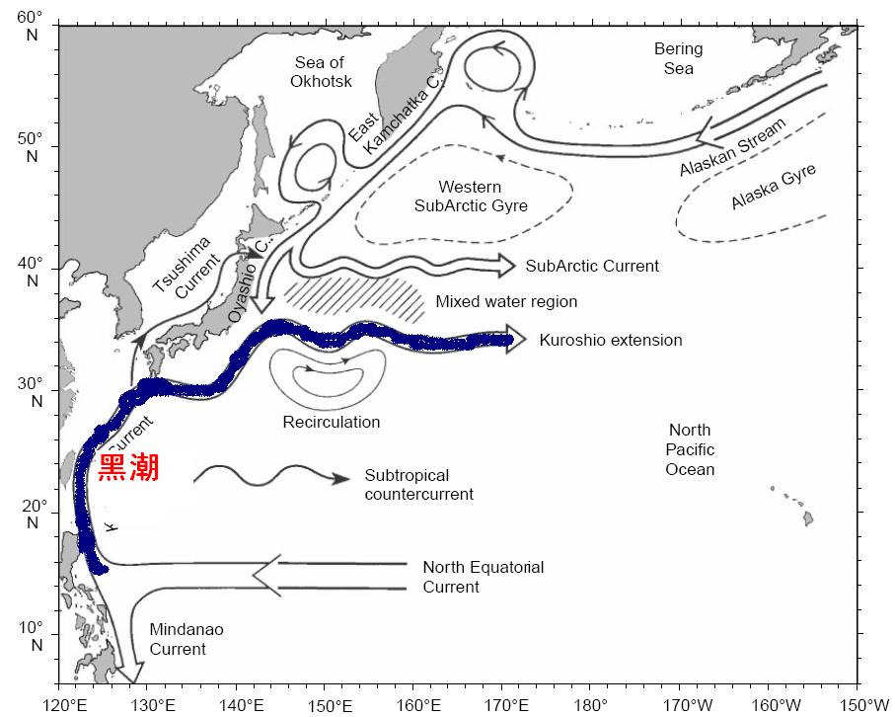
Kuroshio Current
Kuroshio current is a strong northward-flowing western boundary current in the western North Pacific. This current is featured with high temperature and nutrient.
It originates southeast of Philippines and is a north branch of the North Equatorial Current, flow northward along the Bashi strait, east coast of Taiwan, and enter the East China Sea, and then flow along the continental shelf to the south of Japan.
Width of Kuroshio: ~ 150km. Surface current speed: 1-7.5km/hour, thickness: ~ 800-1000m.
Kuroshio brings warm climate and plentiful fish to Japan
Notes:
The Kuroshio is the western boundary current of the subtropical gyre. Its transport is 60-70 Sv with large seasonal variations. It arises at the western boundary in the bifurcation of the North Equatorial Current; the southward flow is the Mindanao Current and the northward flow the Kuroshio. It passes along the coast of Taiwan and west of the Ryukyu Islands. The western boundary in this region is actually the broad shelf of the East China Sea rather than a continent, and so some of the Kuroshio's transport is actually up on the shelf, although the main core of flow remains in the deep channel. The Kuroshio turns eastward and emerges through Tokara Strait. A small portion remains west of Japan, entering the Japan Sea as the Tsushima Current; surface drifter measurements suggest that the actual continuity of flow into the Japan Sea is marginal. After passing through Tokara Strait, the Kuroshio continues eastward and passes through the Izu Ridge just south of Japan. Between Tokara Strait and the Izu Ridge, the Kuroshio exists in one of two modes - it either flows due eastward or undergoes a large southward meander. This bimodality appears to be due to the wave-guide nature of the two bounding ridges. When the Kuroshio is in the large meander state, its transport is usually reduced compared to when it follows the "straight" (progressive meandering) path.
The Kuroshio separates from the land at the southeastern corner of Honshu (south of the Boso Peninsula). At this location the Kuroshio often undergoes a large northward meander, which often produces a warm core ring.
In the relatively shallow regions where it is a true western boundary current, the Kuroshio extends to the bottom. On either side of the northward flow it has narrow southward recirculations. Once the Kuroshio crosses the Izu Ridge and enters deep water, its dynamic signature appears to extend to the ocean bottom. Thus the mean currents measured at great depth at 155E show flow below the Kuroshio axis which is eastward relative to stronger recirculation regions to the north and south. However, the actual mean flow along the Kuroshio axis at great depth is weakly westward; one might think of this as a superposition of deep westward flow, perhaps driven through thermohaline forcing, on the deep Kuroshio, which derives its energy from the winds.

Slide 18
Kuroshio at western boundary: velocity sections (Bingham and Talley, 1991)

Slide 19
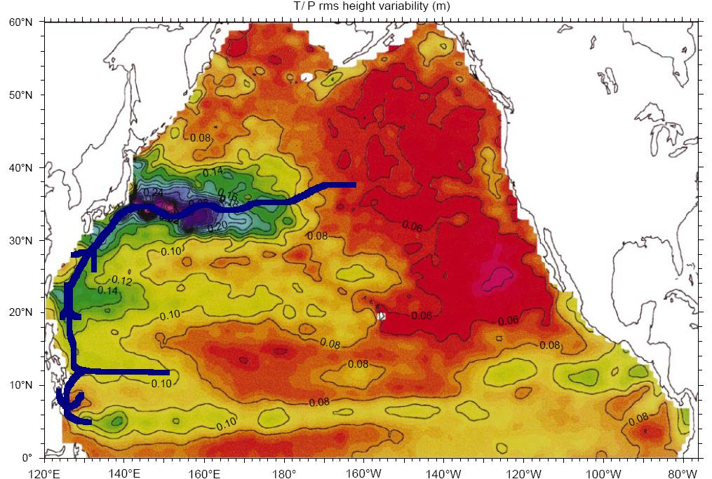
Kuroshio Extension Meandering

Slide 20
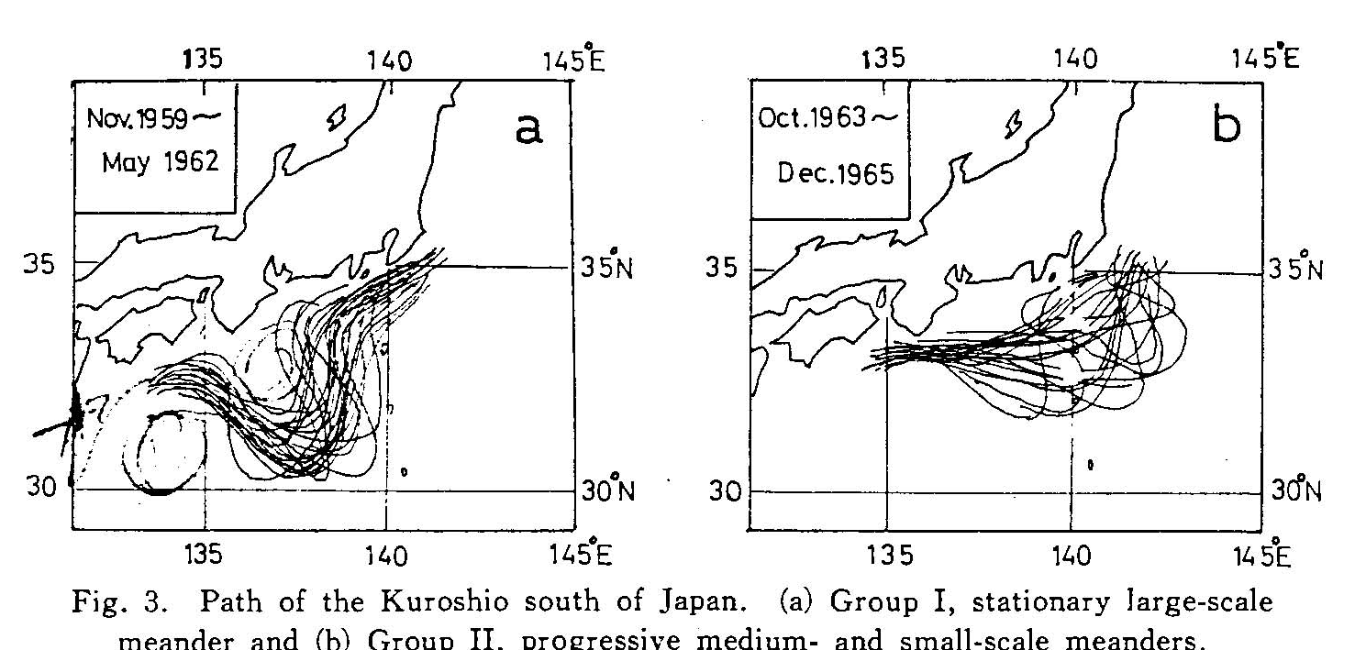
Kuroshio Large meander
Individual Kuroshio tracks
Normal meanders
“Large meander”

Slide 21
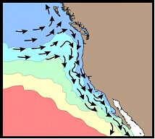
California Cold Current
When the eastward Kuroshio Current meets the west coast of North America, it turns southward. This is called California Cold current.
Notes:
黑潮向东流，遇到加州沿岸，一支折向南，此即为加利福尼亚寒流
因为风来自西北，所以有沿岸上升流，水温比周围海水可低5°以上
营养盐丰富，鱼类众多，如长鳍金枪鱼
影响加州的气候，凉爽干燥少雨，造成沙漠地带
70年代后半期在加利福尼亚沿岸发现的古代石锚是考古界的一次重大突破性发展，而且目前所发现的和中国有关系的文化材料皆都发现在北美洲南部和拉丁美洲北部的沿太平洋沿岸，这应该引起人们的高度重视。当然，如果仅凭现在发现的这几件石锚就断定中华古人是美洲的最初主人是有失 偏颇和难以令人信服的。在几千年之前，古人以非常简单的交通工具横越浩瀚的太平洋，这是一件极为困难和难以令人相信的事，为 此必须对当时的地理条件进行严谨而深入的考察。 如果古代中华先祖要东渡美洲，有二条航线可通：（1）北越白令海峡。从古地质学的研究中可以知道，这里在大约七万 前，海平面曾经大为下降，有些地方甚至露出了海底，形成陆桥，在古地理学上把它称为“白令及亚”。大约在距今二万五千至一万五千年前是陆桥最后存在的时期，因此当时的白令海峡对于古人并非是不可逾越的天堑。古人完全有可能经过许多世纪的漫长 时间从亚洲东北部启程陆续抵达北美阿拉斯加，然后逐次南下。（2）中路，即借助于源于赤道，从台湾东部北上沿日本海向东的黑潮暖流。 这一暖流宽度为三十海里左右，而且恰恰于其洋底海沟走向一致，古人极有可能趁黑潮暖流向东漂流，到达阿留申群岛，链状的阿留申群岛是东进 过程中一个良好的中途休整基地，星罗齐布，顺次连接的各个海岛极适合于向东挺进，逐岛跳跃，而且古人在抵达阿留申群岛之后，又与常年顺风顺水的西风漂流相结合，在北美沿岸船只可沿南向的加利福尼亚海流而至墨西哥。在古气候学证据方面，已有资料可推断，在三千多年以前，这一带的气候较之现在要暖和的多，降雨量相当充足，足以保证淡水的供给，沿途海洋动植物资源丰富，如鱼类、海豹和藻类植物等。完全可能提供食物补充。更为重要的是，我们往往从现在的情况来推测古人，对先人们的能力估计过低。 因此，发生于三千年左右以前的25万殷代亡国军民在中华土地突然失踪，最有可能迁徙到了美洲就是沿循着这一路线；秦时徐福带领三千童男女一去东海仙山不回，除少数留在日本，大部分也极有可能到了美洲。当然，海上风向难测，水流变幻，古人航海工具简陋，在路径上出现一些偏差也是在所难免，所以要进一步完全肯定这一论 断尚须更全面的考古实物证实。
太平洋金枪鱼资源
在太平洋金枪鱼主要有五大渔场：北太平洋渔场、北太平洋中纬度渔场、南海渔场、太平洋赤道海域渔场、南太平洋渔场。
北太平洋渔场是指东经150°至西经150°、北纬25°以北的海域。在这一带海域中主要是长鳍金枪鱼、大眼金枪鱼和鲣鱼。长鳍金枪鱼的分布与流系有密切的关系，在北太平洋流系、黑潮、和加利福尼亚海流的北部，长鳍金枪鱼的分布密度最大。大眼金枪鱼的分布状况大致同长鳍金枪鱼相同，但大眼金枪鱼的分布中心在180°以东海域，而在175°以东的海域内，其密度最大。

Slide 22
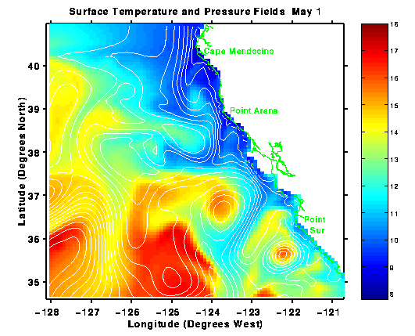
California Cold Current
There is also upwelling because the wind blows from the northwest. The water temperature is 5º lower than the surroundings. High nutrient region which supports Tuna.
The climate of California is thus cool, dry and less rain. Desert there.
Notes:
It is very clear from this figure we can see the cold region because of upwelling.

Slide 23
N. Pacific Upper Ocean Circulation (Tomczak and Godfrey)
Notes:
Because the return flow for this interior ocean transport must be in western boundary currents, this produces cyclonic circulation in the north (the subpolar gyre), anticyclonic circulation at mid-latitudes (subtropical gyre), and a meridionally narrow cyclonic circulation centered at 10°N. The western boundary currents associated with these three gyres are: East Kamchatka Current/Oyashio, Kuroshio, and Mindanao Current. These surface circulation patterns are clearly evident in any surface dynamic topography relative to greater depth - e.g. Wyrtki, Reid and Arthur.

Slide 24
North Pacific Subpolar Gyre
Ekman upwelling: northward interior flow, southward western boundary current = Oyashio and East Kamchatka Current
Subarctic Front (or “Subpolar Front”): sharp demarcation all across the North Pacific from west to east, marking boundary between the subtropical and subpolar gyres.
North of the Subarctic Front, upwelling and nutrient rich surface waters, productive fisheries
South of Subarctic Front, downwelling, nutrient-poor surface waters.

Slide 25
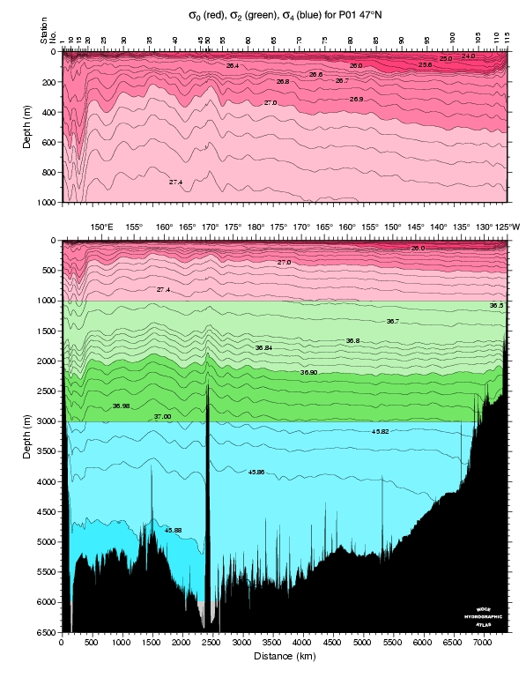
Vertical Section of Subpolar Gyre
From WHP Pacific Atlas; http://www-pord.ucsd.edu/whp_atlas/pacific_index.html

Slide 26
Questions (Due in 2-week)
Name the major surface currents north of about 15°N in the Pacific.
What drives the large gyres of the North Pacific? Describe the dynamic topography distribution that is associated with the gyres. Describe the vertical structure of the subtropical gyre. (What happens to its structure with depth?)
Where is the Kuroshio? Where does it become the Kuroshio Extension? How deep does the Kuroshio Extension reach? What is the circulation just to the south of the Kuroshio Extension? Does the Kuroshio Extension transport vary with longitude?
What is the surface structure that separates waters of the subtropical and subpolar gyres? What is its importance for fisheries?
How does water get from the surface to below the surface in the subtropical gyre? (What is subduction?)

Slide 27
Calculations
If the California Current velocity is 10 cm/sec over a depth of 200 m, with a width of 100 km, what is its approximate transport?
Calculate the approximate heat transport associated with the shallow part of the Kuroshio and its return flow. Assume that 50 Sv flows northward in the Kuroshio at 22°C, and returns southward in the interior at 18°C. Use a density of 1025 kg/m³ and a specific heat of 3850 J/(kg°C).

Slide 28
Learning about the Ocean, the Climate and the Nature

