Slide 1
Lecture 13: Pacific Ocean: Equatorial Circulation and Eastern Boundary Current
Descriptive Physical Oceanography
杨海军（YANG Haijun）复旦大学大气与海洋科学系
Department of Atmospheric and Oceanic Sciences, Fudan University
Email: yanghj@fudan.edu.cn
This powerpoint was prepared for purposes of this lecture and course only. It contains graphics from copyrighted books, journals and other products. Please do not use without acknowledgment of these sources.

Slide 2
Reading:
  Tomczak and Godfrey pp 112-121 (Pacific Equatorial)
  Tomczak and Godfrey pp. 131-136 (Eastern Boundary Current)
Outline:
  North Equatorial Current
  North Equatorial Counter Current
  South Equatorial Counter Current
  Equatorial Current System
    Equatorial Undercurrent
    Equatorial Intermediate Current
    Equatorial Upwelling
Notes:
Paper on these currents

Slide 3
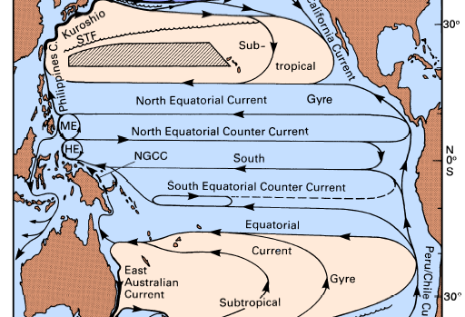
Tropical Pacific Surface Current (Tomczak and Godfrey )
Indonesia Throughflow
Mindanao Eddy
Halmahera Eddy
New Guinea Coastal Current
Notes:
HE：哈马黑拉涡旋。 哈马里拉岛印度尼西亚东部的一座岛屿，位于新几内亚与苏拉威西岛之间。它形状不规则，是摩鹿加群岛中最大的一个岛。日军对它的占领使它在1944年成为盟军一个频繁轰炸的目标

Slide 4
North Equatorial Current (NEC) and South Equatorial Current (SEC)
155^{O}W
Notes:
This northern path is suppressed near the surface during the Northwest Monsoon season (December - March) but continues below the then prevailing southward surface flow as the Great Barrier Reef Undercurrent (Figure 8.11). The SEC therefore continues to feed the Equatorial Undercurrent during the monsoon season but does not supply source waters for the North Equatorial Countercurrent during those months.

Slide 5
North Equatorial Current (NEC)
Westward, directly wind-driven
Strongly seasonal, greatest strength during the winter when the trade winds are strongest.
NEC: 45 Sv, speeds ~ 0.3 m/s; strongest in February (?).
Notes:
This northern path is suppressed near the surface during the Northwest Monsoon season (December - March) but continues below the then prevailing southward surface flow as the Great Barrier Reef Undercurrent (Figure 8.11). The SEC therefore continues to feed the Equatorial Undercurrent during the monsoon season but does not supply source waters for the North Equatorial Countercurrent during those months.

Slide 6
South Equatorial Current (SEC)
SEC: strongest in August, speeds ~ 0.6 m/s. Transport at 155°W ~ 27 Sv; 7 Sv in February (?).
SEC bifurcates near 18°S; part of it feeds the East Australian Current, while its northern part continues northward along the Great Barrier Reef and through the Solomon Sea and passes through Vitiaz Strait to feed the NECC and the EUC.
Notes:
This northern path is suppressed near the surface during the Northwest Monsoon season (December - March) but continues below the then prevailing southward surface flow as the Great Barrier Reef Undercurrent (Figure 8.11). The SEC therefore continues to feed the Equatorial Undercurrent during the monsoon season but does not supply source waters for the North Equatorial Countercurrent during those months.

Slide 7
North Equatorial Countercurrent (NECC)
135^{O}E
110^{O}W
90^{O}W
Eastward, fed by WBC both from the south and the north.
Annual mean transport decreases uniformly from 45 Sv west of 135°E to 10 Sv east of (90^{O}W) the Galapagos Islands (加拉帕哥斯群岛, 位于厄瓜多尔西部).
In its formation region the NECC participates in the Mindanao Eddy. At its other end it turns north on approaching the central American shelf, creating cyclonic flow close to the continent.

Slide 8
North Equatorial Countercurrent (NECC)
The NECC varies seasonally in strength and position.
During February - April when the Northwest Monsoon prevents the South Equatorial Current from feeding the NECC the Countercurrent is fed only from the north. It is then restricted to 4 - 6°N with a volume transport of 15 Sv and maximum speeds below 0.2 m/s; east of 110°W it disappears altogether.
During May - January the NECC flows between 5°N and 10°N with surface speeds of 0.4 - 0.6 m/s. It is then fed from both hemispheres. The water that enters the NECC west of 140°E from the south is again lost to the south before reaching the dateline. Significant loss of water from the current is indicated by the strong eastward decrease of its transport. Historical data indicate that in the eastern Pacific Ocean most of this loss occurs to the south.

Slide 9
South Equatorial Countercurrent (SECC)
135^{O}E
180^{O}E
110^{O}W
90^{O}W
Weak eastward surface current, not seen in current maps based on ship drifts but persistently found in results of geostrophic calculations.
Lack of ship traffic, high variability in space and time.
Typical surface speeds < 0.3 m/s at 170°E, transport ~ 10 Sv.

Slide 10
South Equatorial Countercurrent (SECC)
Located at a minimum of annual mean wind stress and is therefore strongly seasonal. It is strongest during the Northwest Monsoon (the cause of the wind stress minimum, February - April) and barely seen during austral winter.
In both seasons its strength decreases rapidly east of the dateline, and it may be absent from the eastern Pacific Ocean during most months.

Slide 11
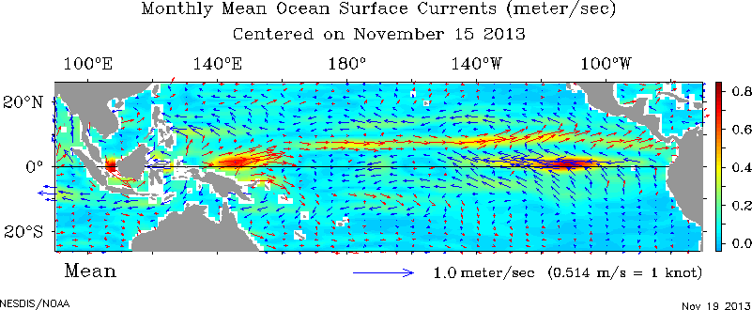
Equatorial Surface Current
Near-realtime ocean surface currents derived from satellite altimeter and scatterometer data
http://www.oscar.noaa.gov/datadisplay/ (doesn’t work anymore)

Slide 12
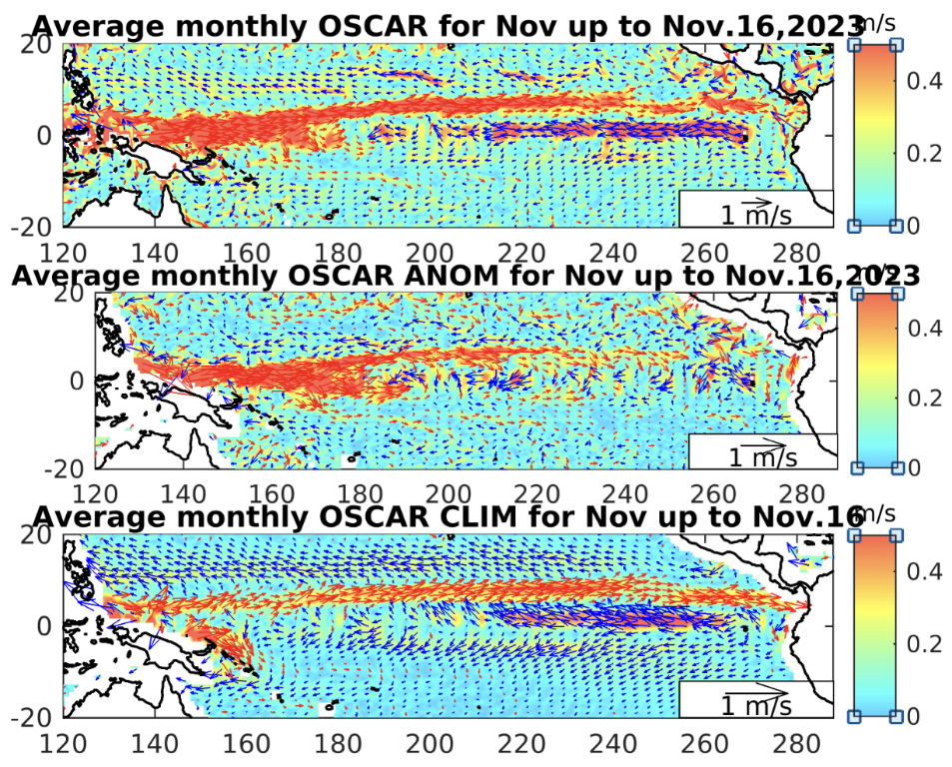
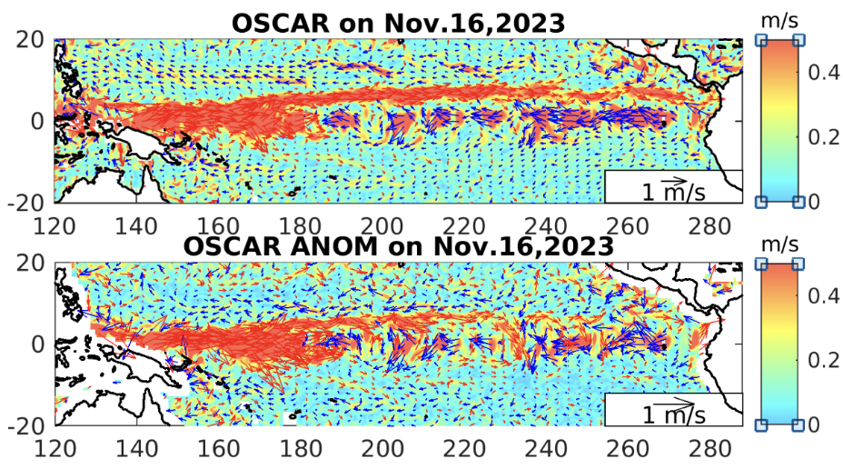
Equatorial Surface Current
https://www.esr.org/research/oscar/equatorial-pacific-conditions/

Slide 13
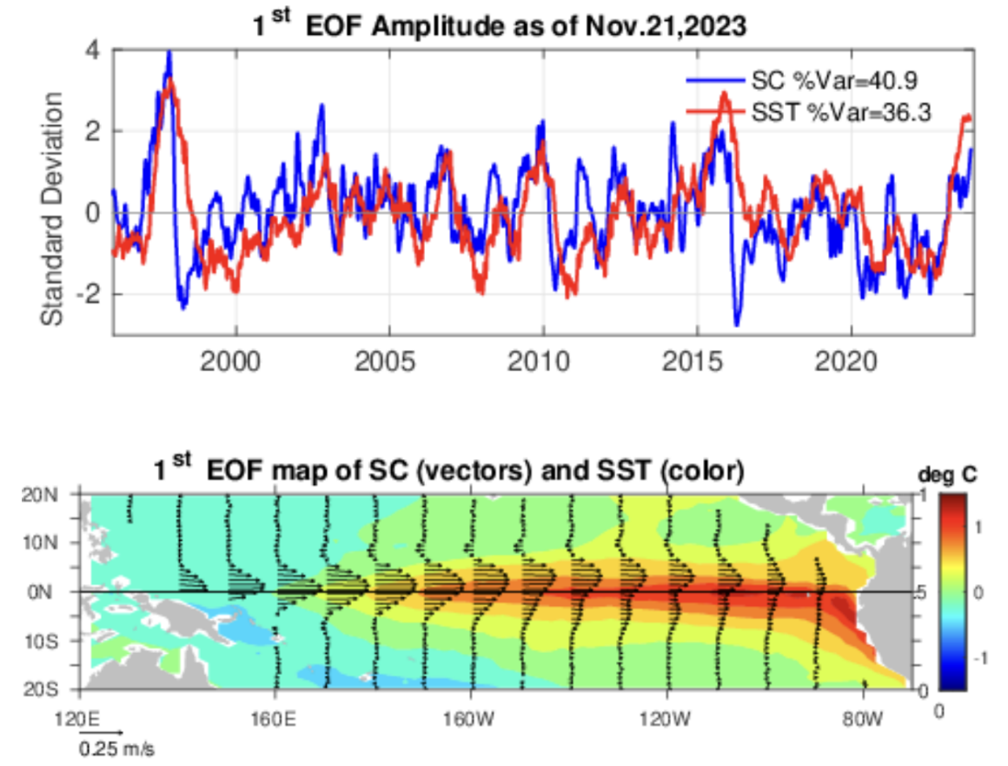
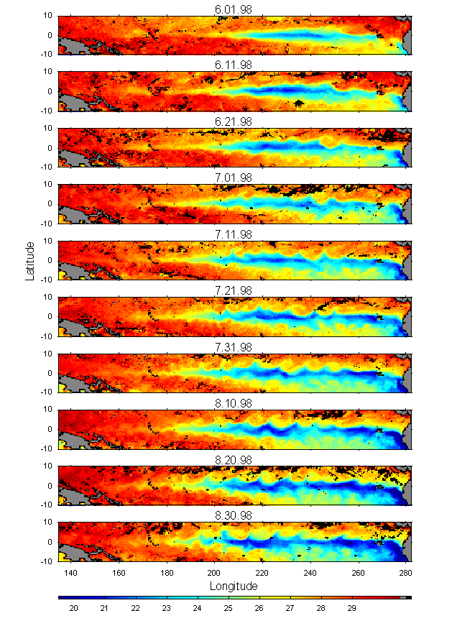
Equatorial Surface Current manifested by SST
https://www.esr.org/research/oscar/equatorial-pacific-conditions/

Slide 14
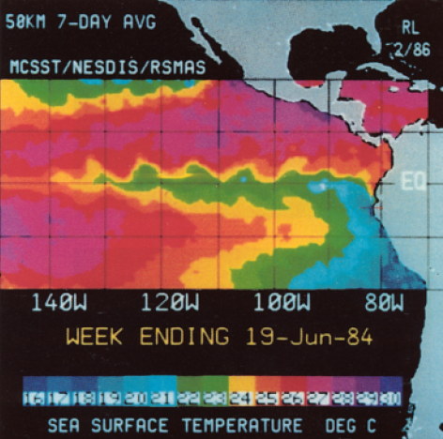
Instability
Instabilities at the front between the SEC and the NECC in the eastern Pacific Ocean between 110°W and 140°W due to large horizontal shear. Satellite image of SST showing cool water along the equator resulting from upwelling and waves of about 1000 km wavelength in the region of the largest gradient. The instability disappears during March - May when the SEC and NECC flow with reduced strength. From Legeckis (1986).

Slide 15
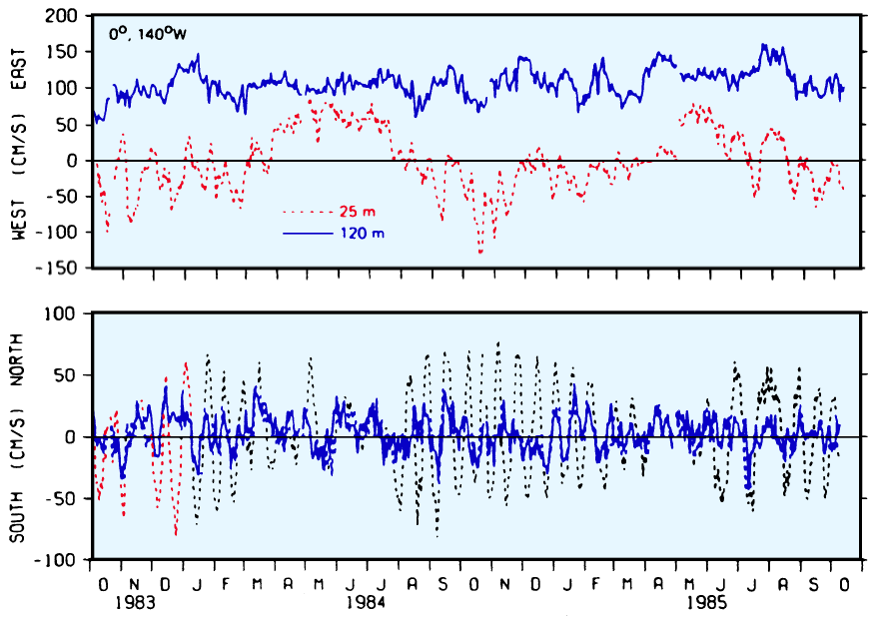
Instability
U
V
Daily means of current components at the equator, 140°W. Note that the 20 - 25 day oscillations do not occur in the Equatorial Undercurrent (120 m level) and are restricted to the meridional component. Note also the absence of oscillations during March - June. From Halpern et al. (1988).

Slide 16
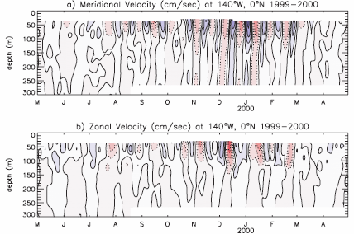
Tropical Instability Waves
Period: 15-40 days / Wavelengths: 700-1600 km
John M. Lyman et al, 2006, JPO: Distinct 17-day and 33-day Tropical Instability Waves in Subsurface Observations.

Slide 17
Equatorial Current System
Equatorial current system in the Pacific has a banded structure and contains more elements of eastward flow than from the integrated flow field.
The most prominent of all eastward flows is the Equatorial Undercurrent (EUC). It is a swift flowing ribbon of water extending over a distance of more than 14,000 km along the equator with a thickness of only 200 m and a width of at most 400 km. The current core is found at 200 m depth in the west, rises to 40 m or less in the east and shows typical speeds of up to 1.5 m s⁻¹. Surface flow above the EUC is usually to the west.
Notes:
None of the theories of ocean dynamics at the time predicted eastward subsurface flow at the equator. The discovery of the Atlantic Equatorial Undercurrent by Buchanan 80 years earlier (see Chapter 14) had been forgotten, and the discovery of the Pacific EUC was therefore a major event in oceanography; for a few years after Cromwell's death the Undercurrent was called the Cromwell Current.

Slide 18
Equatorial Current System
EUC does not appear in reports of ship drift. Although it is the swiftest of all equatorial currents its existence remained unknown to oceanographers until 1952 when it was discovered by Townsend Cromwell and Ray Montgomery.
Notes:
None of the theories of ocean dynamics at the time predicted eastward subsurface flow at the equator. The discovery of the Atlantic Equatorial Undercurrent by Buchanan 80 years earlier (see Chapter 14) had been forgotten, and the discovery of the Pacific EUC was therefore a major event in oceanography; for a few years after Cromwell's death the Undercurrent was called the Cromwell Current.

Slide 19
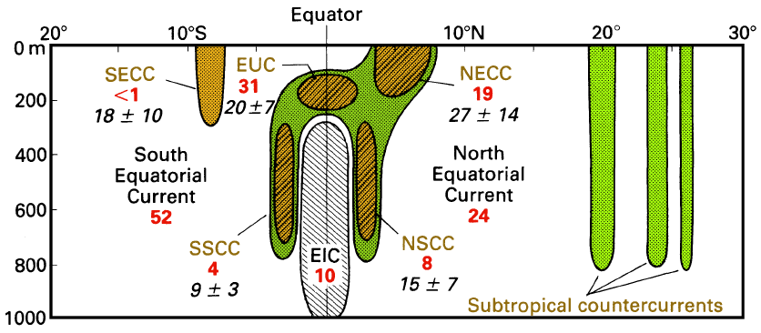
Equatorial Current System
Along 170°W (the central Pacific Ocean). Eastward flow is colored.
All westward flow north of 5°N are the NEC, westward flow south of 5N outside the EIC represents the SEC.
EIC = Equatorial Intermediate Current, NSCC and SSCC = North and South Subsurface Countercurrents.
Transports in Sverdrup are given for 155°W (red, based on observations from April 1979 - March 1980) and 165E (black, based on January 1984 - June 1986).

Slide 20
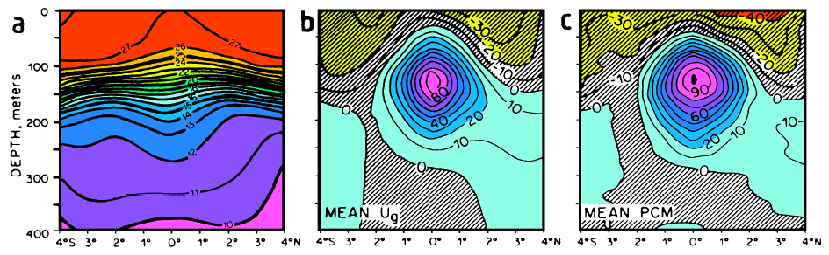
Equatorial Undercurrent (EUC, 赤道潜流)
The Equatorial Undercurrent during February 1979 - June 1980 near 155°W. (a) Mean temperature (°C), (b) mean geostrophic zonal velocity (cm/s), (c) mean observed zonal velocity (cm/s). Note the spreading of the isotherms at the equator. From Lukas and Firing (1984).

Slide 21
Equatorial Undercurrent
The EUC is seen as a spreading of the isotherms in the thermocline. This weakening of the vertical temperature gradient occurs for two reasons.
Firstly, it shows the "thermal wind" character of the Undercurrent : above about 150 m, eastward current increases with depth, and isotherms slope downward on either side of the current; between 150 m and 250 m, eastward current decreases with depth, and isotherms slope upward.
A second reason: The pressure gradient at the equator also has a zonal component, a result of the trade winds which dominate the tropics and subtropics from 30°S to 30°N and produce an accumulation of warm water in the western Pacific Ocean.
Notes:
155 W

Slide 22
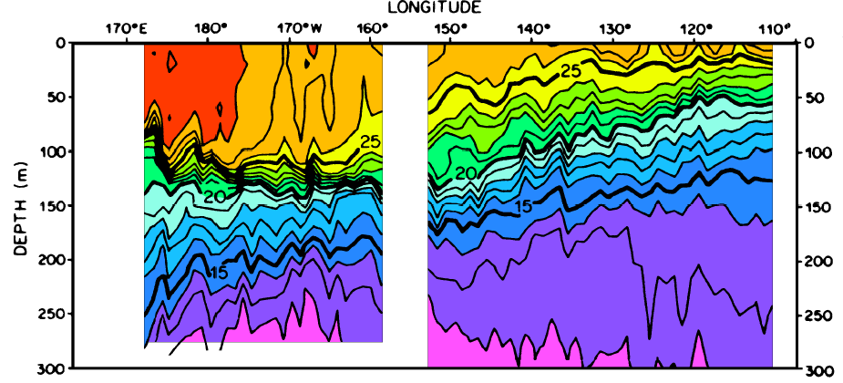
Equatorial Undercurrent
Temperature section along the equator. Note the variation in the thickness of the nearly isothermal layer (temperatures above 26°C) from 100 m in the west to less than 20 m in the east, and the upward slope of the thermocline (temperatures between 15°C and 20°C) from west to east from 200 m to 70 m. From Halpern (1980).
The sea level difference between the Philippines and Central America amounts to about 0.5 m and produces a zonal pressure gradient which is unopposed by a Coriolis force. As a result, the current below the wind-driven surface layer accelerates down the pressure gradient (i.e. from west to east) until friction between the current and its surroundings prevents further acceleration of the flow and establishes a steady state. Friction is associated with mixing, and the Equatorial Undercurrent is therefore a region of unusually strong mixing. This leads to a weakening of the gradients normally found in the thermocline and contributes to the observed spreading of isotherms.

Slide 23
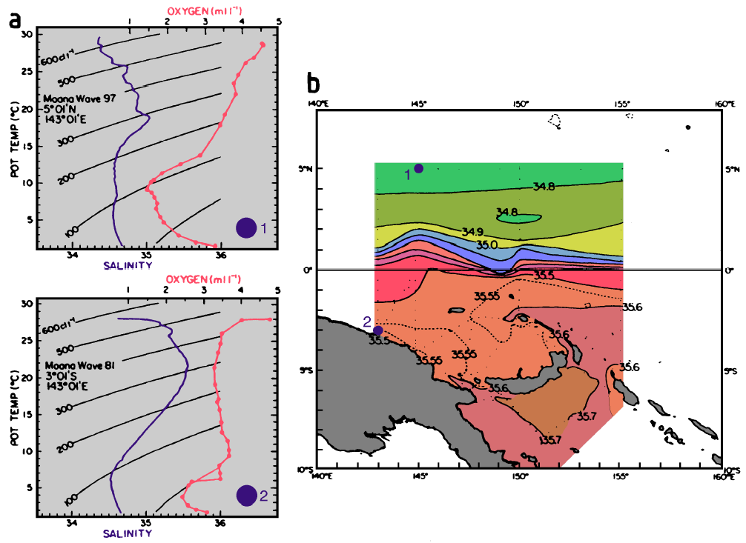
Source Water of EUC
Evidence for separation between northern and southern hemisphere circulation systems in the Pacific thermocline. (a) T-S diagrams and T-O2 diagrams (identified by circles) from two stations north of Papua New Guinea, (b) salinity on an isopycnal surface located at approximately 180 m depth. Note the difference in maximum salinity and the crowding of the isohalines between the equator and 3°N. From Tsuchiya et al. (1989).

Slide 24
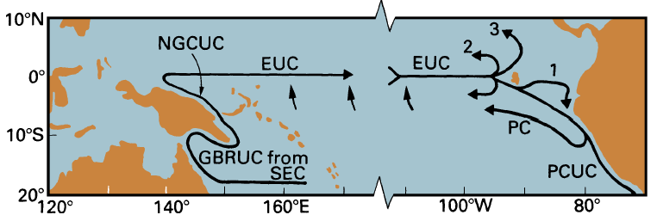
Source Water of EUC
The path of the EUC. SEC: South Equatorial Current. GBRUC: Great Barrier Reef Undercurrent. NGCUC: New Guinea Coastal Undercurrent. PCUC: Peru/Chile Undercurrent. PC: Peru Current (extends to the surface). Flow along path (1) does not occur during July-November. Path (2) is a contribution to the northern flank of the South Equatorial Current, path (3) a smaller contribution to the North Equatorial Current. Based on Tsuchiya et al. (1989) and Lukas (1986).
The EUC belongs entirely to the southern circulation system. Observations show that its source waters originate nearly exclusively from the SH. Most of the 8 Sv transported by the EUC past 143°E can be traced back to the SEC. The transport of the EUC increases downstream, reaching 35 - 40 Sv in the east. The water drawn into the EUC along its way also stems mainly from the south. The southern origin of its waters allows the EUC to be identified as a subsurface salinity maximum.

Slide 25
Equatorial Intermediate Current (EIC)
The EIC is an intensification of westward flow within the general westward movement of the SEC.

Slide 26
Equatorial Intermediate Current (EIC)
Observations over 30 months at 165°E gave an average westward transport of 7.0 ± 4.8 Sv with speeds above 0.2m/s near 300m.
Its core is consistently found with speeds above 0.1 m/s near 900 m. At the same latitudes the cores of the South Subsurface Countercurrent and the North Subsurface Countercurrent are usually located near 600 m.
Recent observations indicate that the banded structure of currents at the equator continues to great depth. The EIC, NSCC, and SSCC are integral parts of a dynamic system that reaches much deeper than the thermocline.

Slide 27
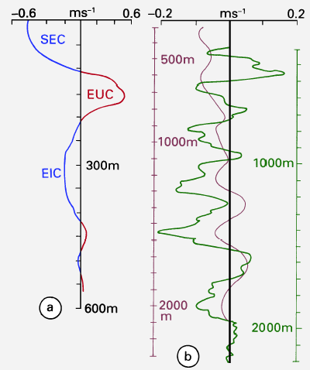
Current Vertical Structure
Westward
Eastward
Evidence for banded structure of currents at the equator.
(a) The South Equatorial Current (SEC), Equatorial Undercurrent (EUC), and Equatorial Intermediate Current (EIC) at 165°E;
(b) deep equatorial currents at 150 - 160°W during 1980 (solid line, right depth scale) and during March 1982 - June 1983 (thin line, left depth scale). The cores of all current bands coincide if the entire current system during 1982/83 is shifted upward some 130 m. Note the different depth and velocity scales. Adapted from Delcroix and Henin (1988) and Firing (1987).

Slide 28
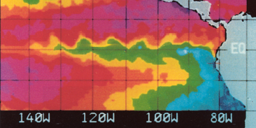
Equatorial Upwelling
2 cm/day
At the equator, there is weak but important meridional movement due to Ekman transport.
This produces a surface divergence and equatorial upwelling in the upper 200 m of the water column between NEC and SEC.
The resulting vertical movement can be determined only by indirect means. Using an array of current meter moorings and applying the principle of continuity of mass between diverging flows it has been estimated as of the order of 0.02 m/day. This is about one order of magnitude smaller than vertical movement in coastal upwelling regions, but the effect is clearly seen in the sea surface temperature.
Vertical transport ~ 47 Sv, indicating that upwelling is an important element of the current system. The meridional motion associated with the upwelling is also essential for the heat balance of the tropical Pacific Ocean. The heat input received at the surface is balanced by advection of cold water, but zonal advection does not achieve much in that respect in the tropics where the east-west temperature gradients are small. It is therefore mainly meridional advection and upwelling of colder subsurface water that balances the heat input.

Slide 29
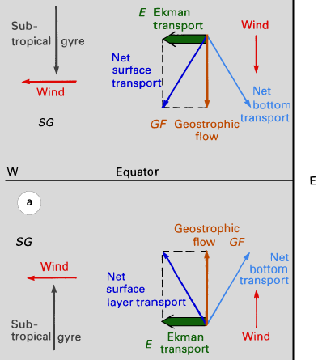
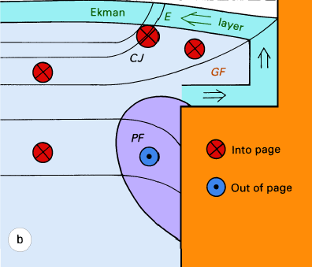
Eastern Boundary Coastal Upwelling
Dynamics of coastal upwelling regions. (a) plan view, (b) vertical section (southern hemisphere). The thin lines in (b) represent isotherms or isopycnals.
CJ: coastal jet. PF: poleward flow.

Slide 30
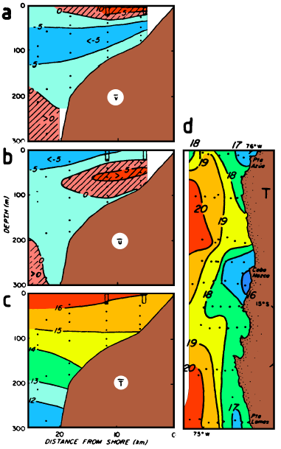
Peru/Chile Upwelling System.
The Peru/Chile upwelling system.
Mean alongshore velocity (cm s⁻¹, positive is equatorward),
mean cross-shelf velocity (cm s⁻¹, positive is shoreward); the offshore Ekman transport is indicated by negative values in the surface layer),
mean temperature (°C); all means are for the period 22/3 - 10/5/1977. Dots indicate current meters, the blocks at the surface special moorings.
Sea surface temperature during 20 -23/3/1977. From Brink et al. (1983).
Notes:
Figure 8.26 shows equatorward surface flow above 30 m, the poleward undercurrent between 30 m and 200 m, offshore Ekman transport above 30 m, and onshore movement of water mainly in the range 30 - 100 m with very little onshore or offshore movement below. Onshore transport in coastal upwelling regions does not extend below 400 m at most. The depth range for onshore movement in the Peru/Chile upwelling system is, however, particularly shallow, probably as a result of the extreme narrowness of the shelf. Upwelling is indicated by the shoaling of the 16°C isotherm, while the downward slope toward the coast of the isotherms below 100 m indicates geostrophic adjustment of the density field to the undercurrent along the slope.

Slide 31
Peru/Chile Current
The most impressive coastal upwelling system of the world ocean.
This current is strong enough to lower sea surface temperatures along South America by several degrees from the zonal average.
Embedded in the current is a vigorous upwelling circulation which lowers the temperatures within 100 km of the coast by another 2 - 4°C.
The Peru/Chile upwelling system is the most productive coastal upwelling region of the world ocean. It extends from south of 40°S into the equatorial region where it blends into the equatorial upwelling belt.
Notes:
the most important fishing regions of the world ocean because they offer optimum conditions for primary production.
The basis for all marine life is photosynthesis in phytoplankton, which can only occur in a layer as deep as sunlight can reach. The other requirement are nutrients to support phytoplankton growth.
Coastal upwelling regions are among the few regions of the world ocean where nutrients are returned to the surface layer and made available for phytoplankton growth. This forms the basis for a marine food chain with high productivity. All coastal upwelling regions therefore support important fisheries.
The Peru/Chile upwelling system is the most productive coastal upwelling region of the
world ocean. It extends from south of 40°S into the equatorial region where it blends into
the equatorial upwelling belt. Despite its vast resources, human greed managed to destroy
the basis of what before 1973 was the largest fishery in the world. Overfishing and natural
variability of the upwelling environment brought about the end of an industry. This aspect
of the Peru/Chile Current System will be taken up again in Chapter 19.
Considerable uncertainty exists about the details of the flow field in the southern part of
the Peru/Chile Current. The upwelling undercurrent is known to extend from at least north
of 10°S to 43°S and possibly beyond, decreasing in strength from some 0.1 m s-1 in the
north to barely more than 0.02 m s-1 in the south. Further offshore a conspicuous feature
is a surface salinity minimum along 40°S (Figure 2.5b). It is known that rainfall along the
coast is large in the region; but it can easily be shown that rainfall alone cannot explain the
observed salinity minimum. Some researchers conclude that westward flow against the
prevailing direction of the subtropical gyre circulation must occur in the region. This may
explain why the Subtropical Front is displaced so far northward in the Pacific Ocean off
South America and ill defined.

Slide 32
Questions (Due 2-week)
Why is there such strong upwelling at the equator?
What are the principle zonal currents in the equatorial Pacific?
What is thought to drive the Equatorial Undercurrent?
Where does the water in the Equatorial Undercurrent come from?
What direction must the wind blow for coastal upwelling to occur?
How are boundary currents on the eastern and western margins of the ocean different? What features do they have in common?

Slide 33
Calculations
A steady westward wind blows across an ocean basin which is 5000 km wide. The surface wind stress measured at 5º north and 5º south is 0.05 N/m². Calculate the net Ekman mass transport at these two latitudes. What is the average rate of upwelling between 5º north and 5º south.
Suppose the water upwelling between 5º north and 5º south has a temperature of 24º and the mean ocean heating over this region is 100 W/m². What is the mean temperature of the water flowing across 5º latitude in the Ekman layer?

Slide 34

Learning about the Ocean, the Climate and the Nature

