Slide 1
Lecture 15: Indian Ocean and Monsoons Descriptive Physical Oceanography
杨海军（YANG Haijun） 陈长霖（CHEN Changlin)
复旦大学大气与海洋科学系
Department of Atmospheric and Oceanic Sciences, Fudan University
Email: yanghj@fudan.edu.cn
This powerpoint was prepared for purposes of this lecture and course only. It contains graphics from copyrighted books, journals and other products. Please do not use without acknowledgment of these sources.

Slide 2
Reading:
Tomczak and Godfrey ch. 11
Good site for many resources in Indian Ocean: Southampton Oceanography Centre site
Outline:
Indian Ocean monsoons
Indian Ocean: other wind-driven gyres
Indonesian throughflow (印度尼西亚贯穿流)
Agulhas Current (阿加勒斯海流)
Indian Ocean Dipole
Indian Ocean deep ocean circulation and contribution to global circulation

Slide 3
The Indian Ocean
The most striking difference from the Pacific Ocean is the seasonal reversal of the monsoon winds and its effects on the ocean currents in the northern hemisphere.
Absence of a temperate and polar region north of the equator
None of the leading oceanographic research nations shares its coastlines with the Indian Ocean. Few research vessels entered it, fewer still spent much time in it.
International Indian Ocean Expedition (IIOE) during 1962 – 1965.
Notes:
The Indian Ocean is the only ocean where due to lack of data the truly magnificent textbook of Sverdrup et al. (1942) missed a major water mass - the Australasian Mediterranean Water - completely. The situation did not change until only thirty years ago, when over 40 research vessels from 25 nations participated in the International Indian Ocean Expedition (IIOE) during 1962 - 1965. Its data were compiled and interpreted in an atlas (Wyrtki, 1971, reprinted 1988) which remains the major reference for Indian Ocean research. Nevertheless, important ideas did not exist or were not clearly expressed when the atlas was prepared, and the hydrography of the Indian Ocean still requires much study before a clear picture will emerge. Long-term current meter moorings were not deployed until two decades ago, notably during the INDEX campaign of 1976 - 1979; until then, the study of Indian Ocean dynamics was restricted to the analysis of ship drift data and did not reach below the surface layer.

Slide 4
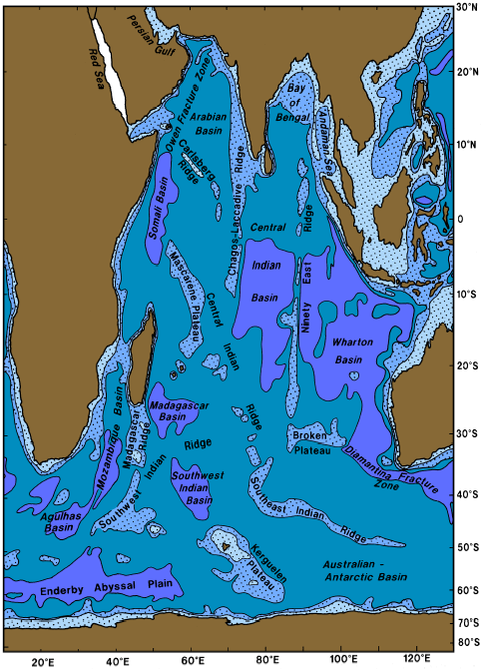
Bottom Topography
Topography of the Indian Ocean. The 1000, 3000, and 5000 m isobaths are shown, and regions less than 3000 m deep are shaded. (Tomczak and Godfrey text) The smallest oceans, N-S: 9600 km; E-W: 7800 km; Area: 74.1x10⁶ km²; many basins, ridges, no high northern latitudes. Arabian Sea; Bay of Bengal; Persian Gulf; Red Sea Height of Tibetan plateau important for monsoons
Notes:
The Indian Ocean is the smallest of all oceans (including the Southern Ocean). It has a
north-south extent of 9600 km from Antarctica to the inner Bay of Bengal and spans
7800 km in east-west direction between southern Africa and western Australia. Without its
southern ocean part it covers an area of 48.106 km2. If the southern ocean part is included,
the area increases to 74.1.106 km2. The only large shelf area is the Northwest Australian
Shelf, a region of strong tidal dissipation. It is part of the large expanse of continental shelf
between Australia and south-east Asia that continues as the Timor and Arafura Seas and the
Gulf of Carpentaria; however, these latter regions are considered part of the Pacific Ocean.
The Northwest Australian Shelf itself is insufficient in size to have much impact on the
mean depth of the Indian Ocean, which with 3800 m is between that of the Pacific and
Atlantic Oceans. Most basins show depths well below 5000 m; in the east, the Wharton
Basin exceeds 6000 m depth. The Arabian Sea reaches depths below 3000 m over most of
its area, while the depth in the Bay of Bengal decreases gradually from 4000 m south of Sri
Lanka to 2000 m and less at 18°N.
Three mediterranean seas influence the hydrographic properties of Indian Ocean water
masses. The Persian Gulf is the smallest of the three; with a mean depth of 25 m, a
maximum depth of only 90 m, and a sill which rises barely above the mean depth its
impact is not felt much beyond the Gulf of Oman. The Red Sea is a very deep basin with
maximum depths around 2740 m and a mean depth near 490 m; its sill depth is about
110 m. The Australasian Mediterranean Sea, a series of very deep basins with depths
exceeding 7400 m, communicates with the Indian Ocean through various passages between
the Indonesian islands where the depth is in the range 1100 - 1500 m.

Slide 5
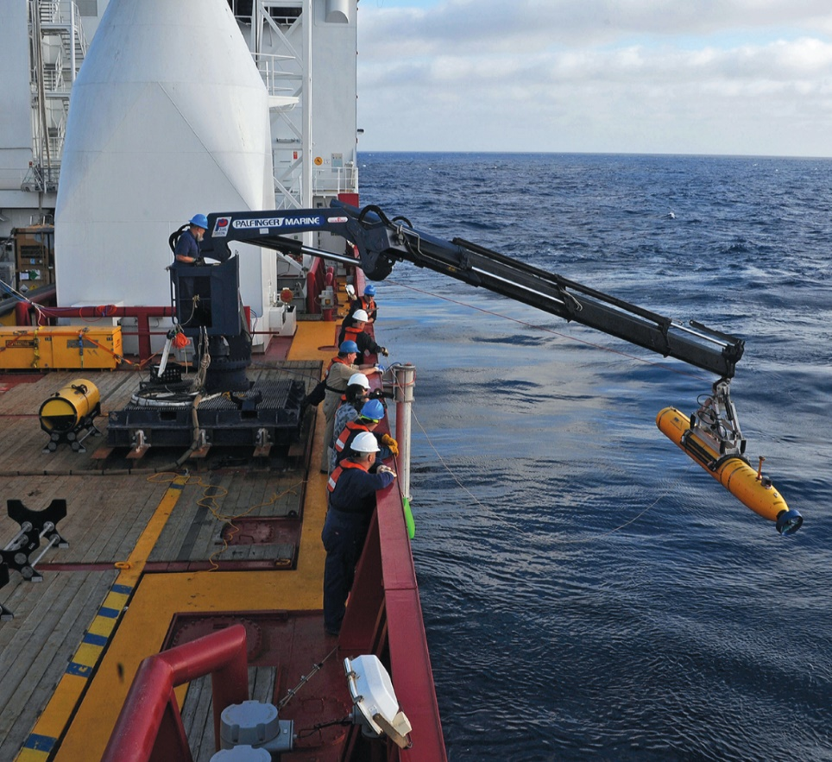
An Australian navy vessel deploys the U.S. Navy's Bluefin-21 Artemis AUV, which has used side-scan sonar to scour 400 square kilometers of seabed in the search for MH370.
D Normile Science 2014;344:963-965
Published by AAAS
Notes:
An Australian navy vessel deploys the U.S. Navy's Bluefin-21 Artemis AUV, which has used side-scan sonar to scour 400 square kilometers of seabed in the search for MH370.

Slide 6
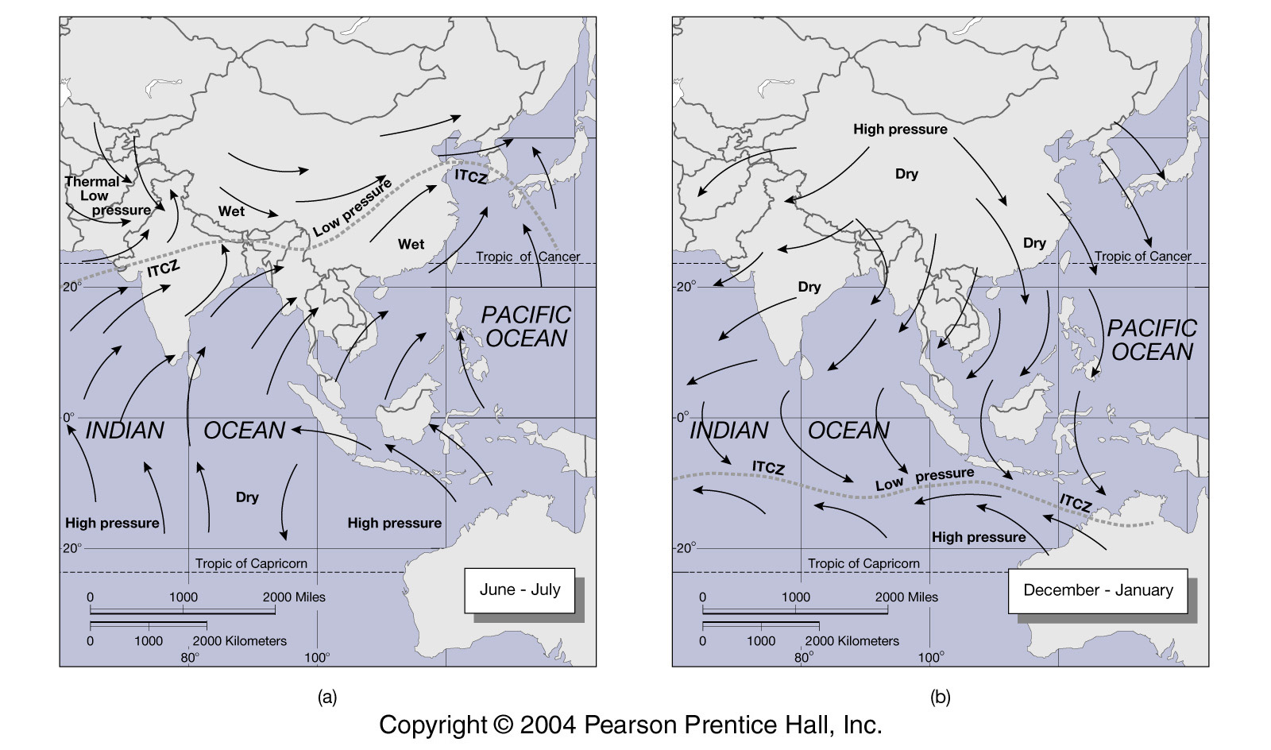
Indian Ocean Monsoon
SW Monsoon
NE Monsoon
Kump et al. Text (2004)
Notes:
Monsoonal climate dominates the northern Indian Ocean, and its effects are felt far into
the subtropics of the southern hemisphere. Annual mean distributions of atmospheric and
oceanic parameters are therefore of only limited use. Instead, we define two mean states and
discuss both separately. The information is again contained in Figs 1.2 - 1.4. A summary
of the monsoon cycle is given in Figure 11.2. An introductory but comprehensive account
of monsoon meteorology is given by Fein and Stephens (1987).
The Northeast or Winter Monsoon determines the climate of the northern Indian Ocean
during the northern hemisphere winter (December - March). It is characterized by high
pressure over the Asian land mass and northeasterly winds over the tropics and northern
subtropics. The situation resembles the annual mean wind circulation over the Pacific
Ocean, except that the Intertropical Convergence Zone (ITCZ) and the Doldrums are located
south of the equator (near 5°S) rather than north. The wind over the northern Indian Ocean
represents the Trades, but because of its seasonality it is known as the Northeast Monsoon.
(The word monsoon is derived from the Arabic, meaning seasonally reversing winds.) Since
most of the air pressure gradient is retained behind the Tibetan Plateau, air pressure
gradients over the ocean are small. This protects the ocean from the full force of the winds
blowing off the Mongolian high pressure region and results in a wind of moderate strength,
comparable to the Pacific Northeast Trades which are also relatively weak at this time of
year. The wind also carries dry air, and the Winter Monsoon season is the dry season for
most of southern Asia.
The situation in the southern hemisphere is dominated by the pressure gradient between
the tropical low and the subtropical high pressure belts. The axis of low pressure in the
tropics is near 10°S, while the subtropical high pressure belt is dominated by an air
pressure maximum 1000 km north of the Kerguelen Islands. The resulting Southeast
Trades are rather uniform and somewhat stronger than in the Pacific Ocean. As in the other
oceans the Trades are southerly along the eastern coast, but over Australia's Northwest
Shelf winds become south-westerly, skirting the heat low over that continent. This brings
summer rain to northern Australia. Rain also occurs throughout the Doldrums, with
maximum rainfall in the Indonesian region.
The Southwest or Summer Monsoon determines the climate of the northern Indian Ocean
during the northern hemisphere summer (June - September). A deep heat low develops over
northern Arabia and Pakistan. The Australian heat low of the southern summer is replaced
by a centre of high pressure, while the atmospheric high north of the Kerguelen Islands is
shifted westward towards southern Africa. Whereas during the winter monsoon season the
north-south pressure gradient from Arabia to Madagascar barely exceeds 6 hPa, there is now
a gradient of 22 hPa acting in the opposite direction. As a result the winds in the northern
Indian Ocean reverse completely and are no longer like the Trades anywhere. A wind jet,
believed to be an atmospheric version of a western boundary current, develops along the
high east African topography. Winds blow steadily at Beaufort 6 or more over the entire
western Indian Ocean north of the equator. Further east along the equator the winds weaken,
bringing moderate rainfall; but there is still a southerly component throughout the entire
Indian Ocean everywhere north of 30°S. On the Northwest Shelf the wind blows directly
offshore with moderate strength.
The Southwest Monsoon, as this wind is called in the northern hemisphere, is the
continuation of the southern hemisphere Trades, which between 10 and 20°S are stronger,
during this time of year, than anywhere else in the world. The Southwest Monsoon skirts
the low over Pakistan to deposit rain on the Himalayas, thus bringing with it the monsoon
rains and floods that are so crucial to Asian agriculture.
The position of the ITCZ over the ocean changes little between the seasons, but during
the Southwest Monsoon frequent disturbances break away from it to settle south of the
Himalayas, bringing with them most of the season's rain. Winds at the equator change
direction but remain weak throughout the year. Because of their meridional orientation the
associated Ekman transport does not develop a divergence at the equator. There is therefore
no equatorial upwelling in the Indian Ocean. Strong equatorial downwelling occurs during
the transition months (May and November) when the winds turn eastward at the equator,
producing Ekman transport convergence.
Conditions for coastal upwelling are also markedly different in the Indian Ocean. Along the
eastern coastline, where the most important upwelling regions of the Pacific and Atlantic
Oceans are found, winds favourable for upwelling along the Australian coast are weak
during the Northeast Monsoon season and absent during the Southwest Monsoon season. A
small upwelling region can be expected in the latter season along the coast of Java. But the
strongest upwelling of the Indian Ocean occurs along its western coastline when the
Southwest Monsoon produces strong Ekman transport away from the coasts of Somalia and
Arabia.
We saw in Chapter 4 that the Sverdup relation, which compares circulation patterns
derived from annual mean integrated steric height and annual mean wind stress, gives very
good agreement in the Indian Ocean despite the seasonal reversals of the monsoon winds. It
is therefore instructive to look at the annual mean atmospheric circulation over the Indian
Ocean as well. The southern hemisphere Trades stand out as particularly strong, in the
annual mean, when compared with the other oceans. As we have seen, the larger
contribution to this comes from the Summer Monsoon season. The stronger winds of this
season dominate the annual mean in the northern Indian Ocean as well. This produces a net
southwesterly stress over the northwestern Indian Ocean and in particular along the East
African coast. Mean winds in the northeast and along the equator are weak and westerly.

Slide 7
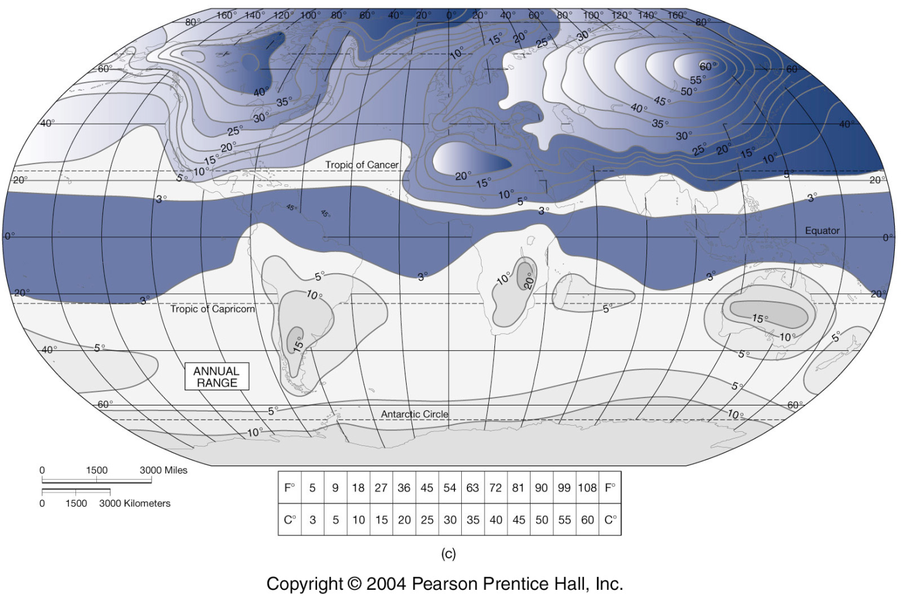
Surface Temperature Range
Sea surface temperature variations are much smaller than land surface temperature variations. (Mainly the seasonal cycle) (Kump et al. text, 2004)

Slide 8
Monsoon Schematic: Summer Hemisphere
Idealized representation of the monsoon circulation. The island in the figure represent the tropical continents in the summer hemisphere. Solid lines represent isobars or geopotential height contours near sea level or 1000 mb (lower plane) and 14 km or 200 mb (upper plane. Short solid arrows indicate the cross-isobar flow. Vertical arrows indicate the sense of the vertical motion in the middle troposphere. Wallace and Hobbs textbook (1977)
Notes:
Idealized

Slide 9
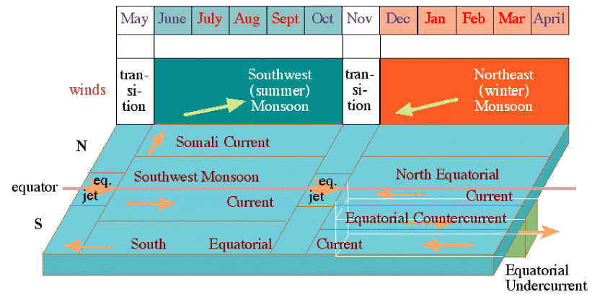
Asian (Indian) Monsoon
Large changes in wind direction, precipitation, and ocean circulation. A summary of the monsoon system in the Indian Ocean. The top part indicates the wind cycle, the lower part shows the major currents that develop in response to the wind. (Tomczak and Godfrey textbook)

Slide 10
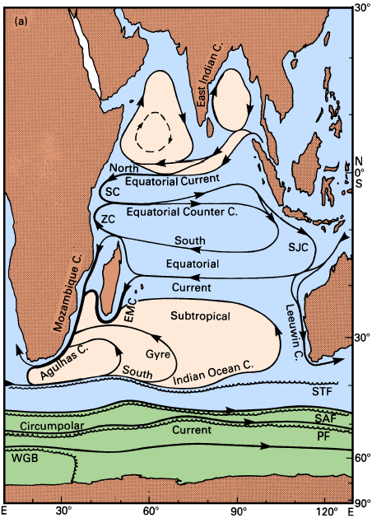
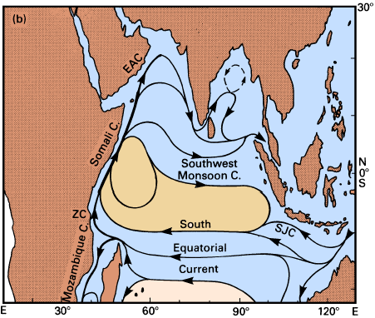
The Surface Flow
Left: late Northeast Monsoon season (March - April);
Right: late Southwest Monsoon season (September - October; the circulation south of 20°S remains unchanged).
Abbreviations are used for the East Arabian (EAC), South Java (SJC), Zanzibar (ZC,桑给巴尔), East Madagascar (EMC), and Somali (SC) Currents. Other abbreviations denote fronts: STF: Subtropical Front, SAF: Subantarctic Front, PF: Antarctic Polar Front, WGB: Weddell Gyre Boundary. (Tomczak and Godfrey textbook)
Notes:
We begin the comparison between the depth-integrated flow (Figs 4.4 - 4.7) and the
observed surface circulation (Figure 11.3) with the southern Indian Ocean which does not
experience monsoonal winds. The Sverdrup stream function (Figure 4.7) shows a
particularly strong subtropical gyre, a result of large wind stress curl between the annual
mean Trades and Westerlies (Figure 1.4). South of 10°S and away from the Australian coast
the pattern agrees well with the observations. Both show the South Equatorial Current
being fed by the throughflow of Pacific water through the Indonesian seas and strengthening
westward. The bifurcation east of Madagascar and again near the African coast is also seen
in the Sverdrup flow, as is the joining of the Mozambique and East Madagascar Currents
into the Agulhas Current. Furthermore, the Sverdrup relation implies net southward flow
across 10°S in response to strong negative wind stress curl; this generates the eastward
flowing Equatorial Countercurrent north of 10°S as its source of supply. To the best of our
knowledge, the annual mean transports of the open-ocean currents are well predicted by the
Sverdrup relation, and the transports of the East Madagascar, Mozambique, and Agulhas
Currents follow quite accurately from mass continuity.
Significant discrepancies between the Sverdrup circulation and observations are seen in
the Agulhas Current extension region, for reasons discussed in Chapter 4, and in the
Leeuwin Current. The net depth-averaged flow along the Australian coast is in fact very
close to that given by the Sverdrup circulation; but the shallow Leeuwin Current is
accompanied by an undercurrent of nearly equal transport (to be discussed below), and the
surface circulation is therefore not representative for the depth-averaged flow.
In contrast, the annual mean flow in the northern Indian Ocean is almost featureless, both
in the Sverdrup circulation maps and in observations. The stream function map does not
show a single streamline for the northern hemisphere, so any mean circulation that does
develop must be weaker than 10 Sv (the contour interval used for Figure 4.7). This is, of
course, a somewhat theoretical result since it represents the mean of two strong monsoonal
current systems. The annual mean is still of use when it comes to the calculation of heat
fluxes between the hemispheres, and we shall come back to this in Chapter 18. But in a
discussion of monsoonal surface currents the Sverdrup relation has its limits, and we now
turn to a description based on current and hydrographic observations.
During the Northeast Monsoon season the current system resembles closely those of the
Pacific and Atlantic Oceans. The subtropical gyre dominates the southern hemisphere. For a
long time it was believed that eastward flow in the south is achieved by the Circumpolar
Current. Following the recent discovery of the South Atlantic Current as a distinct element
of the south Atlantic subtropical gyre (Chapter 14), Stramma (1992) showed the existence
of a similar South Indian Ocean Current north of the Circumpolar Current. The current
follows the northern flank of the Subtropical Front, carrying some 60 Sv in the upper
1000 m southeast of Africa and gradually releasing its waters into the gyre. Southwest of
Australia its transport is reduced to about 10 Sv. Zonal flow immediately south of the
Subtropical Front is usually weak, indicating that the South Indian Ocean and the
Circumpolar Currents are two distinct features of the circulation.
The subtropical gyre of the northern hemisphere is not well-defined; most of the water
carried in the North Equatorial Current returns east with the Equatorial Countercurrent near
5°S, leaving little net transport for the weak currents in the northern Indian Ocean. The
Equatorial Countercurrent continues into the South Java Current, which during this season
feeds its waters into the Indonesian seas and southward into the South Equatorial Current.
Currents flow in the opposite direction north of 10°S during the Southwest Monsoon
season, when the South Equatorial Current intensifies and feeds part of its flow into the
Somali Current, the western boundary current of the anticyclonic circulation that develops
in the northern hemisphere. The North Equatorial Current disappears, and the Equatorial
Countercurrent becomes absorbed into the Southwest Monsoon Current. Its broad eastward
flow dominates the northern Indian Ocean.
A feature of the circulation which is independent of the monsoon cycle is the strong
separation of the northern and southern hemisphere flow fields along the ITCZ east of 60°E.
Little flow crosses the Doldrums east of the western boundary current. The semi-annual
reversal of the intense flow across the ITCZ along the east African coast north of 10°N has
been well documented during the last two decades. However, it is obvious that at least some
of the water that enters the northern hemisphere from June to October in the west must
leave it during that season. Likewise, at least some of the water that is withdrawn during
December to April has to enter it somewhere in the east during these months. Our
knowledge of the circulation near Java is, however, incomplete, and the details of the mass
balance on seasonal time scales are a topic for the future.
The Indonesian throughflow from the Pacific Ocean enters the Indian Ocean during both
seasons as a narrow band of low salinity water. It is embedded in generally westward flow
and therefore apparently does not develop the strong lateral shear necessary to induce much
instability. It continues westward, providing the core of maximum westward flow in the
equatorial current system, and can be followed over the entire width of the Indian Ocean.
The subtropical gyre of the southern hemisphere is seen with two western boundary
currents, one along eastern Madagascar and one along the coast of Mozambique. Whether
both feed into the Agulhas Current - as indicated by the depth-integrated flow - or whether
the East Madagascar Current feeds back into the gyre independently has been the subject of
debate for some time and will be discussed in more detail later on. Here we only note the
difference between the flow fields based on 1500 m and 2500 m levels of no motion
(Figs 4.5 and 4.6) south of Madagascar; they indicate that the circulation near the end of
the East Madagascar Current reaches deeper than 1500 m, not unlike the situation found in
separation regions of other western boundary currents. The fact that deep flow is not
restricted to the Agulhas Current but extends eastward away from Madagascar makes the
estimation of transports in the gyre difficult and affects in particular our estimates for the
South Equatorial Current.

Slide 11
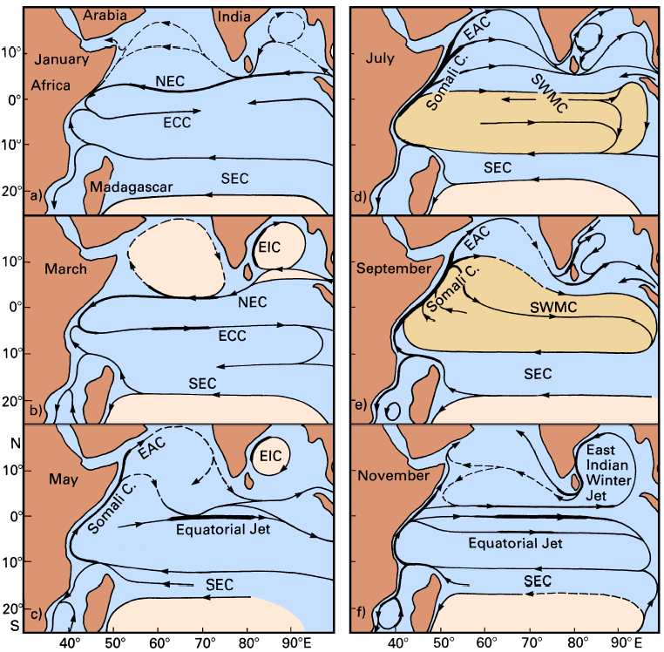
The Equatorial Current System
Surface currents in the northern Indian Ocean as derived from ship drift data.
SEC: South Equatorial Current,
NEC: North Equatorial Current,
ECC: Equatorial Countercurrent,
SWMC: Southwest Monsoon Current, EAC: East Arabian Current,
EIC: East Indian Current.
Adapted from Cutler and Swallow (1984).
Notes:
Cutler and Swallow (1984) used the records of ship drifts collected by the British
Meteorological Office from daily log book entries of merchant ships, to compile an atlas of
surface currents. Currents in the Indian Ocean are stronger than in the Pacific or Atlantic
Oceans during most of the year, which makes ship drift estimates reasonably reliable.
Given the paucity of other information, this atlas is the best source of information on
surface currents near the equator. Information on the subsurface structure became available
with the long-term current meter moorings and time series of vertical current profiles taken
during INDEX; unfortunately it is restricted to the region west of 62°E.
The evolution of surface currents through the seasons is shown in Figure 11.4. The
North Equatorial Current is prominent in January and March when the Northeast Monsoon
is fully established. It runs as a narrow current of about 0.3 m s-1 from Malacca Strait to
southern Sri Lanka, where it bends southward and accelerates to reach 0.5 - 0.8 m s-1
between 2°S and 5°N in the region between 60°E and 75°E. The South Equatorial Current
occupies the region south of 8°S with velocities rarely exceeding 0.3 m s-1. Between these
westward flows runs the Equatorial Countercurrent with 0.5 - 0.8 m s-1 in the west but
getting weaker in the east; in January it does not reach beyond 70°E, being opposed in the
east by weak westward flow.
The transition from Northeast to Southwest Monsoon (Figure 11.4c) is characterized by
the intense Indian Equatorial Jet first described by Wyrtki (1973a). The long-term mean
distributions derived from the ship drift data show it from early April until late June with
velocities of 0.7 m s-1 or more. It is possible that in any particular year the jet appears
within the three-month window April - June as a feature of shorter (one month) duration
with higher peak velocities. The averaging employed with the ship drift data would spread it
over the three months as a weaker feature. The jet is easily observed with drifting buoys
since the current converges at the equator, keeping drifting objects trapped near its core.
Away from the equator the current speed falls off to less than 0.2 m s-1 at 3°S or 3°N.
When the Southwest Monsoon is fully established during July and September, the entire
region north of 5°S is dominated by the eastward flow of the Southwest Monsoon Current,
the only exception being a narrow strip along the equator in July to which we shall return
in a moment. Velocities in the Southwest Monsoon Current are generally close to
0.2 - 0.3 m s-1, but an acceleration to 0.5 - 1.0 m s-1 occurs south and southeast of Sri
Lanka. The South Equatorial Current expands slightly towards north, reaching 6°S in
September. The transition before the onset of the Northeast Monsoon (Figure 11.4f) is
again characterized by the Equatorial Jet. Concentrating all eastward flow in a 600 km wide
band along the equator it reaches its peak in November with velocities of 1.0 - 1.3 m s- 1
and disappears in early January, when the annual cycle is repeated.

Slide 12
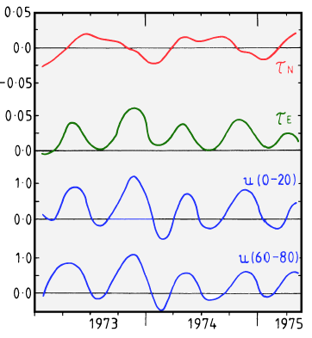
Wind and Current
Monthly mean winds and currents during 1973 - 1975 near the equator at 73°E ( McPhaden, 1982):
Meridional wind stress component τ_{N} (Pa), zonal wind stress component τ_{E} (Pa), and zonal velocities (m/s) averaged over 20 m for 0 - 20 m and 60 - 80 m depth. All directions indicate where currents and winds are going, north and east are positive.
Notes:
A remarkable feature of the equatorial current system is the dominance, within the annual
monsoon cycle, of a semi-annual flow reversal in a narrow band along the equator.
Figure 11.5 compares 21/2 years of wind data near the equator with average currents in two
layers above the thermocline. Winds at the equator are generally light, the meridional wind
component being dominated by the annual monsoon cycle. The zonal wind component, on
the other hand, shows westerly winds during the transition periods and exerts a strong semiannual
signal on the ocean. The associated change of current direction produces semi-annual
variations in thermocline depth and sea level (Figure 11.6). The 20°C isotherm rises off
Africa and falls off Sumatra during periods of eastward flow, indicating a net transport of
20 Sv in the equatorial band. The same transport in the opposite direction occurs during
periods of westward flow when the 20°C isotherm rises off Sumatra and falls off Africa.
The associated zonal slope of the thermocline finds its mirror image (as expressed in our
Rule 1a of chapter 3) in the slope of the sea surface, as indicated by the sea level at
Sumatra.
Figure 11.5 suggests a direct relationship between the zonal current and the zonal wind.
However, the current is not purely wind-driven. An array of current meter moorings was
deployed along the equator between 48°E and 62°E during INDEX (1979 - 1980), with
instruments at 250 m, 500 m, and 750 m depth. The semi-annual current reversal occurred
at all depths, much deeper than could be explained by direct wind forcing (Luyten and
Roemmich, 1982). It appears that the wind reversal in the west is only the triggering
mechanism for a wave phenomenon peculiar to the equatorial region known as a Kelvin
wave. The same process is responsible for interannual climate variations in the equatorial
Pacific Ocean which will be discussed in detail in Chapter 19. We therefore leave the
explanation of Kelvin waves to that chapter and note here only the essence of the process,
which is as follows. The arrival of westerly winds in the west lifts the thermocline up near
the African coast. The resulting bulge in the thermocline travels eastward, accompanied by
strong eastward flow, until it reaches Sumatra. Thus, eastward flow does not occur
simultaneously but propagates along the equator. This explains why we find both eastward
and westward flow at the equator on occasions, as in Figs. 11.4a and d.

Slide 13
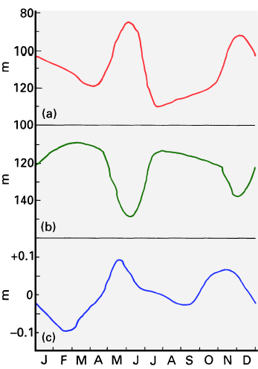
Thermocline and Sea Level
WEST
Climatological mean monthly thermocline depth and sea level at the equator (Wyrtki, 1973a)
(a) Depth of 20ºC isotherm off Africa,
(b) Depth of 20°C isotherm off Sumatra,
(c) Sea level at the west coast of Sumatra.
EAST
EAST

Slide 14
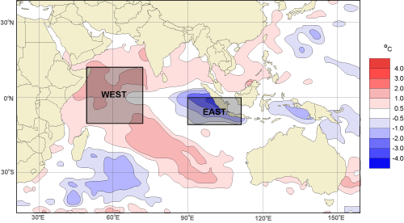
Indian Ocean Dipole（印度洋偶极子）
Saji, N. H. et al., 1999: A dipole mode in the tropical Indian Ocean. Nature, 401, 360-363.
Anomalously low SST off Sumatra and high SST in the western Indian Ocean, with accompanying wind and precipitation anomalies.
SST - winds coupling: through the precipitation field and ocean dynamics.
Ocean-atmosphere interaction and Interannual timescale
IOD: accounts for about 12% of the SST variability
Independent of the ENSO
Active years, causes severe rainfall in
eastern Africa and droughts in Indonesia

Slide 15
Indian Ocean Dipole (IOD)
DMI: Difference in SST anomaly between the tropical western Indian Ocean (50-70E, 10S-10N) and the tropical south-eastern Indian Ocean (90-110E, 10S-EQ).
Dipole mode and El Nino events since 1958. Plotted in blue, the dipole mode index (DMI) exhibits a pattern of evolution distinctly different from that of the El Nino, which is represented by the Nino3 SST anomalies (black line). On the other hand, equatorial zonal wind anomalies Ueq (plotted in red) coevolves with the DMI. All the three time series have been normalized by their respective standard deviations. Removed variability with periods of 7 years or longer, based on harmonic analysis, from all the data sets used in this analysis. In addition, Smoothed the time series using a 5-month running mean.
Notes:
difference in SST anomaly between the tropical western Indian Ocean (50E-70E, 10S-10N) and the tropical
south-eastern Indian Ocean (90E-110E, 10S-Equator).

Slide 16
Indian Ocean Dipole
A composite dipole mode event. Anomalies of SSTs and winds exceeding 90% significance are indicated by shading and bold arrows, respectively

Slide 17
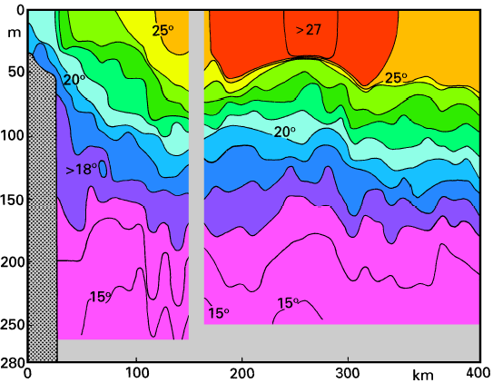
Arabian Sea
Upwelling along coast of Arabia during southwest monsoon (due to offshore Ekman transport)
Results in decrease in temperature and increase in biological productivity
A temperature section across the Arabian upwelling region during July 1983, from the Kuria Muria Islands(库里亚穆里亚) (18°N) towards southeast. The break in the isotherm slope about 150 km from the coast separates the coastal upwelling to the left from the Ekman suction region to the right. After Currie et al. (1973).
Notes:
Seasonal reversal of the currents dominates the two major subdivisions of the northern
Indian Ocean as well, but the opposing flows occupy periods of very different length, and
the transitions are less well defined than in the equatorial zone. Weak westward flow, an
extension of the North Equatorial Current with velocities rarely exceeding 0.2 m s-1,
dominates in the Arabian Sea at the peak of the Northeast Monsoon season. Northwestward
flow along the western Indian shelf begins as early as November (Figure 11.4f) and persists
into January, with a width of some 400 km and a depth of about 200 m in the south
(10°N), getting narrower and deeper as it flows along the continental slope. This current
flows against the prevailing Northeast Monsoon and thus cannot be wind driven. The East
Indian Winter Jet supplies fresh, low density water from the Bay of Bengal at this time,
while on the north Indian coast cold continental winds result in cooling and convective
overturn (Shetye et al., 1991). The resulting gradient of steric height overwhelms the wind
forcing. These dynamics are discussed in more detail with the Leeuwin Current below.
Westward flow prevails south of 15°N and west of 65°E until late April, while in the
remaining area currents are less and less well defined and change gradually into the weak
anticyclonic pattern of Figure 11.4b. The Somali Current responds quickly to the onset of
the Southwest Monsoon in April; northward flow develops, strengthening the pattern in the
west. By mid-May (Figure 11.4c) the East Arabian Current is fully established with
velocities of 0.5 - 0.8 m s-1. At the same time the anti-cyclonic pattern breaks up from
the east where the flow joins the Equatorial Jet around southern India and Sri Lanka.
Moderate eastward flow, an extension of the Somali and Southwest Monsoon Current
dominates the region during the next 4 - 5 months. During its peak in June and July it
reaches 0.3 m s-1 and more but weakens rapidly in October when the second occurrence of
the Equatorial Jet concentrates most eastward transport in the equatorial zone and outflow
from the Bay of Bengal begins to oppose eastward flow around Sri Lanka. By mid-
November currents are again diffuse; south of 15°N they are weak but already westward.
General westward flow is again established by early December.
A notable feature of the Arabian Sea circulation is the occurrence of strong coastal
upwelling in the East Arabian Current. As in other coastal upwelling regions it owes its
existence to an offshore transport direction in the Ekman layer (the Southwest Monsoon
blowing parallel to the coast with the coast on its left). Positive curl( τ/f) over a 400 km
wide strip along the coast adds to the upwelling through Ekman suction. From May to
September coastal temperatures are lowered by 5°C and more (Figure 11.8). The fact that
the upwelling is embedded in a western boundary current reduces its effectiveness for
primary production - the swift current removes much of the additional biomass from the
system before it can be utilized. Compared to upwelling regions in the Pacific and Atlantic
Ocean, zooplankton levels in the Arabian Sea upwelling are much less exceptional.
Nevertheless, an abundance of sea birds off the Arabian coast during the upwelling period
indicates that it is sufficient to support a significant marine resource.

Slide 18
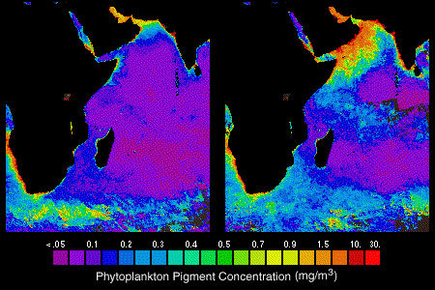
Effects of Upwelling on Biomass
Spring
(NE monsoon)
September (SW monsoon)
Ocean color: high values indicate more phytoplankton. Note Arabian Sea upwelling signature during the SW monsoon. (NASA SeaWifs ocean color project)

Slide 19
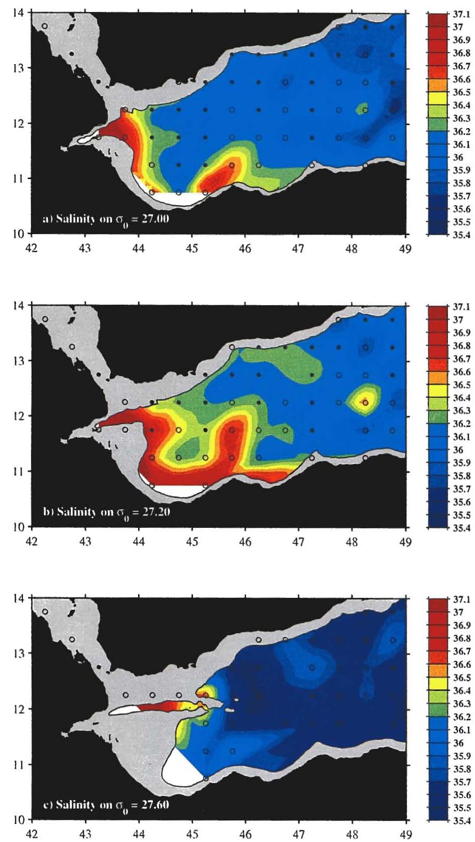
Red Sea (and Persian Gulf) Water
27.00 σ_{θ} (~400 m)
27.20 σ_{θ} (~600 m)
Outflow of high salinity water from the Red Sea into the Gulf of Aden (Bower, 2005)
27.60σ_{θ} (~1200m)

Slide 20
Red Sea Water
Salinity on isopycnal at about 800 m
Spread of Red Sea Water into the Indian Ocean (Beal et al. 2000)

Slide 21
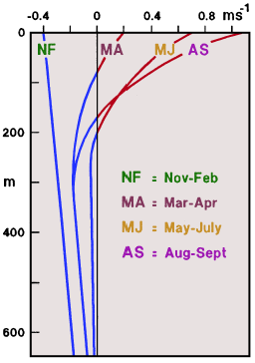
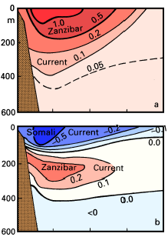
Somali Current
(Left) Mean meridional current velocity (m/s) in the western boundary currents at the equator, derived from 2 years of observations during 1984 - 1986. (a) June - September, (b) December - February. After Schott et al. (1990).
(Right) Mean alongshore velocity (positive = northeastward) in the Somali Current at 5°N, from 30 months of current meter records. After Quadfasel and Schott (1983).
Notes:
桑给巴尔

Slide 22
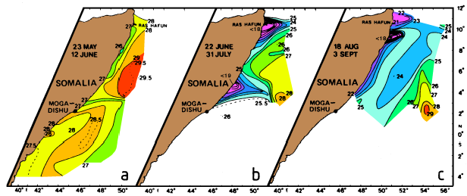
Somali Current
Development of the Somali Current during the onset of the Southwest Monsoon as seen in the sea surface temperature during 1979. (a) Advection of warm water south of 3°N and coastal upwelling north of 3°N, (b) two gyres with upwelling regions near 4°N (minimum temperature <19°C) and Ras Hafun(哈丰角) (minimum temperature <18°C), (c) continuous northward flow and upwelling near Ras Hafun (minimum temperature <17°C). From Evans and Brown (1981).

Slide 23
Indonesian Throughflow（印尼贯穿流）
Salinity
Connection of upper ocean waters from Pacific to Indian Ocean through complicated set of straits.
Low salinity Pacific water evident in zonal jet across Indian tropical region.

Slide 24
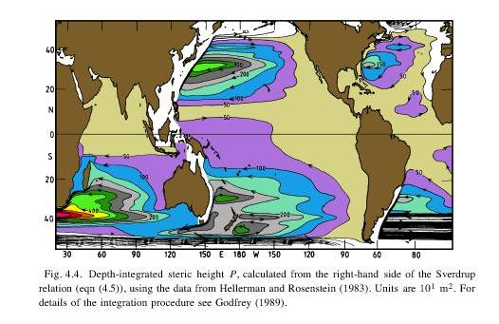
Sverdrup transport (Tomczak and Godfrey)

Slide 25
Western Boundary Currents (WBC)
The WBC begins east of Madagascar, where the South Equatorial Current separation into a northern and southern branch. The distribution of their transports - 30 Sv in the northern branch, 20 Sv in the southern branch - varies little over the year (Swallow et al., 1988).
The contribution of the northern branch to the circulation in the southern hemisphere is the Mozambique Current; it is maintained throughout the year. The contribution to the circulation in the northern hemisphere ceases during the Northeast Monsoon season. The southern branch feeds the East Madagascar Current.
Notes:
The story of the western boundary currents begins east of Madagascar, where both the
integrated flow (Figure 4.7) and the ship drift currents show a separation of the South
Equatorial Current into a northern and southern branch. The distribution of their transports -
30 Sv in the northern branch, 20 Sv in the southern branch - varies little over the year
(Swallow et al., 1988). The contribution of the northern branch to the circulation in the
southern hemisphere is the Mozambique Current; it is maintained throughout the year. The
contribution to the circulation in the northern hemisphere ceases during the Northeast
Monsoon season. The southern branch feeds the East Madagascar Current. The current field
of this small but well-defined western boundary current reaches to the 2000 m level. Below
3100 m some 4 - 5 Sv are carried northward, with little movement in-between. Having
passed the southern tip of Madagascar the current apparently alternates between three flow

Slide 26
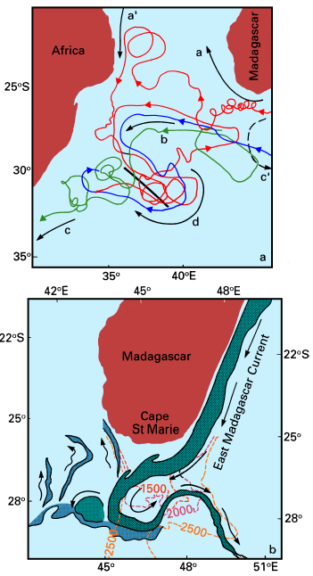
Western Boundary Currents
Paths of the East Madagascar Current (EMC) extension. (a) from tracks of satellite-tracked drifters, (b) from a satellite image of sea surface temperature on 13 June 1984.
The EMC warm core is indicated by dark shading. Light shading indicates intermediate water temperatures.

Slide 27
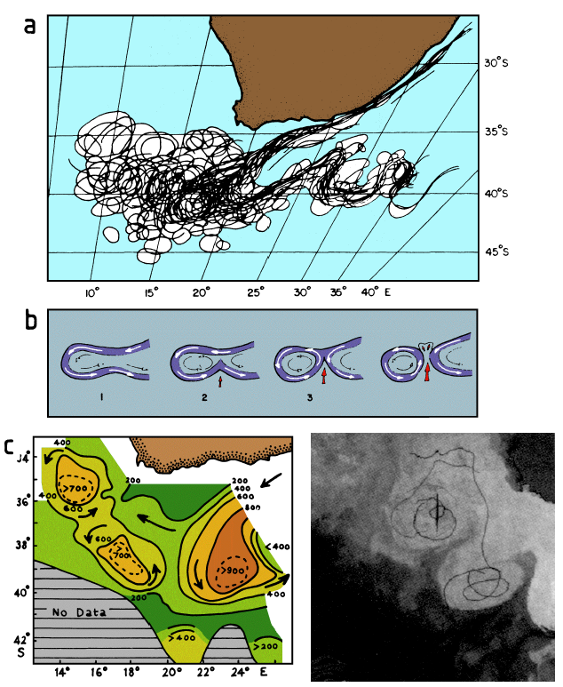
Agulhas Retroflection
Western boundary current wishes to continue further southward, but Africa ends, so current passes to the west, retroflects back to the east.
Part of transport continues westward to South America and joins the Brazil Current.
The retroflection region of the Agulhas Current. (a) Positions of the temperature front along the Agulhas Current for a 12 month period 1984/85; (b) sketch of the eddy shedding process at the retroflection; (c) depth of the 10°C isotherm (representative for the thermocline) in November/December 1983; (d) sea surface temperature during 7 - 9 December 1983 and tracks of drifting buoys in November/December 1983. The area shown is approximately 32°- 42°S, 10°- 20°E. To minimize cloud disturbance the picture is a composite of three images. Lighter tones indicate warmer water. From Lütjeharms and van Ballegooyen (1988) and Gordon (1985) (Tomczak and Godfrey text)

Slide 28
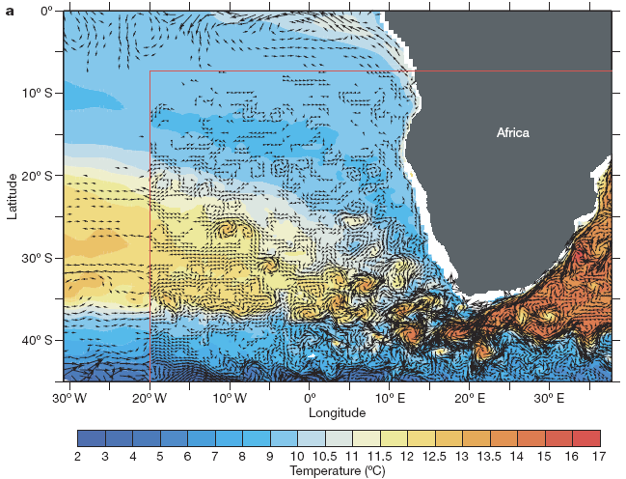
Agulhas Retroflection
Temperature (colour) and velocities at 450-m depth for model (0.1º) Agulhas nest hosted in a global ocean model of 0.5º resolution. (Biastoch et al., 2008, Nature, 456, 489-492)
Notes:
Temperature (colour) and velocities (every fourth vector shown of a five-day
average around 15 September 2004) at 450-m depth for model
experiment AG01, the high-resolution (0.1º) Agulhas nest (the northwestern
portion is delineated by the red lines) hosted in a global ocean model of 0.5º
resolution.
Biastoch et al., 2008, Agulhas leakage dynamics affects decadal variability in Atlantic overturning circulation. Nature, 456, 489-492.

Slide 29
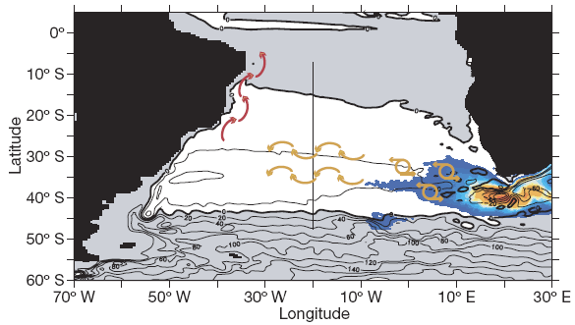
Agulhas Retroflection
Illustration of the wave processes conveying Agulhas-induced anomalies in the upper limb of the MOC. The contour lines depict the time mean barotropic stream function (Sv), the colour information shows
the time-mean eddy kinetic energy. The arrows give an illustration of the dynamic processes transporting eddies and Rossby waves (yellow) and Kelvin waves along the continental slope of South America (red).
Notes:
Figure 4 Illustration of the wave processes conveying Agulhas-induced
anomalies in the upper limb of the MOC. The contour lines depict the timemean
barotropic stream function (Sv), indicating the anticyclonic (white
area) subtropical gyre in the South Atlantic; the colour information shows
the time-mean eddy kinetic energy. The arrows give an illustration of the
dynamic processes transporting eddies and Rossby waves originating in the
Agulhas across the South Atlantic (yellow) and Kelvin waves along the
continental slope of South America (red).

Slide 30
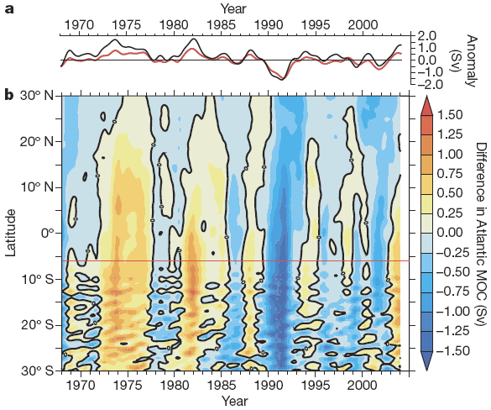
Agulhas Retroflection
Low-pass-filtered Agulhas-induced MOC anomalies. Contribution of ±1.5 Sv
Notes:
Figure 3 Low-pass-filtered Agulhas-induced MOC anomalies
Comparison of the (low-pass-filtered) time series of the MOC anomalies
(red) at 6u S (dashed red line in b) with the corresponding anomalies of the
North Brazil current at this latitude (black). b, Hovmoeller diagram showing
the difference in Atlantic MOC between model experiments with (AG01)
and without (ORCA05) a high-resolution Agulhas nest. Integrated over the
upper 1,000 m, this typically represents the total strength of the MOC
(compare with Supplementary Fig. 2).

Slide 31
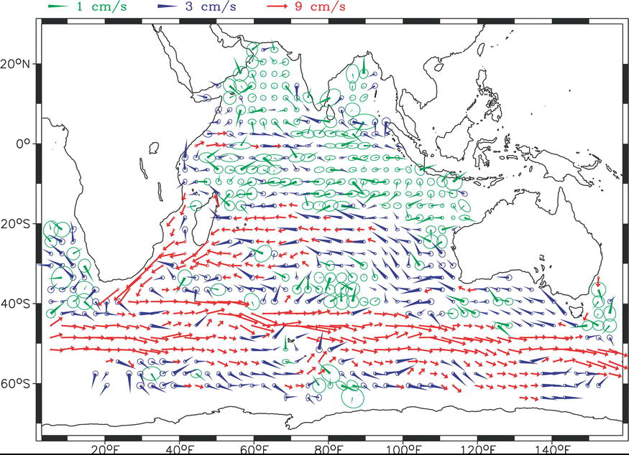
Indian Mid-depth Circulation
Mean velocity vectors, 900 meter subsurface float array (Davis, 2005)

Slide 32
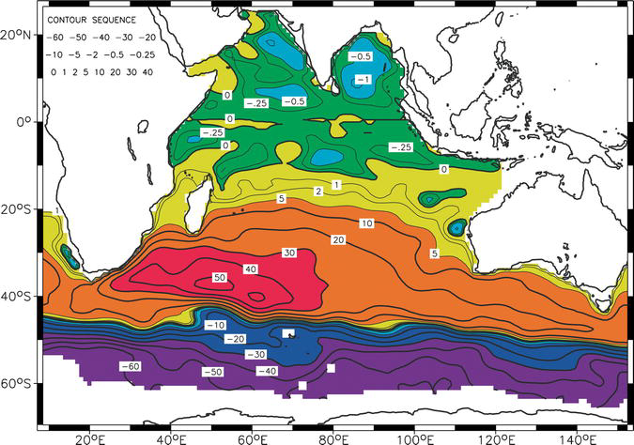
Indian Mid-depth Circulation
Geostrophic stream function based on floats. 900 meter subsurface float array (Davis, 2005)

Slide 33
Indian Abyssal Circulation
DWBCs
Other
3500 dbar steric height based on hydrographic data (Reid, 2003)

Slide 34
Indian Water Masses
From South:
Subantarctic Mode Water (high oxygen, thick near-surface)
Antarctic Intermediate Water (low salinity intermediate depth)
Circumpolar Deep Water
Upper CDW: high salinity core is NADW
Lower CDW: fresher, cold, from the Antarctic - AABW)
From north:
Red Sea Water (very saline, similar to Mediterranean Overflow Water in N. Atlantic)
Indonesian throughflow products
Indian Deep Water: Indian-mixing of inflowing waters plus upwelling to produce local, low oxygen, high salinity water mass at mid-depth

Slide 35
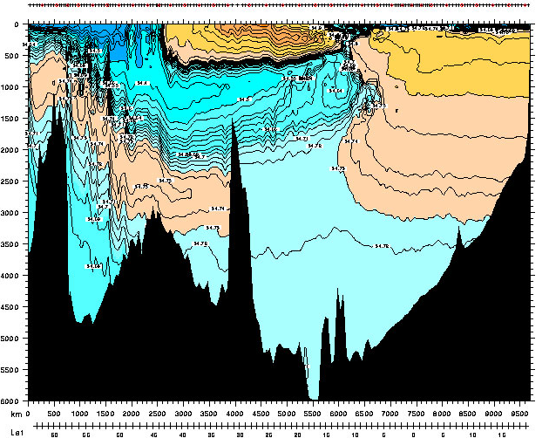
Eastern Indian Water Masses: Salinity
Higher salinity - Indian Deep Water and Circumpolar Deep Water
Lower salinity - Antarctic Intermediate and bottom waters (Lower Circumpolar Deep Water)
South
32°S
North

Slide 36
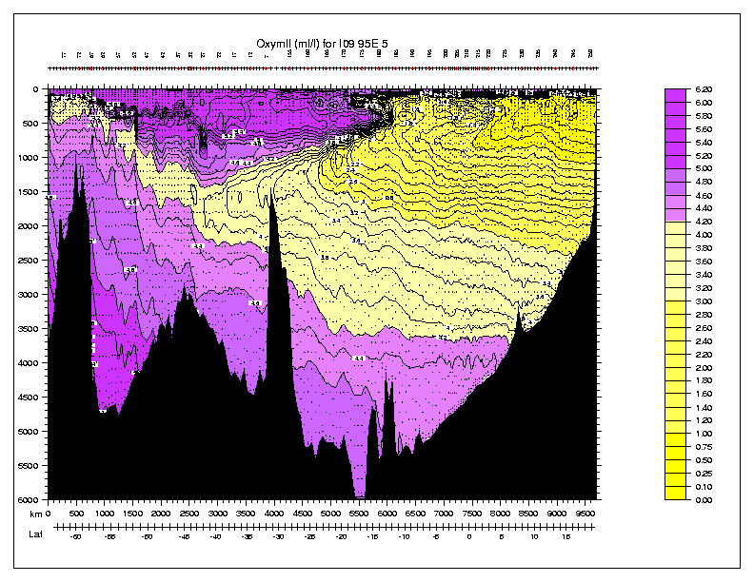
Eastern Indian Water Masses: Oxygen
Lower oxygen: Red Sea Water and other northern Indian waters
Higher oxygen- Subantarctic Mode Water and Circumpolar Deep Water
South
32°S
North

Slide 37
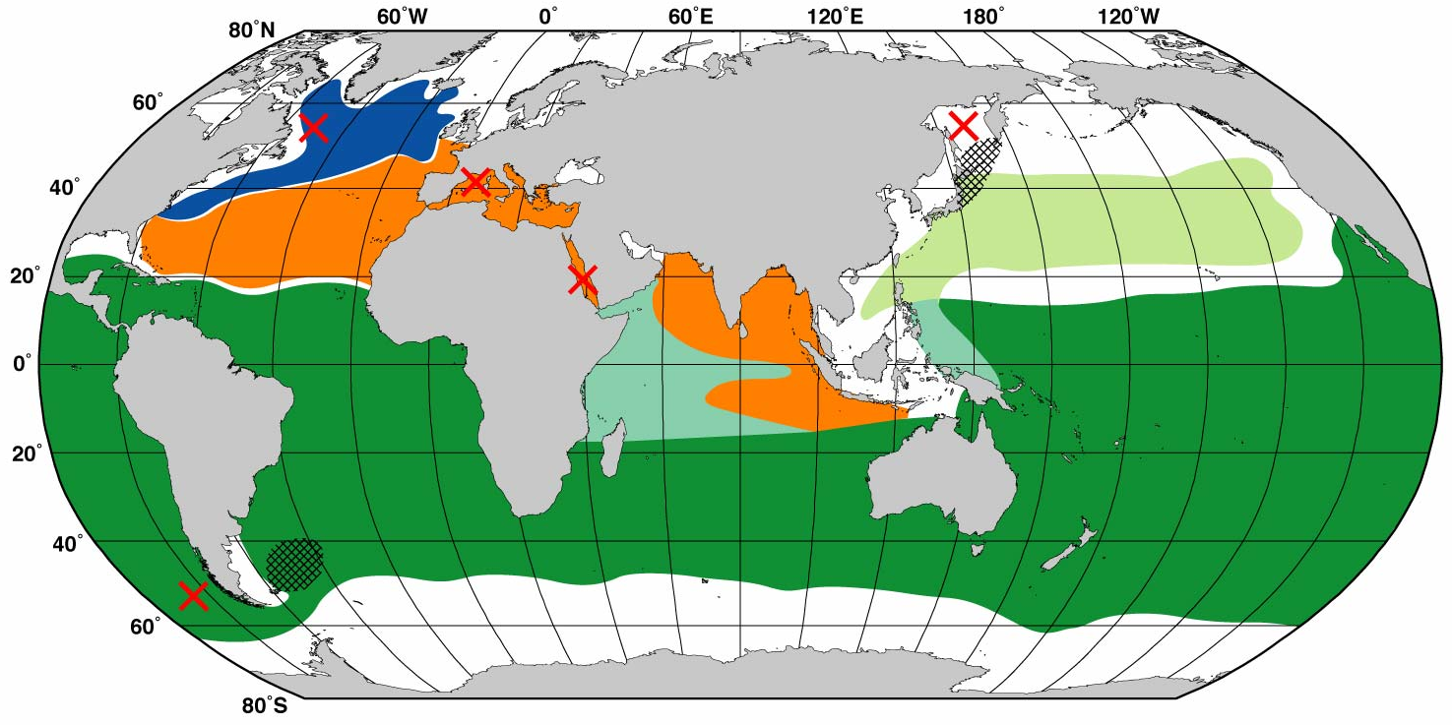
Intermediate water masses in Indian Ocean based on salinity
Red Sea Water
Indonesian Intermediate Water - low salinity water from throughflow
x
Antarctic Intermediate Water- SE Pacific convection/SW Atlantic mixing

Slide 38
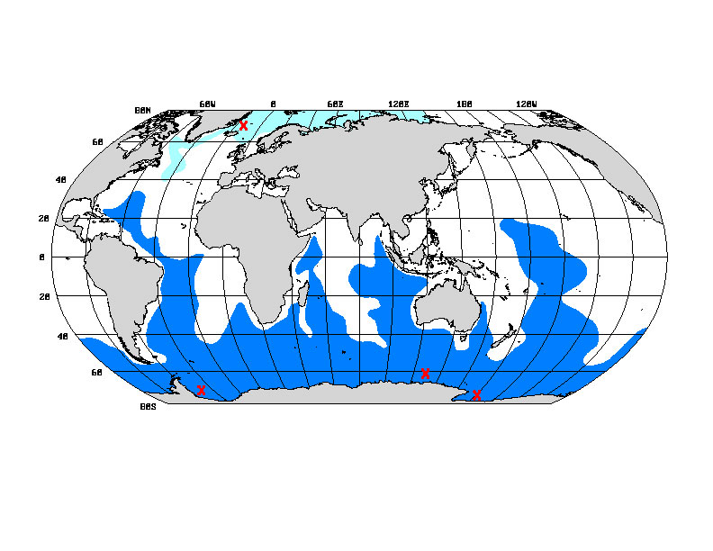
Deep and Bottom Waters
Nordic Sea waters/NADW
Antarctic shelf waters (ice) /AABW

Slide 39
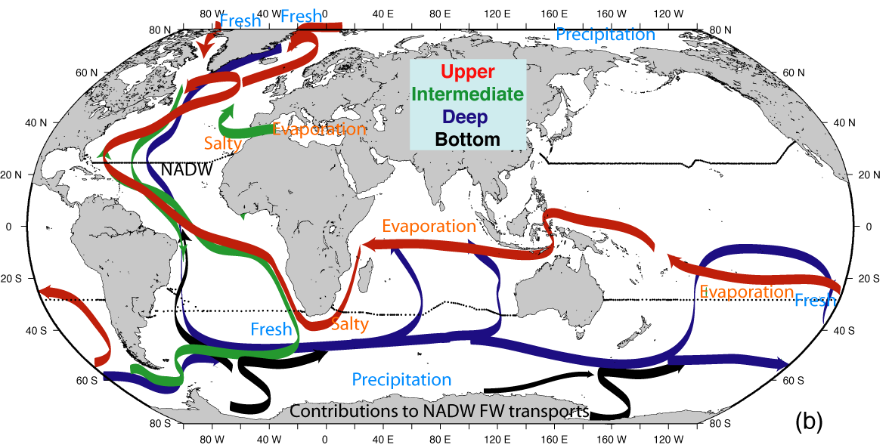
Indian Ocean Role in Global Overturning Circulation
Upwelling of abyssal waters to upper ocean
Indonesian Throughflow
Agulhas retroflection, eddy shedding and transport of warm water into S. Atlantic

Slide 40
Questions (Due in 2-week)
What causes upwelling in the Arabian Sea and during which monsoon does it occur?
During which part of the monsoon cycle is the tropical Indian Ocean circulation most like that of the Pacific and Atlantic?
What happens to surface currents along the equator during the transition between monsoons?
Where does upper ocean water pass from the Indian to the Atlantic Ocean? What current does it start in the Indian Ocean? What current does it possibly join in the Atlantic Ocean?
Where are the two locations where water passes between the Pacific and Indian Oceans?

Slide 41
Learning about the Ocean, the Climate and the Nature

