Slide 1
Lecture 16: Atlantic: Upper Ocean Circulation
Descriptive Physical Oceanography
杨海军（YANG Haijun）复旦大学大气与海洋科学系
Department of Atmospheric and Oceanic Sciences, Fudan University
Email: yanghj@fudan.edu.cn
This powerpoint was prepared for purposes of this lecture and course only. It contains graphics from copyrighted books, journals and other products. Please do not use without acknowledgment of these sources.

Slide 2
Reading:
  Tomczak and Godfrey chps 14-15
Outline:
  N. Atlantic subtropical gyre
  N. Atlantic subpolar gyre
  S. Atlantic subtropical gyre
  Atlantic equatorial circulation
Notes:
A glance at the distribution of high quality ocean data tells us that the Atlantic Ocean is by far the best researched part of the world ocean. This is particularly true of the North Atlantic Ocean, the home ground of many oceanographic research institutions
of the USA and Europe. We therefore have a wealth of information, and our task in describing the essential features of the Atlantic Ocean will not so much consist of finding reasonable estimates for missing data but finding the correct level of generalization from a bewildering and complex data set.

Slide 3
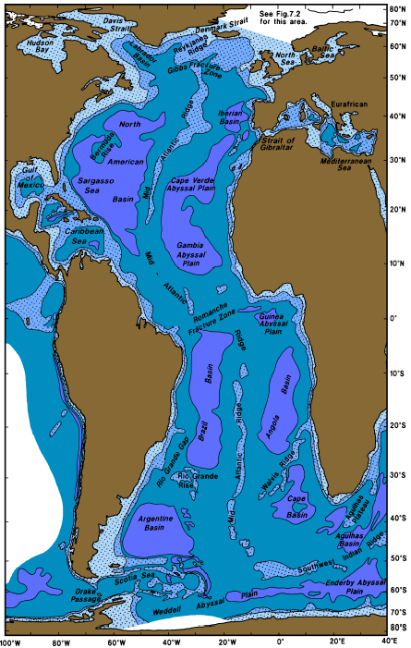
Bottom Topography
Topography of the Atlantic Ocean. The 1000, 3000, and 5000 m isobaths are shown, and regions less than 3000 m deep are shaded.
Distinguish features: N-S 21,000km, W-E 8,300km; the largest number of adjacent seas; the Mid-Atlantic Ridge
Area: 106.6x10⁶km²; Mean depth: 3300 m
Notes:
Several outstanding topographic features distinguish the Atlantic Ocean from the Pacific
and Indian Oceans. First of all, the Atlantic Ocean extends both into the Arctic and
Antarctic regions, giving it a total meridional extent - if the Atlantic part of the Southern
Ocean is included - of over 21,000 km from Bering Strait through the Arctic Mediterranean
Sea to the Antarctic continent. In comparison, its largest zonal distance, between the Gulf
of Mexico and the coast of north west Africa, spans little more than 8,300 km. Secondly,
the Atlantic Ocean has the largest number of adjacent seas, including mediterranean seas
which influence the characteristics of its waters. Finally, the Atlantic Ocean is divided
rather equally into a series of eastern and western basins by the Mid-Atlantic Ridge, which
in many parts rises to less than 1000 m depth, reaches the 2000 m depth contour nearly
everywhere, and consequently has a strong impact on the circulation of the deeper layers.
When all its adjacent seas are included, the Atlantic Ocean covers an area of
106.6.106 km2. Without the Arctic Mediterranean and the Atlantic part of the Southern
Ocean, its size amounts to 74.106 km2, slightly less than the size of the Southern Ocean.
Although all its abyssal basins are deeper than 5000 m and most extend beyond 6000 m
depth in their deepest parts (Figure 14.1), the average depth of the Atlantic Ocean is
3300 m, less than the mean depths of both the Pacific and Indian Oceans. This results from
the fact that shelf seas (including its adjacent and mediterranean seas) account for over 13%
of the surface area of the Atlantic Ocean, which is two to three times the percentage found
in the other oceans.
Three of the features shown in Figure 14.1 deserve special mention. The first is the
difference in depth east and west of the Mid-Atlantic Ridge near 30°S. The Rio Grande Rise
comes up to about 650 m; but west of it the Rio Grande Gap allows passage of deep water
near the 4400 m level. In contrast, the Walvis Ridge in the east, which does not reach
700 m depth, blocks flow at the 4000 m level. The second is the Romanche Fracture Zone
(Figure 8.2) some 20 km north of the equator which allows movement of water between
the western and eastern deep basins at the 4500 m level (its deepest part, the Romanche
Deep, exceeds 7700 m depth but connects only to the western basins). Other fracture zones
north of the equator have similar characteristics; but the Romanche Fracture Zone is the
first opportunity for water coming from the south to break through the barrier posed by the
Mid-Atlantic Ridge. The third feature is the Gibbs Fracture Zone near 53°N which allows
passage of water at the 3000 m level; its importance for the spreading of Arctic Bottom
Water was already discussed in Chapter 7.
Of interest from the point of view of oceanography are the sill characteristics of the five
mediterranean seas. The Arctic Mediterranean Sea, which is by far the largest comprising
13% of the Atlantic Ocean area, was already discussed in Chapter 7; its sill is about
1700 km wide and generally less than 500 m deep with passages exceeding 600 m depth
in Denmark Strait and 800 m in the Faroe Bank Channel. The Strait of Gibraltar, the point
of communication between the Eurafrican Mediterranean Sea and the main Atlantic Ocean,
spans a distance of 22 km with a sill depth of 320 m. The American Mediterranean Sea
has several connections with the Atlantic Ocean basins, the major ones being east of Puerto
Rico and between Cuba and Haiti where sill depths are in the vicinity of 1700 m and
between Florida and the Bahamas with a sill depth near 750 m. Baffin Bay communicates
through the 350 km wide Davis Strait where the sill depth is less than 600 m. Finally,
communication with the Baltic Sea is severely restricted by the shallow and narrow system
of passages of Skagerrak, Kattegat, Sund and Belt where the sill depth is only 18 m.

Slide 4
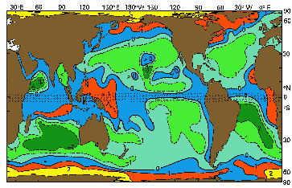
Global map of Ekman-induced upwelling (suction) and downwelling (pumping)
Tomczak and Godfrey

Slide 5
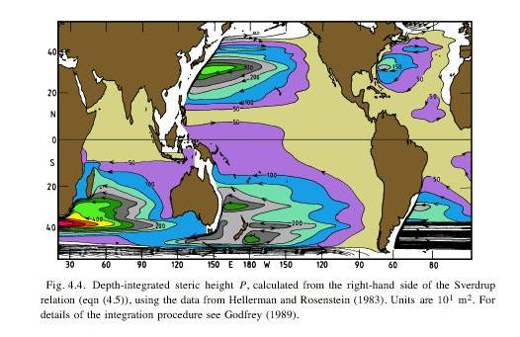
Sverdrup transport (Tomczak and Godfrey)

Slide 6
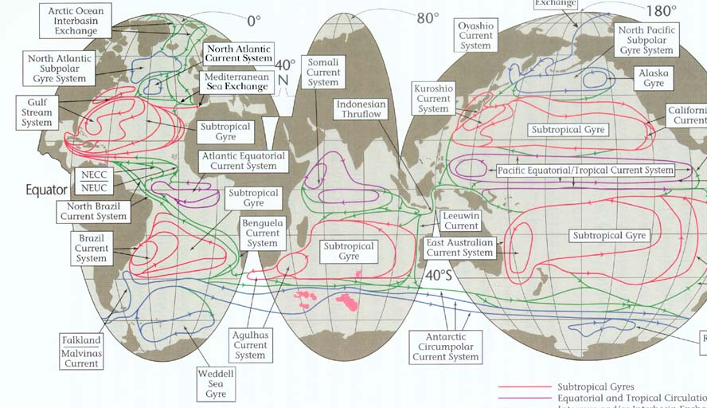
Schematic of surface circulation (Schmitz, 1995)

Slide 7
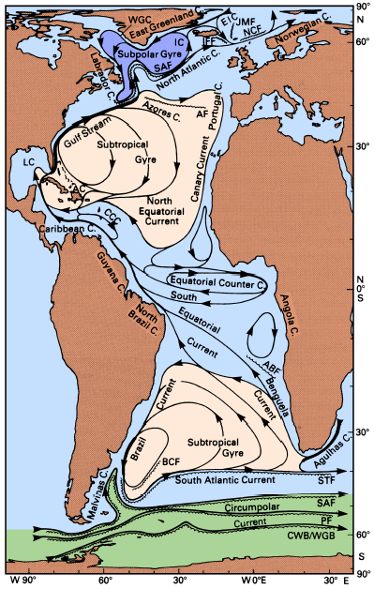
Schematic of surface circulation
Abbreviations are used for the East Iceland (EIC), Irminger (IC, 伊尔明格海流), West Greenland (WGC), and Antilles (AC) Currents and the Caribbean Countercurrent (CCC).
Other abbreviations refer to fronts: JMF: Jan Mayen Front, NCF: Norwegian Current Front, IFF: Iceland - Faroe Front, SAF: Subarctic Front, AF: Azores Front, ABF: Angola - Benguela Front, BCF: Brazil Current Front, STF: Subtropical Front, SAF: Subantarctic Front, PF: Polar Front, CWB/WGB: Continental Water Boundary / Weddell Gyre Boundary.
Duncan et al. (1982), Krauss (1986) and Peterson and Stramma (1991).
Notes:
When the Sverdrup balance was introduced and tested in Chapter 4 we noted that the
largest discrepancies between the integrated flow fields deduced from wind stress and CTD
data are found in the Atlantic Ocean. We now go back to Figure 4.4 and Figures 4.5 or 4.6
for a more detailed comparison, keeping in mind that with the exception of the Southern
Ocean, the CTD-derived flow pattern should describe the actual situation quite well. The
largest discrepancy between the two flow fields occurs south of 34°S; it was discussed in
Chapters 4 and 11. North of 34°S, the subtropical gyres of both hemispheres are well
reproduced from both atmospheric and oceanic data, as in the other oceans. To be more
specific, the gradient of depth-integrated steric height across the North and South Equatorial
Currents is calculated fairly well from both data sets, and the gradient across the equator in
the Atlantic seen in the CTD-derived pattern (one contour crosses the equator; P increases
westward, as in the Pacific Ocean) also occurs in the wind-calculated pattern (even though
no contour happens to cross the equator in this case). That this must be so is evident by
inspection of Figure 1.2 which shows weak mean westerly winds along the equator in the
Atlantic Ocean; hence the only term on the right hand side of eqn (4.7) at the equator is
negative, and P must increase towards the west. However, the agreement between
Figures 4.4 and 4.5 or 4.6 is not as good in the Atlantic as in the other oceans. The major
reason for this is the recirculation of North Atlantic Deep Water, which was mentioned
already in Chapter 7 and will be further discussed Chapter 15. It makes the assumption of a
depth of no motion less acceptable than in the other oceans. The transport of thermocline
water from the Indian into the Atlantic Ocean which is part of the North Atlantic Deep
Water recirculation is also not included in the flow pattern derived from wind data.
In the region where the two circulation patterns compare well, the Sverdrup relation
reveals the existence of strong subtropical gyres in both hemispheres and a weaker subpolar
gyre in the northern hemisphere. The gyre boundaries coincide reasonably well with the
contour of zero curl(t/f) (Figure 4.3). The northern subtropical gyre consists (Figure 14.2)
of the North Equatorial Current with its centre near 15°N, the Antilles Current east of, and
the Caribbean Current through the American Mediterranean Sea, the Florida Current, the
Gulf Stream, the Azores Current, and the Portugal and Canary Currents. The southern gyre
is made up of the South Equatorial Current which is centred in the southern hemisphere but
extends just across the equator, the Brazil Current, the South Atlantic Current, and the
Benguela Current. The subpolar gyre of the northern hemisphere is modified by interaction
with the Arctic circulation, to the extent that it is hardly recognizable as a gyre. It involves
the North Atlantic Current, the Irminger Current, the East and West Greenland Currents,
and the Labrador Current, with substantial water exchange with the Arctic Mediterranean
Sea through the North Atlantic Current (and its extension into the Norwegian Current) and
the East Greenland Current.
The Sverdrup relation performs particularly well near the equator, where geostrophic
gradients are very small. It reveals the existence of an equatorial countercurrent between the
North and South Equatorial Currents. As in the Pacific Ocean, this countercurrent flows
down the Doldrums; but it is broader and less intense. This results from the reduced width
of the Atlantic Ocean and from the fact that the Doldrums (or ITCZ) are not strictly zonal
but angle across from Brazil to Sierra Leone, as mentioned earlier.
A notable discrepancy between Figures 4.4 and 4.5 or 4.6 is the failure of the wind calculated
pattern to reproduce the intense crowding of the contours of depth-integrated steric
height off North America near Cape Hatteras (35°N). A similar failure occurs in the northeast
Pacific Ocean, but it is not as severe there; in the Atlantic Ocean, the wind-calculated
flow follows the coast to Labrador (50°N) before flowing east, whereas it in fact breaks
away from the coast at Cape Hatteras (as indicated in the CTD-based flow field) and takes
on the character of an intense jet.

Slide 8
Schematic of surface circulation
Notes:
When the Sverdrup balance was introduced and tested in Chapter 4 we noted that the
largest discrepancies between the integrated flow fields deduced from wind stress and CTD
data are found in the Atlantic Ocean. We now go back to Figure 4.4 and Figures 4.5 or 4.6
for a more detailed comparison, keeping in mind that with the exception of the Southern
Ocean, the CTD-derived flow pattern should describe the actual situation quite well. The
largest discrepancy between the two flow fields occurs south of 34°S; it was discussed in
Chapters 4 and 11. North of 34°S, the subtropical gyres of both hemispheres are well
reproduced from both atmospheric and oceanic data, as in the other oceans. To be more
specific, the gradient of depth-integrated steric height across the North and South Equatorial
Currents is calculated fairly well from both data sets, and the gradient across the equator in
the Atlantic seen in the CTD-derived pattern (one contour crosses the equator; P increases
westward, as in the Pacific Ocean) also occurs in the wind-calculated pattern (even though
no contour happens to cross the equator in this case). That this must be so is evident by
inspection of Figure 1.2 which shows weak mean westerly winds along the equator in the
Atlantic Ocean; hence the only term on the right hand side of eqn (4.7) at the equator is
negative, and P must increase towards the west. However, the agreement between
Figures 4.4 and 4.5 or 4.6 is not as good in the Atlantic as in the other oceans. The major
reason for this is the recirculation of North Atlantic Deep Water, which was mentioned
already in Chapter 7 and will be further discussed Chapter 15. It makes the assumption of a
depth of no motion less acceptable than in the other oceans. The transport of thermocline
water from the Indian into the Atlantic Ocean which is part of the North Atlantic Deep
Water recirculation is also not included in the flow pattern derived from wind data.
In the region where the two circulation patterns compare well, the Sverdrup relation
reveals the existence of strong subtropical gyres in both hemispheres and a weaker subpolar
gyre in the northern hemisphere. The gyre boundaries coincide reasonably well with the
contour of zero curl(t/f) (Figure 4.3). The northern subtropical gyre consists (Figure 14.2)
of the North Equatorial Current with its centre near 15°N, the Antilles Current east of, and
the Caribbean Current through the American Mediterranean Sea, the Florida Current, the
Gulf Stream, the Azores Current, and the Portugal and Canary Currents. The southern gyre
is made up of the South Equatorial Current which is centred in the southern hemisphere but
extends just across the equator, the Brazil Current, the South Atlantic Current, and the
Benguela Current. The subpolar gyre of the northern hemisphere is modified by interaction
with the Arctic circulation, to the extent that it is hardly recognizable as a gyre. It involves
the North Atlantic Current, the Irminger Current, the East and West Greenland Currents,
and the Labrador Current, with substantial water exchange with the Arctic Mediterranean
Sea through the North Atlantic Current (and its extension into the Norwegian Current) and
the East Greenland Current.
The Sverdrup relation performs particularly well near the equator, where geostrophic
gradients are very small. It reveals the existence of an equatorial countercurrent between the
North and South Equatorial Currents. As in the Pacific Ocean, this countercurrent flows
down the Doldrums; but it is broader and less intense. This results from the reduced width
of the Atlantic Ocean and from the fact that the Doldrums (or ITCZ) are not strictly zonal
but angle across from Brazil to Sierra Leone, as mentioned earlier.
A notable discrepancy between Figures 4.4 and 4.5 or 4.6 is the failure of the wind calculated
pattern to reproduce the intense crowding of the contours of depth-integrated steric
height off North America near Cape Hatteras (35°N). A similar failure occurs in the northeast
Pacific Ocean, but it is not as severe there; in the Atlantic Ocean, the wind-calculated
flow follows the coast to Labrador (50°N) before flowing east, whereas it in fact breaks
away from the coast at Cape Hatteras (as indicated in the CTD-based flow field) and takes
on the character of an intense jet.

Slide 9
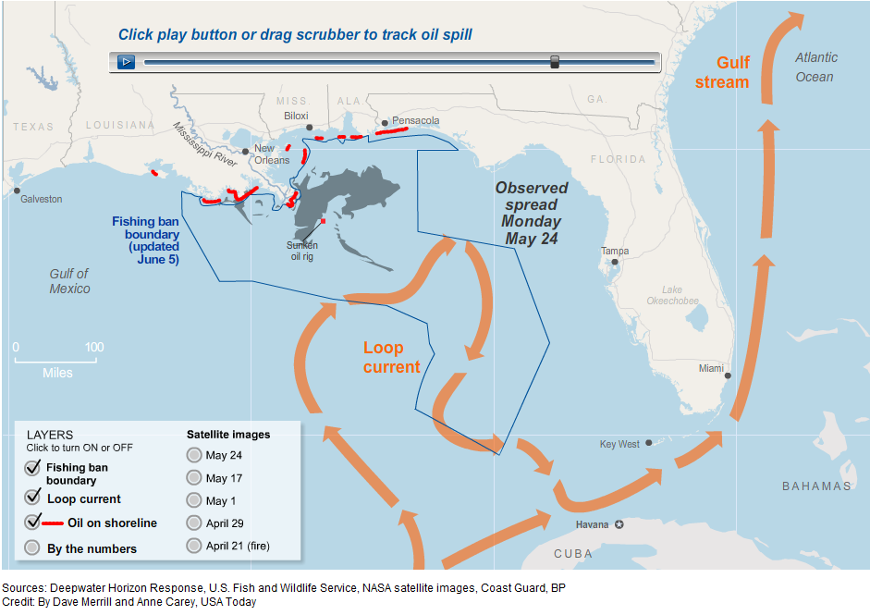
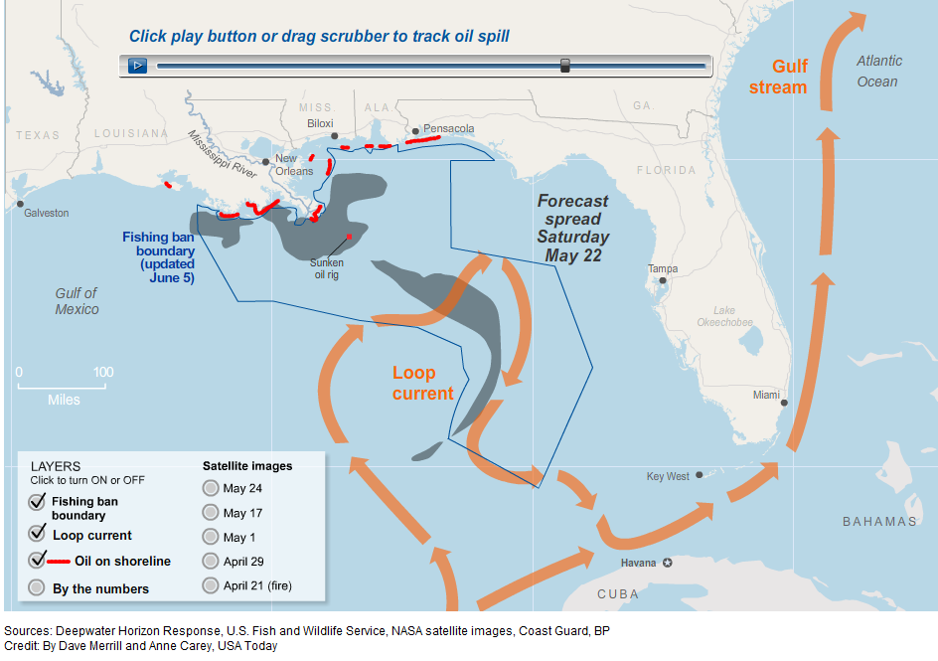
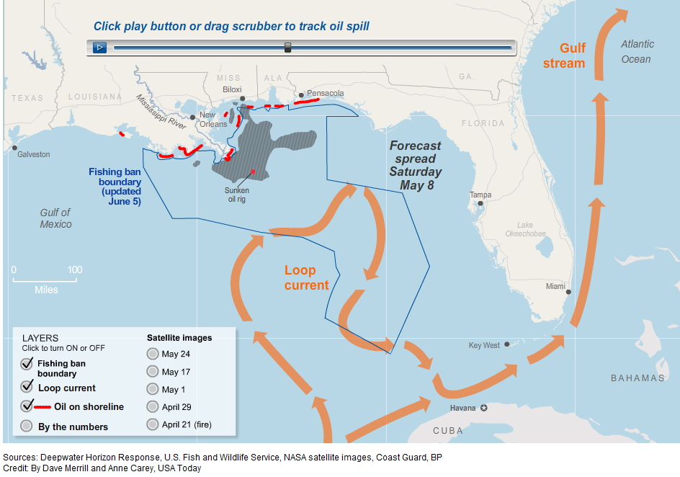
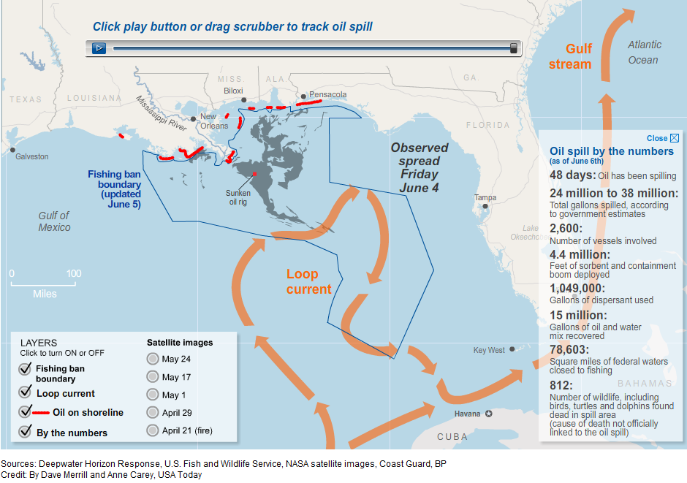
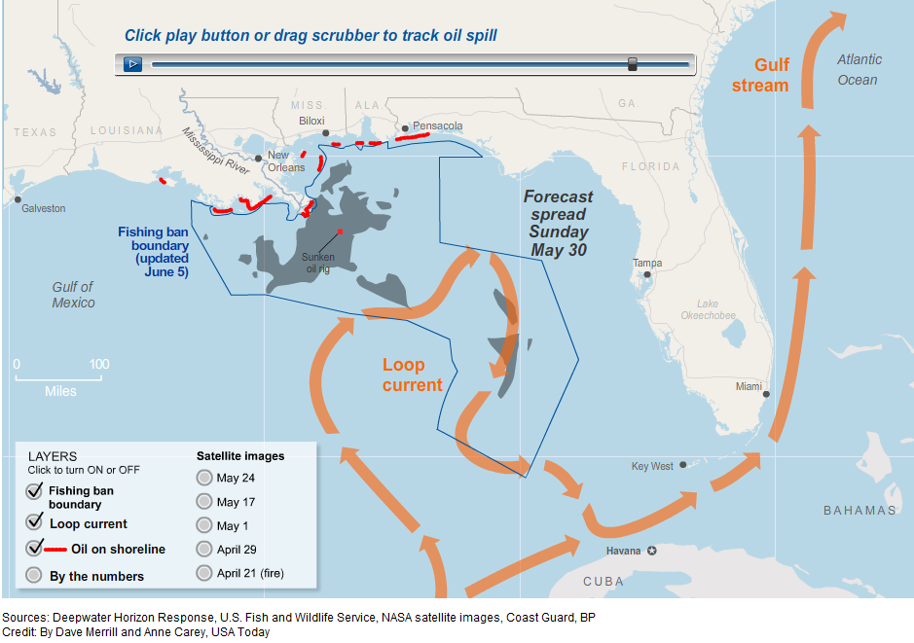
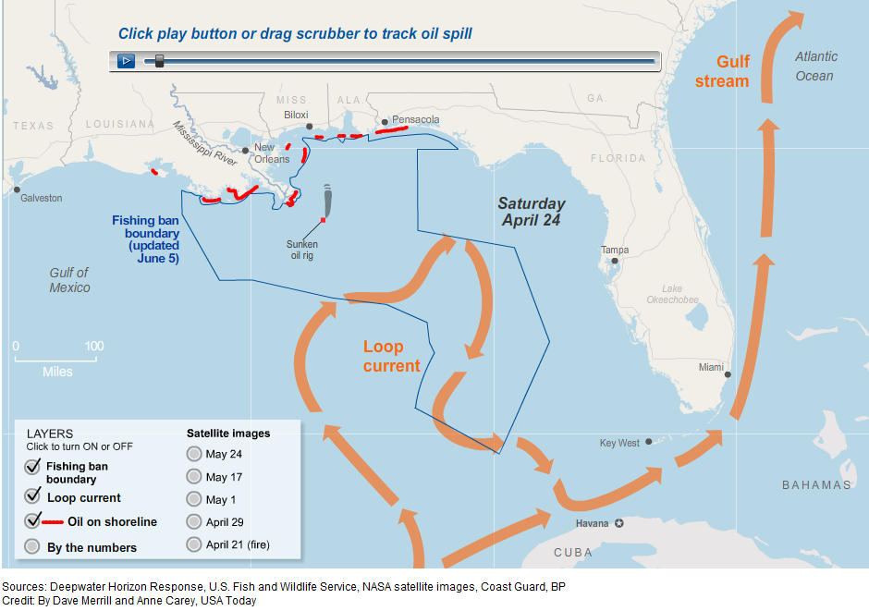
http://www.usatoday.com/news/nation/oil-spill-map.htm
Notes:
2010.4.20

Slide 10
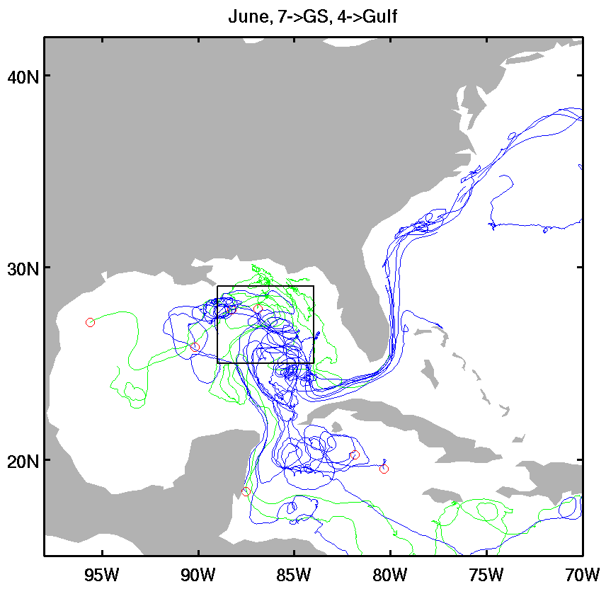
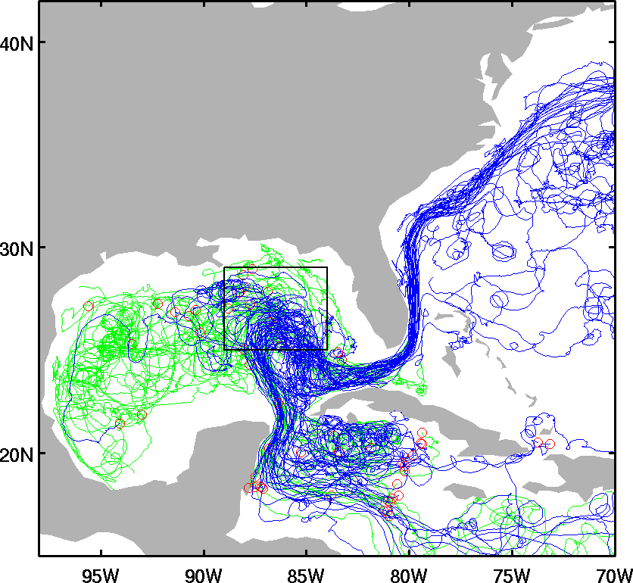
Paths taken by drifters deployed as part of NOAA’s Global Drifter Program (www.aoml.noaa.gov/phod/dac/gdp_doc.html) Scientific lead: Rick Lumpkin of NOAA/AOML. These drifters are drogued so that they move with the currents at ~15meter depths. The picture on the left shows all drifters that have ever passed through the box marked in black. Colors indicate roughly half of all such drifters stay in the Gulf of Mexico (green) and half exit into the Gulf Stream (blue). However, drawing inferences from the lefthand picture comes with several caveats, 1: the currents are seasonal. The picture on the right shows that only 11 drifters pass through the box in June of which 7 enter the Gulf Stream, 2: the drifters are more likely to enter the Loop Current since most are not deployed originally in the Gulf of Mexico, but enter the Gulf through the Loop Current! 3: since the drifters are drogued at 15 meters they will be less affected by wind drift than would that component of the oil which is surface trapped. (figure credit: Semyon Grodsky, Univ. MD).
Notes:
If significant amounts of oil enter the Loop Current at the surface will that oil (e.g. the infamous ‘tar balls’) show up along the US coastline?
One way to address this question is to look at the paths taken by surface drifters which have passed through the Gulf of Mexico (Fig. 1 ). Surface drifters are simple devices that float on the surface with a thermometer (to measure the temperature of the ocean), gps receiver (to determine location), a 15 meter deep sea anchor (so they are less affected by winds), and transmitter (to relay this information). Despite the limitations in interpreting surface drifter paths as if they were oil particles, you can see several important features in Fig. 1 . If the oil does enter the Loop Current then on average the trajectories are closest to the following coasts: a) northern Cuba, b) Florida Keys, c) southeastern Florida (you can see the GS off Miami in radar data here). Once north of central Florida the shallow (100meter deep) continental shelf widens and the Gulf Stream, which follows the outer edge of the continental shelf, is pushed well offshore. The shelf narrows somewhat at Cape Hatteras (close to Norfolk, Va. -- you can see the hf radar currents here), but further north the Gulf Stream veers northeastward away from the coast and on out into the North Atlantic. The seasonal winds along this coast north of Florida are southerly veering to southwesterly with increasing latitude. If these seasonal winds prevail then we can expect wind-driven currents to be offshore. While it is possible to have an early season storm such as a hurricane or noreaster, in which case the oil can go anywhere, the former are quite rare.
Another way to anticipate the movement of oil is to conduct a numerical simulation of the equations of motion governing ocean circulation response to winds. In the youtube video produced by scientists at the National Center for Atmospheric Research shown in Fig. 2 the simulated movement of oil is carried out of the Gulf of Mexico, eventually being carried into the open North Atlantic Ocean. One interesting feature of the simulation is that it suggests that oil might be able to be transported out of the Gulf Stream at Cape Hatteras and then carried southwestward to the coastal areas of such southern states as the Carolinas by the shallow coastal circulation. Observational studies such as a recent surface drifter experiment reported in Edwards et al. (J. Cont. Res., 26, 2008, 1375-1394), showing movement southwestward approximately following depth contours, seems qualitatively consistent with this result.
Another forecast of the evolution of the currents in the Gulf of Mexico, produced by the Naval Research Laboratory, is shown in Fig.3. The model used in this forecast has 4x the horizontal resolution of the model used for the simulation in Fig. 2.
(answer provided by Jim Carton with advice from Mike Kearney)

Slide 11
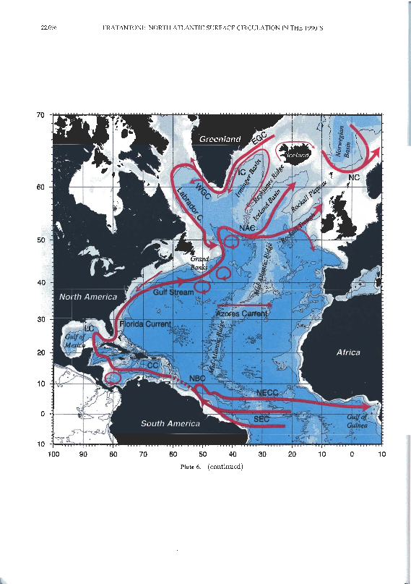
The Gulf Stream System
世界上第一大海洋暖流。墨西哥湾流一部分来自墨西哥湾，绝大部分来自加勒比海。当南、北赤道流在大西洋西部汇合之后，进入加勒比海，通过尤卡坦海峡，其中的一小部分进入墨西哥湾，再沿墨西哥湾海岸流动，海流的绝大部分是急转向东流去，从美国佛罗里达海峡进入大西洋。这支进入大西洋的湾流起先向北，然后很快向东北方向流去，横跨大西洋，流向西北欧的外海，一直流进寒冷的北冰洋水域. 它的厚度为200米～500米，流速2.05米／秒，输送的水量比黑潮大1.5倍
Notes:
大西洋北部气温高于南部。东西两侧气温差别也很大，在南北纬30度之间，东部比西部约低5℃；在北纬30度-60度间，东部气温又高于西部约10℃，使西欧的气候终年温暖如春。如法国的巴黎，它与我国的东北哈尔滨位置相仿，但巴黎的冬日气温，却与中国的上海、南京相似。在南大西洋，南纬30度以南，东西两侧差别不明显
在北大西洋，也有一个顺时针环流，由北赤道流、墨西哥湾暖流、北大西洋暖流和加那利寒流组成。其中，墨西哥湾暖流是世界最大的暖流，它的流量相当于全世界河流量总和的120倍，像一条巨大的暖气管，供应巨量的热，使西北欧的气候温暖如春。
湾流不是一股普通的海流，而是世界上第一大海洋暖流，有一部分来自墨西哥湾，但它的绝大部分来自加勒比海。当南、北赤道流在大西洋西部汇合之后，便进入加勒比海，通过尤卡坦海峡，其中的一小部分进入墨西哥湾，再沿墨西哥湾海岸流动，海流的绝大部分是急转向东流去，从美国佛罗里达海峡进入大西洋。这支进入大西洋的湾流起先向北，然后很快向东北方向流去，横跨大西洋，流向西北欧的外海，一直流进寒冷的北冰洋水域。它的厚度为200米～500米，流速2.05米／秒，输送的水量比黑潮大1.5倍。
湾流蕴含着巨大的热量，它所散发的热量，恐怕比全世界一年所用燃煤产生的热量还要多。由于它的到来，英吉利海峡两岸的土地每年享受着湾流带来的巨大热能。如果拿同纬度的加拿大东岸加以对照，差别更为明显：大西洋彼岸的加拿大东部地区，年平均气温可低到零下10℃，而同纬度的西北欧地区可高到10℃。

Slide 12
The Gulf Stream System
Three named components –
The Florida Current where it passes between Florida and the Bahamas,
The Gulf Stream where it flows along the coast of the U.S. and
The Gulf Stream Extension after it separates from the coast.
Notes:
大西洋北部气温高于南部。东西两侧气温差别也很大，在南北纬30度之间，东部比西部约低5℃；在北纬30度-60度间，东部气温又高于西部约10℃，使西欧的气候终年温暖如春。如法国的巴黎，它与我国的东北哈尔滨位置相仿，但巴黎的冬日气温，却与中国的上海、南京相似。在南大西洋，南纬30度以南，东西两侧差别不明显
在北大西洋，也有一个顺时针环流，由北赤道流、墨西哥湾暖流、北大西洋暖流和加那利寒流组成。其中，墨西哥湾暖流是世界最大的暖流，它的流量相当于全世界河流量总和的120倍，像一条巨大的暖气管，供应巨量的热，使西北欧的气候温暖如春。
湾流不是一股普通的海流，而是世界上第一大海洋暖流，有一部分来自墨西哥湾，但它的绝大部分来自加勒比海。当南、北赤道流在大西洋西部汇合之后，便进入加勒比海，通过尤卡坦海峡，其中的一小部分进入墨西哥湾，再沿墨西哥湾海岸流动，海流的绝大部分是急转向东流去，从美国佛罗里达海峡进入大西洋。这支进入大西洋的湾流起先向北，然后很快向东北方向流去，横跨大西洋，流向西北欧的外海，一直流进寒冷的北冰洋水域。它的厚度为200米～500米，流速2.05米／秒，输送的水量比黑潮大1.5倍。
湾流蕴含着巨大的热量，它所散发的热量，恐怕比全世界一年所用燃煤产生的热量还要多。由于它的到来，英吉利海峡两岸的土地每年享受着湾流带来的巨大热能。如果拿同纬度的加拿大东岸加以对照，差别更为明显：大西洋彼岸的加拿大东部地区，年平均气温可低到零下10℃，而同纬度的西北欧地区可高到10℃。

Slide 13
The Gulf Stream System
An energetic, unstable flow and meanders vigorously, with the meanders occasionally cutting off to form rings. Anticyclonic warm core rings are found north of the Gulf Stream and cyclonic cold core rings are found south of the Gulf Stream. The rings migrate westward and occasionally remerge with the Gulf Stream.
Connection with the North Atlantic Current.
Notes:
大西洋北部气温高于南部。东西两侧气温差别也很大，在南北纬30度之间，东部比西部约低5℃；在北纬30度-60度间，东部气温又高于西部约10℃，使西欧的气候终年温暖如春。如法国的巴黎，它与我国的东北哈尔滨位置相仿，但巴黎的冬日气温，却与中国的上海、南京相似。在南大西洋，南纬30度以南，东西两侧差别不明显
在北大西洋，也有一个顺时针环流，由北赤道流、墨西哥湾暖流、北大西洋暖流和加那利寒流组成。其中，墨西哥湾暖流是世界最大的暖流，它的流量相当于全世界河流量总和的120倍，像一条巨大的暖气管，供应巨量的热，使西北欧的气候温暖如春。
湾流不是一股普通的海流，而是世界上第一大海洋暖流，有一部分来自墨西哥湾，但它的绝大部分来自加勒比海。当南、北赤道流在大西洋西部汇合之后，便进入加勒比海，通过尤卡坦海峡，其中的一小部分进入墨西哥湾，再沿墨西哥湾海岸流动，海流的绝大部分是急转向东流去，从美国佛罗里达海峡进入大西洋。这支进入大西洋的湾流起先向北，然后很快向东北方向流去，横跨大西洋，流向西北欧的外海，一直流进寒冷的北冰洋水域。它的厚度为200米～500米，流速2.05米／秒，输送的水量比黑潮大1.5倍。
湾流蕴含着巨大的热量，它所散发的热量，恐怕比全世界一年所用燃煤产生的热量还要多。由于它的到来，英吉利海峡两岸的土地每年享受着湾流带来的巨大热能。如果拿同纬度的加拿大东岸加以对照，差别更为明显：大西洋彼岸的加拿大东部地区，年平均气温可低到零下10℃，而同纬度的西北欧地区可高到10℃。

Slide 14
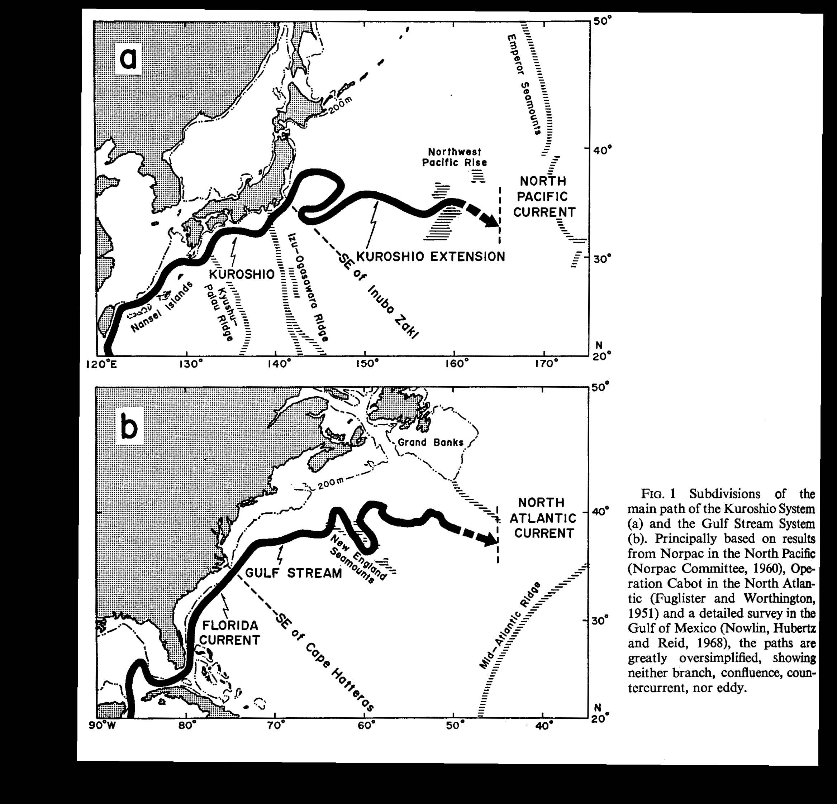
Gulf Stream and Kuroshio Anatomies
Kawai (1972)

Slide 15
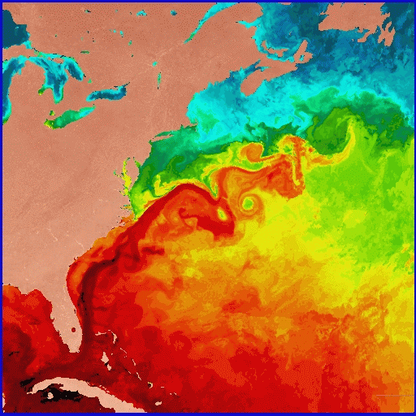
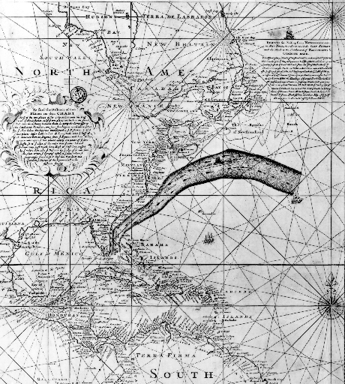
SST and Benjamin Franklin’s Map
Franklin-Folger (1769-1770)
SST satellite image, from U. Miami RSMAS
Richardson, Science (1980)
Notes:
Shown as a bright red band, the Gulf Stream is about 27C (~80F) in this sea surface temperature image of the Western North Atlantic during the first week of June 1984. This image is based on data from NOAA-7 Advanced Very High Resolution Radiometer (AVHRR) infrared observations, analyzed at the U. Miami Rosenstiel School's Remote Sensing Laboratory. Warmer hues denote warmer temperatures.
Credit: O. Brown, R. Evans and M. Carle, University of Miami Rosenstiel School of Marine and Atmospheric Science, Miami, Florida
The Franklin-Folger map of the Gulf Stream, printed in 1769-1770. This early map of the Gulf Stream location was produced by B. Franklin for the mail service from England, based on information from whaling captain Timothy Folger. This map was rediscovered by P. Richardson (1980), and is remarkably accurate. This image is from R. Peterson et al. (1996), article in Progress in Oceanography.

Slide 16
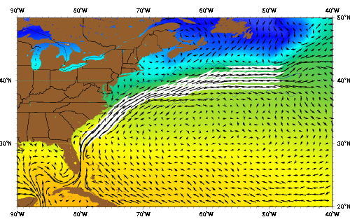
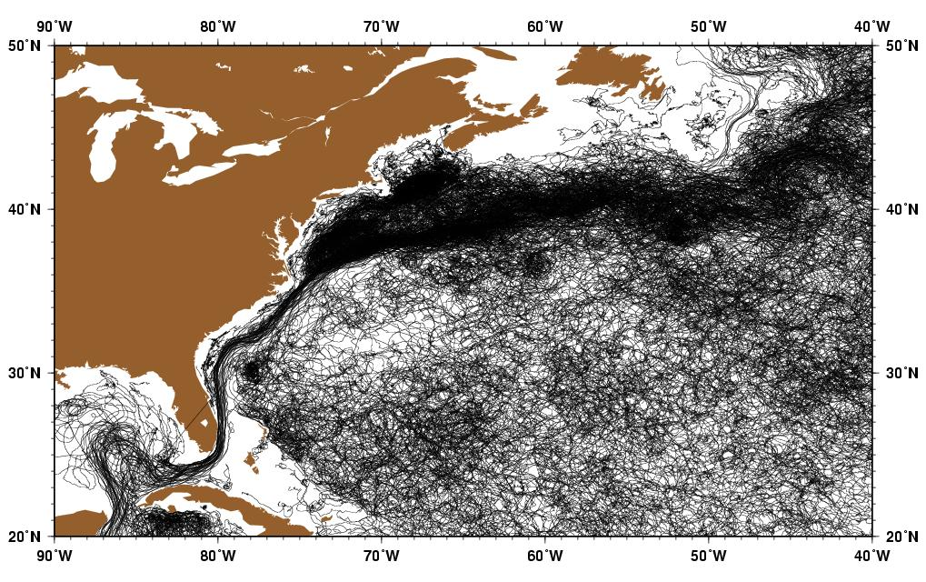
The Gulf Stream
湾流的输送水量可达30 Sv (1 Sv = 1×10⁶m³/s)，输送能量为1.4PW (1PW=10¹²W)，而所有流入大西洋河流的输送量只有0.6 Sv。
湾流对欧洲气候有巨大的影响，使北欧温度高于同纬度的世界其它地区，冬季温暖湿润，全年降水丰富，甚至通常在热带生长的植物也能在英国生长。
湾流对维持大西洋能量和质量平衡至关重要，湾流的中断会带来严重后果
Notes:
虽然愈来愈多的温室气体将把更多的太阳能阻挡在地球表面，但 是我们的蓝色星球不一定就会因此而无限加热。一些科学家们认为， 全球变暖的一个可能后果就是下一次冰河期的到来。 这一观点的主要论据就是墨西哥湾流。这巨大的洋流源源不断地 把温暖的表层海水推向东方和南方，它也是加热欧洲的主要动力。旅途中水分蒸发使海水变得更咸更重，从而使表层水沉入海底，流回南 方。在赤道附近，热带河流和降水产生的温暖淡水稀释并加热海水， 使之升到海面再次展开东南方向的万里旅程。 但在温室作用下，格陵兰和北冰洋融化的寒冷淡水将涌入北大西 洋。温暖气候也将带来更加丰沛的降水，这同样会稀释大西洋。这种 情况一旦出现，墨西哥湾流将不再变咸，也不会轻易沉入海底。得不 到水流补给的南方洋流将逐渐中断，于是墨西哥湾流也会停止。在这 种情况下，欧洲将变得非常寒冷。例如与芝加哥位于同一纬度上的罗 马，到时将面临着一片冰天雪地。不断飘落的雪花将渐渐覆盖全球， 这层闪亮的冰面将像镜子一样把阳光反射回太空。由于墨西哥湾流与 其它洋流有着直接或间接的关系，它的关闭意味着全球洋流将会发生 重组，最终导致总蒸发量急剧下降。大气中的水分子是一种重要的温 室气体，它的含量下降必将带来气温更大幅度的下降，科学家们预言 将下降八度之多。 最糟糕的是，专家们相信，这样的变化将以惊人的速度降临地球， 也许在不到十年之内这一切就会发生。
The Gulf Stream, also known as the North Atlantic Drift, is a powerful, warm, and swift Atlantic ocean current that originates in the Gulf of Mexico, exits through the Straight of Florida, and follows the eastern coastlines of the United States and Newfoundland. Its extension toward Europe, called the North Atlantic drift, makes West-European countries considerably warmer than they would be otherwise.
A river of sea water, called the North Equatorial Current, flows westward off the coast of northern Africa. When this current interacts with the northwestern coast of South America, the current forks into two branches. One passes into the Caribbean, while a second flows north and east of the West Indies. These two branches rejoin to pour through the Straits of Florida.
Consequently, the resulting Gulf Stream is one of the strongest ocean currents known, transporting 1.4 Petawatts of power. It moves at an incredible rate of 30 million cubic meters per second. After it passes Cape Hatteras, this rate only increases to 80 million cubic meters per second. The volume of the Gulf Stream easily dwarfs all rivers that empty into the Atlantic combined, which barely total .6 million cubic meters per second.
As it travels north, some of the warm water transported by the Gulf Stream evaporates. This increases the salinity of the water in the stream, and in the North Atlantic Ocean the water is so cold and dense with salt that it begins to sink. It then becomes a part of the North Atlantic Deep Water, a southgoing stream.
The effect of the Gulf Stream is sufficient to cause certain parts of the west of Britain and Ireland to be an average of several degrees warmer than most other parts of those countries. Indeed, in Cornwall, and particularly the Isles of Scilly, its effects are such that plants associated with much warmer climes, such as palm trees are able to survive the rigours of northern winters. Logan Botanic Garden in Scotland benefits strongly from the Gulf Stream, allowing their specimens of Gunnera Manicata to grow to over 3 metres tall.
With the recent phenomenon of global warming, some scientists have expressed concern about the sink mechanism outlined above. Specifically, fresh water resulting from the melting of the Arctic polar cap could dilute the Gulf Stream and make it light enough not to sink. The result would be a huge climate change in northern Europe, with unknown consequences. Some fossil remnants hint at the possibility that a similar event has already happened several times in the past, but fossil evidence is questioned. After an initial rejection, the scientific community is evaluating this theory more seriously, as data about historic climate show sudden changes between cold and warm periods
Beginning in the Caribbean and ending in the northern North Atlantic, the Gulf Stream System is one of the world's most intensely studied current systems. This extensive western boundary current plays an important role in the poleward transfer of heat and salt and serves to warm the European subcontinent. Traditional hydrographic studies in this region include those of Iselin (1936) and Gulf Stream '60 (Fuglister 1963). The high degree of mesoscale activity associated with this system also has attracted oceanographers. Studies of these phenomena have focused on the "snapshot" representation of the region and have included studies such as SYNOP, Gusto, and ABCE/SME. The Gulf Stream system is powerful enough to be readily seen from space and was visible in even the earliest satellite altimetry studies, such as Seasat and later Geosat. Strong thermal gradients also made it visible to infrared measurements, like VHRR (Very High Resolution Radiometer) readings using the early NOAA satellites, THIR (Temperature and Humidity Infrared Radiometer) readings from Nimbus satellites, and Advanced VHRR (AVHRR) readings from later NOAA satellites.
The Gulf Stream begins upstream of Cape Hatteras, where the Florida Current ceases to follow the continental shelf. The position of the Stream as it leaves the coast changes throughout the year. In the fall, it shifts north, while in the winter and early spring it shifts south (Auer 1987; Kelly and Gille 1990; Frankignoul et al. 2001). Compared with the width of the current (about 100-200 km), the range of this variation (30-40 km) is relatively small (Hogg and Johns 1995). However, recent studies by Mariano et al. (2002) suggests that the meridional range of the annual variation in stream path may be closer to 100 km. Other characteristics of the current are more variable. Significant changes in its transport, meandering, and structure can be observed through many time scales as it travels northeast.
The transport of the Gulf Stream nearly doubles downstream of Cape Hatteras (Knauss 1969; Hall and Fofonoff 1993; Hendry 1988; Leaman et al. 1989) at a rate of 8 Sv every 100 km (Knauss 1969; Johns et al. 1995). It appears that the downstream increase in transport between Cape Hatteras and 55°W is mostly due to increased velocities in the deep waters of the Gulf Stream (Johns et al. 1995). This increase in velocity is thought to be associated with deep recirculation cells found north and south of the current (Hall and Fofonoff 1993). Examples of these recirculations include small recirculations east of the Bahamas (Olson et al. 1984; Lee et al. 1990), the Worthington Gyre south of the Gulf Stream between 55° and 75°W (Worthington 1976), and the Northern Recirculation Gyre north of the Gulf Stream (Hogg et al. 1986). Recent studies suggest that the recirculations steadily increase the transport in the Gulf Stream from 30 Sv in the Florida Current to a maximum of 150 Sv at 55°W (Hendry 1982; Hogg 1992; Hogg and Johns 1995).
The Gulf Stream transport varies not only in space, but also in time. According to Geosat altimetry results, the current transports a maximum amount of water in the fall and a minimum in the spring, in phase with the north-south shifts of the its position (Kelly and Gille 1990; Zlotnicki 1991; Kelly 1991; Hogg and Johns 1995). Rossby and Rago (1985) and Fu et al. (1987) obtained similar results when they looked at sea level differences across the Stream. All of these studies found that the Gulf Stream has a marked seasonal variability, with peak-to-peak amplitude in sea surface height of 10-15 cm. The fluctuation is mostly confined to the upper 200-300 m of the water column and is a result of seasonal heating and expansion of the surface waters (Hogg and Johns 1995). Height differences this small, if assumed to decay linearly to zero at 300 m, would only result in annual transport fluctuations of about 1.5 Sv (Hogg and Johns 1995).
Interestingly, the variations in transport of the deep waters in the current appear to be almost opposite in phase to the surface waters, and their magnitude is more significant (Hogg and Johns 1995). As Worthington (1976) suggested, the maximum transport occurs in the spring, and the amplitude of the annual cycle is as large as 5-8.5 Sv (Manning and Watts 1989; Sato and Rossby 1992; Hogg and Johns 1995). The mechanism Worthington proposed was extensive convection south of the Gulf Stream in winter due to the atmospheric cooling of surface waters. This causes the thermocline to deepen and the baroclinic transport to increase (Fu et al. 1987). Although his idea has been controversial, alternate hypotheses have not adequately explained observations (Hogg and Johns 1995).
Like transport, the meandering of the Gulf Stream intensifies downstream of Cape Hatteras, reaching a maximum near 65°W. Meanders often pinch off from the current to form Gulf Stream rings. On average, the Stream sheds 22 warm-core rings and 35 cold-core rings per year (Hogg and Johns 1995).
Once it reaches the Grand Banks, the structure of the Gulf Stream changes from a single, meandering front to multiple, branching fronts (Krauss 1986; Johns et al. 1995). Early oceanographic papers on the North Atlantic (Iselin 1936; Fuglister 1951a, 1951b; Sverdrup et al. 1942) mention the branching, but due to sparse data in this area, the branch points were considered largely theoretical until confirmed by Mann (1967). Mann (1967) showed two branches at 38°30;N 44°W. One branch curves north along the continental slope, eventually turning east between 50° and 52°N. This branch is called the North Atlantic Current and was well known even in Iselin's time. The other branch flows southeastward towards the Mid-Atlantic Ridge and is called the Azores Current. This southern branch is most likely synonymous with Iselin's "Atlantic Current" and was formally named the Azores Current in a paper by Gould (1985).
The region of the Gulf Stream's branch point is highly dynamic and subject to rapid change. The high degree of mesoscale activity, along with rapid changes in the major surface currents, make this a very difficult region to study. Part of this variability arises from the high amount of eddy activity. Eddy kinetic energy along both the Gulf Stream and the North Atlantic Current is at peak values here (Richardson 1983). There is also the presence of elongated, high-pressure cells along the offshore side of the North Atlantic Current (Worthington 1976; Clarke et al. 1980; Baranov and Ginkul 1984; Krauss et al. 1987). These pressure cells may be linked to outbursts of Labrador Current water from the Grand Banks (Krauss et al. 1987) that lead to extensive mixing at the end of the Gulf Stream

Slide 17
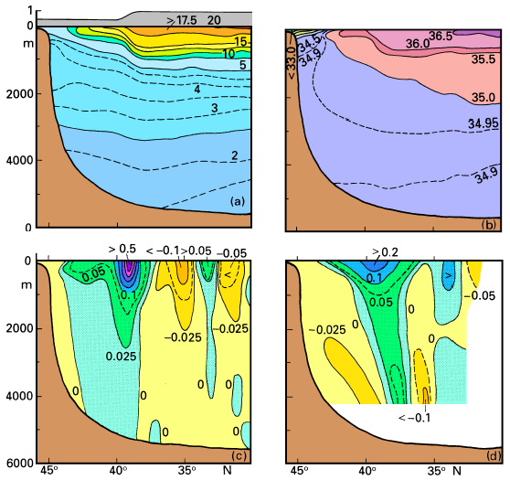
Gulf Stream Section
North
A section through the Gulf Stream and its countercurrents across 55°W. (a) Potential temperature (°C) and sea level (m), (b) salinity, (c) geostrophic current (ms⁻¹) relative to the sea floor, (d) mean current (ms⁻¹) as derived from observation. The sections are based on data from 8 cruises between 1959 - 1983. From Richardson (1985).
Notes:
Most transport estimates for the Gulf Stream are based on geostrophic calculations
which, according to our Rule 2 in Chapter 3, should be accurate to within 20%. The
associated pressure gradient is maintained by a drop in sea level across the current of some
0.5 m towards the coast and, according to our Rule 1a, a corresponding thermocline rise of
about 500 m. This is demonstrated by Figure 14.12 which also reveals the existence of
two countercurrents, one inshore - between the continental slope and the Gulf Stream - and
one offshore, as part of the long-term mean situation. Actual velocities at any particular
time can be much larger, since the strong currents in the rings disappear in the mean and
variability in the position of the Gulf Stream acts to reduce the peak velocity in the mean
as well. Observed peak velocities usually exceed 1.5 m s-1.The Gulf Stream is an
important heat sink for the ocean. Net annual mean heat loss, caused by advection of cold
dry continental air from the west, exceeds 200 W m-2 (Figure 1.6). A brief period of net
heat gain occurs from late May to August when warm saturated air is advected from the
south (Figure 1.2).

Slide 18
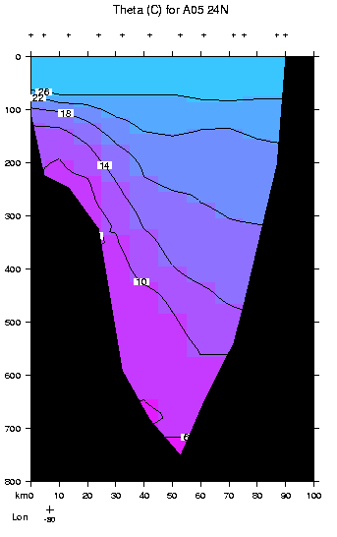
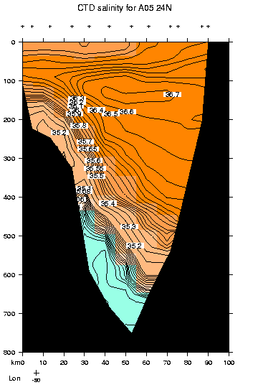
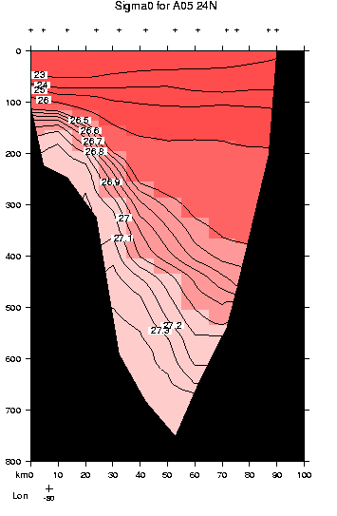
Gulf Stream: vertical sections along 24N

Slide 19
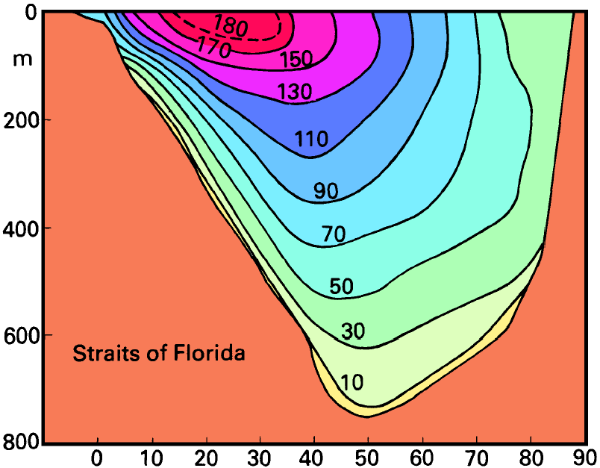
Gulf Stream Velocity Section
Tomczak and Godfrey

Slide 20
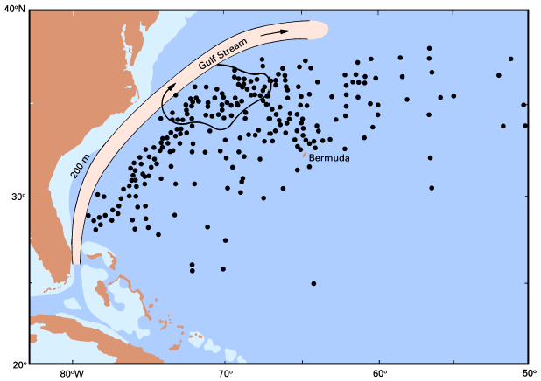
Eddies
Geographical distribution of 225 cold-core rings reported for the period 1932 - 1983. Ring movement is generally towards the southwest until the rings decay or are absorbed again into the Gulf Stream. The arrow, the path of a ring observed in 1977, gives an example of typical ring movement. Adapted from Richardson (1983b).

Slide 21
Subtropical Gyre
Components:
Gulf Stream (WBC)
Azores Current (亚述尔海流)
Canary Current (EBC)
North Equatorial Current

Slide 22
Canary Current
Eastern boundary current of the N. Atlantic subtropical gyre

Slide 23
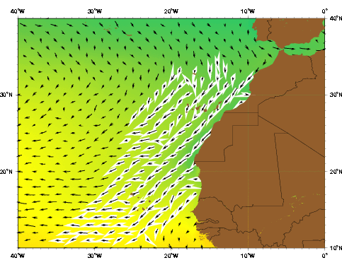
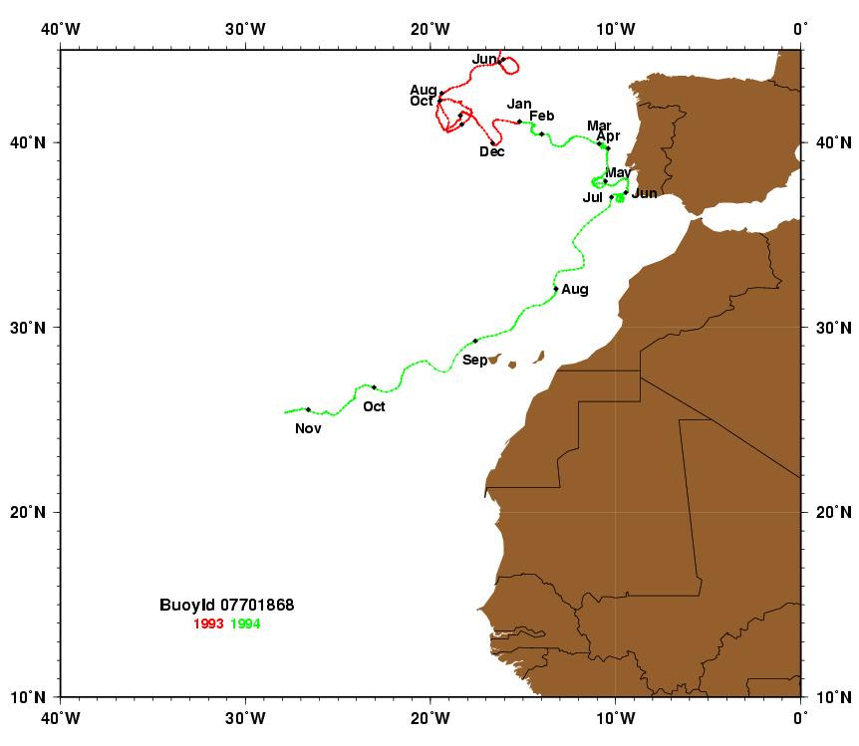
Canary Current
葡萄牙
西班牙
摩洛哥
西撒哈拉
加那利海流，湾流流到大洋东岸折向南的那支。摩洛哥西海岸。
东边界流，宽约1000km，流速约为10-30cm/s，厚度约500米。沿岸有上升流，水温较周围海水低。
对非洲的气候有显著影响，与撒哈拉沙漠的形成有关系
Notes:
Although people have known about the Canary Current for centuries (Peterson et al. 1996), it is only recently that a handful of studies have provided detailed information about it. The Canary Current flows along the African coast from north to south between 30°N and 10°N and offshore to 20°W (Fedoseev 1970). Like other eastern boundary currents, it is wide (1000 km) and slow (10-30 cm s-1), and it flows year-round towards the equator (Wooster et al. 1976; Batten et al. 2000). Its surface waters are relatively cool because as it travels south it entrains upwelled water from the coast (Mittelstaedt 1991). On average, the current is about 500 m deep (Wooster et al. 1976) and flows at a speed of 10-15 cm s-1 (Zhou et al. 2000). The Canary Island Archipelago reaches depths of more than 3000 m and thus forms an obstacle to the flow of the Canary Current (Barton et al. 2000).
The Canary Current system contains coastal upwelling, filaments, and eddies (Johnson and Stevens 2000). Eddies with length scales of 100 to 300 km form along the coastal boundary of the current (Mittelstaedt 1991).The eddy kinetic energy values for the Canary Current are less than 100 cm2 s2 (Zhou et al. 2000).
A branch of the Azores Current joins the Canary Current along the continental slope between the Madeira Plateau and the Canary Islands (Zhou et al. 2000). Batten et al. (2000), citing Tomczak and Godfrey (1994), state that the Portugal Current, which lies off the Iberian west coast, is actually part of the Canary Current. Other sources, however, distinguish the Portugal Current as a separate current that transports about 3 Sv southward in the upper 800 m (Stramma 1984).
Fedoseev (1970) described the seasonal patterns of the Canary Current based on data collected from 1957-1966 as part of the Atlant-NIRO expedition. During winter the trade winds are at their peak strength, and so is the Canary Current. Its core velocity can be more than 75 cm s-1 as it passes through the Canary archipelago. It moves parallel to the coastline up to 20°N, forming cyclonic gyres on the shelf along the way. When the current reaches the area of 15°N, it begins to flow west under the influence of the Equatorial Countercurrent. Although the two currents flow in the same direction, they do so at different speeds; this causes two anti-cyclonic gyres to form at the border between them. In spring the Canary Current weakens along with the trade winds, while the Equatorial Countercurrent strengthens. An anti-cyclonic gyre forms to the west of the current. The summer brings about further weakening of the trade winds, and this reduces the water inflow from the north. The Canary Current weakens further and spreads outward from the coast. The cyclonic gyres on the shelf weaken or disappear completely. The Equatorial Countercurrent, on the other hand, is at its peak and shifts north, separating the Canary Current from the coast. During autumn the Canary Current is at its weakest, but some of its characteristics are very similar to those during winter. The current passes through the Canary archipelago, the influence of the Equatorial Countercurrent is the same as in winter, and the strong cyclonic gyres form once again.
Stramma and Siedler (1988) provide a contradictory description. Their geostrophic computations indicated that the Canary Current is weak and variable in the winter and spring. Their one-year record also detected northward flows during November-December 1984, April-May 1985, and September-October 1985.

Slide 24
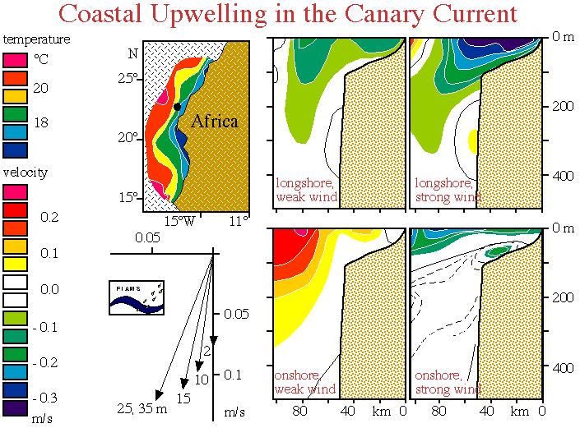
Canary Current upwelling system. (a) SST (°C) as observed in April/May 1969; (b) alongshore and (c) onshore velocities (cm s⁻¹, positive is northward and eastward) during periods of weak and strong wind, (d) observed mean velocities over a 29 day period at the position indicated by the dot in panel (a), in 74 m water depth; numbers indicate distance from the bottom. Note the alignment of the current at mid-depth with the direction of the coast, and the shoreward turning of the current as the bottom is approached. From Hughes and Barton (1974), Huyer (1976), and Tomczak and Hughes (1980).

Slide 25
N. Atlantic Circulation (Fratantoni, JGR 2001)
Subpolar gyre
Cyclonic circulation
Western boundary currents: East Greenland Current and Labrador Current
Feeding into the Norwegian Sea (Norwegian Current)

Slide 26
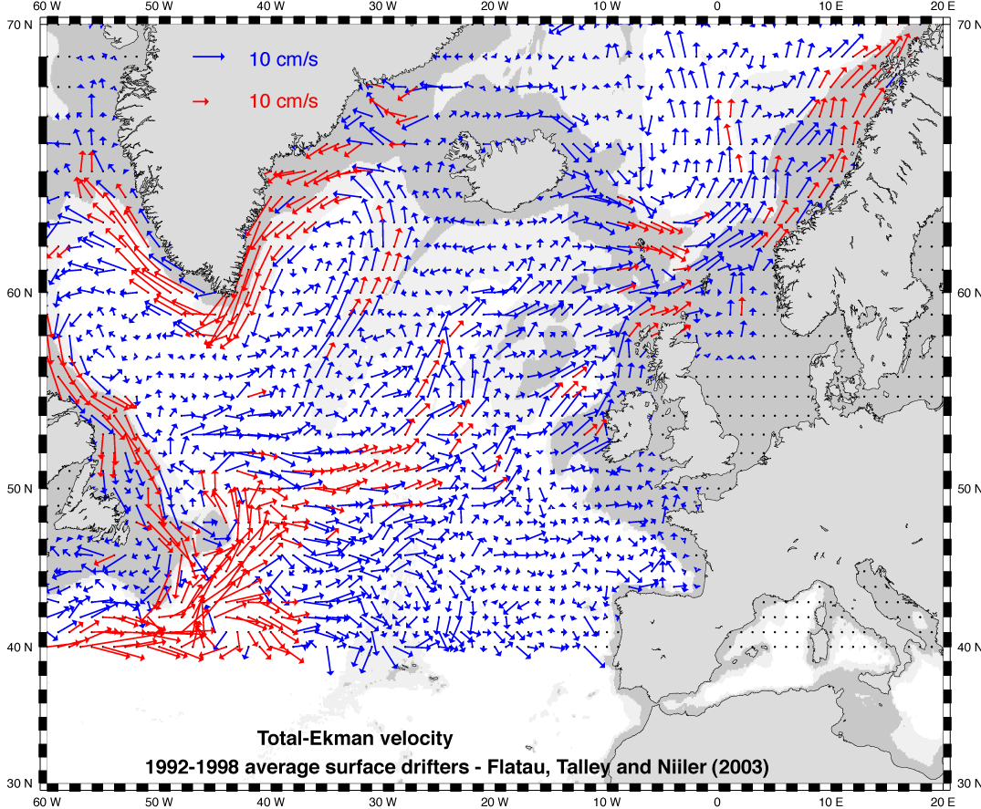
Surface flow from drifters (Flatau, Talley and Niiler, 2003)

Slide 27
South Atlantic Subtropical Gyre
Brazil Current and Benguela Current (本格拉海流)
Malvinas or Falkland Current and the Antarctic Circumpolar Current; Weddell Sea gyre

Slide 28
Atlantic Equatorial Currents
North Brazil Current (a tropical western boundary current)
South Equatorial Current and Equatorial Counter Current

Slide 29
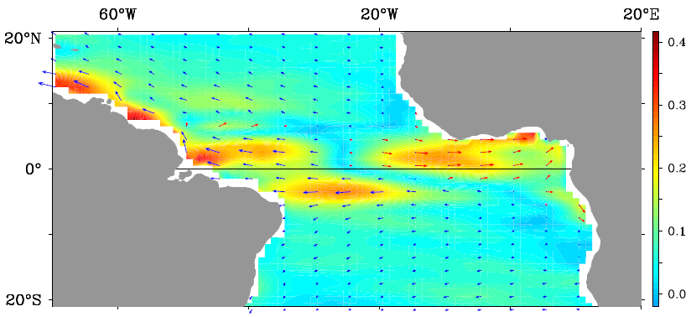
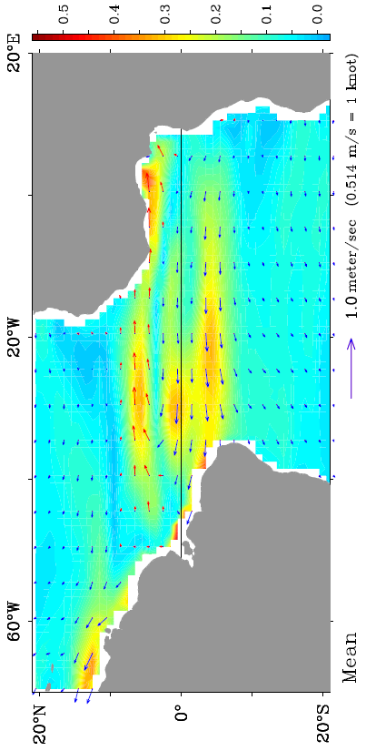
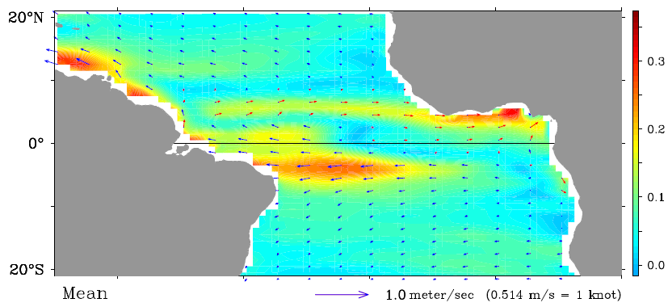
Atlantic Equatorial Currents
Surface currents in the equator (1993-2011)
Jan-Mar
Jun-Aug
Ocean surface currents derived from satellite altimeter and scatterometer data
Annual
http://www.oscar.noaa.gov/datadisplay/latlon-nj.htm

Slide 30
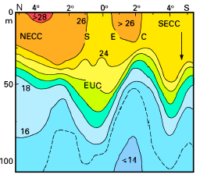
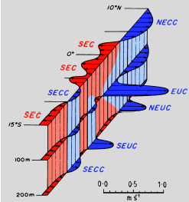
Atlantic Equatorial Currents
A sketch of the structure of the equatorial current system during August.
Temperature section (°C) across the central part of the equatorial current system along 5°W. Note the low surface temperature at the equator due to upwelling, the weakening of the thermocline in the EUC, and the poleward rise of the thermocline in the countercurrents.
Notes:
As in the Pacific Ocean, the equatorial current system displays a banded structure when
investigated in detail. Figure 14.3 is a schematic summary of all its elements as they occur
in mid-year. The Equatorial Undercurrent (EUC) is the strongest, with maximum speeds
exceeding 1.2 m s-1 in its core at about 100 m depth and transports up to 15 Sv. It is
driven and maintained by the same mechanism as in the Pacific Ocean (see Chapter 8),
strongest in the west and weakening along its path as a result of frictional losses to the
surrounding waters. Observations show that it swings back and forth between two extreme
positions 90 km either side of the equator at a rate of once every 2 - 3 weeks, while speed
and transport oscillate between the maxima given above and their respective minima of
0.6 m s-1 and 4 Sv. The EUC was discovered by the early oceanographer John Young
Buchanan during the Challenger expedition of 1872 - 1876 and described in 1886, but this
discovery was forgotten until the discovery of the Pacific EUC in 1952 triggered a search
for an analogous current in the Atlantic Ocean. CTD data reveal the presence of the EUC
through the vertical spreading of isotherms in the thermocline (Figure 14.4); in the eastern
Atlantic Ocean it can be seen as a prominent subsurface salinity maximum.
The three equatorial currents known from the depth-integrated circulation dominate the
surface flow (Figure 14.3) and the hydrography (Figure 14.4; see Chapter 8 for a
discussion of the relationship between thermocline slope and currents) but appear more
complicated in detail. The North Equatorial Current (NEC) is a region of broad and uniform
westward flow north of 10°N with speeds of 0.1 - 0.3 m s-1. The eastward flowing North
Equatorial Countercurrent (NECC, the countercurrent seen in the depth-integrated flow field)
has similar speeds; it is highly seasonal and nearly disappears in February when the Trades
in the northern hemisphere are strongest (Figure 14.5). The South Equatorial Current
(SEC), again a region of broad and uniform westward flow with similar speeds, extends
from about 3°N to at least 15°S. Just as in the Pacific Ocean it is interspersed with eastward
flow both at the surface and below the thermocline. The South Equatorial Countercurrent
(SECC) is weak, narrow and variable and therefore not resolved by Figure 14.5, which is
based on 2° averages in latitude. It often shows maximum speed (around 0.1 m s-1) below
100 m depth and is masked by weak westward flow at the surface. The North Equatorial
Undercurrent (NEUC) and the South Equatorial Undercurrent (SEUC) are both narrow and
swift, with maximum speeds of 0.4 m s-1 near 200 m depth.

Slide 31
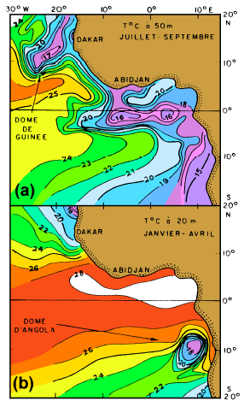
Eastern Upwelling
The Angola Dome and the Guinea Dome as seen in temperature data from 20 m and 50 m depth. From Peterson and Stramma (1991)
Notes:
The North Equatorial Countercurrent is prevented from flowing north by the east - west
orientation of the coastline; it intensifies to an average 0.4 m s-1 along the Ivory Coast
before its energy is dissipated in the Gulf of Guinea. However, some of its flow does escape
north and combines with the North Equatorial Undercurrent to drive a small cyclonic gyre
centred at 10°N, 22°W. A similar small gyre, centred near 10°S, 9°E and clearly distinct
from the larger gyre which incorporates the Angola Current, is driven by the South
Equatorial Undercurrent. We know from our Rules 1, 1a, and 2 of Chapter 3 that cyclonic
flow is accompanied by a sea surface depression and an elevation of the thermocline in the
centre of the gyre (compare Figure 2.7, or Figures 3.3 and 3.4 which show the same rules
operating in an anticyclonic gyre), so in a plot of temperature at constant depth the two
gyres should show up as local temperature minima. Figure 14.6 proves that this is indeed
the case but only in summer when the Trades of the respective hemisphere are weakest and
the Undercurrents strongest. Because of the observed doming of the thermocline in summer
the gyres are known as the Angola and Guinea Domes. The associated circulation exists
throughout the year, although weaker in winter, and reaches to at least 150 m depth.

Slide 32
Questions (Due in 2-week)
Name the major currents in the Atlantic outside of the tropics (north of 15°N and south of 15°S).
Compare the currents in the Atlantic and Pacific, make clear the similarity and differences (optional).

Slide 33

Learning about the Ocean, the Climate and the Nature

