Slide 1
Lecture 17: Atlantic: Deep Circulation and Meridional Overturning Circulation Descriptive Physical Oceanography
杨海军（YANG Haijun）复旦大学大气与海洋科学系
Department of Atmospheric and Oceanic Sciences, Fudan University
Email: yanghj@fudan.edu.cn
This powerpoint was prepared for purposes of this lecture and course only. It contains graphics from copyrighted books, journals and other products. Please do not use without acknowledgment of these sources.

Slide 2
Reading:
Tomczak and Godfrey chapters 14 and 15
Emery, Talley and Pickard chapter 8.9.1.1, 8.9.1.2 and 8.9.2
Outline:
Abyssal circulation dynamics
North Atlantic Deep Water
Meridional overturning circulation
Notes:
A glance at the distribution of high quality ocean data tells us that the Atlantic Ocean is by far the best researched part of the world ocean. This is particularly true of the North Atlantic Ocean, the home ground of many oceanographic research institutions
of the USA and Europe. We therefore have a wealth of information, and our task in describing the essential features of the Atlantic Ocean will not so much consist of finding reasonable estimates for missing data but finding the correct level of generalization from a bewildering and complex data set.

Slide 3
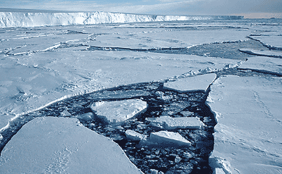

Slide 4
Abyssal Circulation Dynamics（深水环流动力学）
temperature change + temperature advection = heating/cooling term + diffusion
salinity change + salinity advection = evaporation/precipitation/brine rejection + diffusion
Thermohaline processes that most strongly impact deep waters: cooling (convection), brine rejection and diffusion
Convection. Deep convection in world’s oceans: actually mostly to 1500 m. Example: Labrador Sea

Slide 5
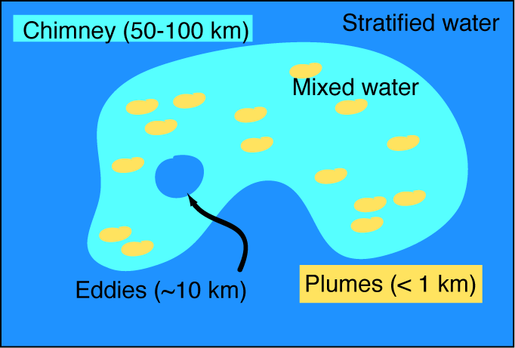
Convection
Structure of convection: (1) a chimney, which is a patch about 100 to 200 kilometers across within which preconditioning can allow convection, and (2) convective plumes which are the actual sites of convection and which are about 1 kilometer or less across. The plumes are about the same size across as they are deep. It is not yet clearly known what the vertical velocity structure is within the convective plumes. Observations in the Labrador Sea have suggested that there is more downward motion than upward motion, and that the required upward motion might occur more slowly over a broader area within the chimney.

Slide 6
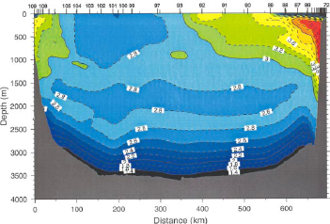
Deep Convection
(a) Potential density profiles from a deep convection region in the Labrador Sea in late winter of 1997 ("119" in the deep convection patch; "62" in a western boundary convection regime; "59" typical of stratified water). (b) Vertical section through the Labrador Sea in late winter 1997 that includes deep convection stations.
Deep convection occurs in only a very few special locations around the world: Greenland Sea, Labrador Sea, Mediterranean Sea, Weddell Sea, Ross Sea, and Japan Sea. These sites (except the Japan Sea), which is effectively isolated from the global ocean, ventilate most of the deep waters of the world.
Notes:
Potential density profiles from a deep convection region in the Labrador Sea in late winter of 1997 ("119" in the deep convection patch; "62" in a western boundary convection regime; "59" typical of stratified water). (b) Vertical section through the Labrador Sea in late winter 1997 that includes deep convection stations.
(Brine rejection, discussed in section 3.5.7, is the other source of very dense water, for instance in the Antarctic.)

Slide 7
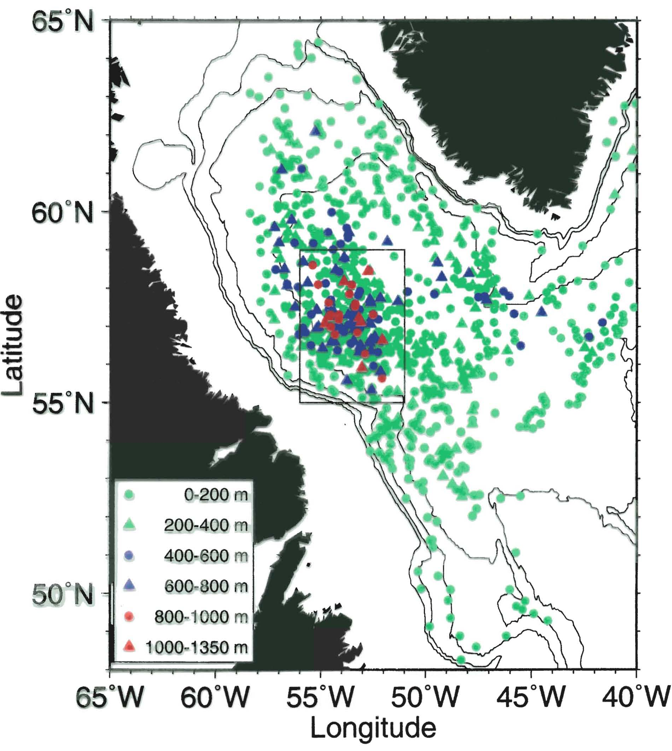
Labrador Sea Water formation: thick mixed layers, intermediate depth convection in Labrador Sea
Deep Convection

Slide 8
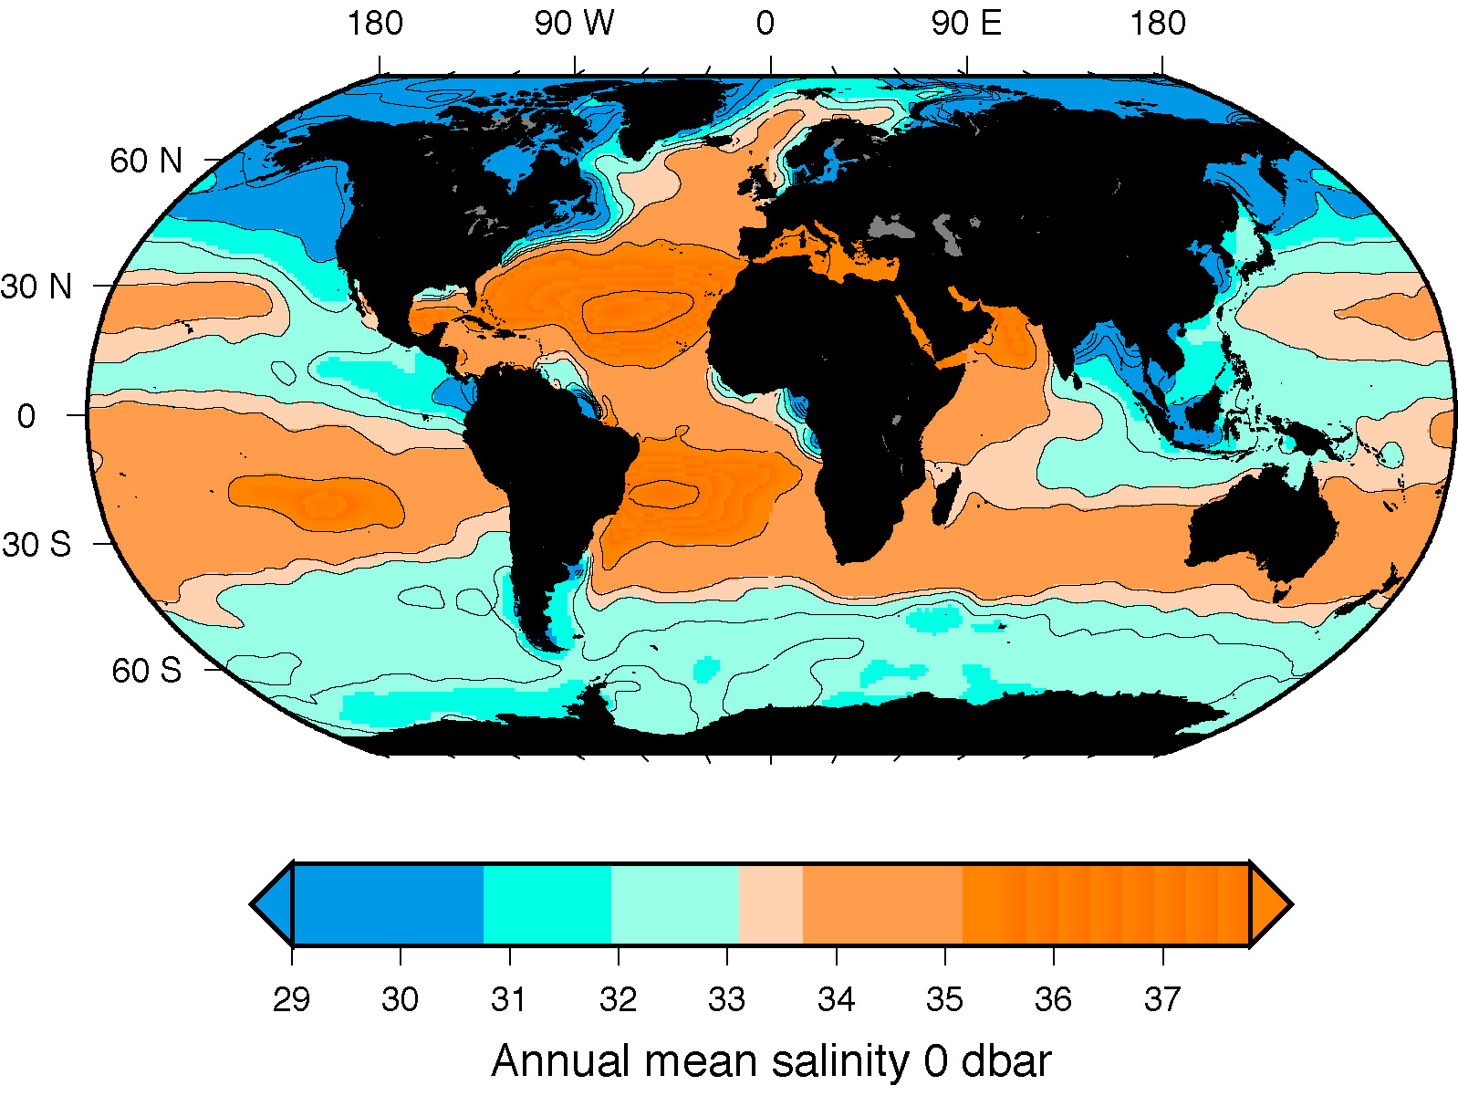
Deep Convection and Brine Rejection Sites
Labrador Sea Greenland Sea Mediterranean Sea
B
X
B
B
B
X
B
Japan Sea (no global impact)
X
X
X
B
X
B
B
B
Brine rejection in all sea ice areas
Ross Sea Weddell Sea

Slide 9
Diffusion
Since there are no significant deep heat sources in the world ocean, waters that fill the deep ocean can only return to the sea surface as a result of downward mixing of heat from the sea surface. This occurs through eddy diffusion. The magnitude of eddy diffusion also helps set the stratification that convection sees.
Diffusion (diapycnal, i.e. across isopycnals) is required to return convected/cooled waters back upwards to surface.

Slide 10
Diffusion
The diapycnal eddy diffusivity estimate was based on the idea of isolated sources of deep water and general upwelling of this deep water through all of the oceans back to the surface. The upwelling requires downward diffusion of heat. Munk assumed that most of the ocean is dominated by the balance
Vertical advection = Vertical diffusion, that is,
$$w\frac{∂T}{∂z}=\frac{∂}{∂z}(κ_{v}\frac{∂T}{∂z})$$
Notes:
(A simplified, crude estimate can be made by using an exponential fit to the average temperature profile, which has an e-folding depth of 1 km, and then taking the observed deep water formation rate in Sverdrups and dividing by the area of the world's oceans. The latter yields an upwelling rate of approximately 1 cm/day.)

Slide 11
Diffusion
Given the observed shape of the temperature distribution with depth, which is nearly exponential below the surface layer, and an estimate of the vertical velocity, a diapycnal diffusivity can be estimated. It has since been found through measurements that the true diffusivity in the open ocean away from boundaries is 10 times smaller than that given by above. This means that there must be much larger diffusivity in some regions of the ocean, now thought to be at the boundaries, at large seamount and island chains, and possibly the equator.
Notes:
(A simplified, crude estimate can be made by using an exponential fit to the average temperature profile, which has an e-folding depth of 1 km, and then taking the observed deep water formation rate in Sverdrups and dividing by the area of the world's oceans. The latter yields an upwelling rate of approximately 1 cm/day.)

Slide 12
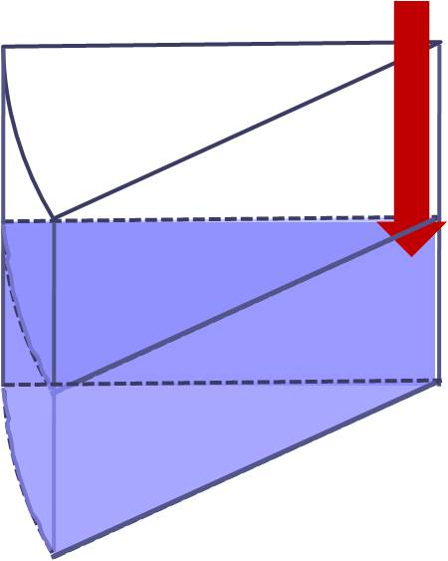
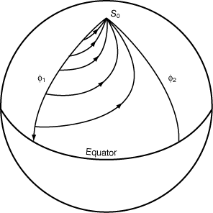
Abyssal Circulation: Stommel-Arons’ Solution
Upper, motionless
EQ
NP
Lower, active
Model assumption:
A 2-layer ocean; A source of deep water at the northernmost latitude; A uniformly upwelling everywhere; The Earth is rotating, β–effect
Notes:
Circulation in the deep ocean that arises from injection of water at isolated deepwater sources was modeled, both theoretically and in rotating tank experiments, by Stommel in the late 1950s, followed by major papers by Stommel and Arons in the early 1960s. They considered an ocean with just 2 layers, and solved only for the circulation in the bottom layer. They assumed a source of deep water at the northernmost latitude, and then assumed that this water upwells uniformly (at the same rate) everywhere (Fig. 8.42). In these respects, the assumptions are the same as Munk's. However Munk did not solve for the actual circulation. An essential part of the Stommel/Arons solution is that the earth is rotating, and that there is a β–effect, in which the Coriolis parameter varies with latitude (section 8.6).
The circulation in the model and laboratory is determined entirely by the upwelling throughout the ocean basin. The result is poleward flow, due to vortex stretching by the upwelling, which results in flow to a region of higher Coriolis parameter in order to conserve potential vorticity. This direction of flow is analogous to the flow in cyclonic wind-driven gyres with Ekman upwelling (section 8.7.1). The interior flow is therefore counterintuitive – it runs towards the deepwater source!
The connection between the isolated deepwater source and the interior poleward flow is in a western boundary current. For want of historical names for these currents, they are called Deep Western Boundary Currents (DWBC), and are associated with the thermohaline circulation. One such DWBC runs southward beneath the Gulf Stream, bringing dense waters from the northern Atlantic and Arctic to the rest of the global ocean. Swallow and Worthington (1961) report that they found this current, which is now recognized as a major part of the global overturning circulation, after being convinced by Stommel to go in search of it, based on his theoretical ideas. Perusal of results from the 1920s Meteor expedition (Wüst, 1932) shows the large-scale consequences of this particular DWBC for deep salinity and oxygen distributions over the whole length of the Atlantic.

Slide 13
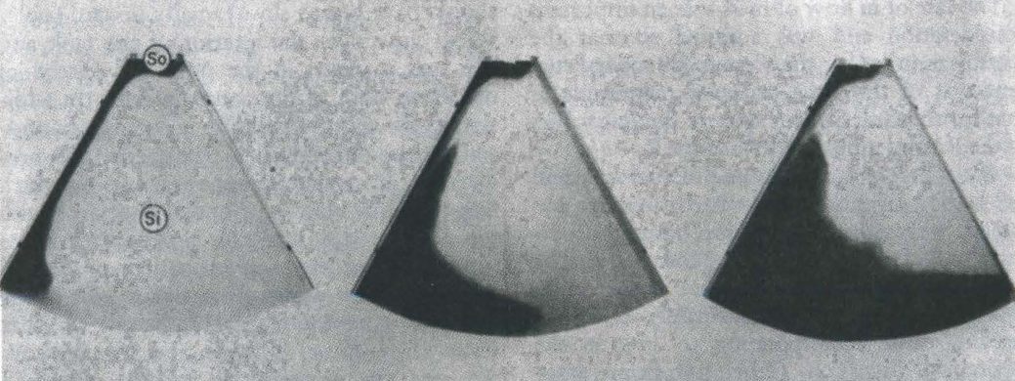
Abyssal Circulation: Stommel-Arons’ Solution
Results:
poleward flow, due to vortex stretching by the upwelling, which results in flow to a region of higher Coriolis parameter in order to conserve potential vorticity. This direction of flow is analogous to the flow in cyclonic wind-driven gyres with Ekman upwelling. The interior flow is therefore counterintuitive – it runs towards the deepwater source!
Deep Western Boundary Currents (DWBC) connects the isolated deepwater source and the interior poleward flow
Notes:
Circulation in the deep ocean that arises from injection of water at isolated deepwater sources was modeled, both theoretically and in rotating tank experiments, by Stommel in the late 1950s, followed by major papers by Stommel and Arons in the early 1960s. They considered an ocean with just 2 layers, and solved only for the circulation in the bottom layer. They assumed a source of deep water at the northernmost latitude, and then assumed that this water upwells uniformly (at the same rate) everywhere (Fig. 8.42). In these respects, the assumptions are the same as Munk's. However Munk did not solve for the actual circulation. An essential part of the Stommel/Arons solution is that the earth is rotating, and that there is a β–effect, in which the Coriolis parameter varies with latitude (section 8.6).
The circulation in the model and laboratory is determined entirely by the upwelling throughout the ocean basin. The result is poleward flow, due to vortex stretching by the upwelling, which results in flow to a region of higher Coriolis parameter in order to conserve potential vorticity. This direction of flow is analogous to the flow in cyclonic wind-driven gyres with Ekman upwelling (section 8.7.1). The interior flow is therefore counterintuitive – it runs towards the deepwater source!
The connection between the isolated deepwater source and the interior poleward flow is in a western boundary current. For want of historical names for these currents, they are called Deep Western Boundary Currents (DWBC), and are associated with the thermohaline circulation. One such DWBC runs southward beneath the Gulf Stream, bringing dense waters from the northern Atlantic and Arctic to the rest of the global ocean. Swallow and Worthington (1961) report that they found this current, which is now recognized as a major part of the global overturning circulation, after being convinced by Stommel to go in search of it, based on his theoretical ideas. Perusal of results from the 1920s Meteor expedition (Wüst, 1932) shows the large-scale consequences of this particular DWBC for deep salinity and oxygen distributions over the whole length of the Atlantic.

Slide 14
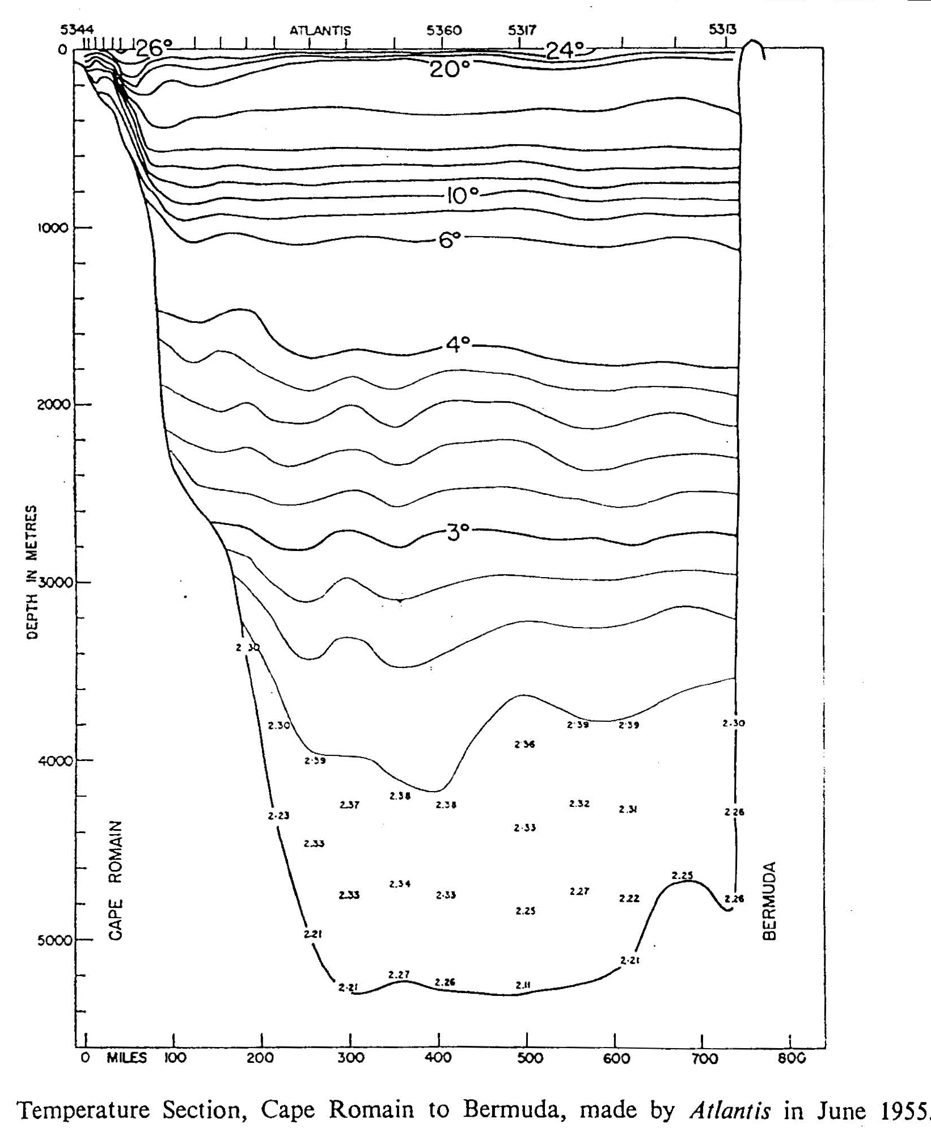
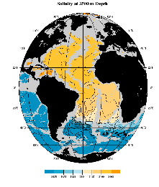
N. Atlantic Deep Western Boundary Current
Level of no motion
Southward: 5-10cm/s
Swallow and Worthington: first observation of DWBC

Slide 15
Abyssal Circulation: Stommel-Arons’ Solution
X
X
Local deep water sources in the northern North Atlantic and in the Antarctic and general upwelling everywhere yield poleward interior flow, connected with Deep Western Boundary Currents
Notes:
Diapycnal (vertical) diffusivity is required in a complete model of the abyssal circulation, in order to permit the upwelling of the dense abyssal water into the less dense upper ocean. However, Stommel and Arons did not need to treat the diffusivity explicitly in order to diagnose the deep circulation arising from the deepwater sources. Another interesting missing element in the original model is abyssal topography, which cuts through this abyssal layer, providing all sorts of local western boundaries, and also all sorts of basin shapes that differ from the simple, flat-bottomed basin of the theory. Treatment of the many publications looking at the resulting flow in different geometries is beyond our scope, but includes the possibility of exactly zonal (east-west) jets connecting a Deep Western Boundary Current to feed through a gap in an offshore ridge to another Deep Western Boundary Current flowing along that ridge

Slide 16
Abyssal Circulation in Atlantic at 4000-4500 dbar(Reid, 1994)
Northward flow in DWBC in S. Atlantic, then crossing to Mid-Atlantic Ridge in N. Atlantic, into Sargasso Sea area, Carries AABW (LCDW)

Slide 17
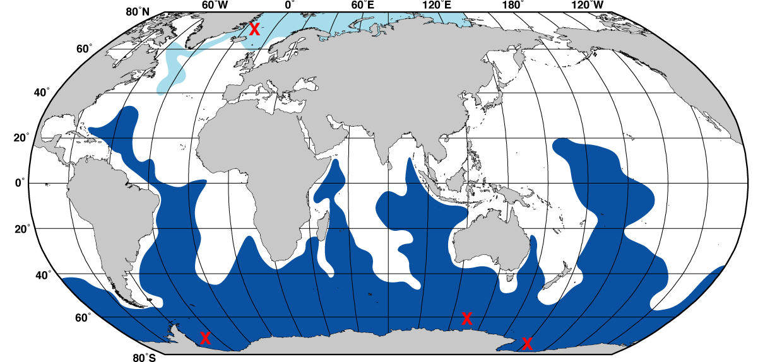
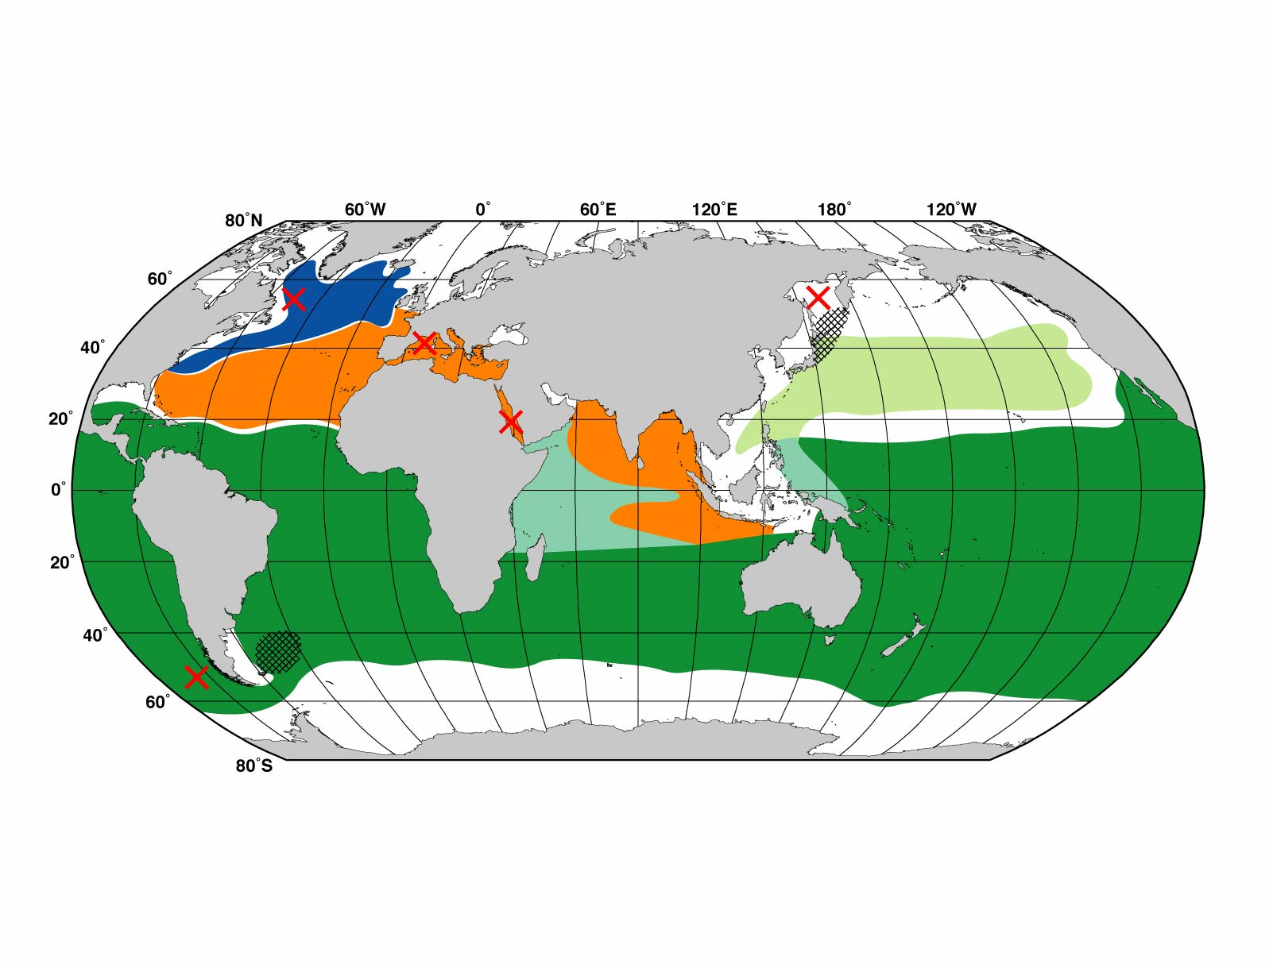
Abyssal Circulation: Localized Sources
Deep and bottom water production sites: big temperature changes
Intermediate water production sites: major impacts on salinity

Slide 18
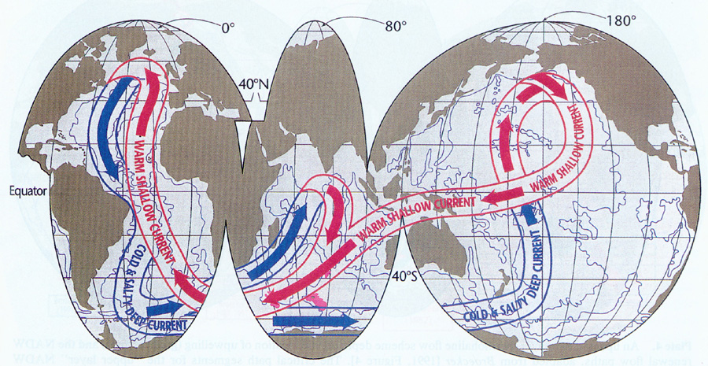
Deep circulation - popular schematic “Ocean Conveyor Belt”, but of course deeper circulation is more complex than this

Slide 19
North Atlantic Deep Water
Large impact, saline, high oxygen, low nutrient water mass
Around 2000 m depth as it exits the N. Atlantic to the south
Signature found throughout world ocean
Notes:
Sources and connection with:
Upper layer water of N. Atlantic, from Gulf Stream through subpolar gyre, including Antarctic Intermediate Water and surface water from the Indian Ocean
Bottom water from Antarctic (Antarctic Bottom Water)
Intermediate depth convection in Labrador Sea (Labrador Sea Water)
Intermediate-deep convection in Greenland Sea (Nordic Seas Overflow Water)
Evaporated, convected waters from Mediterranean Sea (Mediterranean Overflow Water)

Slide 20
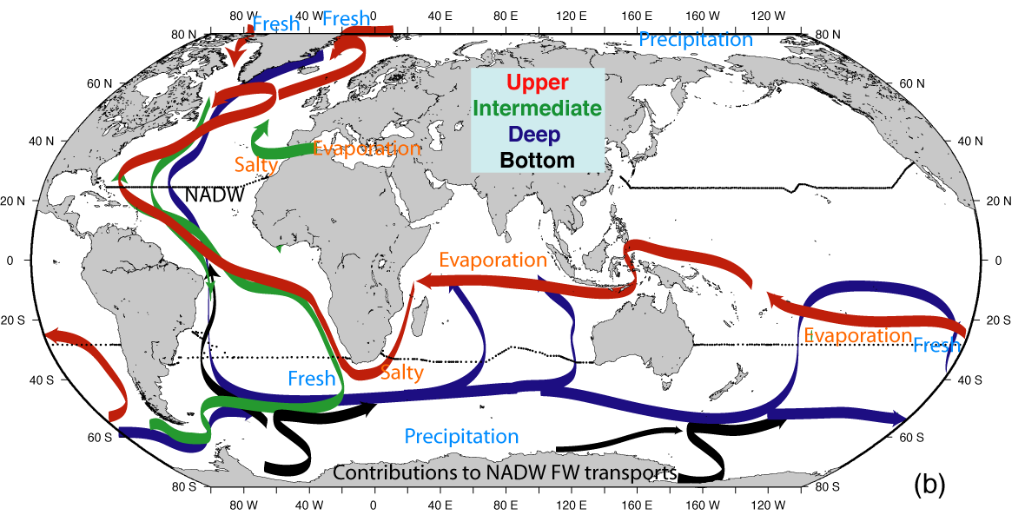
NADW Global Cell: upper ocean inflow including surface waters and Antarctic Intermediate Water
Upper and intermediate ocean inflow

Slide 21
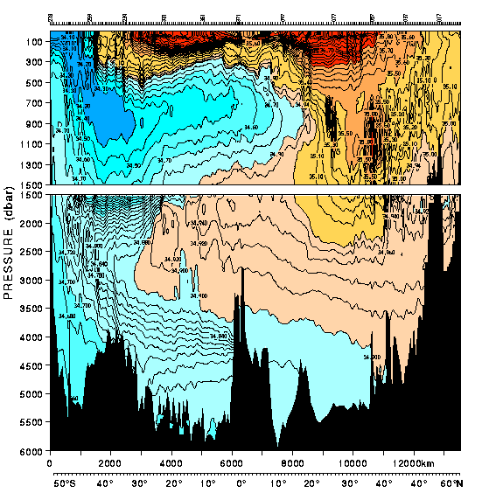
Atlantic 25°W Salinity
High salinity North Atlantic waters
MOW
AAIW
LSW
Low salinity Antarctic intermediate and bottom waters
NSOW
NADW
AABW
30°S
24°N

Slide 22
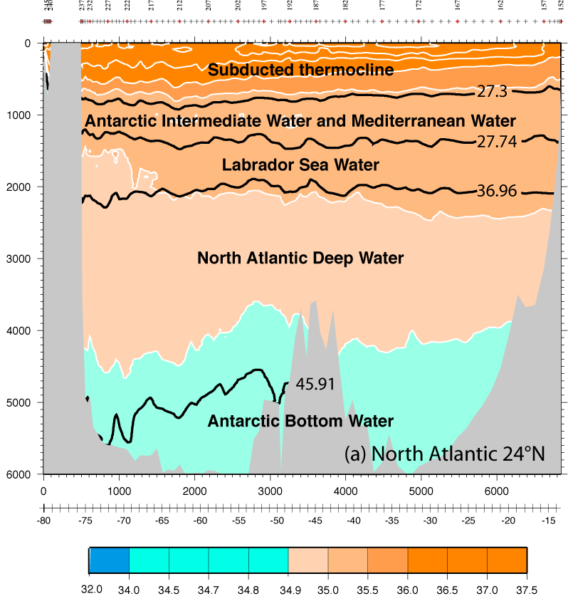
Atlantic Salinity at 24°N

Slide 23
Low and High Salinity Intermediate Waters: 1000-2000 m depth
Labrador Sea Water - convection
Mediterranean Outflow Water
x
Antarctic Intermediate Water- SE Pacific convection/SW Atlantic mixing

Slide 24
Formation of Mediterranean overflow water (MOW) high salinity intermediate water mass becomes part of the NADW, including a major part of its high salinity signature
Mediterranean Overflow Water formation

Slide 25
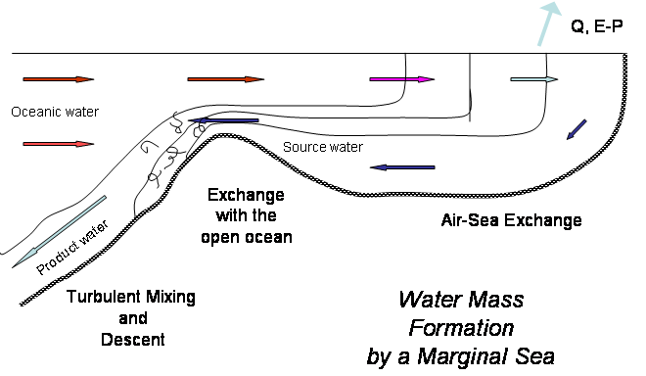
N. Atlantic transformed waters: Mediterranean Overflow Water (MOW)
High salinity water mass, formed by net evaporation in the Mediterranean Sea (involves deep convection there)

Slide 26
Labrador Sea Water formation

Slide 27
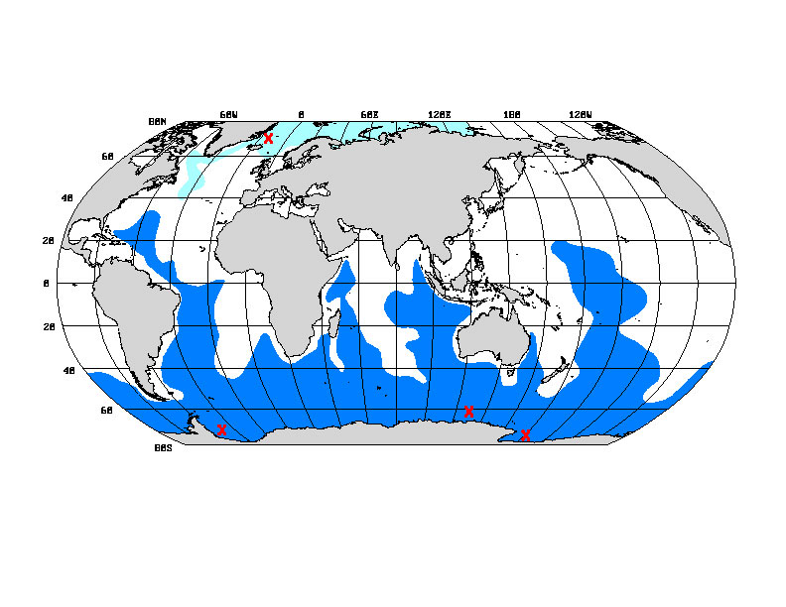
Deep and Bottom Waters
Nordic Sea waters/NADW
Antarctic shelf waters (ice) /AABW or LCDW
Bottom water inflow: Antarctic Bottom Water (also called Lower Circumpolar Deep Water), very cold, fresh, formed around Antarctica

Slide 28
Questions (Due in 2-week)
What are the major water masses of the North Atlantic? What are their sources and what distinguishes them? How is each one formed?
Locate the Antarctic Intermediate Water in the Atlantic using its most common characteristic. How far north is it easily discernible?
Locate deeper waters of Antarctic origin on meridional sections extending to the north. What properties are used to differentiate these from Deep Waters moving south?
Where is there active and relatively deep (>1000m) convection in the North Atlantic and adjacent seas?
Where does the densest water form in the northern hemisphere?
Why does the deep western boundary current in the North Atlantic go the opposite direction from the Gulf Stream?

Slide 29
Calculations
The formation rate of North Atlantic Deep Water is approximately 13 Sv (1 SV = 10⁶ m³/s) and the mean potential temperature of the water mass is 2.5ºC. Suppose the source water which feeds the formation process enters the North Atlantic basin by crossing the equator with a mean temperature of 16ºC. What is the magnitude of the heat loss (over the combined North Atlantic and Greenland/Norwegian Seas) associated with the formation of NADW? (in Watts)
The surface inflow to the Mediterranean Sea through the Strait of Gibralter is 1 Sv with a mean salinity of 36.1 psu. The mean salinity of the lower, outflowing layer is observed to be 38.4 psu. Assuming that salt is conserved in the Mediterranean basin, what is the size of the transport of the outflowing layer? What is the sum of Evaporation-minus-Precipitation for the basin (in kg/s)? The area of the basin is about 2.5 x 10⁶ km². What is the average (E-P) in cm/yr? (Neglect river runoff in you calculations)

Slide 30
Learning about the Ocean, the Climate and the Nature

