Slide 1
Lecture 18: Southern Ocean: Circulation and Water Properties Descriptive Physical Oceanography
杨海军（YANG Haijun）复旦大学大气与海洋科学系
Department of Atmospheric and Oceanic Sciences, Fudan University
Email: yanghj@fudan.edu.cn
This powerpoint was prepared for purposes of this lecture and course only. It contains graphics from copyrighted books, journals and other products. Please do not use without acknowledgment of these sources.

Slide 2
Reading:
Tomczak and Godfrey chp 6
Outline:
Antarctic subpolar gyres (Weddell and Ross Seas)
Antarctic Circumpolar Current
Southern Ocean water mass formation
Southern Ocean water mass properties
Notes:
A glance at the distribution of high quality ocean data tells us that the Atlantic Ocean is by far the best researched part of the world ocean. This is particularly true of the North Atlantic Ocean, the home ground of many oceanographic research institutions
of the USA and Europe. We therefore have a wealth of information, and our task in describing the essential features of the Atlantic Ocean will not so much consist of finding reasonable estimates for missing data but finding the correct level of generalization from a bewildering and complex data set.

Slide 3
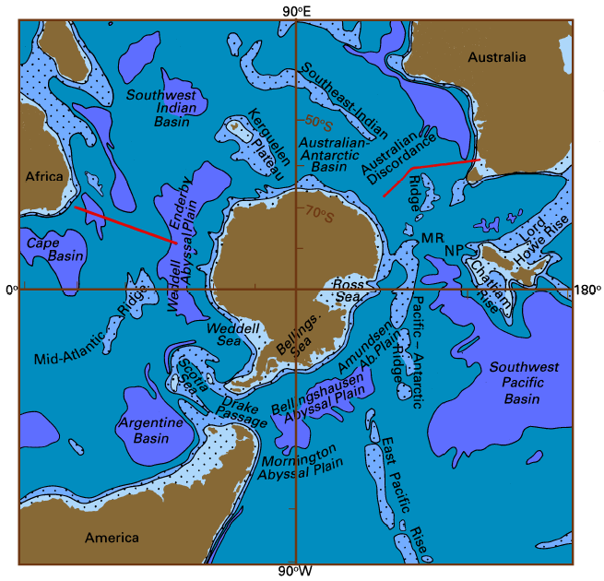
Bottom Topography of the Southern Ocean
Three basins (Depth > 4000m)
Pacific-Antarctic Basin
Australian-Antarctic Basin
Atlantic-Indian Basin
Bottom topography of the Southern Ocean. The 1000, 3000, and 5000 m isobaths are shown, and regions less than 3000 m deep are shaded.
MR: Macquarie Ridge, NP: New Zealand Plateau (Tomczak and Godfrey, chapter 6).
Notes:
More important for the dynamics than the basins are the ridges that separate them. The
Scotia Ridge, which connects Antarctica with South America and contains numerous
islands, is located about 2000 km east of Drake Passage, a narrow constriction where the
southern tip of South America reaches 56°S while the Antarctic Peninsula extends to 63°S.
At the 500 m depth level, the width of Drake Passage is about 780 km. The Scotia Ridge
is generally less than 2000 m deep, but some openings exist at the 3000 m level. The
combined effect of Drake Passage and the Scotia Ridge on the Circumpolar Current is quite
dramatic: The current accelerates to squeeze through the gap and hits the obstacle at increased
speed. It emerges highly turbulent and shifts sharply northward. The shift is a result
of several factors, including deflection by the Coriolis force and changes in bottom depth
along its path; however, the dynamics are too complex to be considered here in detail.
The Kerguelen Plateau, which carries a few isolated islands, reaches and nearly blocks the
2000 m level, although most of its broad plateau is between 2000 m and 3000 m deep. It
leaves a narrow gap between itself and Antarctica through which flow can occur below the
3000 m level. No significant departure of the current direction across the plateau is
observed.
Finally, south of eastern Australia and
New Zealand the Macquarie Ridge, the
Pacific-Antarctic Ridge, and the South-East
Indian Ridge combine to form the third
obstacle to the Circumpolar Current that
reaches the 3000 m level. The only gap at
that depth is located just south of the
Macquarie Ridge, at 59°S. On the other
hand, much of the Macquarie Ridge reaches
above 2000 m, and the ridge carries three
islands. The Campbell Plateau, a large
expanse of water less than 1000 m deep,
reaches 54°S just east of the ridge. As a
result of the complicated topography and
Coriolis force influence, the Circumpolar
Current shows a clear northward deflection in
this region.

Slide 4
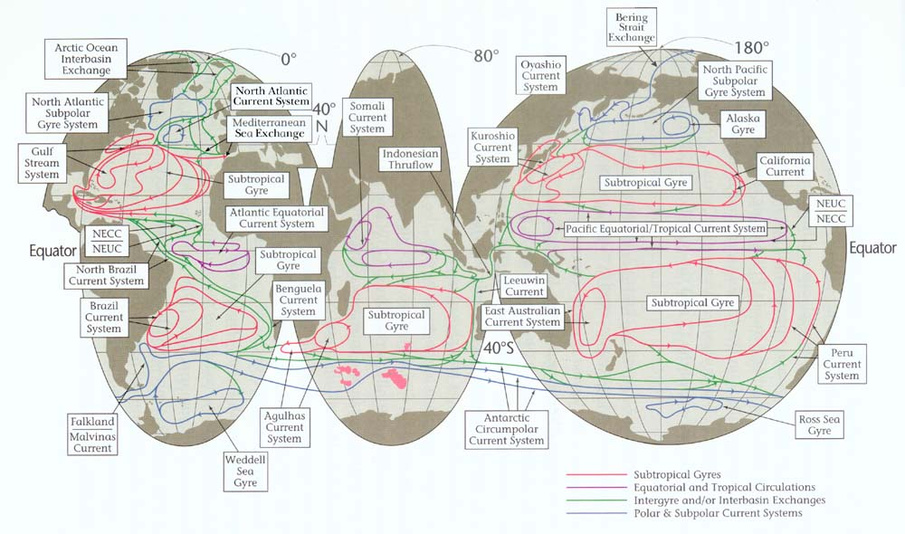
Schematic of Surface Circulation (Schmitz, 1995)

Slide 5
Annual Mean Wind Stress (T&G)
Southern Ocean westerlies are very strong.

Slide 6
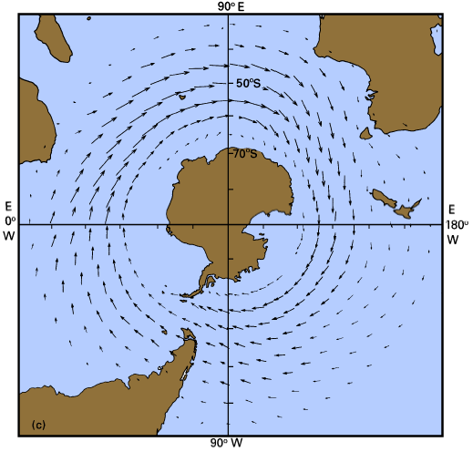
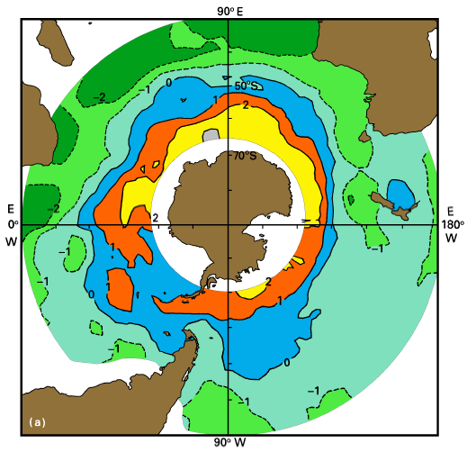
Antarctic Wind Stress and Ekman Pumping
Westerly winds, which decrease in strength towards Antarctica
equatorward Ekman transport AND Ekman upwelling south of the maximum westerly winds (50-55°S) (where wind stress curl is 0), curl(τ/f) over the Southern Ocean (10⁻³ kgm²s⁻¹)

Slide 7
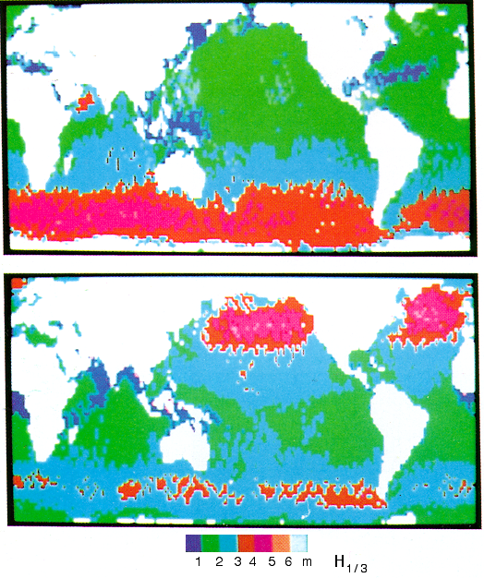
Antarctic Surface Wave
Average significant wave height H_{1/3} for the world ocean during the three-year period November 1986 –October 1989 , determined from GEOSAT data. (H_{1/3} is approximately the mean height of the1/3 highest waves.) top: July, bottom: January. Note the prevalence of large waves (H_{1/3} > 5m) in the Southern Ocean throughout the year, the increase in wave height during winter in both hemispheres, and the large waves in the western Arabian Sea during July.
Jul.
Jan.
Notes:
One observation which stands out clearly in satellite data on the oceanic wave climate is
the combined effect of consistently large wind speeds with little variation in wind direction,
and no land barriers which could impede the build-up of a fully developed sea. The
combination of infinite fetch around Antarctica and high average wind stress makes the
Southern Ocean the region with the largest average wave height. Figure 6.6 shows results
from GEOSAT, a satellite launched in March 1985 and active until October 1989. Wave
data from GEOSAT were not available to non-military applications during the first eighteen
months of its mission; the data used for Figure 6.6 are therefore restricted to a period
between November 1986 and October 1989. This represents the best available estimate of
annual mean conditions at present. The figure shows the Southern Ocean as a region of
extremely high average wave height.

Slide 8
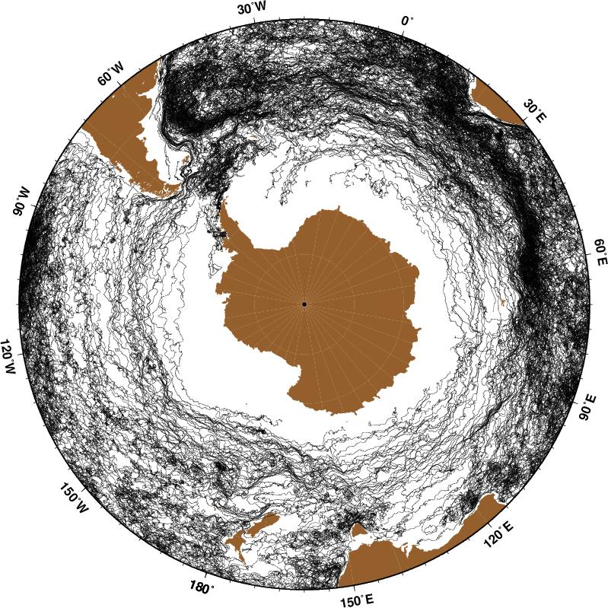
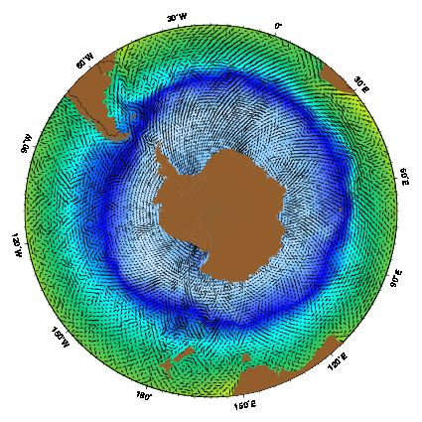
Antarctic Circumpolar Circulation（南极绕极流）
南极绕极流(ACC)是南大洋中最重要的海流，也是地球唯一一支闭合的海流
ACC是海洋中最强大的海流，尽管向东流速只有20cm/s，但流量超过任何一支海流。深度可达2000-4000米，宽度可达2000km，年平均输送量在100-150 Sv。平均温度在－1－5°C之间。
南极冰川可穿越ACC向北输送
Notes:
The Antarctic Circumpolar Current (ACC) is the most important current in the Southern Ocean, and the only current that flows completely around the globe. The ACC, as it encircles the Antarctic continent, flows eastward through the southern portions of the Atlantic, Indian, and Pacific Oceans. Edmond Halley, the British astronomer, discovered the ACC while surveying the region during the 1699-1700 HMS Paramore expedition. Later, the famous mariners James Cook in 1772-1775, Thaddeus Bellingshausen (Estonia) in 1819-1821, and James Clark Ross in 1839-1843 described the Atlantic Circumpolar Current in their journals. Cook was the first person to use the term, Southern Ocean, to describe this area. Other notable expeditions were made by Sir Drake, who reached the tip of South America in 1578, Abel Tasman, who sailed south from Australia into the Southern Ocean in 1642, James Weddell in 1823, and by the HMS Challenger in 1873-74 (Deacon, 1984). The ACC is arguably the "mightiest current in the oceans" (Pickard and Emery, 1990). Despite its relatively slow eastward flow of less than 20 cm s-1 in regions between the fronts, the ACC transports more water than any other current (Klinck and Nowlin, 2001). The ACC extends from the sea surface to depths of 2000-4000 m and can be as wide as 2000 km. This tremendous cross-sectional area allows for the current's large volume transport. The Antarctic Circumpolar Current's eastward flow is driven by strong westerly winds. The average wind speed between 40°S and 60°S is 15 to 24 knots with strongest winds typically bewteen 45°S and 55°S. Historically, the ACC has been referred to as the 'West Wind Drift' because the prevailing westerly wind and current are both eastward. Without the aid of continental reference point, except for the Drake Passage, where by convention, all flow through the Passage is the ACC, the current's boundaries are generally defined by zonal variations in specific water properties of the Southern Ocean (Gordon et al., 1977). Variations in these properties have been used to classify regions whose edges are defined by fronts, where there is rapid changes in water properties which occur over a short distance. North of the ACC is the Subtropical Convergence or Subtropical Front (STF), usually found between 35°S and 45°S, where the average Sea Surface Temperature (SST) changes from about 12°C to 7 to 8°C and salinity decreases from greater than 34.9 to 34.6 or less. Three fronts, south of the STF associated with the ACC, are, from north to south; the Subantarctic Zone (SAZ), the Subantarctic Front (SAF), the Polar Frontal Zone (PFZ), the Polar Front (PF), the Antarctic Zone, and the Southern ACC Front. The Antartic Convergence is approximately 200 km south of the Polar Front. In the Antartic Convergence, summer SST varies between 3°C to 5°C, while winter SST varies between 1°C to 2°C. North of the SAF, average Sea Surface Temperature (SST) is greater than 4°C, while south of the Polar front, average SST is less than 2°C. A fourth zone, the Continental Zone, and the westward flowing Antarctic Coastal (or Polar) Current are located even further poleward, between the Southern Front and the Antarctic continent. SST poleward of 65°S is about -1.0°C (Deacon, 1984). The eastward flow of the Subantarctic Front (SAF) found between 48°S and 58°S in the Indian and Pacific Ocean and beween 42°S and 48°S in the Atlantic Ocean defines the ACC's northern boundary. A region of upwelling, the Antarctic Divergence, occurs at the Southern Front. This area of divergence has been considered to be the ACC's southern boundary (Klinck and Nowlin, 1986) but new analysis puts the southern boundary of the ACC further poleward. Orsi et al. (1995) define the southern boundary of the ACC as the poleward edge of the Upper Circumpolar Deep Water (T > 1.8°C). The southern boundary of the ACC is approximately at 65°S in most of the Indian and Pacific Ocean, from 50°E to the dateline; moves northward to 60°S, east of the dateline to 140°W; is near 70°S by 120°W and moves northward to 60°S, east of the Drake Passage; and northward to 55°S at 10°E. Northward displacement of the southern boundary of the ACC are in the areas of gyres with clockwise surface circulation in the Weddell Sea and in the Ross Sea. Strong, nearly zonal, westerly winds force a large, near-surface, northward Ekman transport and a northward pressure gradient. The ACC current is in approximately geostrophic equilibrium, so that inclined layers of constant density slope towards the surface poleward across the ACC to balance the current's northward sea surface height elevation. The alignment between the prevailing winds and the resulting geostrophic current intensifies the ACC. Because stronger gradients give rise to stronger flow, the majority of the ACC transport is associated with the fronts within the current. Gille (1994) analyzed GEOSAT altimeter data and found 2 well-defined jets in the ACC, at the PF and the SAF, with widths between 35 and 50 km and a dominant meander wavelength of 150 km. Other investigators have found meander wavelengths between 100 and 200 km. In the vicinity of the fronts, eastward jets flow at approximately two to three times the speed of the current found between them (Klinck and Nowlin, 2001). Hoffman (1985) analyzed near-surface drifting buoys from FGGE and found average speeds of 20 cm s-1 at the STF, about 40 cm s-1 in the SAF and PF, and from 23 to 35 cm s-1 between fronts. Zambianchi et al. (1999) analyzed eleven WOCE standard drifting buoys, from 1993 and 1994, in the Eastern Pacific and found mean speeds greater than 15 cm s-1 north of the PF in the PFZ, and greater than 30 cm s-1 near the PF. They also note strong evidence of topographic steering by the Pacific-Antarctic ridge and that the floats bifurcate near 150°W, 55°S with floats either ending up in the Peru Current via the South Pacific Current or that the floats stayed in the ACC and travelled eastward toward the Drake Passage. Meridional ridges in the bottom topography provide a force balance for the Atlantic Circumpolar Current by generating frictional form drag. As the ACC crosses these ridges, frictional drag diminishes the current's deep flow (Munk and Palmen, 1951). Bottom topography also controls the path of the ACC, since slow large-scale oceanic flows are, on the average, parallel to lines of constant planetary vorticity (appoximately the Coriolis acceleration divided by the water depth). The Drake Passage, Kerguelen Plateau (and island), Campbell Plateau, Macquarie Ridge, and the Pacific-Antarctic Ridge are major topographic features that influence both the mean path of the ACC and its meandering. The degree of topographic blocking will also influence the current's eddy kinetic energy. For example, downstream of meridional ridges there will be an increase in the number of eddies present. Even relatively small eddies make up a significant percentage of the current's overall eddy kinetic energy (Knauss, 1996). Typical time and space scales of the eddies range from 2 weeks to 2 months and from 50 to 250 km. The path of the ACC is constrained by land where it flows through the Drake Passage, between Cape Horn and the Antarctic Peninsula. To date, the majority of field studies (hydrographic surveys, mooring deployments, etc.) conducted to better understand the ACC have taken place across this 800 km wide passage (Nowlin et al., 1977). Bryden and Pillsbury (1977) found variations over a yearlong current meter study across the Drake Passage between 28-290 Sv to a depth of 2700 meters. Such a large range of transport values have been found by numerous oceanographers. Historical transport estimates are listed in Table 1 of Peterson (1988) and Table 6 of Sarukhanyan (1985) and range from -15 Sv to 262 Sv with several entries greater than 200 Sv. These earlier measurements should be viewed with suspicion since the estimates are aliased by coarse resolution sampling in an energetic eddy field, and those based on hydrography assume a reference velocity. The most dense set of current meter measurements, during the DRAKE79 experiment, yielded a mean transport of 123 Sv and a range of 87 to 148 Sv (Whitworth, 1983; Peterson, 1988). Climatological estimates by Orsi et al (1995) based on hydrographic data show that the ACC transport, relative to 3000 m, is about 100 Sv at all longitudes. Using Drake Passage current meter measurements at 500 meters during the ISOS, Wearn and Baker (1980) found the variations with the transport correlated with the fluctuations in wind stress when considering periods of longer than 30 days. Similar results are reported for low-frequency time-scales in Peterson (1988) with strong coherence at semi-annual and annual time scales. In recent years, other areas such as sections of the ACC south of Tasmania and New Zealand have also been examined closely. Observations have revealed a mean ACC transport of 100-150 Sverdrups (1 Sv=106 m3 s-1) that can vary by 50 Sv within time scales as short as a month or two (Knauss, 1996). Variability in the ACC is due to tides (5-10 cm s-1), mesoscale eddies (35-50 cm s-1), near-inertial motion (10 cm s-1), and those forced by changes in the large-scale wind stress (25 cm s-1) (Sarukhanyan, 1985). The mean ACC temperature ranges from -1 to 5°C, depending on the time of year and location. The mean surface salinity decreases poleward, in general, from 34.9 at 35°S to 34.7 at 65°S. Typical salinity values are between 33.5 and 34.7, poleward of 65°S. This Temperature-Salinity signature is due to a combination of water masses that meet in the Southern Ocean and are mixed and redistributed by the Antarctic Circumpolar Current. Following the inclined isopycnals, deep waters from the North Atlantic (NADW) are upwelled at the Antarctic Divergence, the current's southern boundary. As this water rises to the surface it mixes with and becomes Antarctic Circumpolar Water (ACW). When the water mass reaches the near surface flow it is diverted northward by Ekman transport. This newly formed Antarctic Circumpolar Water (labeled by some 'modified NADW') travels north across the ACC until it reaches the convergence of the Polar Frontal Zone. Here, near surface Sub-Antarctic Water from the north mixes with the ACW and sinks to a mid-depth becoming Antarctic Intermediate Water (AAIW). While this mixing is taking place the geostrophic component of the ACC is translating the water eastward. The AAIW will continue north but, due to the 'West Wind Drift,' will be ejected into the Atlantic, Indian, and Pacific basins, where over time, it will be upwelled to the surface. The Antarctic Circumpolar Current is a critical component of the 'Great Ocean Conveyor Belt.' During the period July thru October 1978, Seasat radar altimeter measurements where made over the ACC. Fu and Chelton (1984) demonstrated the observational evidence of the temporal variability as well as the zonal coherence of the ACC. Satellite altimetry and sea surface height analysis have recently revealed a previously unknown feature of the Antarctic Circumpolar Current, the Antarctic Circumpolar Wave. This wave propagates westward against the current but ultimately ends up traveling eastward, due to the massive size of the ACC, at a slower rate than the mean flow. The wave circles the earth every eight to nine years (White and Peterson, 1996). It has a long wavelength (wavenumber=2) resulting in two crests and two troughs at any given time. The crests and troughs are associated with massive patches or pools of warm water and cold water respectively. The areas can be thousands of kilometers long. The warm patches are 2 to 3°C warmer than the mean sea surface temperature (SST) and the cold patches are 2 to 3°C cooler than the mean SST (White and Peterson, 1996). Though it is not yet clear how these waves are triggered or maintained, they directly influence the temperature of the overlying atmosphere. While the Wave's effects on climate are just beginning to be studied, the phase (warm pool vs. cold pool) correlates well with four to five year rainfall cycles found over areas of southern Australia and New Zealand (White and Cherry, 1998). Some scientists believe that the Antarctic Circumpolar Wave may be more important than El Niño in governing rainfall over these regions

Slide 9
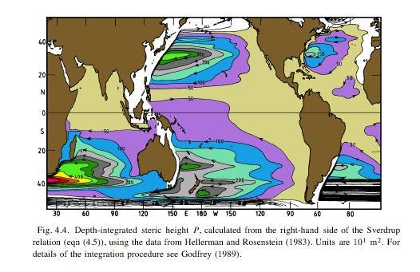
Antarctic Circumpolar Current Dynamics
Traditional Sverdrup balance north of latitude of Drake Passage. Western boundary current is the Falkland (Malvinas ) Current off S. America.

Slide 10
Antarctic Circumpolar Current
Almost no land - no western or eastern boundaries
Processes different from normal gyres (which have western and eastern boundaries)
2 dominant fronts:
Subantarctic Front (SAF) on north side
Polar Front (PF) in middle
Subpolar (cyclonic) circulations south of ACC:
Weddell Sea and Ross Sea

Slide 11
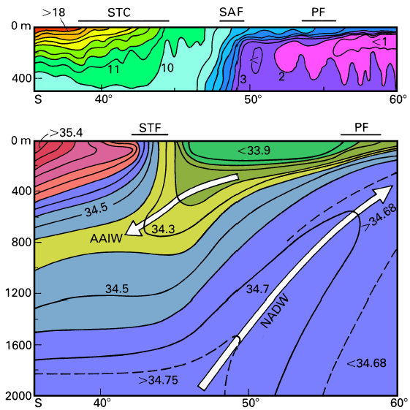
ACC Fronts
(Summer conditions). (Top) Temperature section in the eastern Indian sector. The Polar Frontal Zone is indicated by the 3 - 9°C isotherms, and the split into the Subantarctic (SAF) and Polar (PF) Fronts by the crowding of isotherms at the surface around 7 – 9°C and 5 - 6°C. The Subtropical Front is indicated by the crowding of isotherms near 13 - 15°C within the Subtropical Convergence (STC).
Notes:
In reality, the positions of the fronts and divergences vary greatly in time, and the
intensity of sinking and rising motion is variable as well. There can be no doubt that the
largest variability occurs in the Subtropical Front. Observations like those shown in
Figure 6.9 usually indicate that the band of strong horizontal temperature and salinity
gradients does not extend simply in a zonal direction but includes meanders, convolutions
and eddies of various sizes. They also indicate large shifts in the meridional position of the
front, probably in response to variations in the wind stress field. An idea of these variations
can be gained if it is recalled that the wind is geostrophic, too, and meridional shifts of the
boundary between the Trades and the Westerlies are coupled with similar shifts in
atmospheric isobars. Figure 6.10 shows, for the five years 1972 - 1977, the southernmost
position of the 1015 hPa isobar, which on average (Figure 6.3) coincides with the position
of the Subtropical Front (Figure 6.7). Seasonal variability appears small in the Indian,
Atlantic, and eastern Pacific sectors; but in the western and central Pacific sector the
difference between summer and winter can exceed 10 degrees in latitude. This is the same
region where interannual variability is highest (Figure 6.10b), although the Indian sector
also displays large differences, particularly in summer.

Slide 12
ACC Fronts
(Bottom) Salinity section in the eastern Atlantic sector. Crowding of isohalines near 34.5 indicates the Subtropical Front. The Antarctic Divergence is located poleward of the section; near 65°S its salinity maximum is found just below 150 m. Upwelling of North Atlantic Deep Water (NADW) towards the divergence is indicated by the rise of the salinity maximum and sinking of Antarctic Intermediate Water (AAIW) from the Polar Front by the associated salinity minimum. The different degree of detail between the two sections is the result of very different station density.
Notes:
In reality, the positions of the fronts and divergences vary greatly in time, and the
intensity of sinking and rising motion is variable as well. There can be no doubt that the
largest variability occurs in the Subtropical Front. Observations like those shown in
Figure 6.9 usually indicate that the band of strong horizontal temperature and salinity
gradients does not extend simply in a zonal direction but includes meanders, convolutions
and eddies of various sizes. They also indicate large shifts in the meridional position of the
front, probably in response to variations in the wind stress field. An idea of these variations
can be gained if it is recalled that the wind is geostrophic, too, and meridional shifts of the
boundary between the Trades and the Westerlies are coupled with similar shifts in
atmospheric isobars. Figure 6.10 shows, for the five years 1972 - 1977, the southernmost
position of the 1015 hPa isobar, which on average (Figure 6.3) coincides with the position
of the Subtropical Front (Figure 6.7). Seasonal variability appears small in the Indian,
Atlantic, and eastern Pacific sectors; but in the western and central Pacific sector the
difference between summer and winter can exceed 10 degrees in latitude. This is the same
region where interannual variability is highest (Figure 6.10b), although the Indian sector
also displays large differences, particularly in summer.

Slide 13
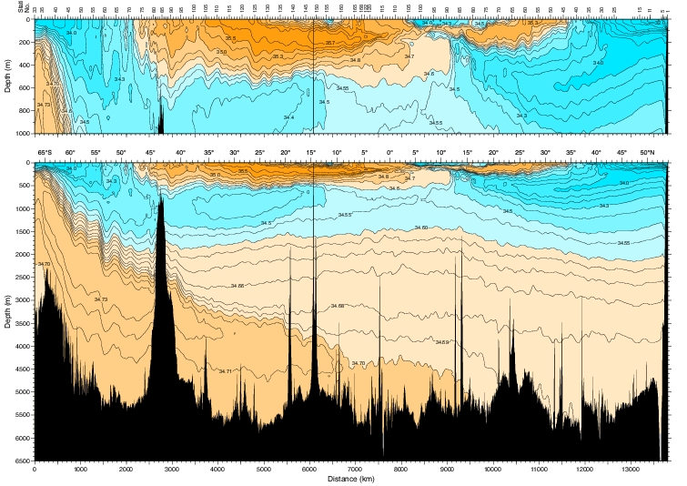
AAIW in mid-Pacific (150W)
Low salinity water mass at mid-depth: all oceans

Slide 14
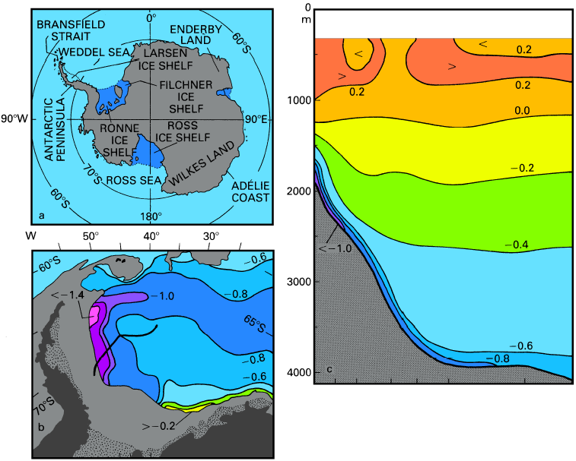
Deep Water Formation
Formation of Antarctic Bottom Water.
(a) Locality map, including the regions where deep convection occurs,
(b) bottom potential temperature (°C) in the Weddell Sea - the stippled area indicates ice shelf, and the edge of the shaded region is the approximate 3000 m contour,
(c) a vertical section of potential temperature (°C) in the Weddell Sea. The position of the section is shown by the heavy line in (b). From Warren (1981a)
Notes:
The areas where convective sinking occurs (Figure 6.14a) are believed to be relatively
limited in size. The only location where sinking to the ocean floor by convective
overturning has been identified from data is Bransfield Strait; but the water which sinks
there is collected in an isolated trough of between 1100 m and 2800 m depth and of little
consequence for Bottom Water formation. In all other areas (the Weddell Sea, the Ross Sea,
and probably also along the Adélie Coast and Enderby Land) the sinking occurs underneath
the ice and is difficult to verify directly. There are, however, sufficient data which show the
effect of the sinking. In the Weddell Sea, which probably contributes most to Bottom
Water formation, the water as it sinks flows westward under the influence of the Coriolis
force, forming a thin layer of extremely cold water above the continental slope
(Figure 6.14c). It mixes with the overlying water, which is recirculated with the large
cyclonic eddy in the central Weddell Sea. This water, known as Weddell Deep Water, has
very stable properties; its potential temperature usually is above 0.4°C and below 0.7°C. It
is renewed by surface cooling and subsequent convection in the ice-free central part
(polynya) of the Weddell Sea (Gordon, 1982). The opportunity for the water on the slope to
mix with Weddell Deep Water is enhanced by the fact that sinking does not occur along the
shortest possible path but in nearly horizontal motion along the slope. On reaching 65°S
some of the water gets injected into the Circumpolar Current, where it continues to mix
with the Circumpolar Water. The properties of the sinking water are somewhat known from
ships that have been trapped in the ice over winter. They measured bottom potential
temperatures around the freezing point (about -1.9°C) and salinities of 34.7 - 34.9. By the
time the water leaves the Weddell Sea its temperature has risen to -0.8°C. The further path
of Antarctic Bottom Water can be followed by looking at the potential bottom temperature
map (Figure 6.15); it indicates the Adélie Shelf and the Ross Sea as other important
regions where cold - and saline - water is injected from the surface. Eventually, the water
spreads from the Circumpolar Current (i.e. with the properties of Circumpolar Water) into
all three oceans. At that stage its properties are best described as 0.3°C and 34.7 salinity.

Slide 15
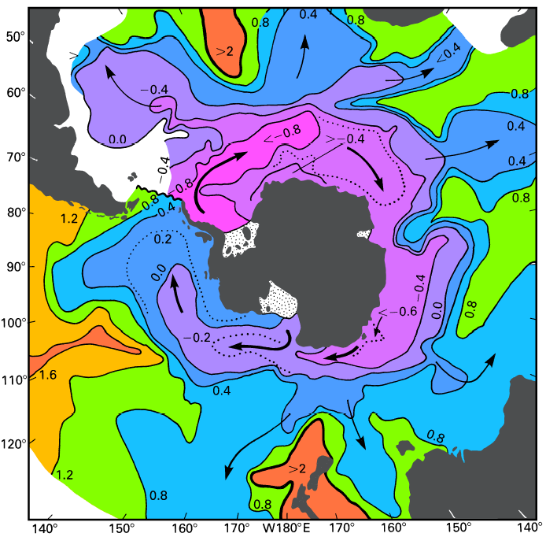
Bottom Water
Bottom potential temperature in the Southern Ocean.
The arrows show inferred movement of Antarctic Bottom Water.
Northward extensions of low potential temperatures indicate movement of Antarctic Bottom Water over sills. Adapted from Gordon (1986b).

Slide 16
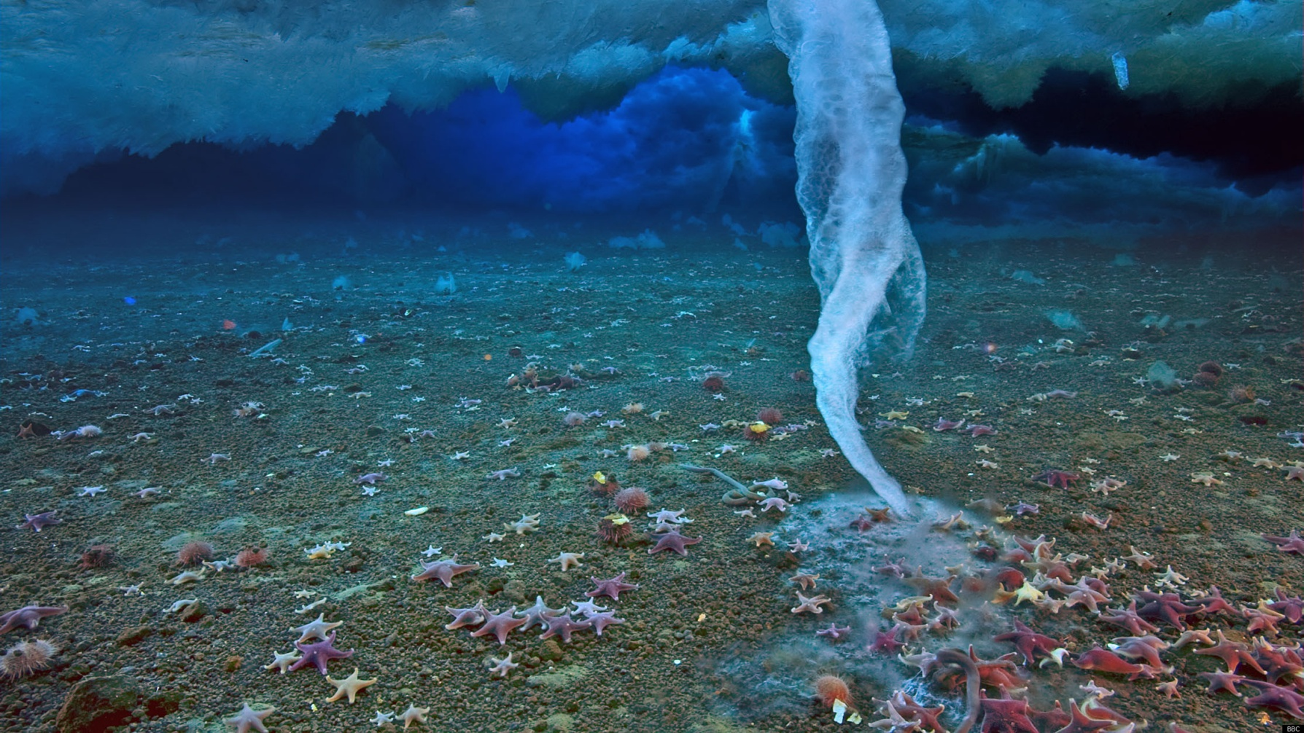
Ice Finger

Slide 17
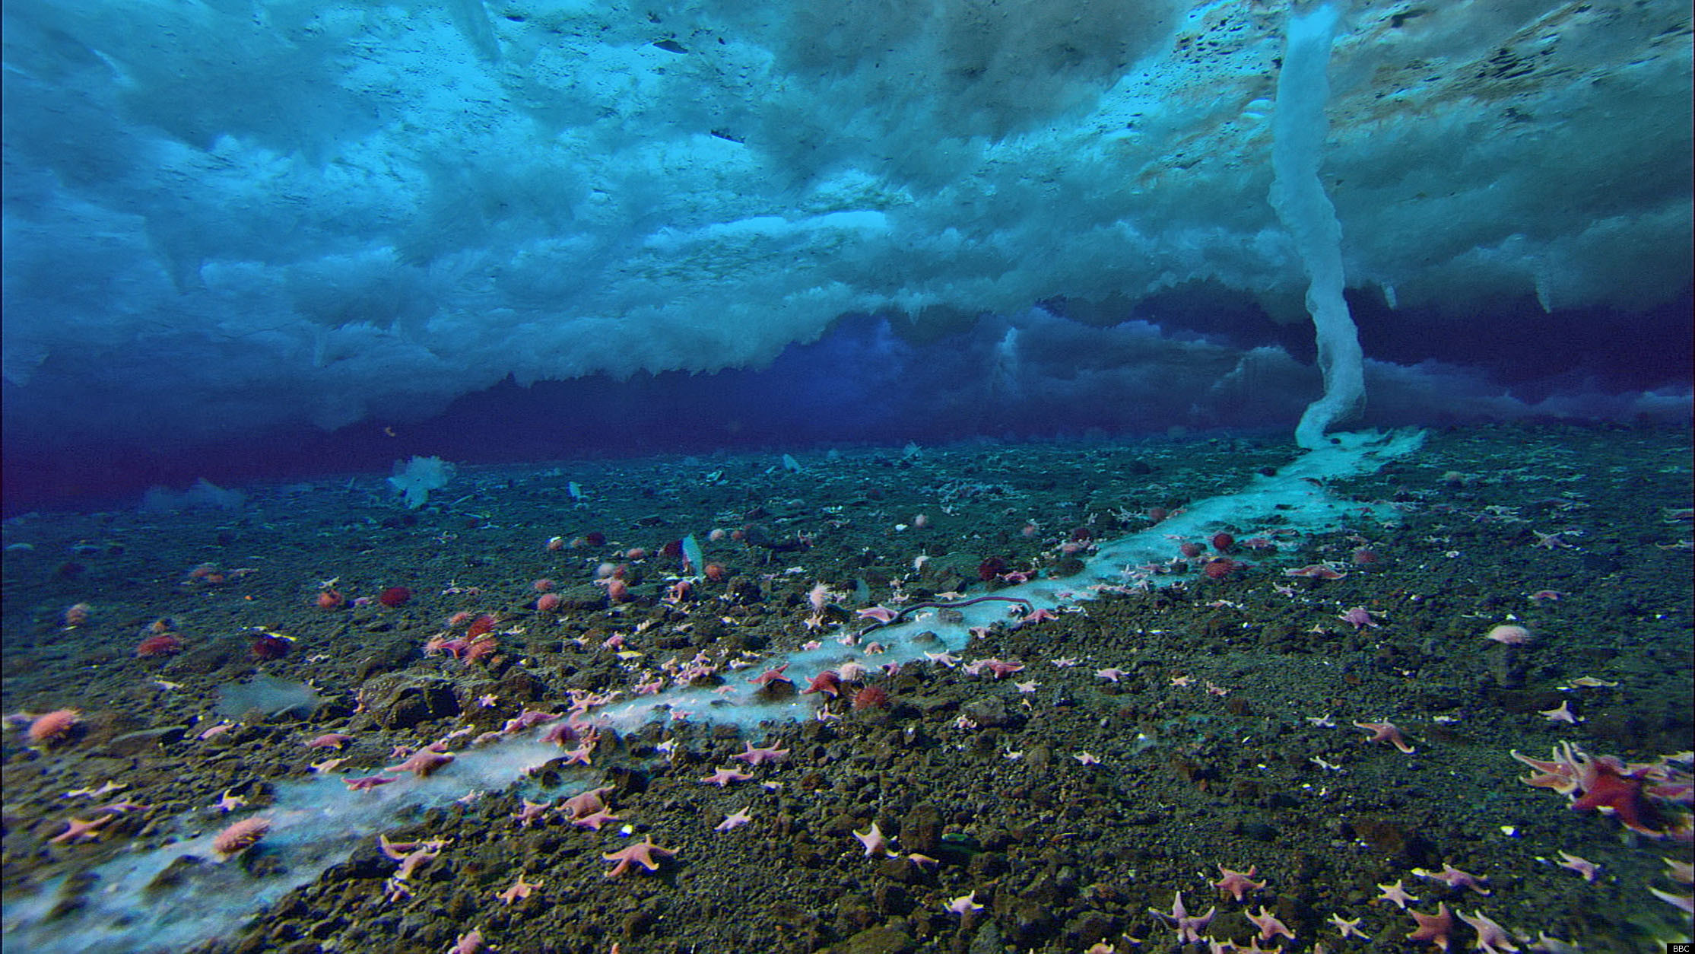
Ice Finger
http://www.bbc.co.uk/nature/15835017
Notes:
Air T < -20C, sea water < -1.9C
Mr Miller set up the rig of timelapse equipment to capture the growing brinicle under the ice at Little Razorback Island, near Antarctica's Ross Archipelago.
Freezing sea water doesn't make ice like the stuff you grow in your freezer. Instead of a solid dense lump, it is more like a seawater-soaked sponge with a tiny network of brine channels within it.
In winter, the air temperature above the sea ice can be below -20C, whereas the sea water is only about -1.9C. Heat flows from the warmer sea up to the very cold air, forming new ice from the bottom. The salt in this newly formed ice is concentrated and pushed into the brine channels. And because it is very cold and salty, it is denser than the water beneath.
The result is the brine sinks in a descending plume. But as this extremely cold brine leaves the sea ice, it freezes the relatively fresh seawater it comes in contact with. This forms a fragile tube of ice around the descending plume, which grows into what has been called a brinicle.
Brinicles are found in both the Arctic and the Antarctic, but it has to be relatively calm for them to grow as long as the ones the Frozen Planet team observed.

Slide 18
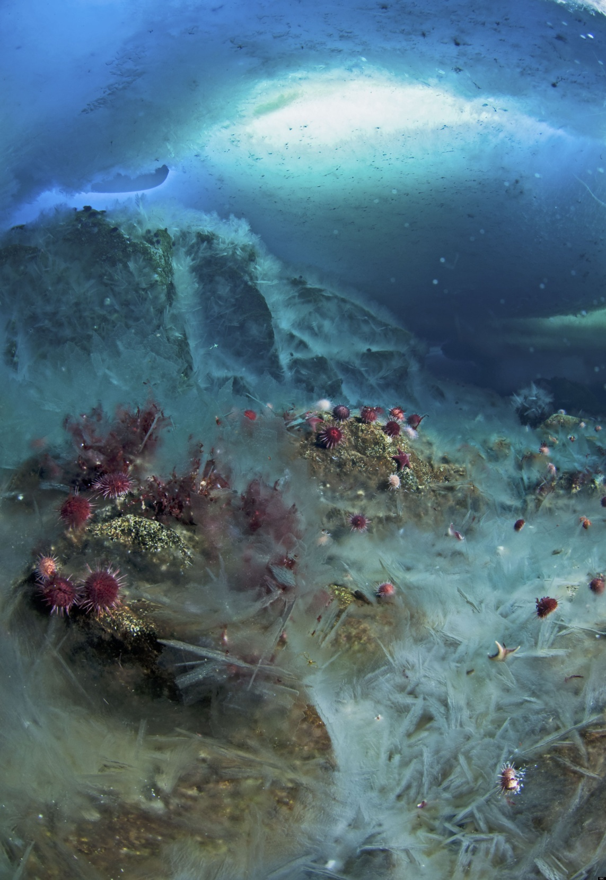
Ice Finger

Slide 19
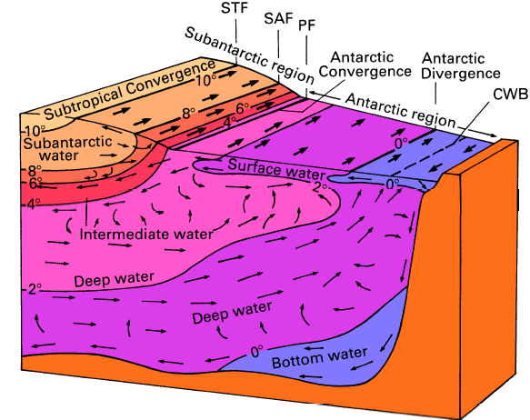
Water Masses
Block diagram of the circulation and Southern Ocean. From Sverdrup et al. (1942), with the addition of frontal locations. (STF: Subtropical Front, SAF: Subantarctic Front, PF: Polar Front, CWB: Continental Water Boundary).

Slide 20
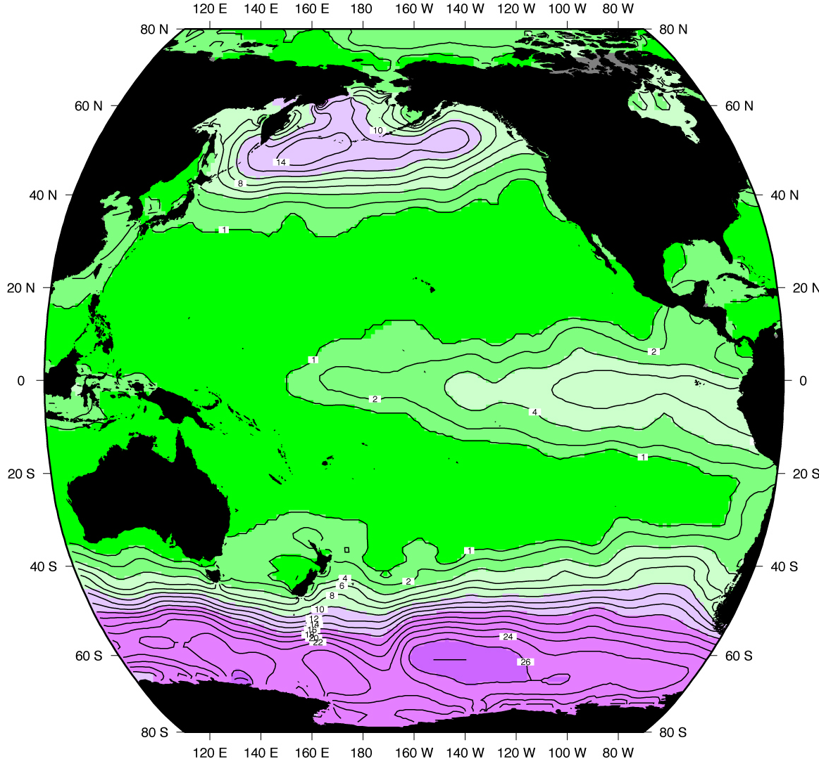
Contrast of surface nitrate in S.O. with the rest of the Pacific: high nitrate in upwelling regions (high latitudes and equator), low in downwelling
Ekman Pumping

Slide 21
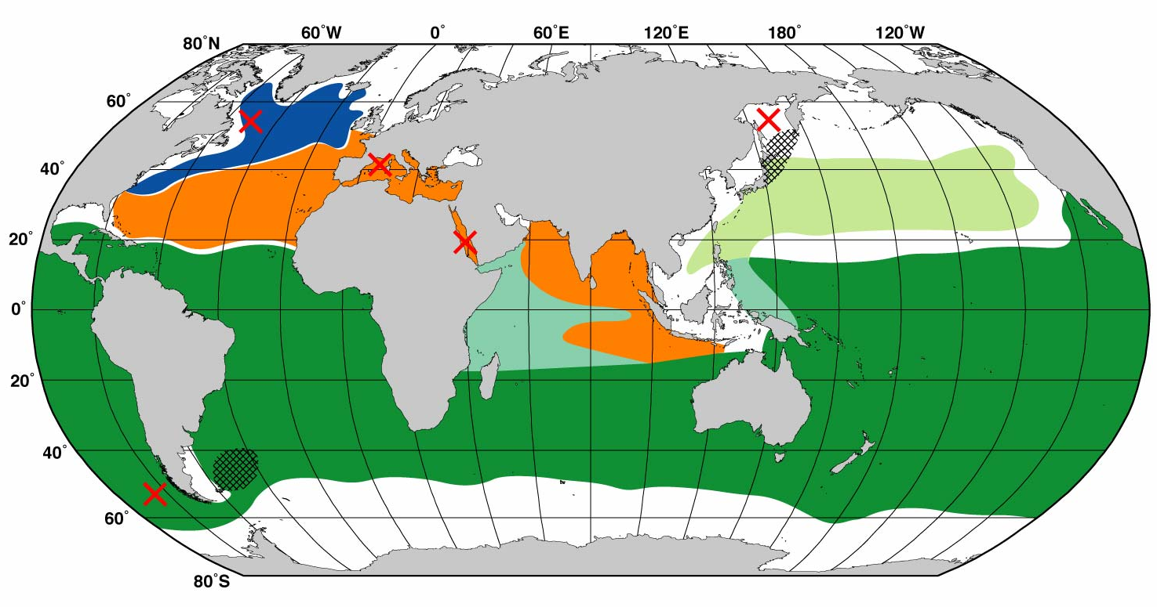
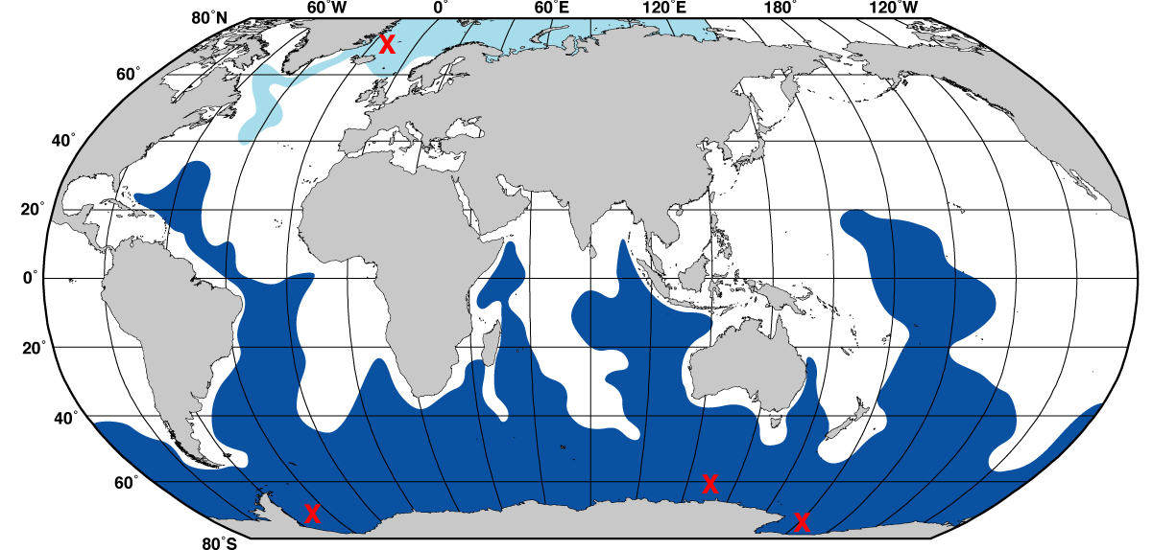
Intermediate and deep water formation
Intermediate water production sites:
Antarctic Intermediate Water formation
Deep and bottom water production sites
Antarctic Bottom Water formation primary sites (brine rejection)

Slide 22
Questions (Due in 2-week)
Why are the properties in the three southern hemisphere oceans fairly similar compared with those in the northern hemisphere?
What distinguishes the Antarctic Circumpolar Current from all of the other strong (non-equatorial) currents?
What are the major fronts of the Antarctic Circumpolar Current? How do you distinguish them from each other on a north-south transect across them?

Slide 23
Learning about the Ocean, the Climate and the Nature

