Slide 1
Lecture 19: Global Ocean: A Summary of Circulations and Water Properties Description Physical Oceanography
杨海军（YANG Haijun）复旦大学大气与海洋科学系
Department of Atmospheric and Oceanic Sciences, Fudan University
Email: yanghj@fudan.edu.cn
This powerpoint was prepared for purposes of this lecture and course only. It contains graphics from copyrighted books, journals and other products. Please do not use without acknowledgment of these sources.

Slide 2
Outlines
Water masses
Primary layers (4) for each ocean and sources
T/S
Meridional overturning
Global overturning

Slide 3
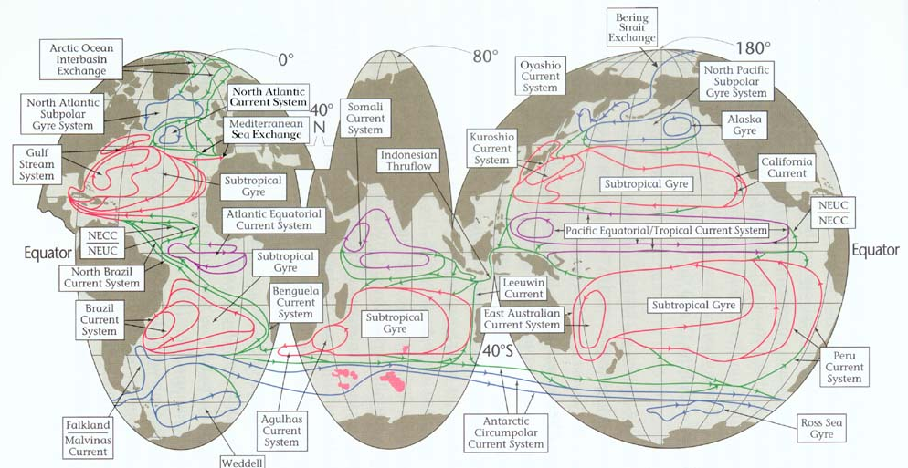
Upper Ocean Circulation

Slide 4
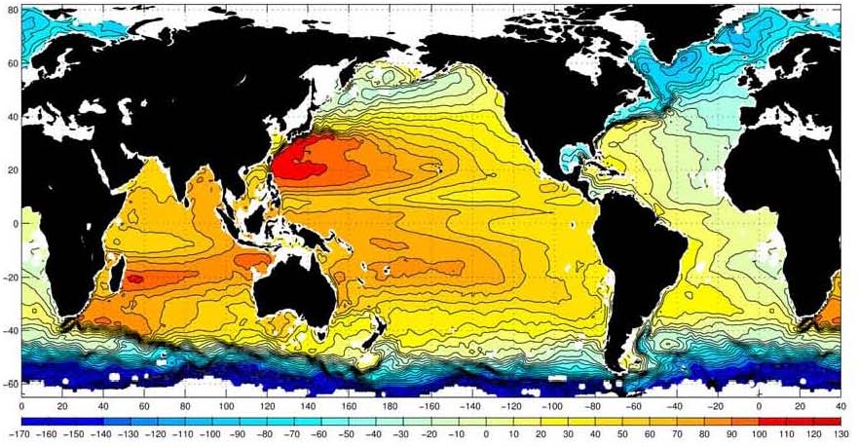
Surface Circulation
1992-2002 mean absolute sea level. Contour interval is 10 cm. (Niiler et al: Absolute sea level of the global ocean)

Slide 5
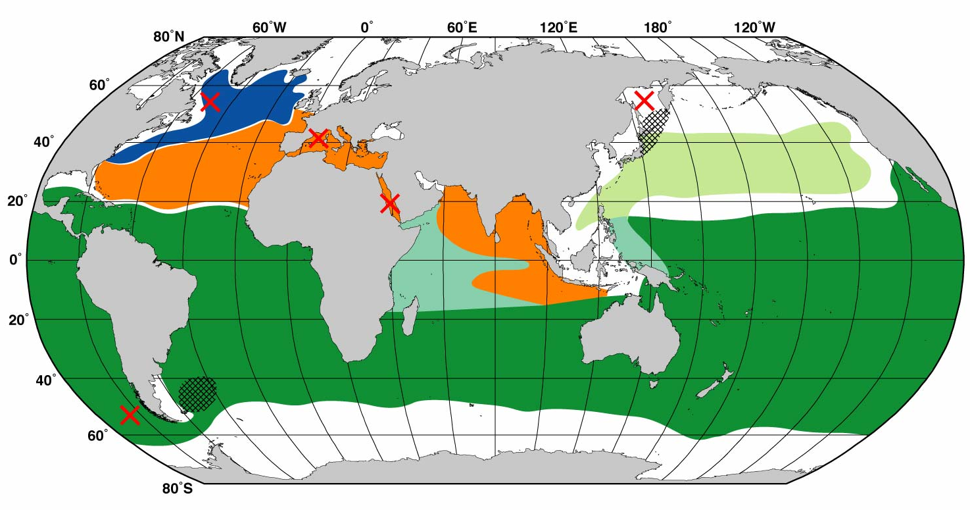
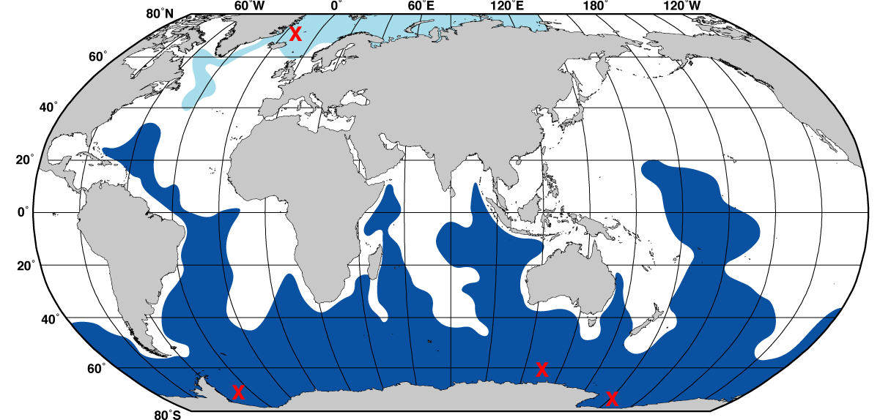
Intermediate and Deep Water Formation
Intermediate water production sites:
Antarctic Intermediate Water formation
Deep and bottom water production sites
Antarctic Bottom Water formation primary sites (brine rejection)

Slide 6
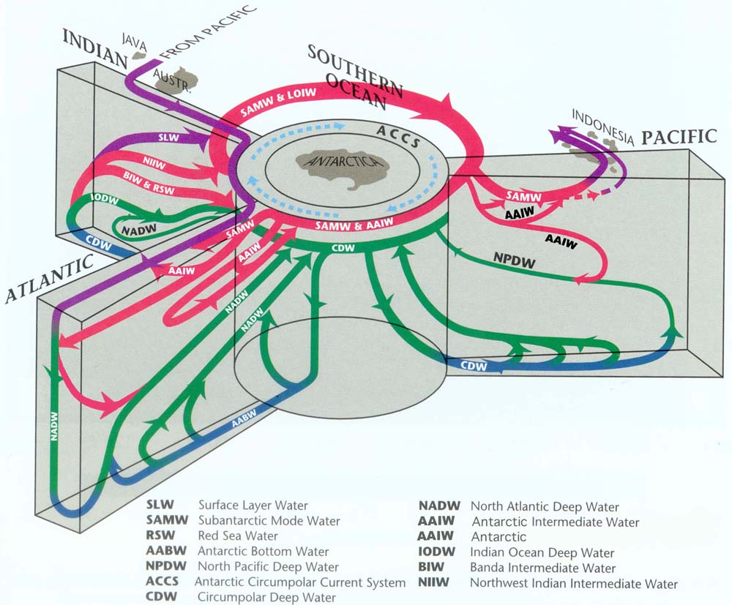
Schmitz (1997) Overturn: Southern Ocean View

Slide 7
4-Layer View of the Global Ocean
Upper layer: ventilated thermocline. Includes Mode Waters, Central Water, subtropical Underwater (salinity maximum water)
Intermediate layer: Labrador Sea Water, Mediterranean Overflow Water, Red Sea Water, North Pacific Intermediate Water, Antarctic Intermediate Water
Deep layer: North Atlantic Deep Water, Pacific Deep Water, Indian Deep Water, Circumpolar Deep Water
Bottom layer: Antarctic Bottom Water (aka Lower Circumpolar Deep Water)

Slide 8
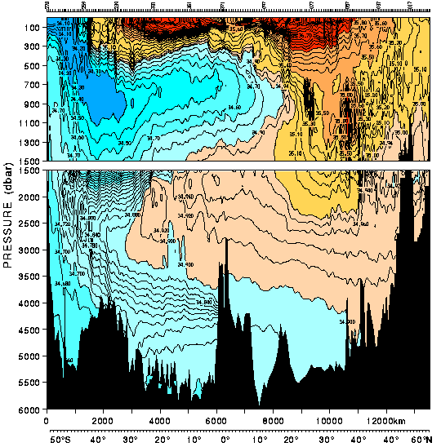
Atlantic Salinity
(1)
(1) surface waters (ventilated thermocline)
(2)
(2) Low salinity Antarctic intermediate water
(3) High salinity North Atlantic Deep Water
(3)
(4)
(4) Low salinity Antarctic bottom water
30°S
24°N

Slide 9
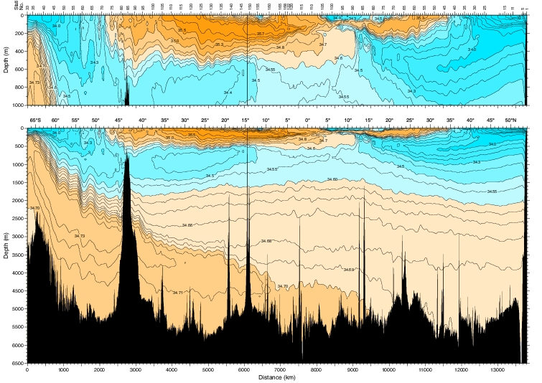
Salinity in the Pacific (150°W)
(1)
(2)
(3)
(4)

Slide 10
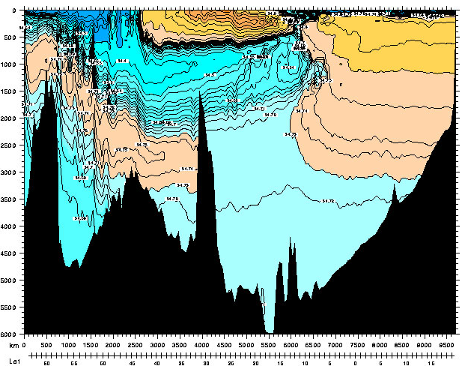
Eastern Indian Water Masses
(1)
Higher salinity - Indian Deep Water and Circumpolar Deep Water
(2)
(3)
(3)
Lower salinity - Antarctic Intermediate and bottom waters (Lower Circumpolar Deep Water)
(4)
32°S

Slide 11
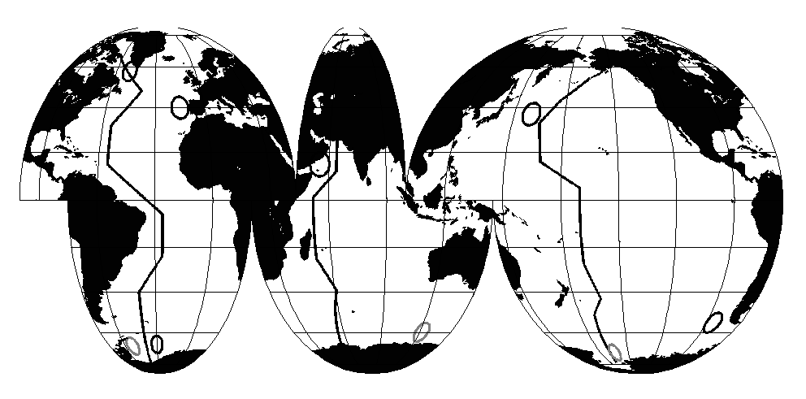
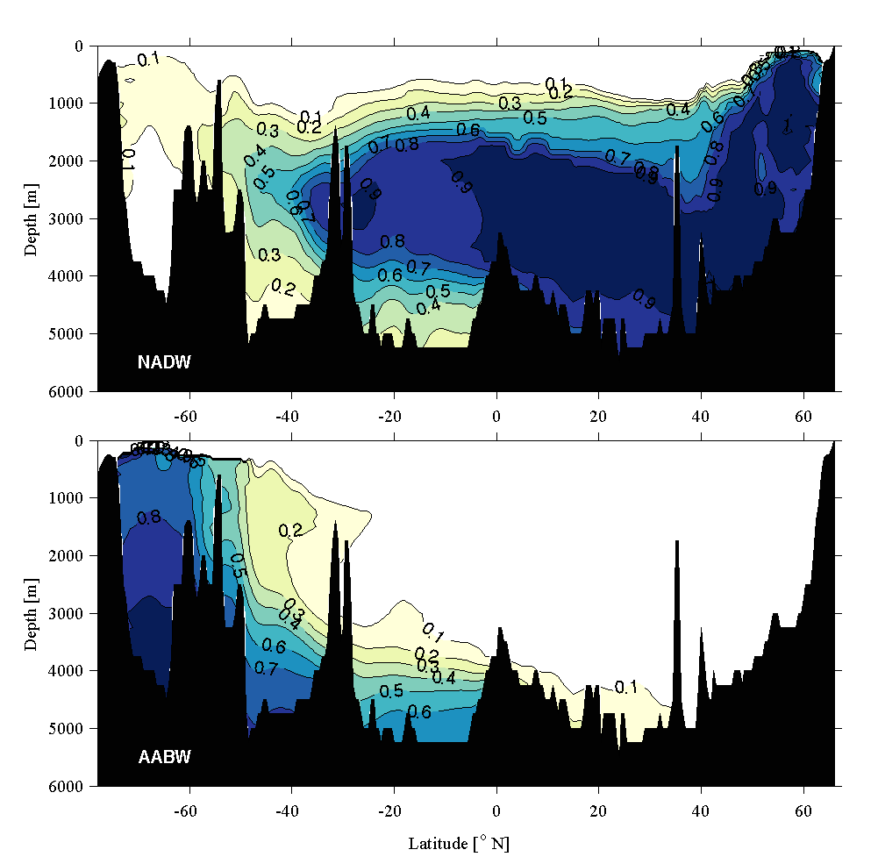
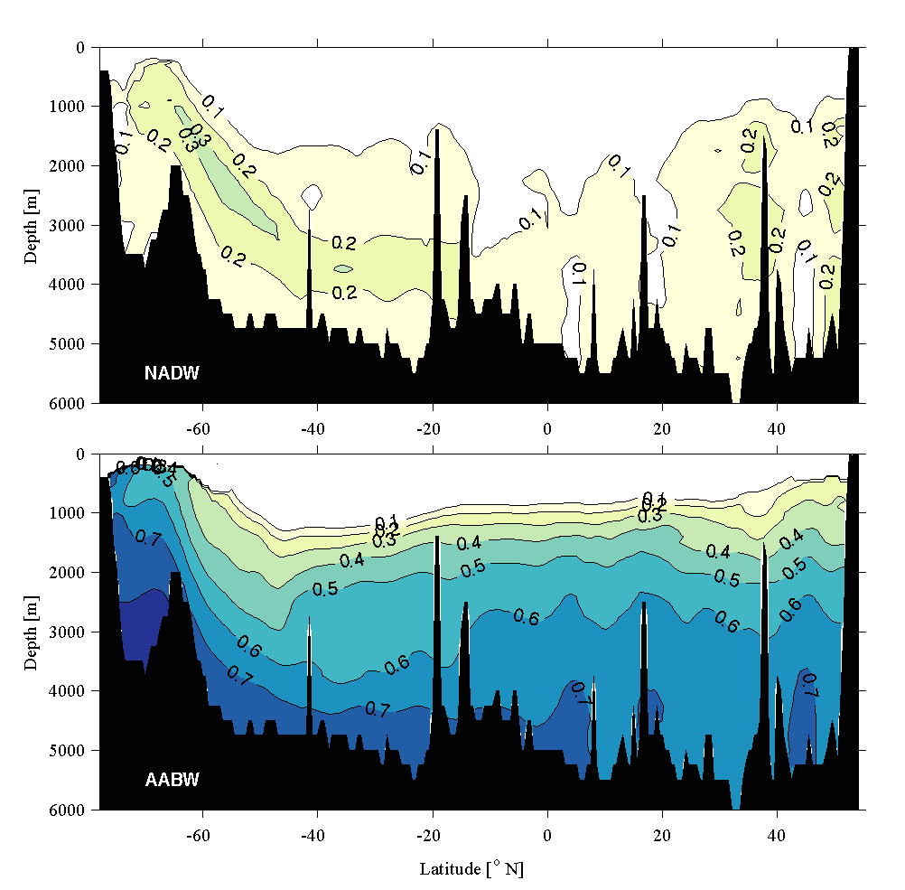
AABW Dominates the Abyss
(Johnson 2008)
NADW prominent in W. Atlantic / Mid-depth ACC
AABW dominates elsewhere
Atlantic Pacific
AABW NADW
Notes:
Fraction of (top) NADW = LNDAW + UNADW and (bottom) AABW = WSBW for a quasi-meridional section through the western basins of the Atlantic Ocean (Figure 1) contoured (with values increasing from light yellow to dark blue) at 0.1 intervals as a function of depth and latitude. Bathymetry is shaded black.

Slide 12
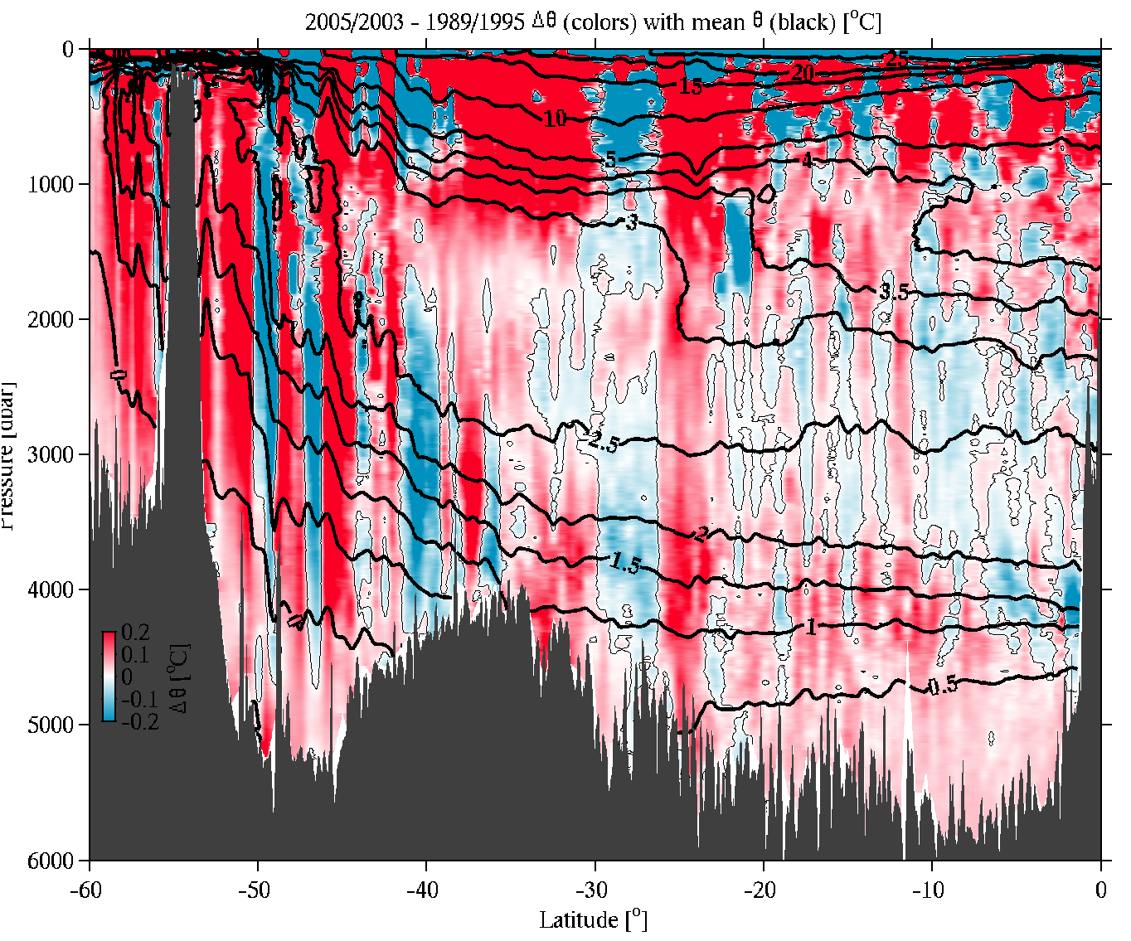
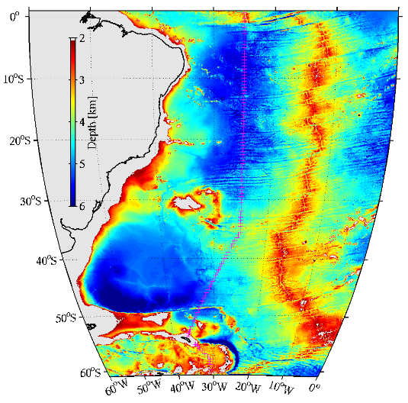
Western S Atlantic Warms 2005 – 1989 (Johnson and Doney, 2006)
Brazil
AABW Warming:
S. Ocean mid-depth
Abyssal northward
Mean 0.04°C warming
16-year time interval

Slide 13
Abyssal & Deep Heat Content Changes (Purkey & Johnson, J. Climate)
Local decadal heat content changes (W m⁻²) for z > 4000 m
The closer to AABW sources, the larger the heat gain.
9 of 17 warming basins significantly different from zero at 95%
1 of 7 cooling basins significantly different from zero at 95%
S. Ocean for 1 > z > 4 km (magenta line & #s) also warms

Slide 14
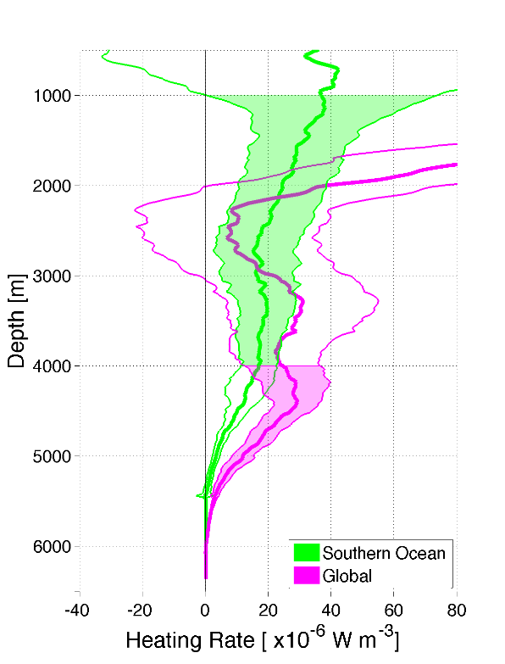
Global Abyssal & Deep S. Ocean Changes
(Purkey & Johnson, J. Climate)
Heating rates with 95% CI
Expressed as contribution to global surface fluxes per unit depth
Vertical integrals for tabulation
S Ocean Deep warming
Z > 1000 m statistically significant
Global Abyssal warming
Statistically significant z > 3000 m
Hypsometry important
Sum ~1/8th of total ocean uptake
Note: Only 28 sections -> large errors
Region | Global Heat Gain (W m⁻²)
Abyssal Ocean (z > 4 km) | 0.027 (±0.009)
Southern Ocean (1 > z > 4 km) | 0.068 (±0.062)
Total (Abyssal + Southern) | 0.095 (±0.062)

Slide 15
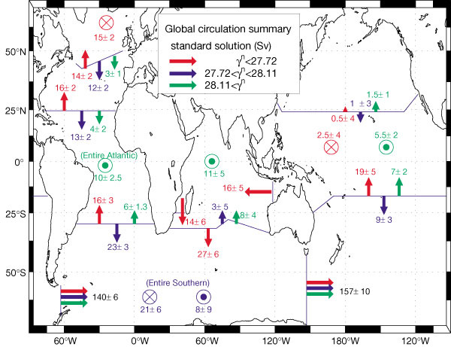
Global Mass Transport (Ganachaud and Wunsch, 2000)

Slide 16
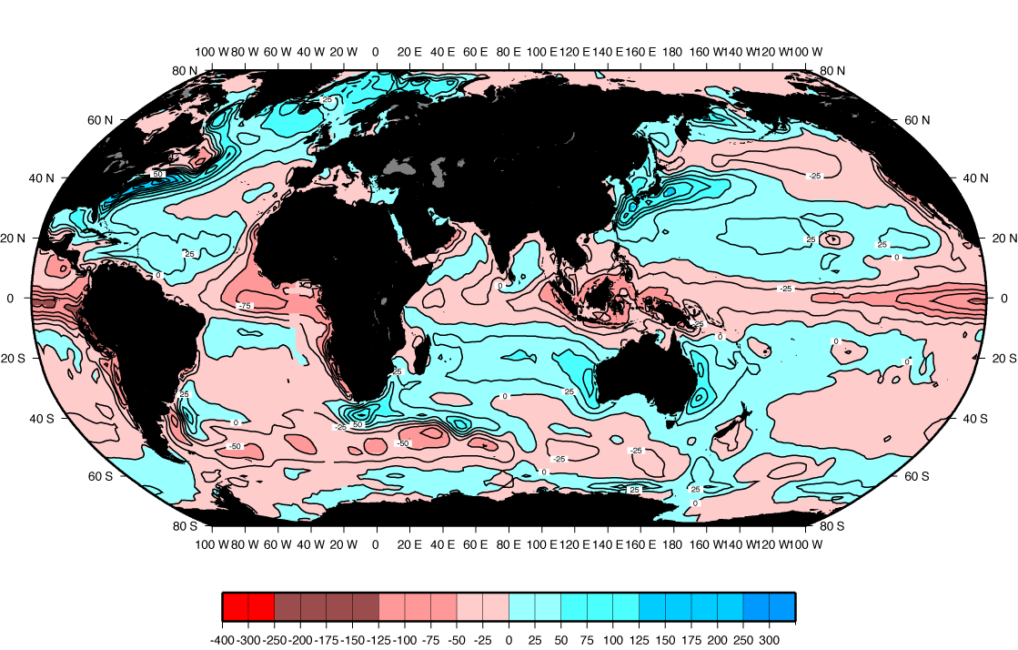
Heat Transported by Ocean Circulation (big arrows)
Air-sea heat flux: Red - ocean gains heat. Blue - ocean loses heat.

Slide 17
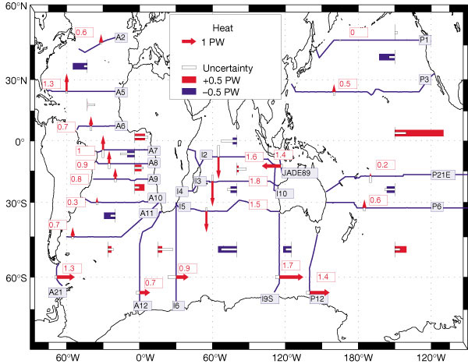
Global Heat Transport (Ganachaud and Wunsch, 2000)

Slide 18
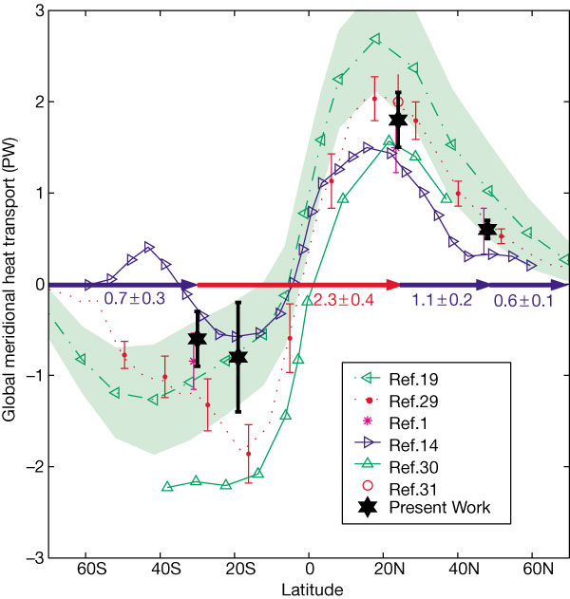
Global Heat Transport (Ganachaud and Wunsch, 2000)

Slide 19
Learning about the Ocean, the Climate and the Nature

