Slide 1
Lecture 21: Climate Change: Decadal and Longer Timescale Variability
Descriptive Physical Oceanography
杨海军（YANG Haijun）复旦大学大气与海洋科学系
Department of Atmospheric and Oceanic Sciences, Fudan University
Email: yanghj@fudan.edu.cn
This powerpoint was prepared for purposes of this lecture and course only. It contains graphics from copyrighted books, journals and other products. Please do not use without acknowledgment of these sources.

Slide 2
Reading:
  Tomczak and Godfrey Chp 18, 20
Outline:
  Climate equilibrium, forcing and feedbacks.
  Pacific Decadal Oscillation - ENSO modulation
  North Atlantic Oscillation and Arctic Oscillation
  North Atlantic meridional overturning and climate change and the biggest question: result of anthropogenic forcing?

Slide 3
Elements of the Climate System
Atmosphere
Ocean
Land surface
Biological and chemical cycles

Slide 4
Climate forcing
External forcing for earth’s climate includes
  Earth orbit parameters (solar distance factors)
  Solar luminosity (发光度)
  Moon orbit
  Volcanoes and other geothermal sources
  Tectonics (plate motion)
  Greenhouse gases (to the extent that they are not part of the climate system itself)
  Land surface (likewise with respect to the climate system) ?

Slide 5
Climate forcing
Internal forcing: looking at each element of the climate system and how it is forced by another element
  Winds forcing ocean, change in ice extent forcing atmosphere or ocean, etc..

Slide 6
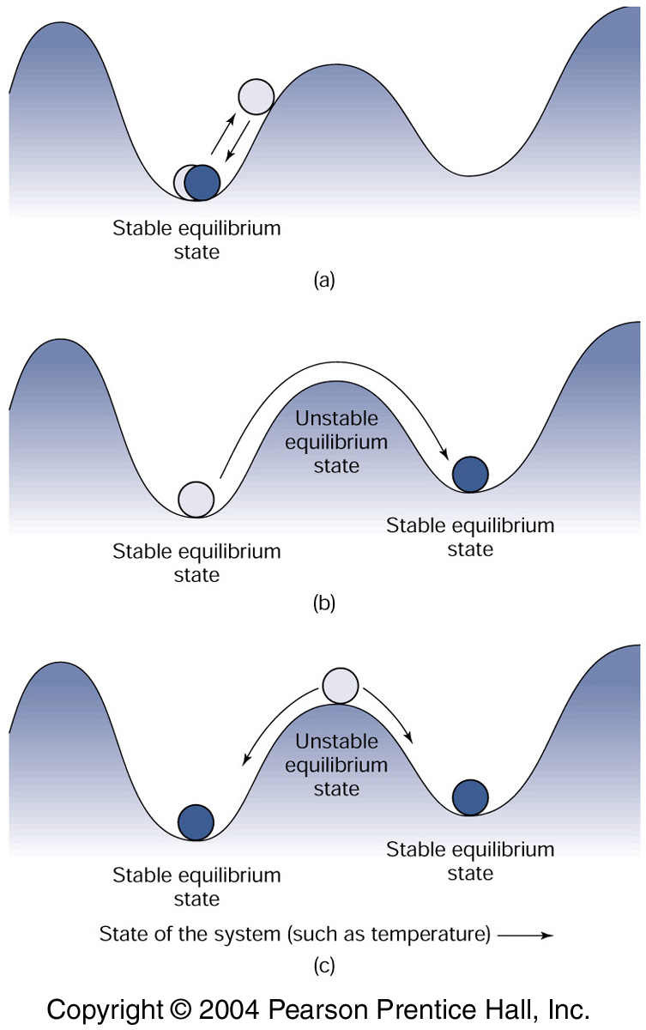
Stability（稳定性） and Equilibrium（平衡态）
Asymptotically stable: force system away from initial condition and the system returns to initial state
Stable or Neutral: force away and system stays where it was pushed to.
Unstable: force away and system moves to a different state. This usually implies multiple possible stable equilibrium, with forcing that is strong enough to push into a different equilibrium state.

Slide 7
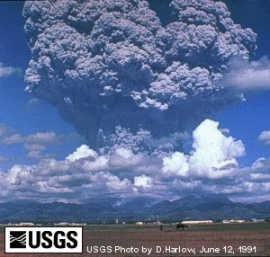
Forcing (coupling) with no feedback
Cause and effect: example of negative coupling
    Volcano causes aerosols
    Causes cooling and decrease in temperature
Negative coupling
Volcano eruption
Temperature decrease
Reduction in sunlight
Feedback? None since air temperature does not change incidence of volcanoes

Slide 8
Climate Systems Oscillations
ENSO: interannual time scale
Pacific Decadal Oscillation: decadal time scale
North Atlantic Oscillation or Arctic Oscillation: decadal time scale
Atlantic overturning mode: centennial time scale
  (centennial and longer time scales - sparse data sets, require more modeling to isolate processes)
What sets the time scales?
  decadal to centennial suggests longer processes than just atmosphere - for instance ocean circulation or changes in land surface

Slide 9
How might the ocean feedback on climate modes and create decadal to centennial to millennial time scales?
Note that advection time scales are similar to these climate modes:
  ocean gyres - decades
  ocean basins - centuries
  global ocean - ~1000 years
Advection of heat and salinity anomalies: from surface forcing regions, subducted, and then returning to surface where they change the forcing for the atmosphere, or change the ice extent.

Slide 10
How might the ocean feedback on climate modes and create decadal to centennial to millennial time scales?
Or similar advection that changes the upper ocean stratification, hence changing the mixed layer depths heated and cooled by the same air-sea fluxes, thus changing surface temperature
Or propagation of anomalies via Rossby or Kelvin waves, which then reset the temperature in remote locations.

Slide 11
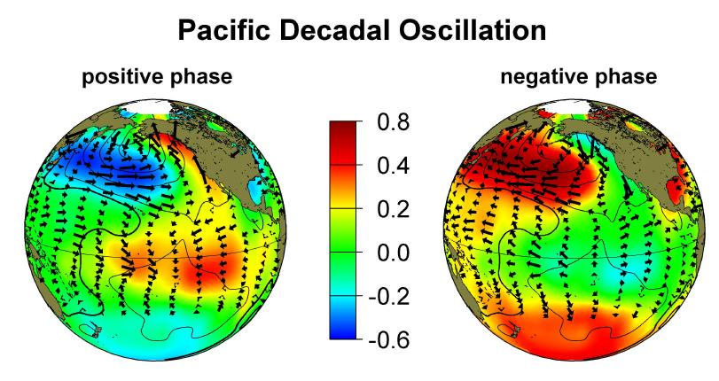
Warm Phase
Cool Phase
http://jisao.washington.edu/pdo/
Yang, H. and Q. Zhang, 2003: On the decadal and interdecadal variability in the Pacific Ocean. Adv. Atmos. Sci., 20(2), 173-184.
Zhang, Y., J.M. Wallace and D.S. Battisti 1997: ENSO-like Interdecadal Variability: 1900-93. J. Climate, Vol. 10, 1004-1020.

Slide 12
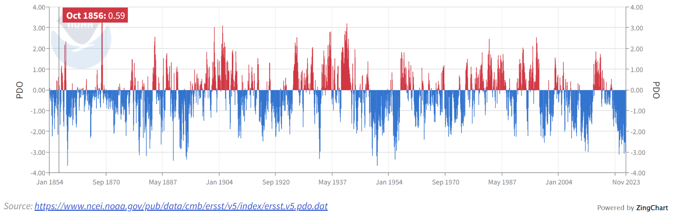
Latest PDO Index
1976 “regime shift” to warm phase PDO, strong Aleutian Low
The PDO was high after about 1976 (“regime shift”) and stayed pretty high until the late 1990s. It looked like it was entering a low phase, but we are back in high.
Lesson for decadal modes: don’t know what you have until you are many years into them.

Slide 13
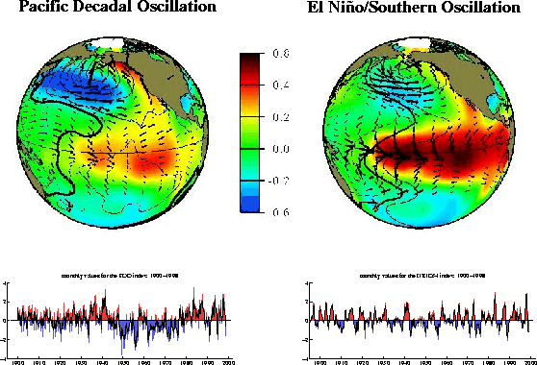
PDO versus ENSO
PDO is a long lived ENSO-like pattern of Pacific climate variability.
Similarity: Spatial pattern
Warm phase – El Nino: E. Tropical Pacific: +ΔSST; W. North Pacific: −ΔSST
Cool Phase – La Nina: E. Tropical Pacific: −ΔSST; W. North Pacific: +ΔSST

Slide 14
PDO versus ENSO
PDO is a long lived ENSO-like pattern of Pacific climate variability.
Difference:
Time scale: PDO: 20-30 years; ENSO: 2-7 years
Signal: PDO: Most visible in North Pacific, secondary in Tropics
ENSO: Most visible in Tropics; Minor signature in North Pacific

Slide 15
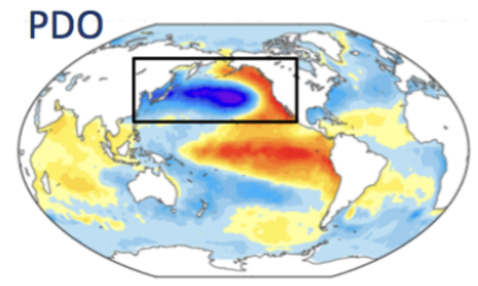
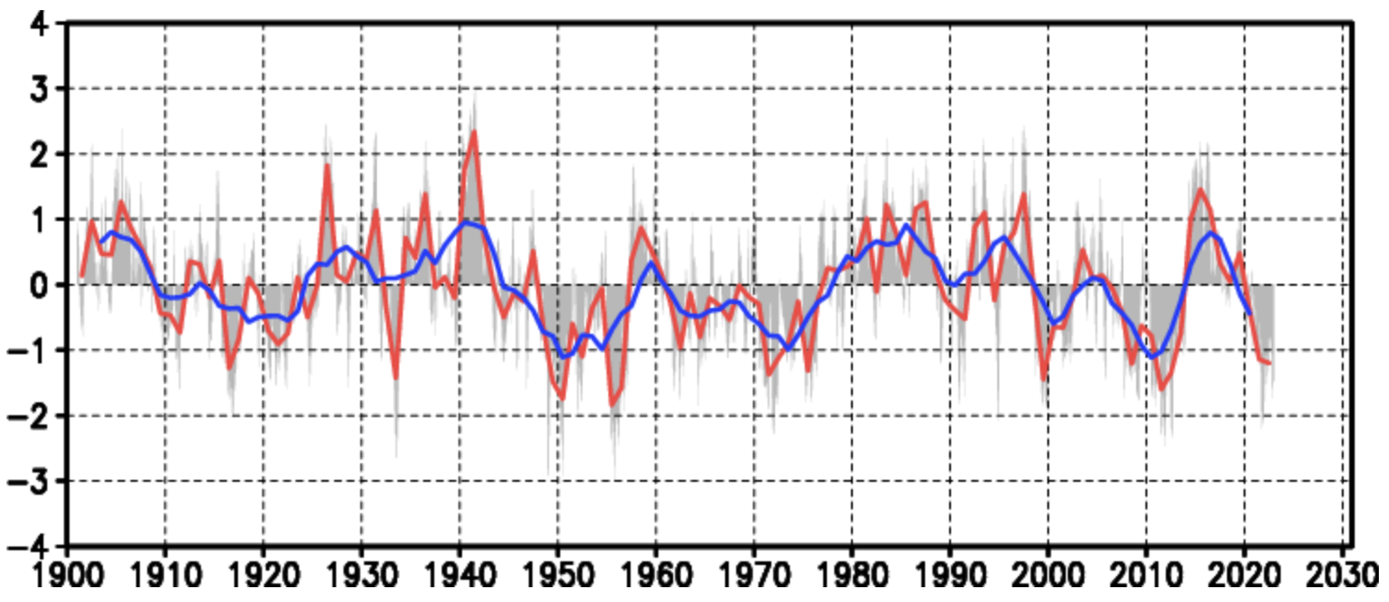
PDO SST index: Defined as the leading PC (EOF) of North Pacific monthly SST anomaly (poleward of 20°N)
PDO SLP index: Defined as an area-averaged North Pacific monthly SLP anomaly (poleward of 20°N)
https://climatedataguide.ucar.edu/climate-data/pacific-decadal-oscillation-pdo-definition-and-indices

Slide 16
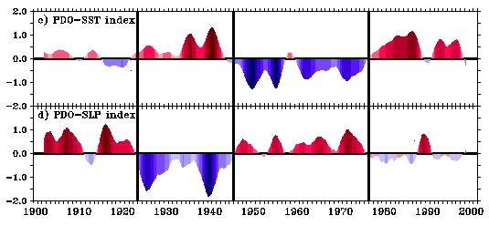
PDO Historical Records
Cool
Warm
Cool
Warm
20th Century PDO Regime shifts: 1924/25, 1946/47, 1976/77

Slide 17
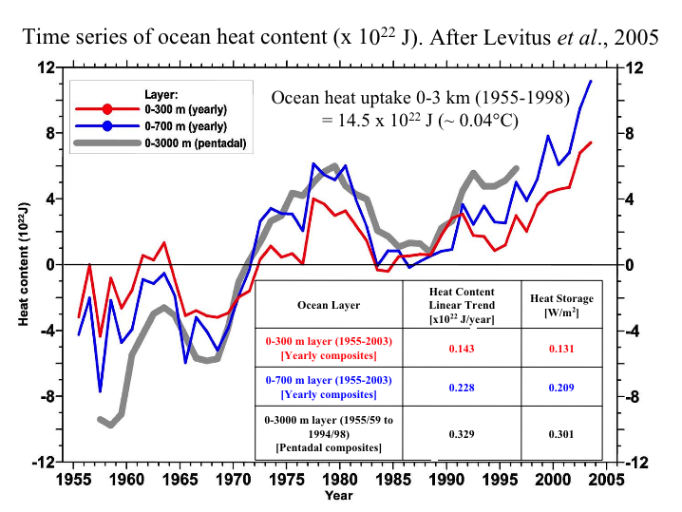
Observed global ocean changes that might be anthropogenic
(Levitus et al. 2005)
0.037°C Warming (0-3000 m)

Slide 18
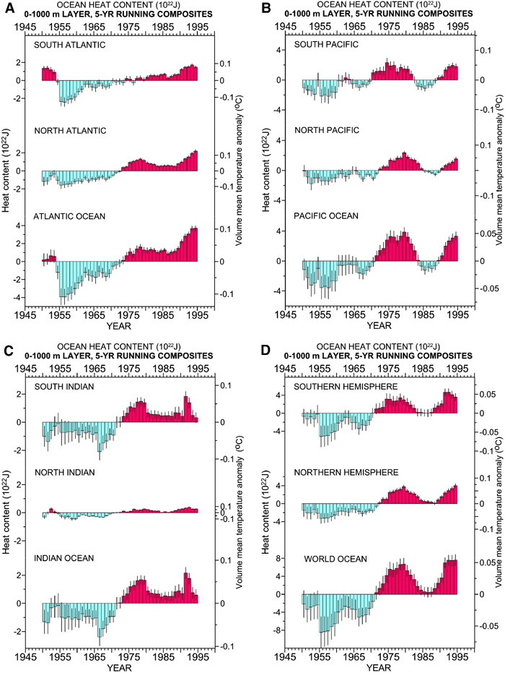
Is There Anthropogenic Climate Change?
Yes (IPCC-AR4)
Levitus et al (2000) heat storage changes in the Atlantic, Pacific, World

Slide 19
Trend in Equatorial Thermocline
(a) SST trend
LOW
HIGH
0
(b)
(c) ∂T/∂z trend
From JEDAC-XBT (1955-2003) averaged between 5°S-5°N. Unit: °C/100-year
Notes:
Let’s check the mean state. This shows the linear trend in equatorial SST and thermocline. We use the XBT data from Scripps institution of Oceanography. The data spans the period from 1955 to 2003. Two features should be noticed: (1) for SST trend, high warming in the east and lower warming in the west, is El-Nino like warming. (2) Although the SST is warming, the thermocline has cooling trend, particular in the west. So the thermocline is enhanced because of warming in the surface and cooling in the subsurface. The dashed green line shows the location of thermocline depth, which is defined as the location of the maximum vertical temperature gradient. The lower one shows the trend of vertical temperature gradient, which becomes stronger here and weaker in the lower thermocline.
Many coupled models have indicated a general increase of interannual variability with an enhanced intensity of the equatorial thermocline, or an increased vertical temperature contrast ΔT across the thermocline. Linear theory, however, suggests that an increase in ΔT is a stabilizing effect on the ENSO variability. The argument is that this will inhibit entrainment across the thermocline, and also the vertical movement of the thermocline. Here it appears that a nonlinear mechanism plays the dominant role: for large ΔT, even relatively small perturbations in the system can change the temperature of the entrained water much more efficiently.
The cooling trend in the western thermocline may result from two processes. The first is a local effect: the weakened zonal wind stress causes the flatting of the east-west thermocline slope (we will return to this later), resulting in an upward movement of the deeper colder water. The second is a remote effect. Observations and modelling studies have suggested a nonlocal mechanism for the cooling. There could be cold Rossby waves originated in the eastern Pacific around 20°N along the coast of the North America, propagating westward and southward along the mean potential vorticity contours, and cooling the western equatorial thermocline. The less cooling trend in the eastern thermocline is resulted from two opposite effects. The weakened Ekman pumping (Fig. 2c) favors a warming of the thermocline, while the cooling in the west could propagate eastward along the thermocline and result in cooling there. Some high-resolution coupled models forced by increasing greenhouse’s gases have successfully simulated the cooling thermocline in the equator.
Note that the SST trend along the equator in the past 50 years shows an El Nino-like pattern (Fig. 2a). There are controversies existing for the trend pattern of the historical SST observations, which could differ substantially among different datasets and for different time periods19. This El Nino-like pattern is robust for all observations over the past 50 years19. The importance of the east-west SST contrast along the equator lies that it could affect the ENSO variability. Some studies show that the enhanced zonal SST contrast (i.e., the La Nina-like pattern) acts as a destabilizing effect on the coupling, and favors a stronger ENSO, while the weakened SST contrast (i.e., the El Nino-like pattern) acts as a stabilizing effect and favors a weaker ENSO. However, sensitivity experiments using fully coupled models suggest that the relationship between the zonal SST contrast and ENSO amplitude is not necessarily straightforward8, because different radiative forcings can affect the zonal SST contrast without notable changes in ENSO amplitude21. And moreover, even there is a direct connection between the zonal SST contrast and the ENSO amplitude, the reduced contrast in observation (Fig. 2a) should favor a weaker ENSO, instead of a stronger ENSO as shown in Fig. 1.

Slide 20
Stability and Equilibrium for the Ocean
If, say, fresh water is dumped on the northern North Atlantic through excessive melting or runoff, how will the N. Atlantic overturning circulation change? Will it:
  Absorb the freshwater and return to nearly the initial condition (asymptotically stable)? (stay in the initial equilibrium state)
  Shift to a slightly different state and remain there? (neutrally stable) (stay in essentially the same equilibrium state)
  Jump into a completely different state of overturn (unstable)? (new equilibrium state)
If the freshwater forcing is continuously changing (increasing and decreasing), what is the response?

Slide 21
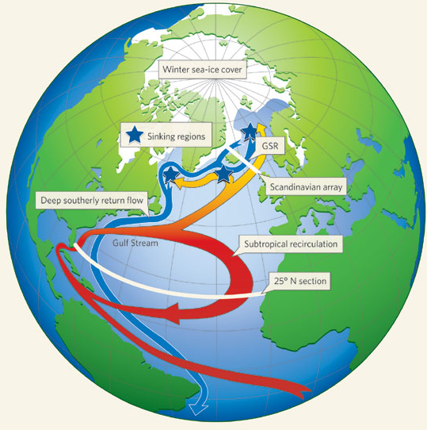
Is the N. Atlantic Conveyor Changing?
Nature (vol. 438, 1 December 2005)
Bryden et al (2005)
and
Quadfasel (comment)
Cartoon of “conveyor” and measurement arrays in place

Slide 22

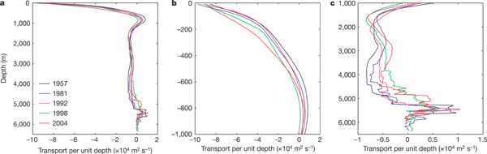
Is the N. Atlantic conveyor changing?
Nature (Bryden et al., vol. 438, 1 December 2005)
Repeat hydrographic sections at 24°N in the N. Atlantic
Deep ocean
Upper ocean

Slide 23
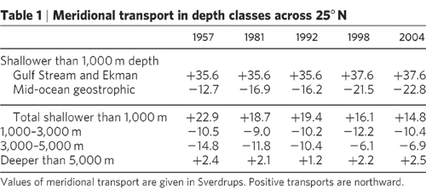
Is the N. Atlantic conveyor changing?

Slide 24
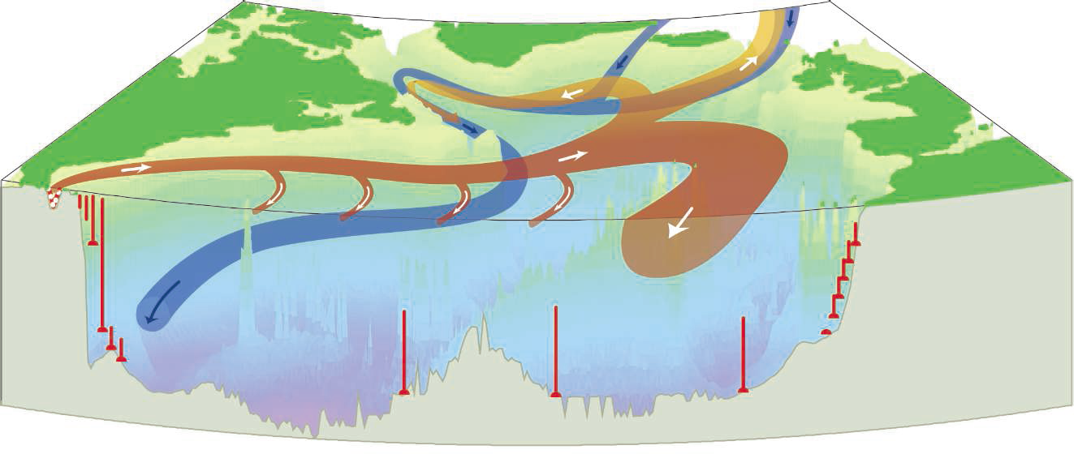
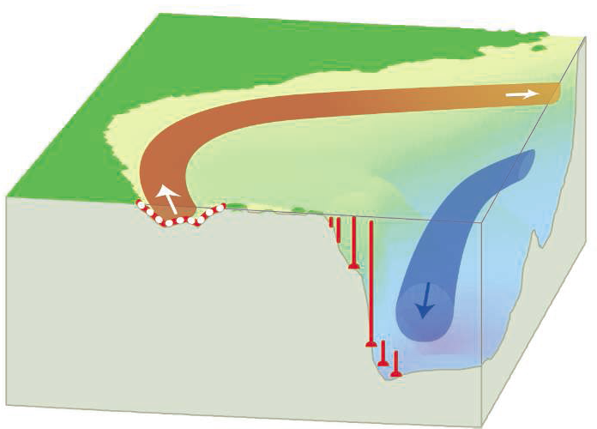
A Change in Circulation ?
John A. Church, Science, 2007, 908-909
Effective monitoring. The RAPID/MOCHA monitoring array, operational since 2004, directly measures the transport of the Gulf Stream in the Florida Strait using an undersea cable (red). A sparse moored array along 26°N measures bottom pressure and water column density at the western and eastern boundary and on either side of the Mid-Atlantic Ridge; in the lower panel, the array is shown in detail for the western boundary. Two articles in this issue report results for the first year of the array’s operation.

Slide 25
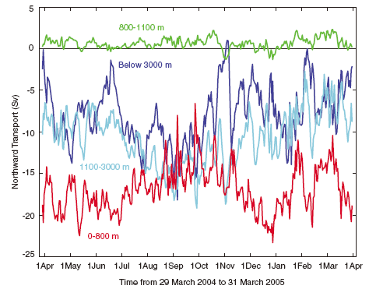
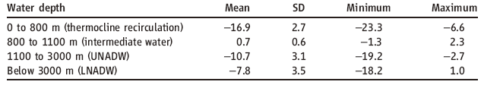
A Change in Circulation ?
Cunningham et al., 2007, Science, 935;
Kanzow et al., 2007, Science, 938

Slide 26
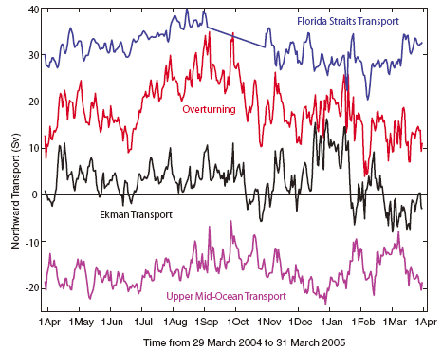
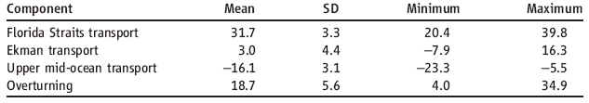
A Change in Circulation ?
Cunningham et al., report a year-long average MOC of 18.7±5.6 Sv, but with large variability range from 4.4 to 35.3 Sv over the year.

Slide 27
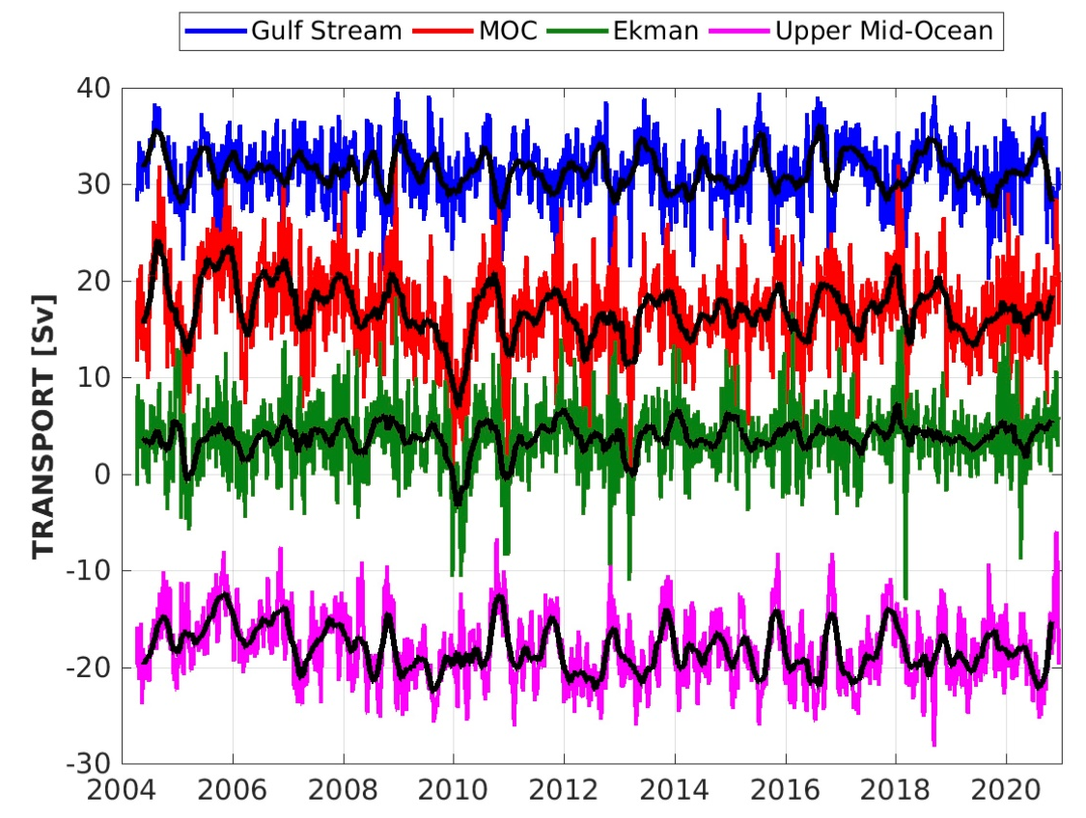
RAPID-MOC program: Monitoring the AMOC at 26.5°N
https://www.rapid.ac.uk/rapidmoc/overview.php

Slide 28
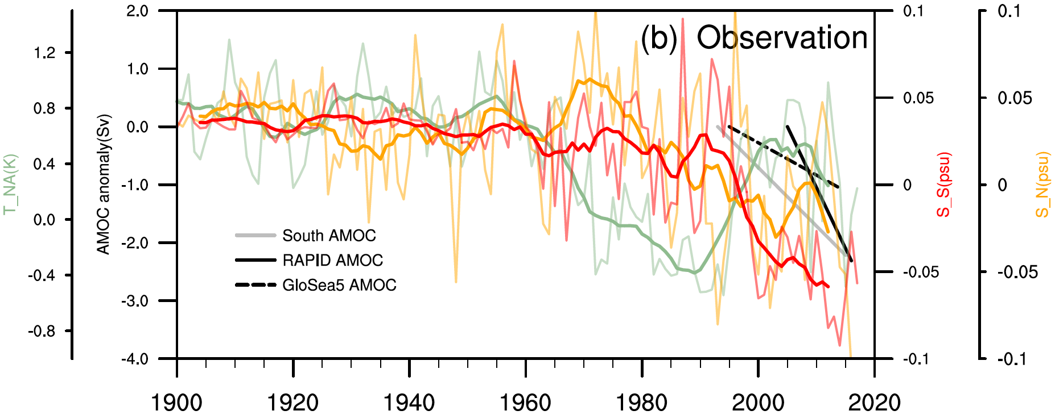
A fingerprint for AMOC slowing down
Zhu Chenyu and Zhengyu Liu (2019). Atlantic Salinity Pileup as a Remote Fingerprint of Weakening Atlantic Overturning Circulation (In preparation)

Slide 29
A fingerprint for AMOC slowing down
Zhu Chenyu and Zhengyu Liu (2019). Atlantic Salinity Pileup as a Remote Fingerprint of Weakening Atlantic Overturning Circulation (In preparation)

Slide 30
Questions (optional)
How is the PDO similar to ENSO? How is it different? How might the PDO modulate the strength of ENSO events?
How is the North Atlantic MOC postulated to have changed between glacial and interglacial times? What is the evidence for this?
What are the implications of multiple equilibrium states of the MOC for future climate change?

Slide 31

Learning about the Ocean, the Climate and the Nature

