Slide 1
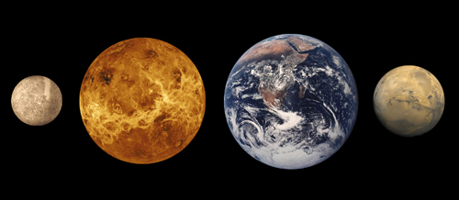
Terrestrial Planets
表面均为坚硬的岩石圈。金星，地球和火星表面有大气，水星无气体
水星离太阳最近，难以肉眼发现，表面温度-173/427ºC
金星无海洋，表面包裹着非常浓密的高速旋转的云，温度高达462ºC，压力相当地球海洋900m深。大气主要是CO₂，硫酸雨滴，无水汽。对太阳光的反射很强，所以最亮。自转243天，公转225天，1天>1年。公转方向与地球相反
地球，人类的家园，生命的港湾，表面稀薄的大气保护着人类得以延续。温度-88/58ºC
火星，大气组成CO₂，N₂， Argon(氩气)；大部分是岩石，极地有冰盖，火山和超强沙尘暴，温度-87/-5ºC。自转周期24.62小时(1.026地球日)
Notes:
The terrestrial planets are the four innermost planets in the solar system; Mercury, Venus, Earth, and Mars. They are called terrestrial because they have a compact, rocky surface like the Earth's. The planets Venus, Earth, and Mars have significant atmospheres, while Mercury has almost none. This diagram shows the approximate relative sizes of the terrestrial planets. Distances are not to scale
－－－－－－－－－－－－－－－－－－－－－－－－－－－
At first glance, if Earth had a twin, it would be Venus. The two planets are similar in size, mass, composition, and distance from the Sun. But there the similarities end. Venus has no ocean. Venus is covered by thick, rapidly spinning clouds that trap surface heat, creating a scorched greenhouse-like world with temperatures hot enough to melt lead and pressure so intense that standing on Venus would feel like the pressure felt 900 meters deep in Earth's oceans. These clouds reflect sunlight in addition to trapping heat. Because Venus reflects so much sunlight, it is usually the brightest planet in the sky.
The atmosphere consists mainly of carbon dioxide (the same gas that produces fizzy sodas), droplets of sulfuric acid, and virtually no water vapor - not a great place for people or plants! In addition, the thick atmosphere allows the Sun's heat in but does not allow it to escape, resulting in surface temperatures over 450 °C, hotter than the surface of the planet Mercury, which is closest to the Sun. The high density of the atmosphere results in a surface pressure 90 times that of Earth, which is why probes that have landed on Venus have only survived several hours before being crushed by the incredible pressure. In the upper layers, the clouds move faster than hurricane- force winds on Earth.
Venus sluggishly rotates on its axis once every 243 Earth days, while it orbits the Sun every 225 days - its day is longer than its year! Besides that, Venus rotates retrograde, or “backwards,” spinning in the opposite direction of its orbit around the Sun. From its surface, the Sun would seem to rise in the west and set in the east. 太阳打西方出来就怎么怎么。。。
虽然美丽，但是地狱，对人类而言。
－－－－－－－－－－－－－－－－－－－－－－
Earth, our home planet, is the only planet in our solar system known to harbor life - life that is incredibly diverse. All of the things we need to survive are provided under a thin layer of atmosphere that separates us from the uninhabitable void of space. Earth is made up of complex, interactive systems that are often unpredictable. Air, water, land, and life - including humans - combine forces to create a constantly changing world that we are striving to understand.
Viewing Earth from the unique perspective of space provides the opportunity to see Earth as a whole. Scientists around the world have discovered many things about our planet by working together and sharing their findings.
Some facts are well known. For instance, Earth is the third planet from the Sun and the fifth largest in the solar system. Earth‘s diameter is just a few hundred kilometers larger than that of Venus. The four seasons are a result of Earth’s axis of rotation being tilted more than 23 degrees.
上帝的恩赐，宇宙的偶然，应珍惜我们的地球，从宇宙观，地球实在是非常脆弱
-------------------------------------------------------------------------
The red planet Mars has inspired wild flights of imagination over the centuries, as well as intense scientific interest. Whether fancied to be the source of hostile invaders of Earth, the home of a dying civilization, or a rough-and-tumble mining colony of the future, Mars provides fertile ground for science fiction writers, based on seeds planted by centuries of scientific observations.
We know that Mars is a small rocky body once thought to be very Earth-like. Like the other "terrestrial" planets - Mercury, Venus, and Earth - its surface has been changed by volcanism, impacts from other bodies, movements of its crust, and atmospheric effects such as dust storms. It has polar ice caps that grow and recede with the change of seasons; areas of layered soils near the Martian poles suggest that the planet's climate has changed more than once, perhaps caused by a regular change in the planet's orbit. Martian tectonism - the formation and change of a planet's crust - differs from Earth's. Where Earth tectonics involve sliding plates that grind against each other or spread apart in the seafloors, Martian tectonics seem to be vertical, with hot lava pushing upwards through the crust to the surface. Periodically, great dust storms engulf the entire planet. The effects of these storms are dramatic, including giant dunes, wind streaks, and wind-carved features.
地球的未来？

Slide 2
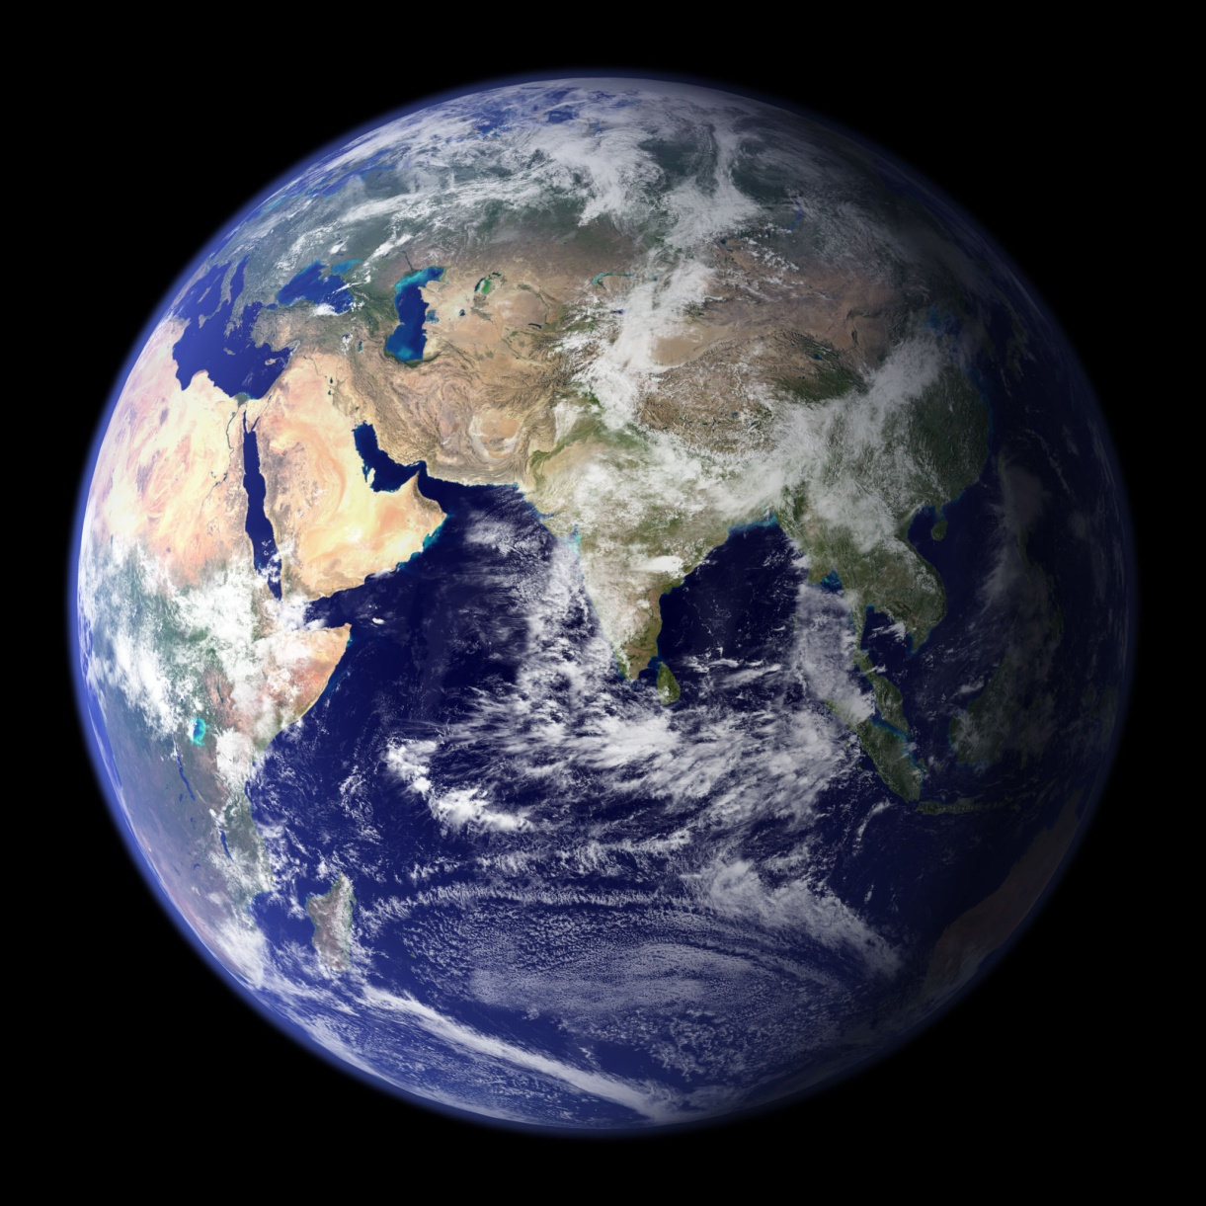
Beautiful Earth
宇宙的一粒尘埃
偶然的存在 (?)
生命－自然的精心杰作
脆弱的地球
空气、水、海洋
Notes:
This true-color image shows North and South America as they would appear from space 35,000 km (22,000 miles) above the Earth. The image is a combination of data from two satellites. The Moderate Resolution Imaging Spectroradiometer (MODIS) instrument aboard NASA’s Terra satellite collected the land surface data over 16 days, while NOAA’s Geostationary Operational Environmental Satellite (GOES) produced a snapshot of the Earth’s clouds.
Image created by Reto Stöckli, Nazmi El Saleous, and Marit Jentoft-Nilsen, NASA GSFC

Slide 3
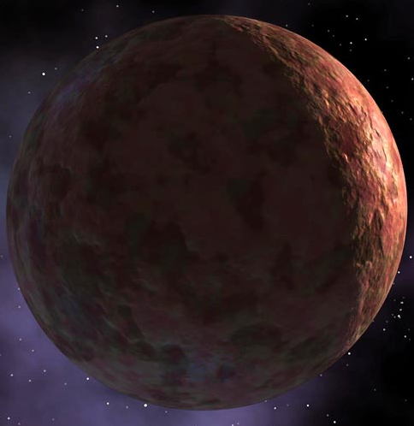
Atmosphere & Ocean – Habitable Earth
模式1：一块裸岩
实际温度 裸岩温度
火星 －53ºC －56ºC
地球 +15ºC －18ºC
金星 +430ºC +41ºC
Notes:
温室效应33C

Slide 4
Atmosphere & Ocean – Habitable Earth
模式2：有静止大气的岩石
实际温度 岩石温度
地球 +15ºC +67ºC
Notes:
没有水汽截止大气的温室效应

Slide 5
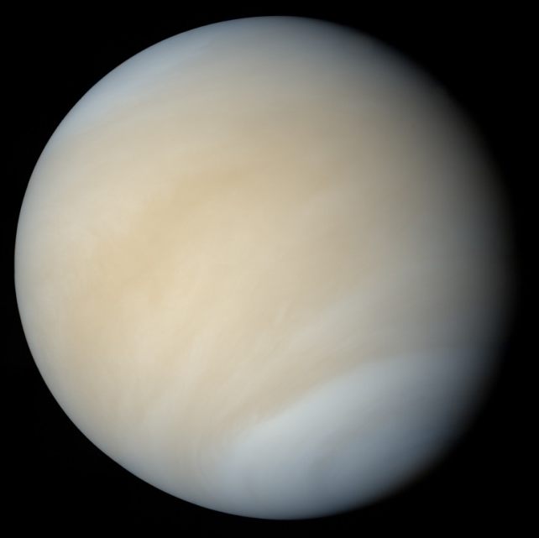
Atmosphere & Ocean – Habitable Earth
模式3：有运动大气的岩石
实际温度 岩石温度
地球 +15ºC <<67ºC

Slide 6
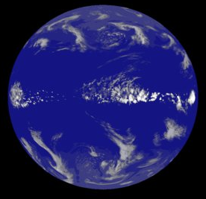
Atmosphere & Ocean – Habitable Earth
模式4：既有大气又有海洋
实际温度 计算温度
地球 +15ºC ~15ºC

Slide 7
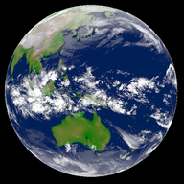
Atmosphere & Ocean – Habitable Earth
模式5：大气海洋陆地
实际温度 计算温度
地球 +15ºC +15ºC
Notes:
运动，以及运动带来的风雨雷电，才有现在的宜居地球

Slide 8
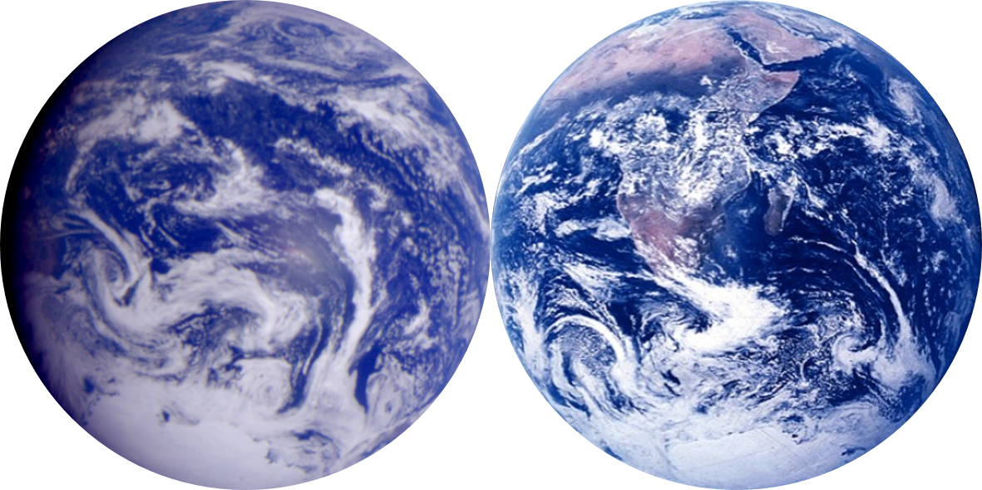
Earth or Aqua-Planet?

Slide 9
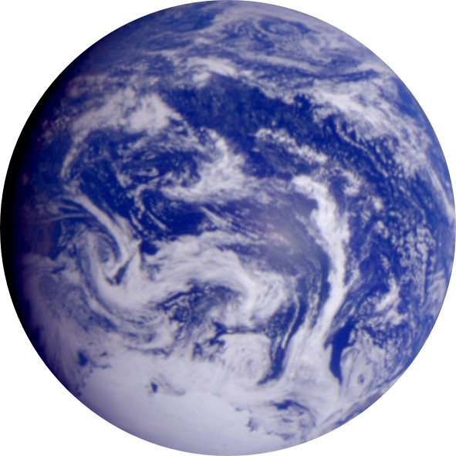
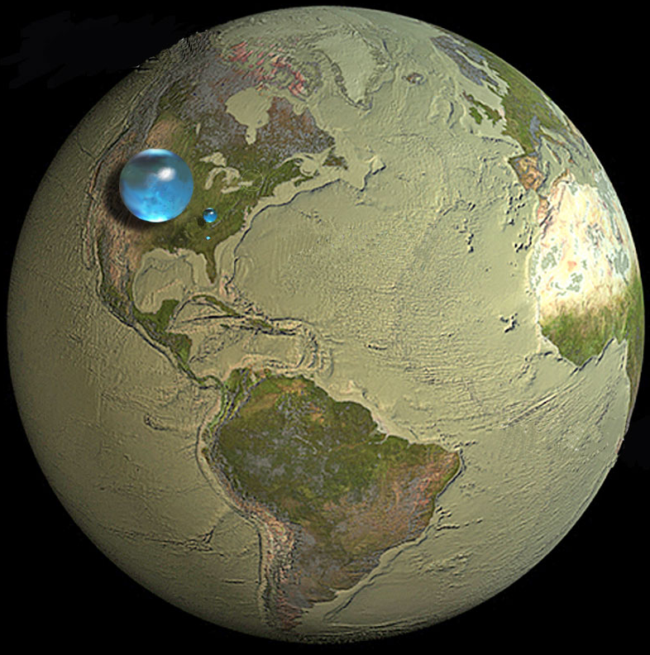
How Much Water is on Earth
Biggest: all water in everything. d=1384 km, v=1.386E9 km³
Small: liquid fresh water. d=272.8 km, v=1.06E7 km³
Tiny: water in lakes and rivers. d=56.2 km, v=9.3E4 km³
http://ga.water.usgs.gov/edu/2010/gallery/global-water-volume.html
Notes:
The largest sphere represents all of Earth's water, and its diameter is about 860 miles (the distance from Salt Lake City, Utah, to Topeka, Kansas). It would have a volume of about 332,500,000 cubic miles (mi³) (1,386,000,000 cubic kilometers (km³)). The sphere includes all the water in the oceans, ice caps, lakes, and rivers, as well as groundwater, atmospheric water, and even the water in you, your dog, and your tomato plant.
Liquid fresh water
How much of the total water is fresh water, which people and many other life forms need to survive? The blue sphere over Kentucky represents the world's liquid fresh water (groundwater, lakes, swamp water, and rivers). The volume comes to about 2,551,100 mi³ (10,633,450 km³), of which 99 percent is groundwater, much of which is not accessible to humans. The diameter of this sphere is about 169.5 miles (272.8 kilometers).
Water in lakes and rivers
Do you notice that "tiny" bubble over Atlanta, Georgia? That one represents fresh water in all the lakes and rivers on the planet, and most of the water people and life of earth need every day comes from these surface-water sources. The volume of this sphere is about 22,339 mi³ (93,113 km³). The diameter of this sphere is about 34.9 miles (56.2 kilometers). Yes, Lake Michigan looks way bigger than this sphere, but you have to try to imagine a bubble almost 35 miles high—whereas the average depth of Lake Michigan is less than 300 feet (91 meters).

Slide 10
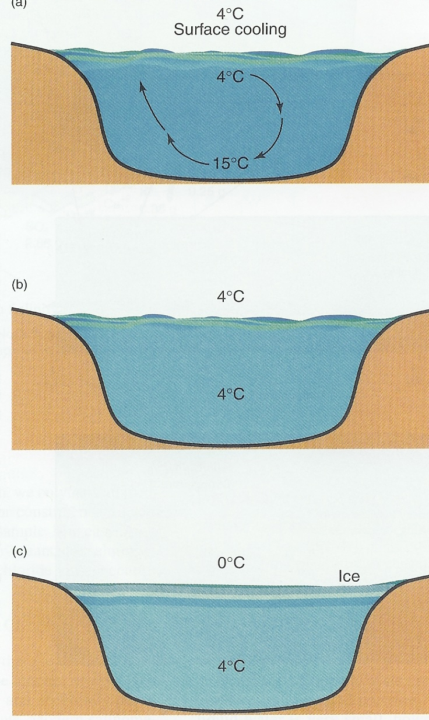
Special Feature of Water
水在4°C时密度最大，由水分子结构决定。因此水在密度最大时仍然为液态
水的特殊性质对海洋环流形成，以及对海洋所有生命的生存极其重要
Notes:
Cool air (4C) in fall causes surface cooling of lake waters and the surface layer becomes more dense than the underlying warner water, shown here as 15C. This creates convection overturn and mixing of lake water.
With continued cooling and convection, the lake water reaches a uniform temperature of maximum density, about 4C.
As winter approaches and air temperature decreases further, additional cooling of the lake surface occurs, but this water is less dense than the underlying 4C water. The surface freezes while the underlying water remains at 4C.

Slide 11
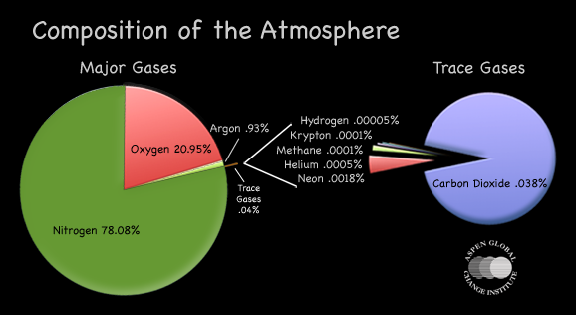
Atmospheric Composition
氮气78.08%，氧气20.95%，氩气0.93%，痕量气体0.04%
二氧化碳0.038%，氢气，氪气，甲烷，氦气，氖气，水汽

Slide 12
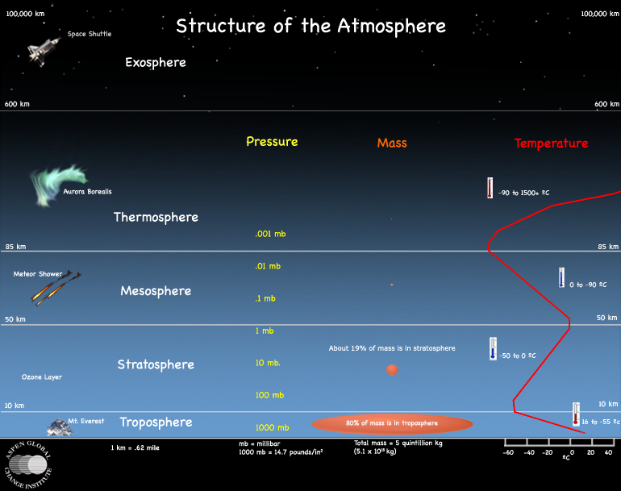
Atmosphere Layers
Notes:
大气总质量 5*10E18 kg

Slide 13
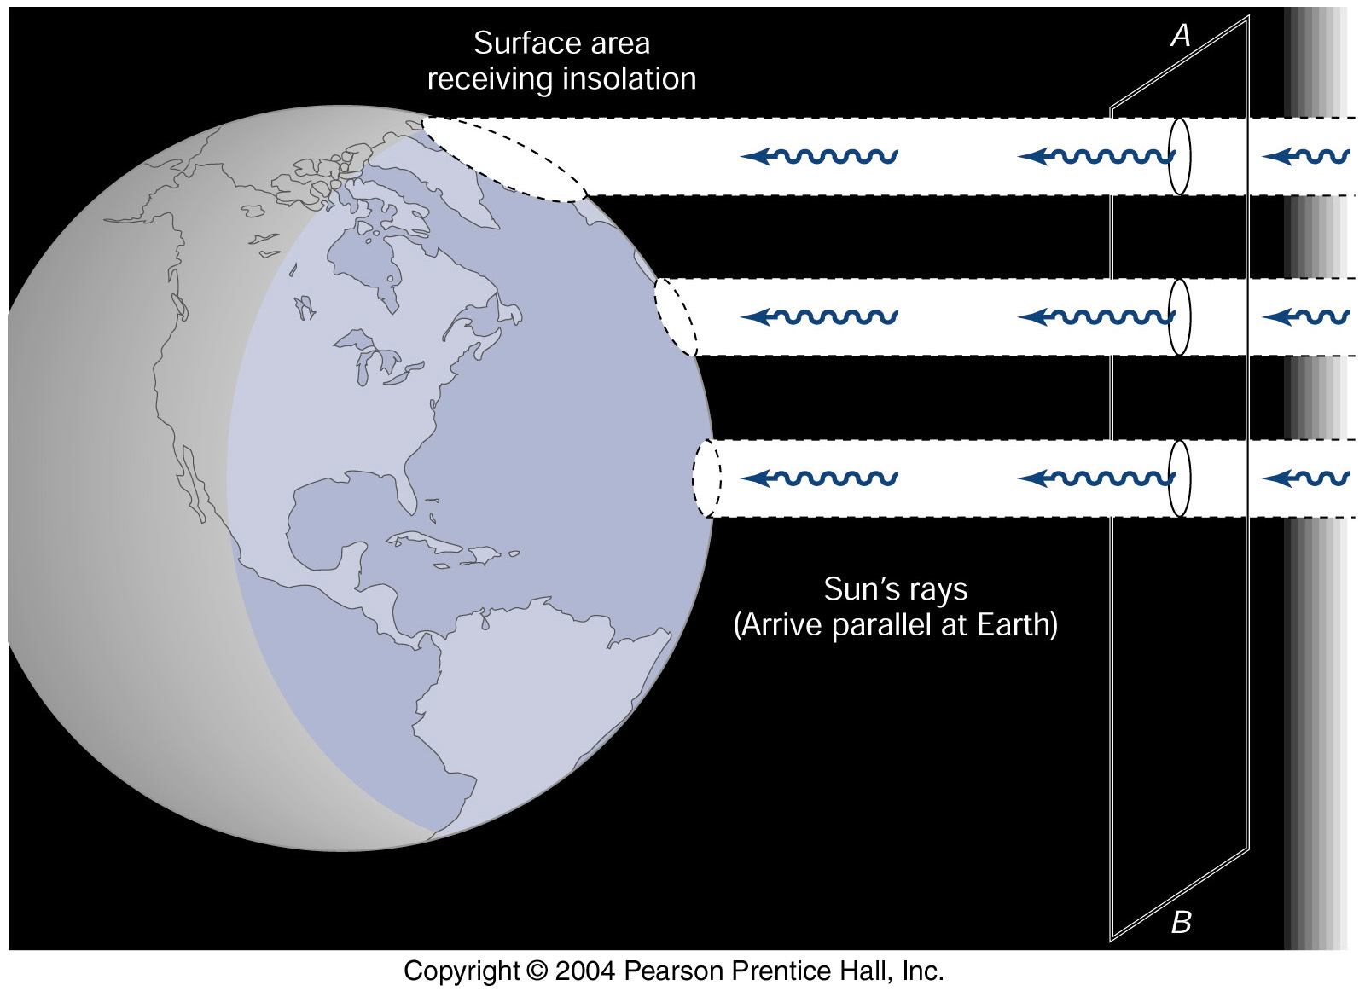
Radiation

Slide 14
Net Heat Budget at the TOA
Notes:
This is well-known figure. There is net heat gain in the tropics and net heat lost in the extratropics. So there must be meridional HT to maintain the earth energy balance.

Slide 15
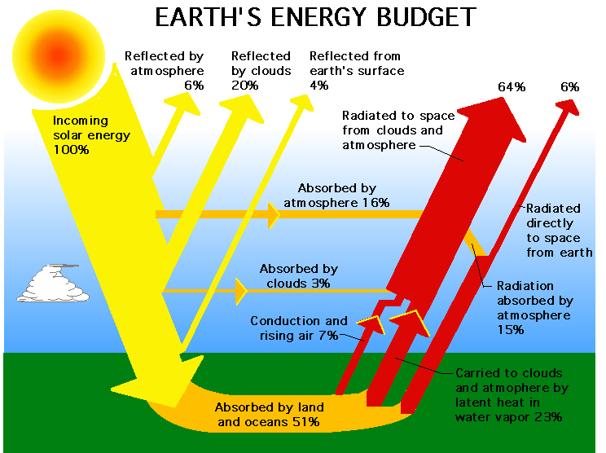
Energy Budget

Slide 16
Meridional Heat Transport
OHT_{VT} = OHT_{HF}
AHT_{VT} = AHT_{HF}
Dotted lines from Obs. Heat Flux (Trenberth and Caron, 2001)
Notes:
This shows the mean AHT, OHT and THT. This is well known structure. OHT dominates in the tropics and AHT dominates in the extratropics. As mentioned before, we use two approaches to calculates the ht. the solid lines are for the direct cal, and the dashed line are for the hf. They are almost identical.

Slide 17
Decomposing AHT_{VT}
DSE vs. LE
Compensate in the tropics
Coordinate in the extratropics
LE == EMP over ocean
Notes:
This shows the components of the AHT. Act against each other in the tropics and act together with each other

Slide 18
Decomposing AHT_{VT}
Mean
Mean
Eddy
Eddy
Notes:
We can further decompose the AHT into the components due to mean circulation and eddy activities.

Slide 19
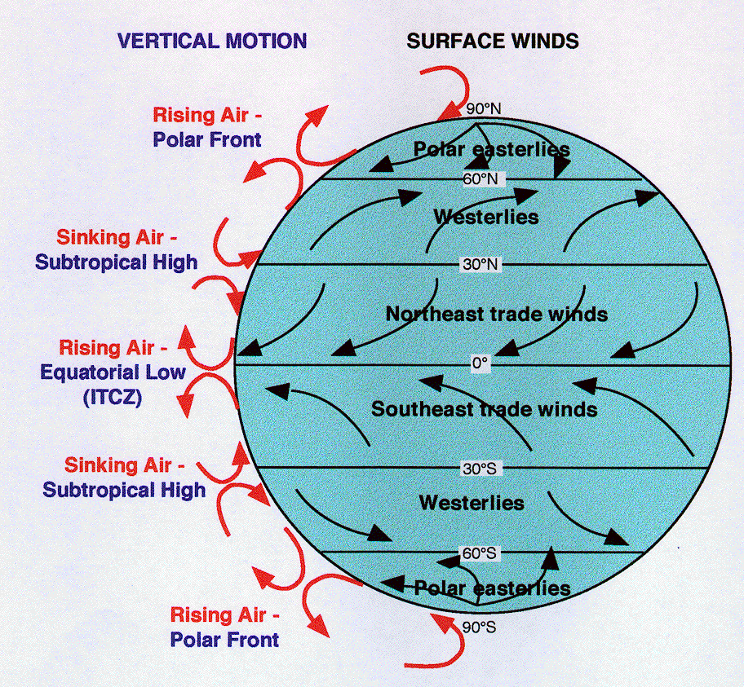
Atmospheric Circulation
Polar Cell
Ferrel Cell
Hadley Cell

Slide 20

Droplet: Gravity Wave

Slide 21
